Slide 1
GROUP C – Case study no.4
Dr. Nadezda BAGRETS (Karlsruhe Institute of Technology)
Dr. Andrea CORNACCHINI (CERN EN Dept.)
Mr. Miguel FERNANDES (CERN BE Dept.)
Dr. Friedrich LACKNER (CERN TE Dept.)
Mr. Shoubo HE (Inst. of Modern Physics - Chinese A. Of Sc.)

Slide 2
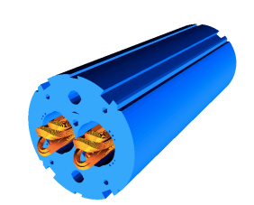
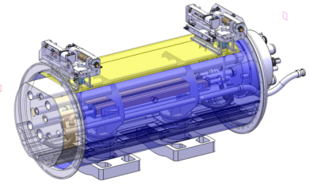
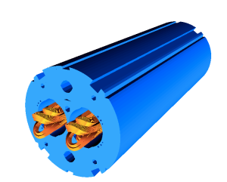
Case study no.4
New collimators to deal with increased beam intensity, energy and ion losses
MB.B8R/L
∫BdL = 119.2 Tm @ I_{nom} = 11.85 kA
with 20 % margin
MB.B11R/L
14.3 m Nb-Ti
GOAL:
Design a Nb₃Sn superconducting dipole with an 60 mm aperture and a operational field (80% of I_{ss}) at 1.9 K of 11 T.
5.5 m Nb₃Sn
3 m Collim.
5.5 m Nb₃Sn

Slide 3
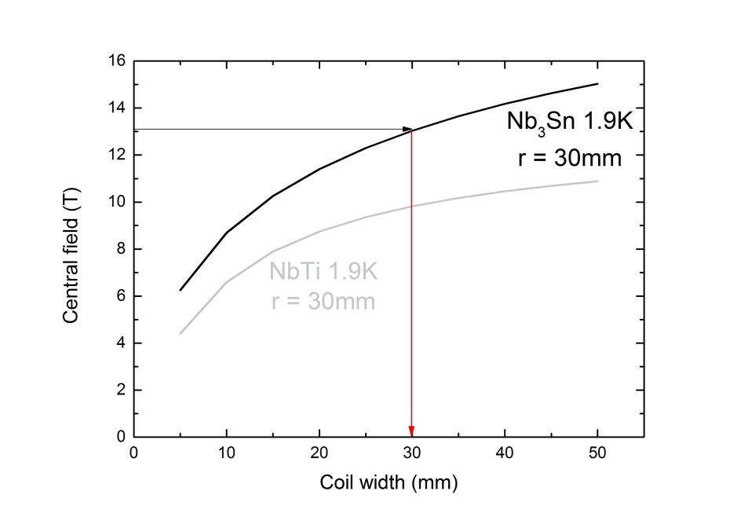
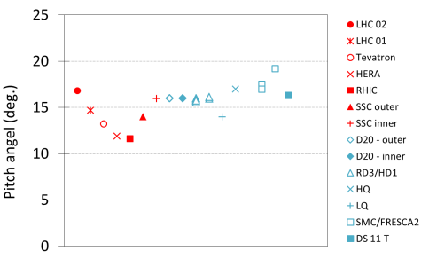
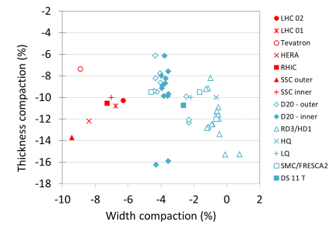
Cable dimensioning
B_{ss}=B_{op} / 0,8 = 13,75 T
Aperture = 60mm ➔ r = 30mm
Cable geometry
Strand diameter 0,75 mm
Number of strands 40
Cu to SC ratio 1,5
Width 15mm
Mid thickness 1.39
Insulation thickness 15%
“Pitch” angle 15.39°
Keystone angle 0.64
Filling factor 0.273
t
w

Slide 4
Short sample solution
Short sample solution
j_{sc_ss} 2560 A/mm²
j_{o_ss} 650 A/mm²
I_{ss} 13.5 kA
B_{peak_ss} 13.75 T

Slide 5
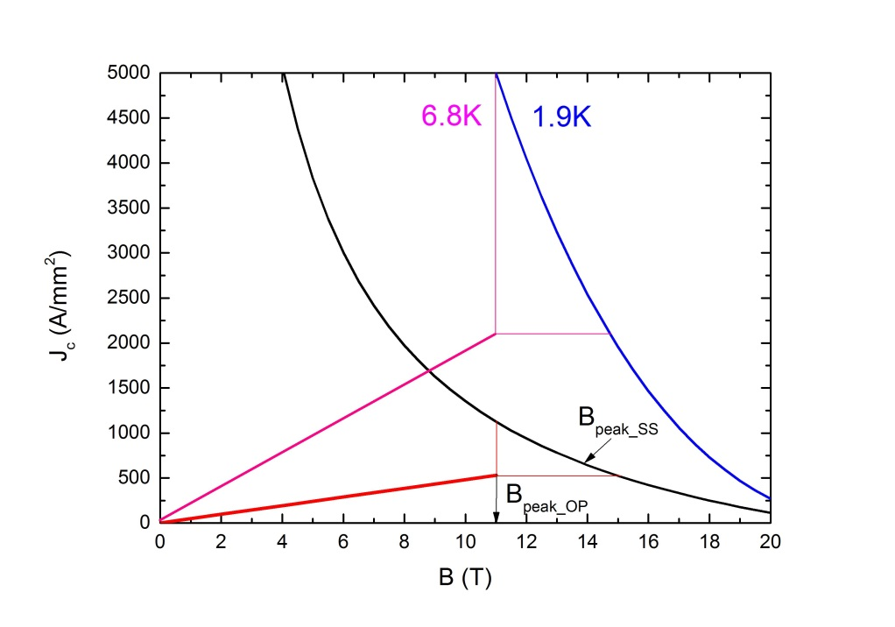
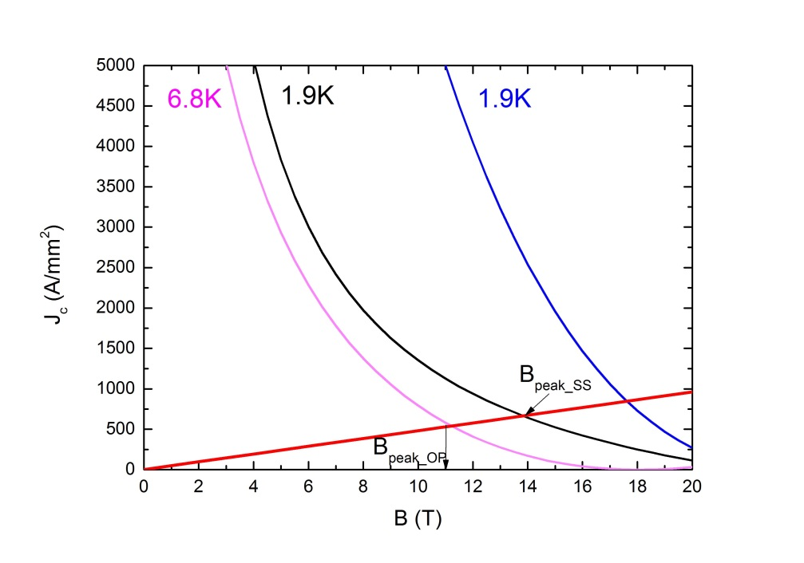
Operational condition & margins
operational cond. (80% I_{ss} )
j_{sc_op} 2114 A/mm²
j_{o_op} 530 A/mm²
I_{op} 10.8 kA
B_{peak_op} 11T
Margins
SC:
j_{op}/ j_{C} 0.42
B_{op}/ B_{C} 0.73
overall:
j_{op}/ j_{C} 0.47
B_{op}/ B_{C} 0.73
T 4.9 K

Slide 6
Comparison NbTi
It’s not possible to obtain
B_{ss} > 13 T
B_{op} > 10T (with a reasonable margin)
using NbTi cables

Slide 7
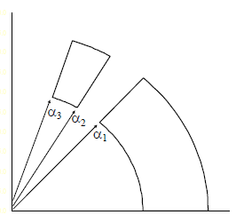
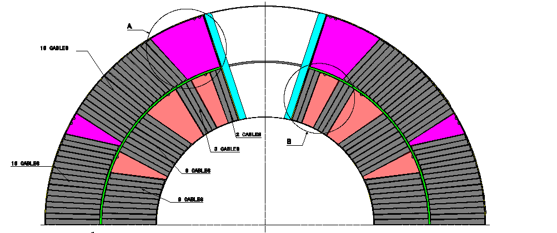
Lay out
Using one wedge, it’s possible to eliminate the B3, B5 and B7 unwanted multipole terms.
A possible solution is 48° 60° 72°
Using more wedges, we can eliminate more multipole terms and have a better field quality.
This is the real case.

Slide 8
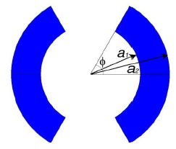
Forces and stresses
We assume:
Uniform j₀=530 A/mm₂ is ⊥ the cross-section plane
Inner (outer) radius of the coils = a1 (a2)
Angle = 60º
No iron
F_{y}
F_{x} = 2424 kN/m
F_{y} = - 2155 kN/m
F_{x}
Accumulate stress on the coil midplane
σ = F_{x}/w = 80.8 MPa

Slide 9
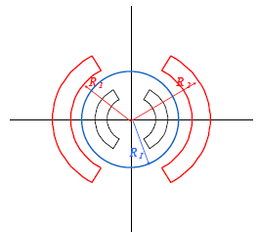
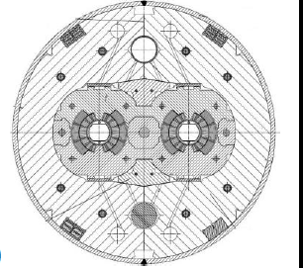
Colliers and Iron yoke
With 90% of I_{ss} ➔ B = 12.4T
t_{iron} = 186 mm
For collars we can use as a reference other high field magnets.
Thickness of collar = 30 mm
We can assume the internal radius of the shrinking cylinder as the result of the sum of:
D/2 + r + w + t_{collar} + t_{iron} = 380 mm
t_{shell} = 12 mm
D

Slide 10
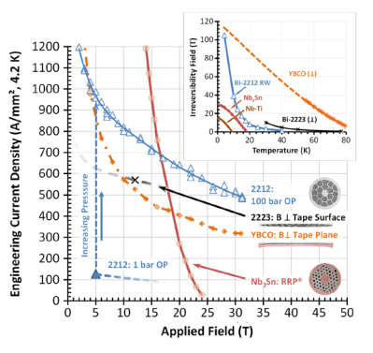
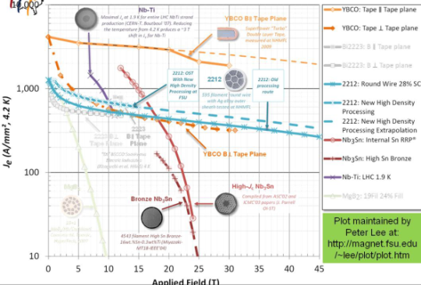
Additional questions
High temperature superconductor: YBCO vs. Bi2212
Compound Year Tc Bc2(0) ξ
Bi2Sr2Ca1Cu2O8 1989 94 > 100a 1 - 2
YBa2Cu3O7 1988 92 > 100a 1 - 2
Bi-2212: Round wires. Future accelerators at >20T. Problem: mechanical stability. No solution yet for enhancing the mechanical reinforcement
YBCO: Tapes. Cables, Current limiters, Wind generators. Main problems: costs, limited lengths: Commercially available: < 500 m SuperPower, USA < 500 m at Fujikura, Japan
Superconducting coil design: block vs. cosΘ
Block coil (HD2, HD3, Fresca2)
Cable is not keystoned, perpendicular to the midplane
Ends are wound in the easy side, but must be flared to make space for aperture (bend in the hard direction)
Internal structure to support the coil neededRatio central field/current density is 12%
less than a cosΘ with the same quantity of cable: less effective than cos theta
Block design is interesting and has good properties but needs more experience
Support structures: collar-based vs. shell-based
All the collared magnets are characterized by significant coil pre-stress losses: the coil reaches the maximum compression (about 100 MPa) during the collaring operation, but after cool-down the residual prestress is of about 30-40 MPa.
➔ BLADDERS and ALUMINIUM THICK SHELL: Initial pre-compression is provided by waterpressurized bladders and locked by keys. After cool-down the coil pre-stress increases due to the high thermal contraction of the aluminum shell.
Assembly procedure: high pre-stress vs. low pre-stress
The pre-stress avoids the appearance of tensile stresses and limits the movement of the conductors.
LHC corrector sextupoles (MCS) ➔ Learning curve was poor in free conditions and training was optimal with low pre-stress and around 30 MPa. Degradation was observed for high pre-stress (above 40 MPa) ➔ Finally, nominal pre-stress for series production was 30 MPa.

Slide 11
Thank you for your attention.
GROUP C – Case study no.4
Dr. Nadezda BAGRETS (Karlsruhe Institute of Technology)
Dr. Andrea CORNACCHINI (CERN EN Dept.)
Mr. Miguel FERNANDES (CERN BE Dept.)
Dr. Friedrich LACKNER (CERN TE Dept.)
Mr. Shoubo HE (Inst. of Modern Physics - Chinese A. Of Sc.)

