Slide 1
Case Study 3c
High field large aperture magnet for a cable test facility
Goal: dipole, 100mm aperture, 15T @ 1.9K

Slide 2
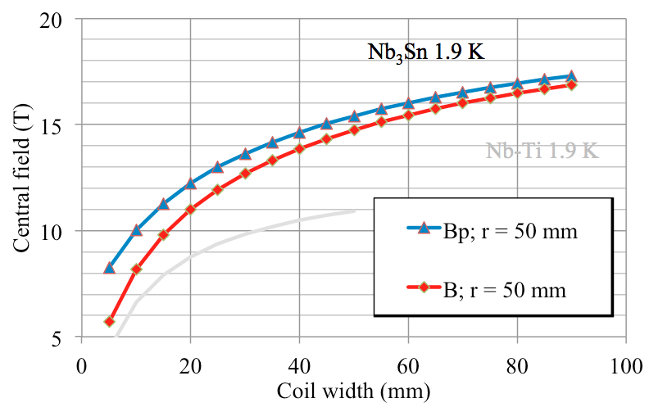
Magnetic Design
$\text{λ}≈1+\frac{ar}{w}$
$γ_{c}= γ_{c0}∗w \left[\frac{T.{mm}^{2}}{A}\right]$
Cable
Aperture radius (r) | 50mm
Coil width | 60 mm
Cable width | 20 mm
Layers | 3
strands | 46
Strand diameter | 0.85 mm
Cu/Sc | 1.20
Keystone angle | 0.64 degrees
Fill factor (κ) | 0.266
$$J_{0}=J_{sc}∗ κ \left[\frac{A}{{mm}^{2}}\right]$$
Design based on Roman Arc
Conductor with is trade-off between max field and practical size
Cable can be 10-20mm, aim to minimise winding: (3*20mm =60mm)

Slide 3
$$B_{p}= λ ∗ γ_{sc} ∗ J_{sc} \left[T\right]$$

Slide 4
Magnetic Design
Inputs
Aperture radius (r) | 50 mm
Coil width (w) | 60 mm
Outputs from Cable selection
Kappa (κ) | 0.266
Lambda (λ) | 1.04
 | Short Sample (ss) | Operational (op) (90% load line)
J₀ | 388 | 349 | A.mm⁻²
I | 17.3 | 15.6 | KA
B_{peak} | 16.0 | 14.8 | T
Margins
Current density (J) | 782 | A.mm⁻²
Field (B) | 2.10 | T
Temperature (T) | 2.80 | K

Slide 5
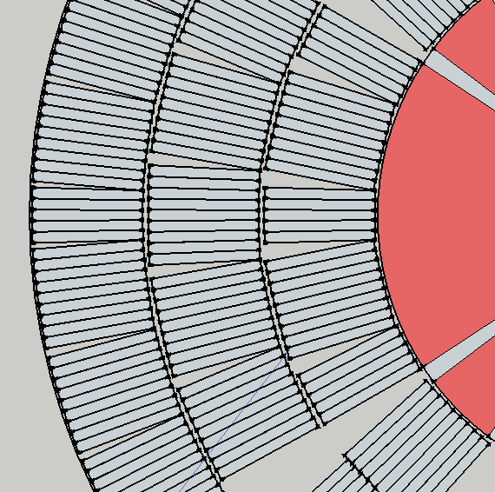
Magneto-Mechanical Design
Three layer conductor coil
Shows mechanical breaks due to keystone angle
Wedges added to reduce higher harmonics.
(angles from the slides)

Slide 6
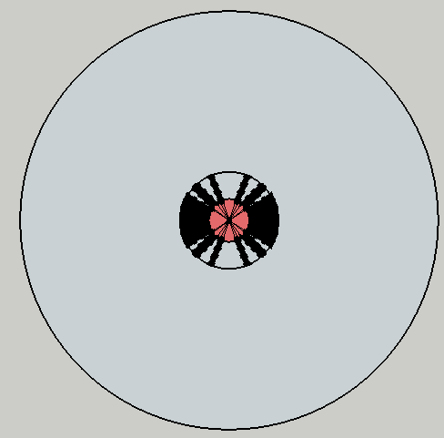
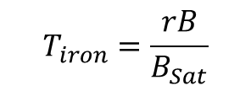
Mechanical Design
Forces on the coil
F_{x} @ 90% I_{ss} | 7.44 MN/m
F_{y} @ 90% I_{ss} | -7.5848 MN/m
$$T_{iron}=\frac{rB}{B_{Sat}}$$
Yoke Dimensions
Thickness | 375mm (min)
Stress
Stress on mid plane | 125MPa (acceptable)
Cylinder thickness | 35 mm (to compensate)
Yoke
Coil

Slide 7
What We learnt (Summary)
High field magnets needs wide coil & low current density
This can be expensive
Field quality is not a driver, but it is still possible to reduce high order harmonics
Iron yoke needs to be considerably large due to high field, a pre-stress can counter the stress in the coil
Stress is tricky….but we got there!!

