Slide 1
CASE STUDY 1: Group 1C
Nb₃Sn Quadrupole Magnet
R. Bonomi
R. Kleindienst
J. Munilla Lopez
M. Chaibi
E. Rogez
CERN Accelerator School, Erice 2013

Slide 2
GOAL
LHC upgrade requires quadrupole magnets with larger apperture.
Design proposal for Nb₃Sn superconducting quadrupole with 150 mm aperture for operation at 1.9 K.
Study includes coil design, magnetic and mechanical properties.
CERN Accelerator School, Erice 2013

Slide 3
COIL WIDTH
The magnetic gradient depends on the width of the coil
Adding additional coil width leads to diminishing rewards
A relatively thin design was chosen as a compromise between cost and gradient
-> 2 coils of 10 mm width
Two layers chosen to allow more possibilities in design for minimizing field errors
3
CERN Accelerator School, Erice 2013

Slide 4
CABLE PARAMETERS
N strand | 24 | Area sc cable | 6,032
Strand d (mm) | 0,8 | Area copper cable | 6,032
Cable width (mm) | 9,8 | Area ins cable | 17,675
Cable in thickn. (mm) | 1,45 | Fill fact | 0,341
Cable out thickn. (mm) | 1,45 | Compression (w) | -0,046
Keystone angle | 0,00 | Compression (t) | -0,094
Insulation thickness (mm) | 0,15
Cu/Sc ratio | 1,00
t
w
4
CERN Accelerator School, Erice 2013

Slide 5
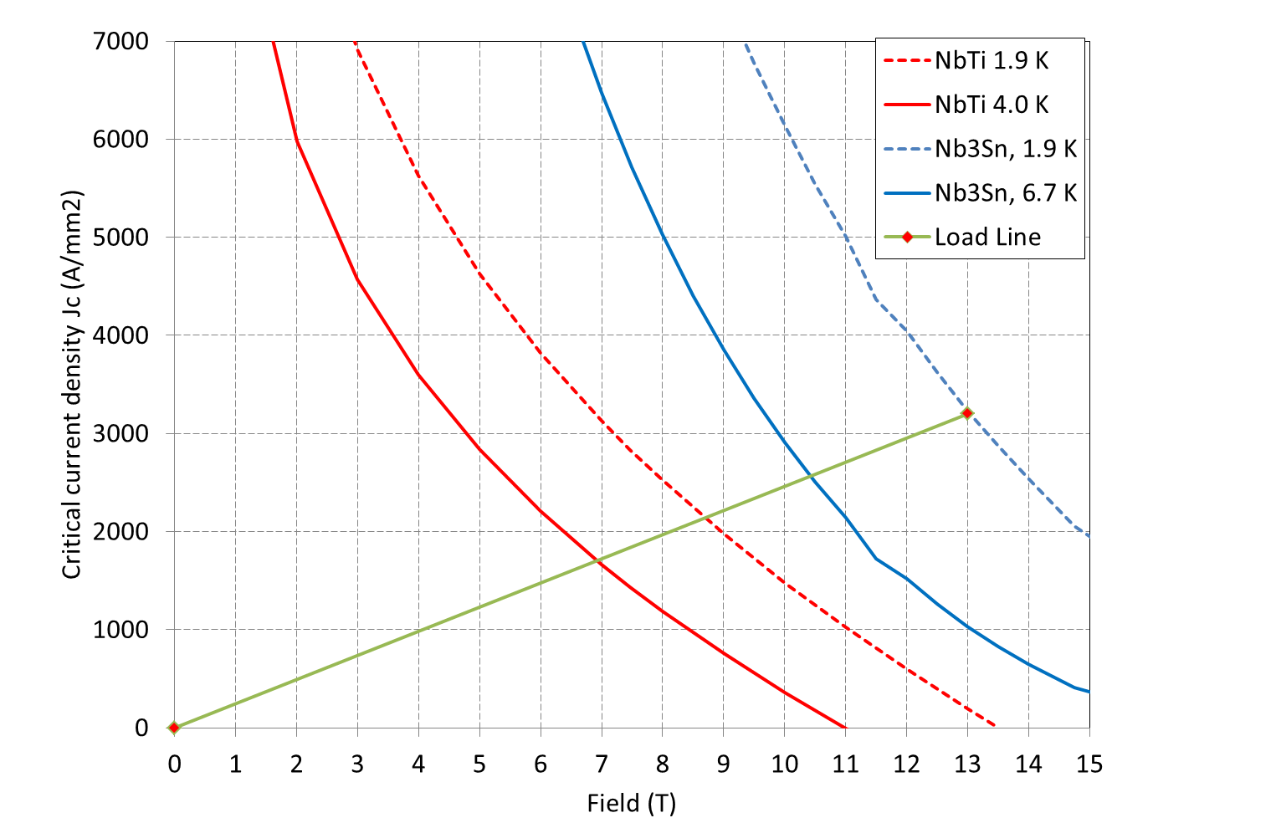
LOAD LINE
Load line plotted for our configuration
Short sample and operational parameters computed
Higher field gradient possible with (118 T/m vs. 83 T/m)
Temperature stability margin higher by ~3K
 | Short Sample | Operational (80%)
Jsc [A/mm²] | 2754 | 2203
Jo [A/mm²] | 939 | 751
I [A] | 16611 | 13300
G [T/m] | 147 | 118
Bpeak [T] | 13 | 10.4
CERN Accelerator School, Erice 2013

Slide 6
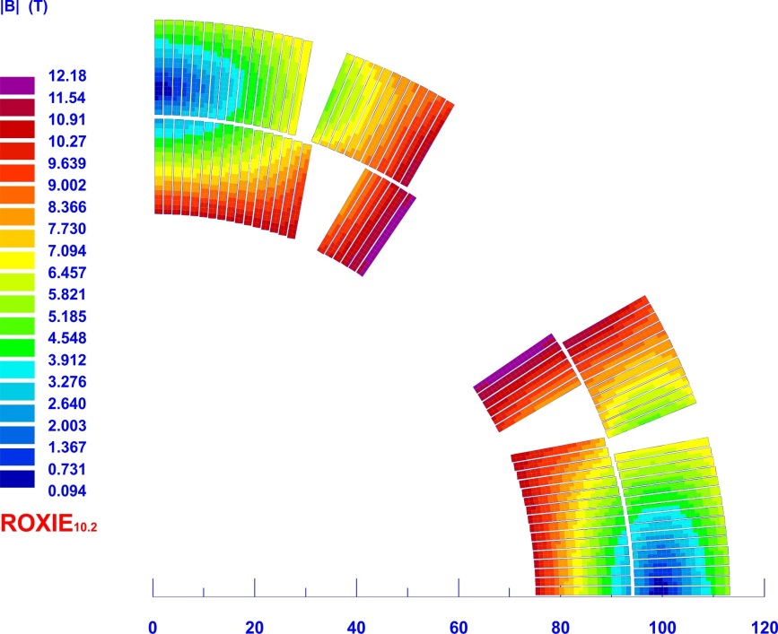
COIL LAYOUT
Coil layout used to compensate higher order multipoles
Each sector used to cancel out next non-forbidden order
CERN Accelerator School, Erice 2013

Slide 7
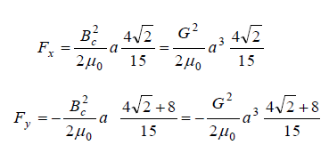
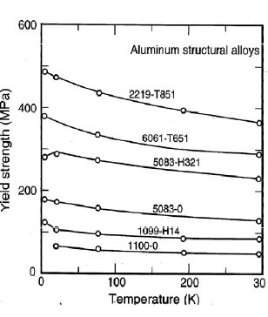
MECHANICAL DESIGN
Mechanical Design should avoid tensile stress
Thin shell approximation used (26%)
Forces computed using formula:
Iron yoke supporting 90% of Iss
Collar thickness 20 mm for a maximum stress of 70 MPa
Thickness of shrinking cylinder 12 mm for up to 100 MPa
-> Use of Aluminium possible
F_{x} | 1.2 MN/m
F_{y} | -2.9 MN/m
σ_{θ} | 158 MPa
CERN Accelerator School, Erice 2013

Slide 8
ISSUES

Slide 9
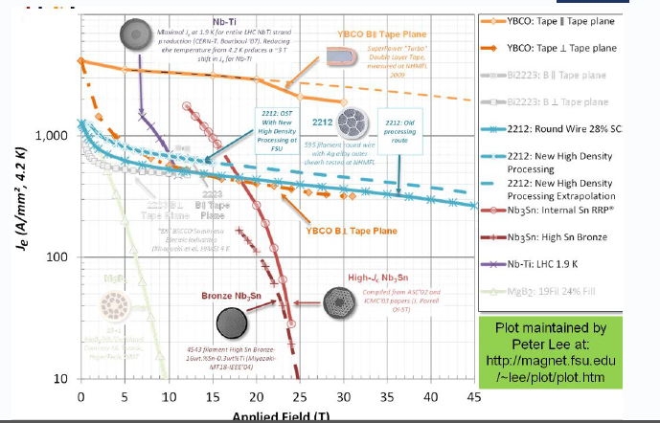
ISSUES: YBCO vs. Bi2212
Both are cuprites, the SC is confined to the CuO plane, mechanism not fully understood
In both cases high critical current in single crystals, however severly lowered by grain boundries!
Bi2212, unlike YBCO can be formed to round wires using power in tube process
Compaction and heating have large impact on SC-properties, large parameter space to optimize
CERN Accelerator School, Erice 2013

Slide 10
ISSUES: SC COIL DESIGN
The block-coil geometry naturally suppresses extrinsic losses, which typically constitute ~half of all ac losses, which are reduced in the block-coil geometry by the aspect ratio of the cable, typically 10:1
The simple equivalent block-coil design requires 20% less superconductor than the cosθ design of the same aperture and field strength.
Furthermore, one of the characteristics of the block-coil model is its scalability. After having studied the basic characteristics of a small aperture block coil magnets, an attempt could be made to design a large aperture magnet in a fast and efficient way by scaling up both the dimension of the aperture and the number of the blocks.
CERN Accelerator School, Erice 2013

Slide 11
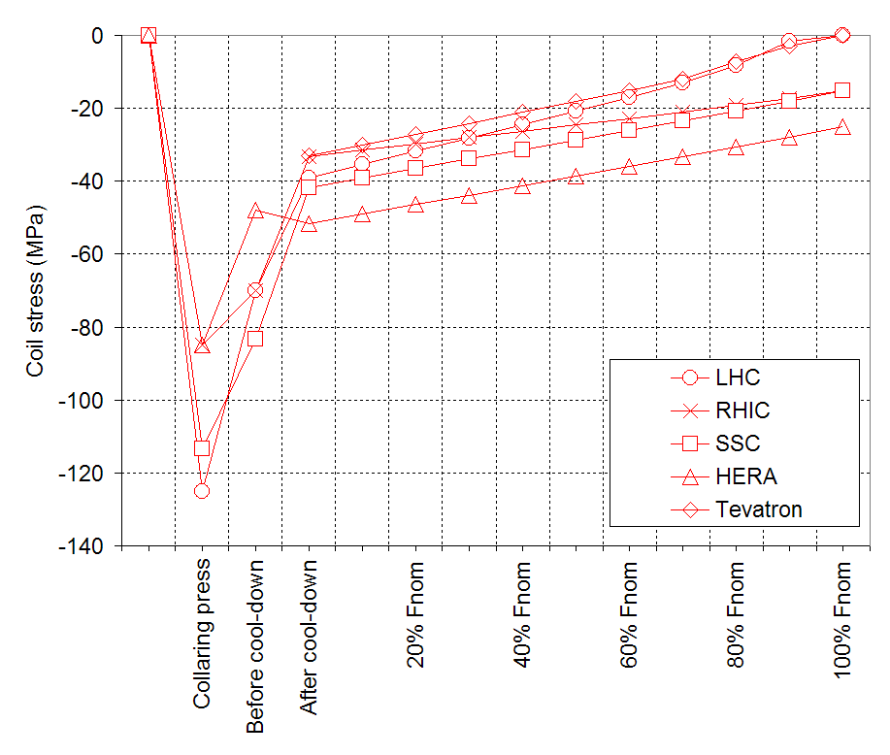
ISSUES: ASSEMBLY PROCEDURE
Pre-stress is needed to be sure that no tensile stresses will be applied on the coil
Pre-stress is usually lowered when the magnet is cooled down
Enough amount of pre-stress to remain at compressive state of stresses at every operation condition is needed.
As a general rule, pre-stress should be as small as needed to accomplish this condition, plus some safety margin of some Mpa as typical value (0-30 MPa)
CERN Accelerator School, Erice 2013

