Slide 2
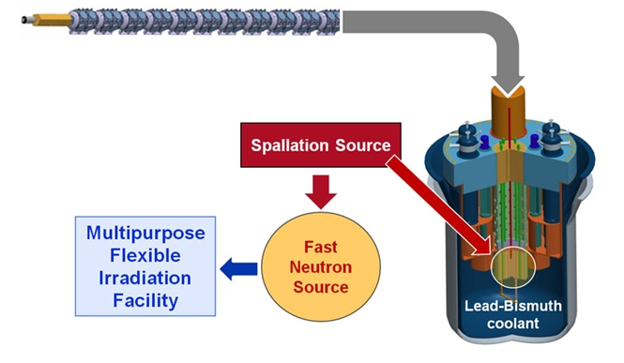
Introduction to ADS
Accelerator Driven Systems may be employed to address several missions, including:
  Transmuting long-lived radioactive isotopes present in nuclear waste (e.g. actinides, fission products) to reduce the burden of these isotopes place on geologic repositories
  Driving a thorium reactor (generating electricity and/or process heat)
  Producing fissile materials for subsequent use in critical or sub-critical systems by irradiating fertile elements
Current projects under study include: Europe (EUROTRANS: MYRRHA,XT-ADS, EFIT, C.Rubia: energy amplifier), India, Japan (TEF), South Korea (KAERI-KOMAC)

Slide 3
Design Requirements
Design of an ADS with the following boundary conditions
  Current Mode: CW
  Average Beam Power: 20MW
  Beam Energy: 1-2 GeV
  Beam Current: 10-20 mA
  Particle type: p or H-

Slide 4
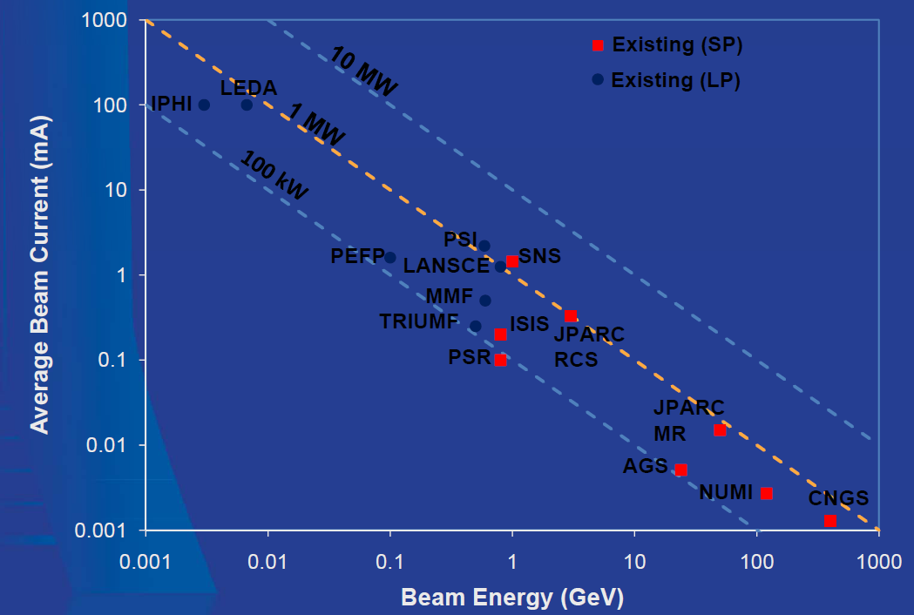
The Beam Power Landscape
SCC is first Industrial-Scale ADS!

Slide 5
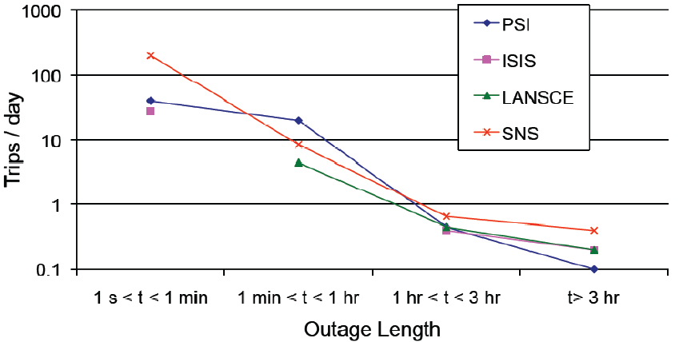
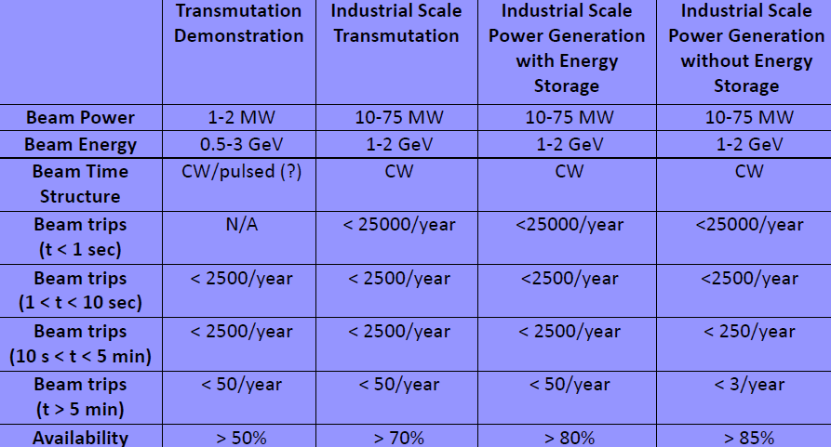
Availability
The beam availability must reach a level which is typically an order of magnitude better than the present day state-of-the-art. This requirement is strongly related to the thermal shocks which a beam interruption causes in an ADS (possibly causing safety issues).
Imposes use of well established accelerator technologies + principles of fault tolerance
Trip statistics of existing accelerators
SCC
The main challenge for industrial scale ADS:

Slide 6
Linac vs Cyclotron
LINAC | CYCLOTRON
(-) Large space requirement (few hundred m long) | (+) Compact
(-) Expensive construction | (+) Cheap construction
(-) Less efficient power conversion | (+) More efficient power conversion
(+) Modularity provides redundancy | (-) No intrinsic redundancy
(+) Upgradable in energy | (-) Difficult to upgrade in energy
(+) Small fraction of beam loss at high energy | (-) High fraction of beam loss at extraction
(+) Capable of high beam current (100 mA) | (-) Modest beam current capability (5 mA)
  Cyclotron is compact and cost effective, but lacks every form of redundancy, and has limited current
  Linacs are a more expensive, but highly modular solutions, making them well suited to tackle the availability issue, and can accelerate high CW currents

Slide 7

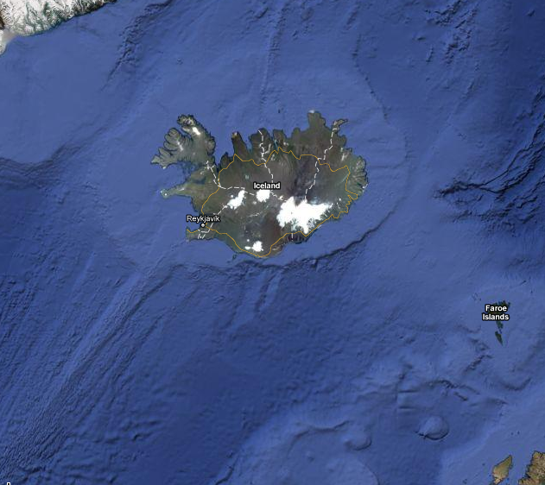
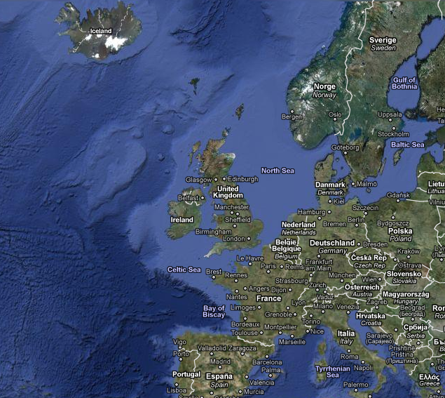
Location + top level parameters
Spallation Center
iCeland
  LINAC Redundant nc FE Linac +
  sc @ high energy
  Pulse length: CW
  Average Power: 20MW
  Beam Energy: 1 GeV
  Particle type: p
  Beam Current: 20mA
  Beam Energy: ± 1%
  Beam Intensity: ± 2%
  Beam Size: ± 10%
SCC
(Spallation Center iCeland)

Slide 8
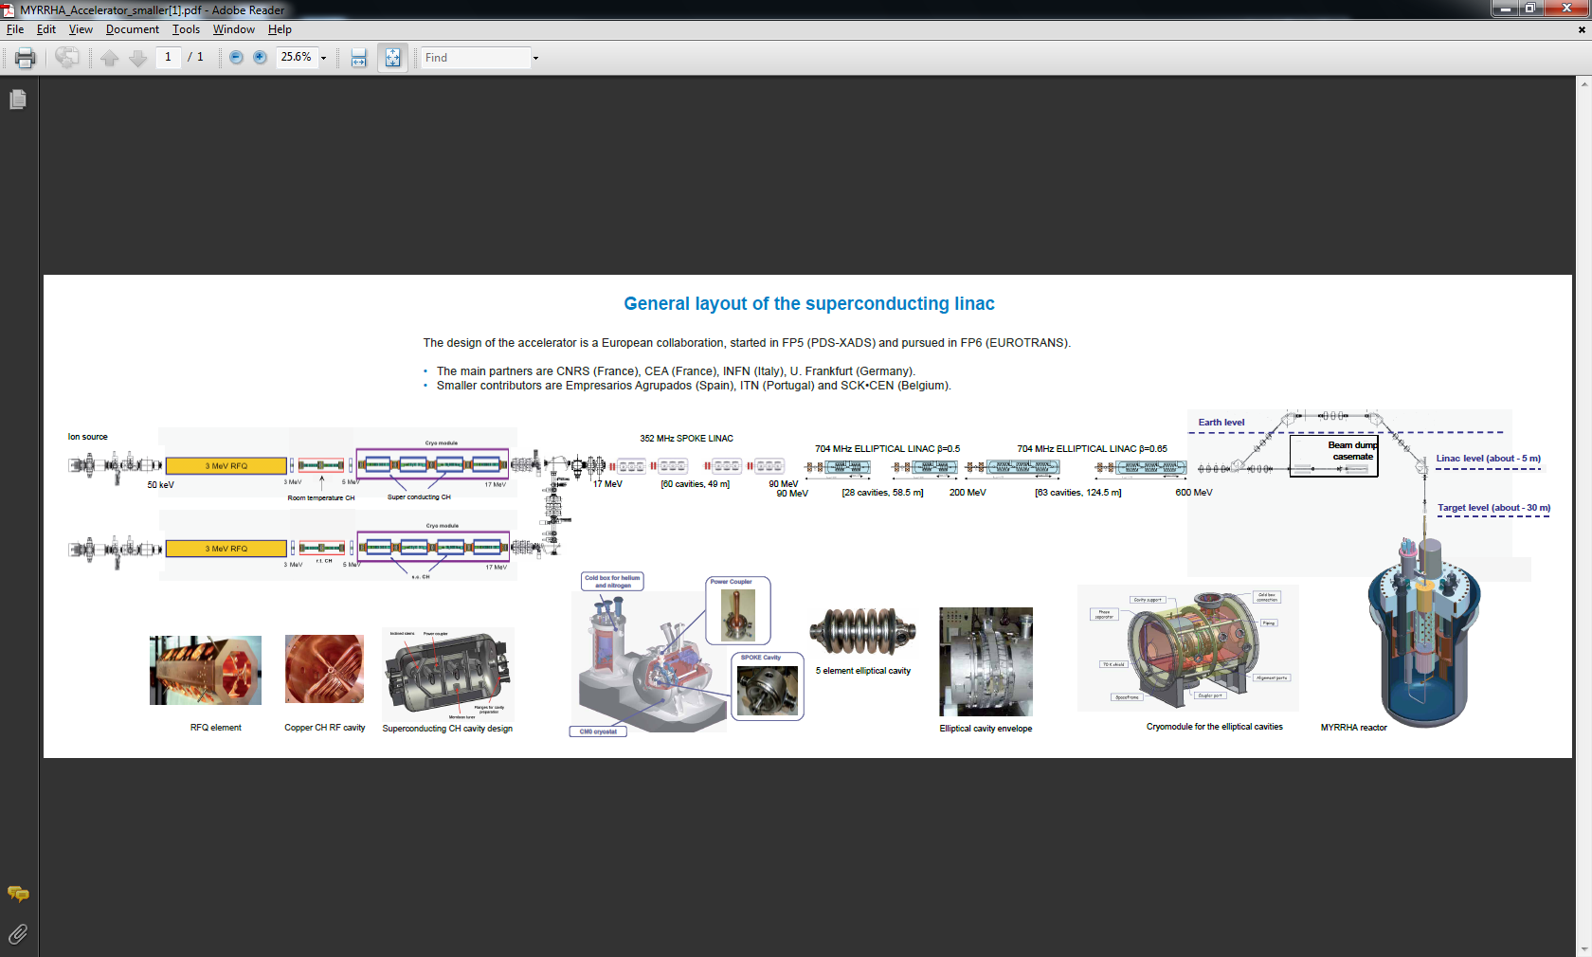
The accelerator design
Front end accelerator
Classic redundancy
independently phased sc section
distributed redundancy

Slide 9
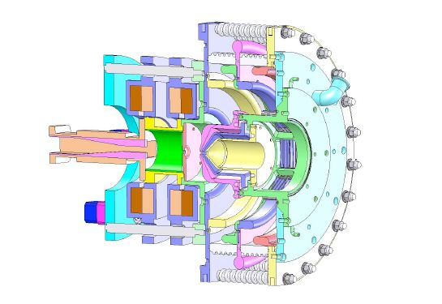
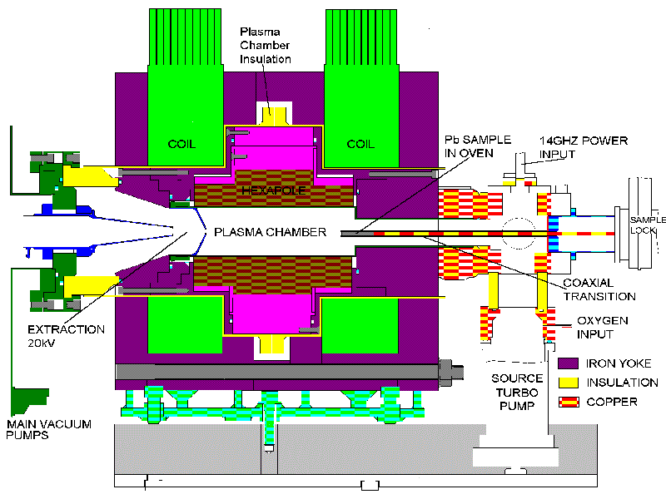
The ECR Source
ECR Source
Plasma chamber
Dimensions 66 mm diameter, 179 mm long.
Plasma electrode aperture 16 mm
RF power source 2 kW max + Klystron amplifier
Power injection (Tuned waveguide to co-axial transition)
Useful beam length (~ 1 ms).
Extraction potential: 2.5 keV/nucleon (nominal)
DC current 50mA

Slide 10
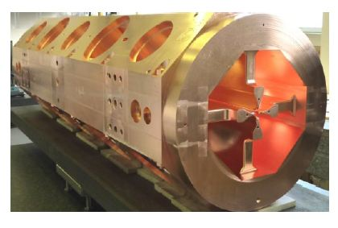
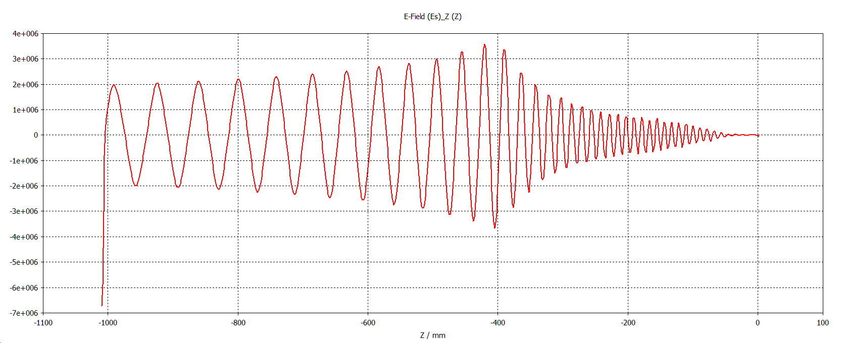
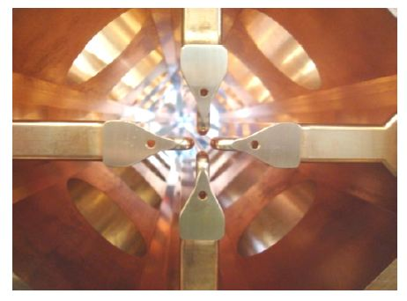
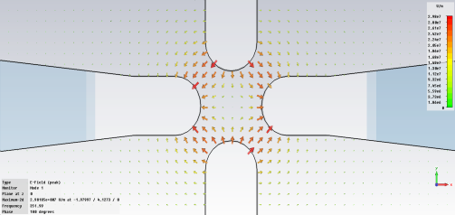
The RFQ
Ez field distribution along an RFQ
Four 1m long resonantly-coupled sections of 4-vane structures (4m total length)
Coupled through two coupling cells delivering a beam of 3 MeV
Maximum current of 50 mA on output
The required RF power comes to be about 1 MW to be delivered by a single klystron
RFQ resonant mode (quadrupole 352 MHZ)

Slide 11
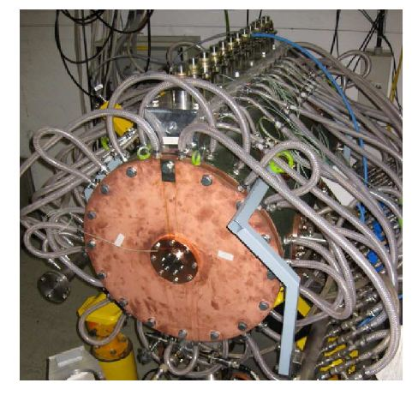
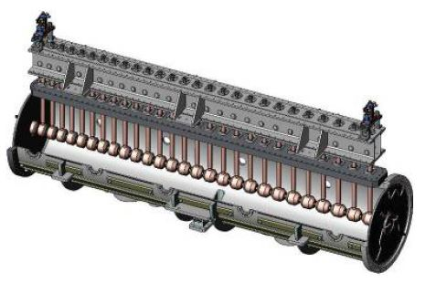
Drift Tube Linac
Output Energy | 25 MeV
Length (2 modules) | 8 m
Cells per cavity | 39/42
Number of klystrons needed | 3
Power per klystron | ~ 1 MW
Frequency | 352 MHz
3.9m
7.34m
Module #1
Module
#2
Klystrons

Slide 12
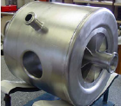
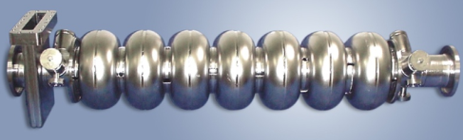
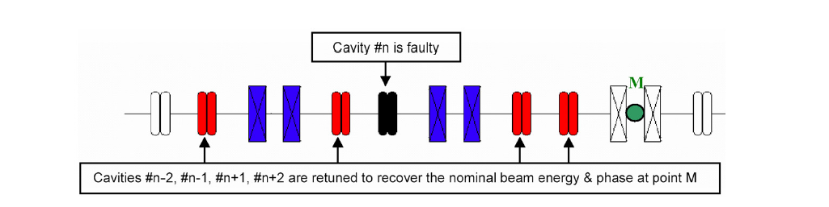
SCL
β=0.35 Spoke Cavities
β=0.5 Elliptical Linac
β=0.75 Elliptical Linac
352MHz
50m
704 MHz
60m
704MHz
200m
1 GeV
25 MeV
100 MeV
200 MeV
Gradient in Cavity | 25 MV/m
Average Gradient | <3 MV/ m
Q | > 10E10
Operating T | 2 K
Distributed redundancy
Detection of Cavity failure -> Retuning of close by cavities
Requires some margin in SCL design + power reserve for each cavity of up to 50%

Slide 13
Conclusions
Propose the construction of a 1st industrial scale ADS, featuring a 1GeV/20MW proton beam
Project will primarily aim at transmutation research, making it the worlds most powerful machine, exploring for a first time industrial scale applications of the technology
Within European collaboration, SCC will be built close to Reykjavik, Iceland, naturally boosting economy, technology and science sectors and allowing to profit from extensive district heating system
Design largely based on well established technologies to achieve dependability requirements of <few long duration trips per year
Implementation of new fail-tolerant concepts and distributed redundancy rather than costly classical redundancy for the expensive sc LINAC
Project cost estimated to ~ 1.85 billion Euros
including associated infrastructure and buildings

Slide 14
Thanks a lot for your attention
Fin
14

Slide 15
Choosing the accelerator design
The accelerator is the driver of the ADS system, providing high energy protons that are used in the spallation target to create neutrons which in their turn feed the sub-critical core
The right beam energy is a compromise between different competing considerations.
  (+) Neutron yield: increases with energy more than linearly.
  (+) Accelerator technology: From a technological point of view it is easier to increase the beam energy than to increase the beam current
  (-) Target size and design: higher energies requires a larger spallation target zone
  (-) He and H production in structure materials: A higher energy proton beam will generate H and He gas in the steel of the structure materials, causing degradation of the material
  (-) Accelerator construction costs: More beam energy will require a larger accelerator and a higher construction cost.
The correct beam shape and profile on target must be defined so as to yield an optimal efficiency while preserving the integrity of the target and of its surroundings

