Slide 1
Green Field Accelerator Study
W. Kaufmann
A. Leonardo
D. Valuch

Slide 2
Key design parameters
Pulse length: CW
Average beam power: ~1.5 MW
Beam Energy: 0.5 - 1 GeV (variable)
Particle species: protons

Slide 3
Design considerations
World’s first truly environmentally friendly accelerator
Technological breakthrough design
Minimal impact on the environment
User friendly operation

Slide 4
Accelerator layout
50 keV
0.05 - 500 MeV
500 - 1000 MeV
POD
ECR
SOURCE
BTTR
LES
VG
HES
POD
POD
POD
ŇUF
GPS
GRS
FFGX
POD
POD
POD
FOO
BLE
ADT
HUH
TARGET
neutrons

Slide 5
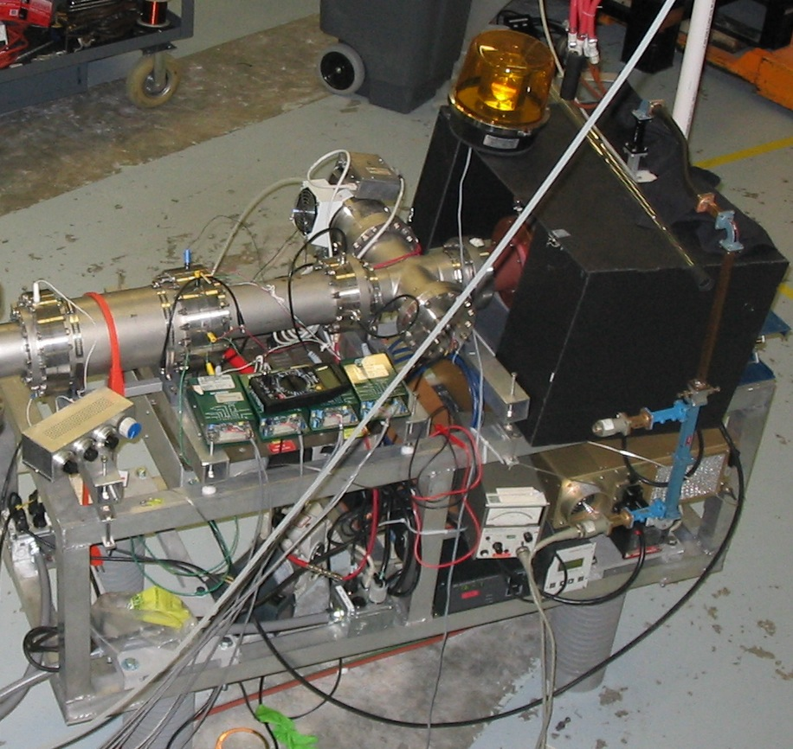
ECR source
For CW machine an ECR source is the choice as a proton source
Well established technology, commercial of the shelf

Slide 6
Low Energy Section
Basic building unit: 1 MeV gain block
BEAM IN
BEAM OUT
1,000,000 Volts
or more
Section of beampipe with
equipotential rings
+
-
Blue LED
AC/DC
convertor
Wind turbine, 5kW min.

Slide 7
Low Energy Section cont.
BEAM IN
AC/DC
convertor
AC/DC
convertor
… 500x
BEAM OUT
AC/DC
convertor
AC/DC
convertor

Slide 8
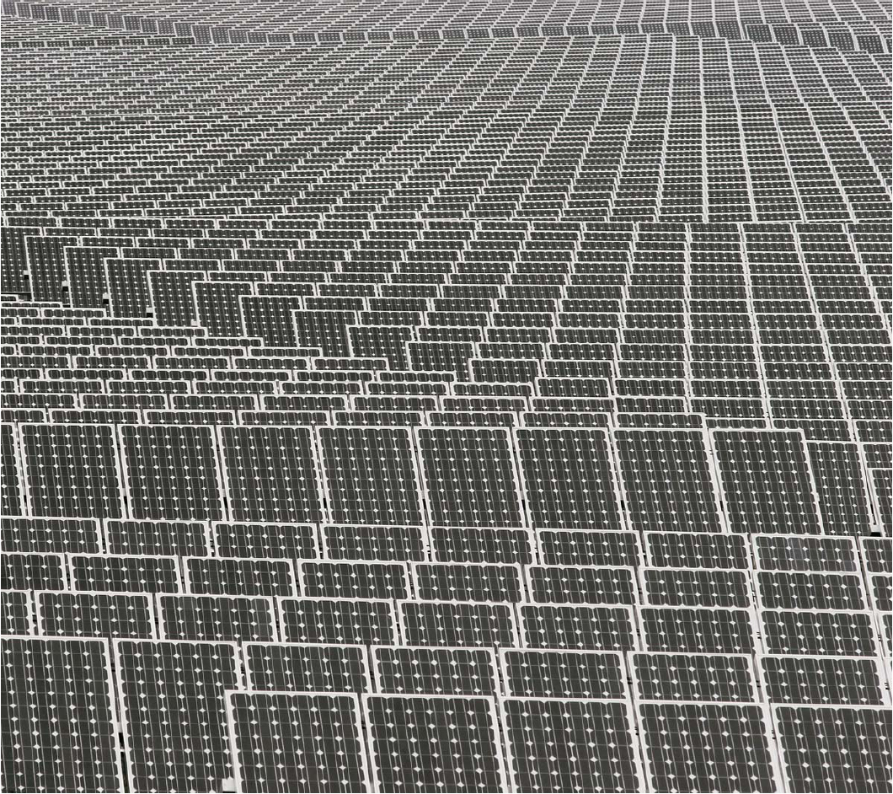
High Energy Section
Basic building unit: 1 MeV gain block
BEAM IN
Section of beampipe with
equipotential rings
1,000,000 Volts
or more
+
-
1,000,000 solar cells in series
or 1 hectare of fertile ground

Slide 9
High Energy Section cont.
… 500x

Slide 10
Vacuum system
Revolutionary design, using only materials available from the nature
Not susceptible to wall currents, no problems with machine impedance

Slide 11
Vacuum system
Built in transversal self focusing feature

Slide 12
Vacuum system
1 MeV gain block
With equipotential rings
1 MeV gain block
With equipotential rings
1 MeV gain block
With equipotential rings

Slide 13
Research program
Mornings: Low energy studies
Day time: High energy studies
Noon: Energy of the day study
Evening: Low energy studies
Nights, spring, autumn, winter, low wind, fog, cloudy conditions: Technical stop

Slide 14
Key facts and figures
~500 employees
15 top management
150 consultants
100 administration managers
100 lawyers
100 external relations
1 scientist
1 engineer

Slide 15
Key facts and figures
In the construction and commissioning phase it will produce 2000 conference papers per year
In the decommissioning phase it will produce about 2000 tons of fuel wood

Slide 16
Summary:
World’s first truly green accelerator
Revolutionary concept, Zero CO₂, No RF emissions nor magnetic fields
No radiation or material activation (guaranteed by design !)
Not a single incandescent light bulb used!

