Slide 1
Timing and Synchronization
H. Schlarb
DESY
  Outline:
  Introduction / Motivation
  Jitter source for beam arrival times
  Microwave properties and components
  RF Controls
  Synchronization references
  Beam feedbacks for FELs

Slide 2
Introduction / Motivation

Slide 3
Types of synchronization signals
There are various types of signals, frequently confused
Trigger signals (digital subsystems, CPU) ~ 100 ps
(10-100Hz)
Clocks (digital subsystems, ADC, DAC, CPU) ~ 5–20 ps
(1-100MHz)
Analog (RF phase reference, VM, LO) ~ 50fs – 1ps
(~0.1-10 GHz)
Optical (laser, diagnostics, experiment) < 10 fs
  e.g. laser pulse train
Notes:
Before you start editing the slides of your talk change to the Master Slide view:
Menu button “View”, Master, Slide Master:
Edit the following 2 items in the 1st slide:
1) 1st row in the violet header:
Delete the existent text and write the title of your talk into this text field
2) The 2 rows in the footer area: Delete the text and write the information
regarding your talk (same as on the Title Slide) into this text field.
If you want to use more partner logos position them left
beside the DESY logo in the footer area
Close Master View

Slide 4
Scope of precision synchronization
Synchronization reach into many different physics/engineering
disciplines and requires wide range of technologies
Radio Frequency:
different types of oscillators (quartz, SAW, dielectric)
phase detectors / mixer / multiplier /divider
low noise amplifier / limiting amplifier / filters / direction couplers
cables / connectors / PCB design / waveguides / RF structure / LLRF / HLRF
Optics & Lasers:
laser oscillator/pulse shaping/amplification/wavelength conversion
fiber optics / fiber optics devices / opto-electronic devices / photo-detection
laser sources (DFB/harmonic mode-lock/passive & active mode)
non-linear optics / opto-mechanics / free-space optics / pump-modules
Environmental control:
temperature / humidity / air pressure / vibration / ground motion / EMI / EMC
Controls & control theory:
multiple feedbacks / PLL theory / automation / SISO / MIMO / …
Longitudinal electron beam dynamics
velocity / magnetic bunch compression/ harmonic cav./collective effects/….
Notes:
Before you start editing the slides of your talk change to the Master Slide view:
Menu button “View”, Master, Slide Master:
Edit the following 2 items in the 1st slide:
1) 1st row in the violet header:
Delete the existent text and write the title of your talk into this text field
2) The 2 rows in the footer area: Delete the text and write the information
regarding your talk (same as on the Title Slide) into this text field.
If you want to use more partner logos position them left
beside the DESY logo in the footer area
Close Master View

Slide 5
New demands on synchronization system
Accelerator development from ns pulse duration to < 100 fs for FELs
⇒ time scale has changed from ps to fs
⇒ accelerator facility length scale ~ 100 – 3.5km
FELs based on exponential growth
⇒ precision control on beam parameter required
⇒ large bunch compression factor (tolerances LLRF!)
Beam based diagnostics on arrival & pulse shape
⇒ important for automation
⇒ accelerator commissioning and sub-system debugging
Pump-probe experiments (optical laser <-> FEL beam)
⇒ knowledge on photon arrivals to one another crucial
⇒ efficiency of experiments & dynamic range of detectors
Notes:
Before you start editing the slides of your talk change to the Master Slide view:
Menu button “View”, Master, Slide Master:
Edit the following 2 items in the 1st slide:
1) 1st row in the violet header:
Delete the existent text and write the title of your talk into this text field
2) The 2 rows in the footer area: Delete the text and write the information
regarding your talk (same as on the Title Slide) into this text field.
If you want to use more partner logos position them left
beside the DESY logo in the footer area
Close Master View

Slide 6


Motivation: Pump-probe experiments
Classical setup:
Probe = flash
Variable delay
probe
Same source
Pump
pump
Shot pulses fs ps
Pump pulse initiate reaction, probe pulse records current state.
Atomic / Molecular Physics/ Solid state dynamics
FELs: two different sources: FEL beam and optical laser
Knowledge of time delay is crucial!
Comments: 1) measured at experiment ⇒ post analysis
<1 fs ⇒ dynamic range of photon arrival detector!!!
2) for small event rates ⇒ not possible
➔ active synchronization required

Slide 7
New demands on synchronization system
Accelerator development from ns pulse duration to < 100 fs for FELs
⇒ time scale has changed from ps to fs
⇒ accelerator facility length scale ~ 100 – 3.5km
FELs based on exponential growth
⇒ precision control on beam parameter required
⇒ large bunch compression factor (tolerances LLRF!)
Beam based diagnostics on arrival & pulse shape
⇒ important for automation
⇒ accelerator commissioning and sub-system debugging
Pump-probe experiments (optical laser <-> FEL beam)
⇒ knowledge on photon arrivals to one another crucial
⇒ efficiency of experiments & dynamic range of detectors
Seeding & slicing and bunch manipulation
⇒ essential for success
⇒ opens new opportunities for FEL mode and FEL pulse control
Notes:
Before you start editing the slides of your talk change to the Master Slide view:
Menu button “View”, Master, Slide Master:
Edit the following 2 items in the 1st slide:
1) 1st row in the violet header:
Delete the existent text and write the title of your talk into this text field
2) The 2 rows in the footer area: Delete the text and write the information
regarding your talk (same as on the Title Slide) into this text field.
If you want to use more partner logos position them left
beside the DESY logo in the footer area
Close Master View

Slide 8
Motivation: seeding with higher harmonics
Generic layout of seeding a single pass FEL
Temporal overlap
Gas cell
30nm
800nm
Separation
Ti:Sa Laser
undulator
>1 GW
100kW
Electron beam
Δt
Gain 10⁴
Transfer line ~ 30-100m, << 10 fs
Ti:Sa Laser
Experiment
Δt
New class of experiments:
Electron beam is seeded or manipulated using external laser
Timing of FEL pulse defined by now by seed (laser)
Requirements:
Temporal overlap between electron bunch & seed pulse essential ~ 10-50 fs
Particular high demands on synchronization to pump-probe laser ~ 1-5 fs

Slide 9
New demands on synchronization system
Accelerator development from ns pulse duration to < 100 fs for FELs
⇒ time scale has changed from ps to fs
⇒ accelerator facility length scale ~ 100 – 3.5km
FELs based on exponential growth
⇒ precision control on beam parameter required
⇒ large bunch compression factor (tolerances LLRF!)
Beam based diagnostics on arrival & pulse shape
⇒ important for automation
⇒ accelerator commissioning and sub-system debugging
Pump-probe experiments (optical laser <-> FEL beam)
⇒ knowledge on photon arrivals to one another crucial
⇒ efficiency of experiments & dynamic range of detectors
Seeding & slicing and bunch manipulation
⇒ essential for success
⇒ opens new opportunities for FEL mode and FEL pulse control
Novel accelerator technology & linear colliders
⇒ e.g. Plasma Wake Field accelerators: wavelength ~ 10-100um
⇒ next linear collider 30-50 km with sub-100fs synchr. demand
Notes:
Before you start editing the slides of your talk change to the Master Slide view:
Menu button “View”, Master, Slide Master:
Edit the following 2 items in the 1st slide:
1) 1st row in the violet header:
Delete the existent text and write the title of your talk into this text field
2) The 2 rows in the footer area: Delete the text and write the information
regarding your talk (same as on the Title Slide) into this text field.
If you want to use more partner logos position them left
beside the DESY logo in the footer area
Close Master View

Slide 10
Arrival time of electron bunch
Electron beam transport through accelerator
1
E = 1 GeV →
Lorentz factor γ = E/m₀c²
β ≈ 1 - = 0.999999869
2γ²
10 m
ΔT
Elec. bunch
Light pulse
0 m
1000 m
Defines start
Predicts arrival
ΔT = 435fs between light pulse and electron beam (T=3.33μs)
Typical energy deviation δE/E < 0.1% ⇒ δt < 0.8 fs ☺
Typical orbit deviation δx < 50μm ⇒ δt < 0.04 fs ☺
⇒ Beam transport over large (straight) distances is no problem!!!

Slide 11
Synchronization & free running clocks
Prediction of arrival using atomic clocks
ΔT
Elec. bunch
0 m
1000 m
Defines start
Predicts arrival
Desired prediction accuracy ~ 10 fs:
Problem: drift during long measurement time ~ 1000sec

Slide 12
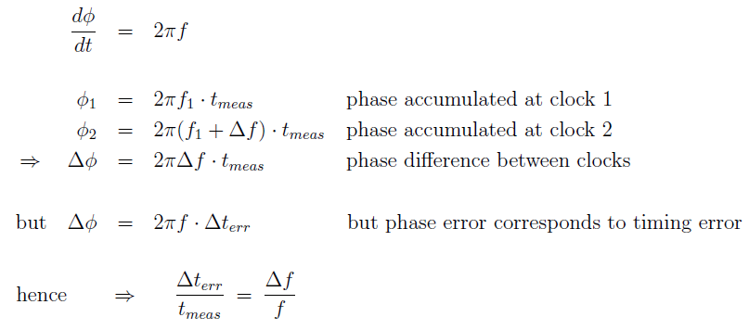
Synchronization & free running clocks
Prediction of arrival using atomic clocks
ΔT
Elec. bunch
0 m
1000 m
Defines start
Predicts arrival
Resynchronization required
Desired prediction accuracy ~ 10 fs:
Problem: drift during long measurement time ~ 1000sec
Best optical clocks have achieved df/f ~ 10⁻¹⁸
Correspond s to loss of ~1sec since big bang (4e17sec)
But by far not good enough of longer time scales &
very expensive / labor intensive
Δt
t
Δf
f
Precision of clock: = ~ 10⁻¹⁷ ☹

Slide 13
Synchronization & free running clocks
Prediction of arrival using atomic clocks
ΔT
Elec. bunch
Light pulse
?
0 m
1000 m
Defines start
Predicts arrival
Resynchronization required
Desired prediction accuracy ~ 10 fs:
Problem: drift during long measurement time ~ 1000sec
Δt
t
Δf
f
Precision of clock: = ~ 10⁻¹⁷ ☹
Resynchronization requires constant propagation time of signal 😐
Detector with femtosecond accuracy (short & long term) 😐

Slide 14
Synchronization & resynchronized clocks
Laser pulses transported in length-stabilized optical fibers
What are the requirements for the optical reference source?
Δt
Elec. bunch
Light pulse
?
0 m
1000 m
Low noise
RF Osc.
Fiber laser ~ 216MHz
Optical fiber
x
PZT
Mirror
x
t_{l} - t_{r}
Round trip time t ~ 10μs (n_{g}=1.5)
Rubidium
Clock
Δt
t
Δf
f
Desired length stabilization ~ 1μm (3fs) ⇒ = ~ 3⋅10⁻¹⁰ 😐
Stability (1s)
Δf/f ~ 10⁻¹¹
Aging (year)
Δf/f ~ 5⋅10⁻¹⁰
Fiber laser provides excellent stability on short time scales ☺
But drifts due to environmental changes over long time scales 😐
Requires locking of the fiber laser to an atomic clock (Rb sufficient) ☺

Slide 15
Jitter source for
beam arrival times

Slide 16
Sources of timing jitter in linear accelerator
Long/transverse beam quality
Arrival time jitter at entrance to undulator
RF gun
Accelerator
Undulator
γ
Photo-cathode
laser
Seed
laser
Pump-probe
laser
Sources of timing jitter (uncorrelated): σ_{t} = [Σ (w_{j} σ_{j})² ]^{1/2}
  Photo-cathode laser w ~ 40-60%
  RF phase of RF gun (non-relativistic electrons) w ~ 60-40%
  Seed and Pump-probe laser w ~ 100%

Slide 17
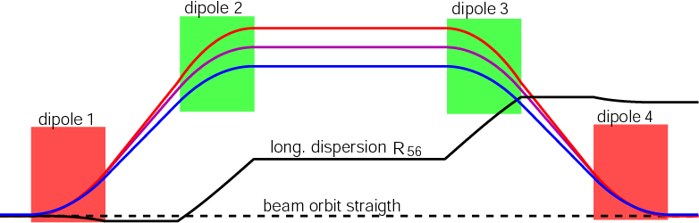
Sources of timing jitter in linear accelerator
Long/transverse beam quality
Arrival time jitter at entrance to undulator
bunch compressor
RF gun
Accelerator
Main Linac
Undulator
γ
Photo-cathode
laser
Seed
laser
Pump-probe
laser
Sources of timing jitter (uncorrelated): σ_{t} = [Σ (w_{j} σ_{j})² ]^{1/2}
  Photo-cathode laser w ~ 40-60%
  RF phase of RF gun (non-relativistic electrons) w ~ 60-40%
  Seed and Pump-probe laser w ~ 100%
Energy chirp + energy dependent path length
V_{acc}
z/c

Slide 18

Sources of timing jitter in linear accelerator
Long/transverse beam quality
Arrival time jitter at entrance to undulator
bunch compressor
RF gun
Accelerator
Main Linac
Undulator
γ
A/φ
THz
Photo-cathode
laser
stabilize I_{peak}
Seed
laser
Pump-probe
laser
Sources of timing jitter (uncorrelated): σ_{t} = [Σ (w σ_{t,I})² ]^{1/2}
  Photo-cathode laser w < 5%
  RF phase of RF gun (non-relativistic electrons) w < 5%
  Seed and Pump-probe laser w ~ 100%
  RF amplitude and phase w ~ 100%
Voltage
Phase
Incoming
compression
factor
C ~5 … 20
Timing jitter
behind BC
XFEL: 3.3 ps/%
FLASH: 5.5ps/%
2 ps/deg
L-band
0.05 ps/ps
C=20

Slide 19
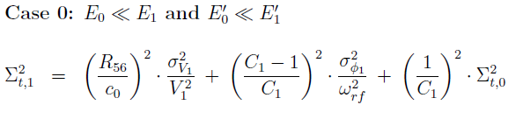
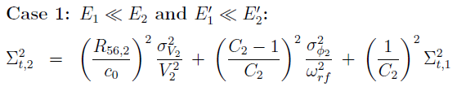
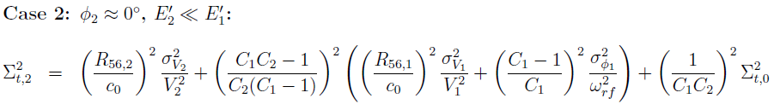
Sources of timing jitter in linear accelerator
Several compressor stages
RF gun
Accelerator
BC1
Accelerator
BC2
Main Linac
A₁/φ₁
R_{56,1}/E₁
A₂/φ₂
R_{56,2}/E₂
dE/E
5
Chirp E’1
4
Bunch
3
head
2
1
0
-1
case1
-2
wake
Recursive case 0
-3
-4
-5
-5
-4
-3
-2
-1
0
1
2
3
4
5
Remark: long. wakefields helps to remove
energy chirp from first accelerator section
z/σ_{z}
Jitter from BC1 remains + additive jitter!

Slide 20
Microwave properties and components
Microwave properties
and components
Notes:
Before you start editing the slides of your talk change to the Master Slide view:
Menu button “View”, Master, Slide Master:
Edit the following 2 items in the 1st slide:
1) 1st row in the violet header:
Delete the existent text and write the title of your talk into this text field
2) The 2 rows in the footer area: Delete the text and write the information
regarding your talk (same as on the Title Slide) into this text field.
If you want to use more partner logos position them left
beside the DESY logo in the footer area
Close Master View

Slide 21



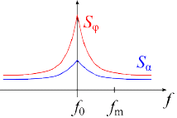
Microwave properties and components
Microwave signal with noise
polar coordinates:
Cartesian coordinates:
Offset / modulation frequency:
Voltage spectral density:
[V²/Hz]
carrier
[1/Hz]
[rad²/Hz]
1.5
For RF sources usually the
amplitude noise spectral density
is much small than the
phase noise spectral density
1
(t)
0.5
ν
0
signal
-0.5
S_{α} << S_{ϕ}
-1
-1.5
-1
-0.5
0
0.5
1
See also: Enrico Rubiola FEMTO-ST Institute http://rubiola.org
time t/T₀
Notes:
Before you start editing the slides of your talk change to the Master Slide view:
Menu button “View”, Master, Slide Master:
Edit the following 2 items in the 1st slide:
1) 1st row in the violet header:
Delete the existent text and write the title of your talk into this text field
2) The 2 rows in the footer area: Delete the text and write the information
regarding your talk (same as on the Title Slide) into this text field.
If you want to use more partner logos position them left
beside the DESY logo in the footer area
Close Master View

Slide 22
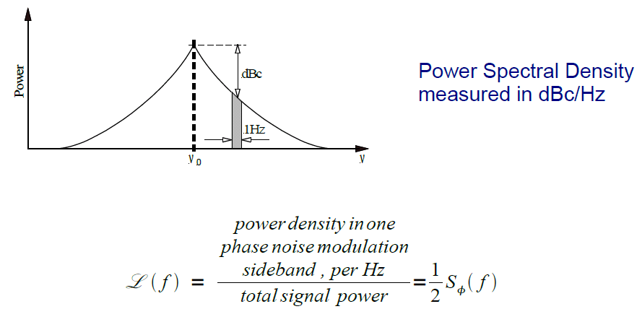
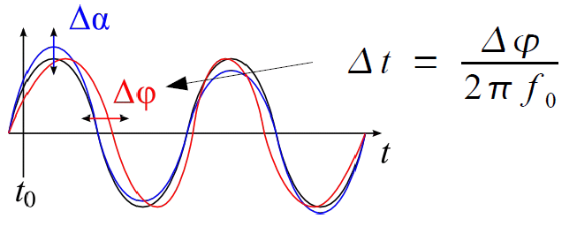
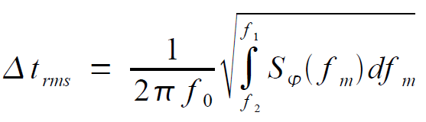

Phase noise & timing jitter
Phase noise:
dBc = dB relative to carrier
10 log [|L(f_{m})|] dBc/Hz
IEEE standard 1139-1999
Timing jitter:
[rad²/Hz]
Independent of carrier frequency
[sec²/Hz]
Δϕ_{rms}= [rad]
Notes:
Before you start editing the slides of your talk change to the Master Slide view:
Menu button “View”, Master, Slide Master:
Edit the following 2 items in the 1st slide:
1) 1st row in the violet header:
Delete the existent text and write the title of your talk into this text field
2) The 2 rows in the footer area: Delete the text and write the information
regarding your talk (same as on the Title Slide) into this text field.
If you want to use more partner logos position them left
beside the DESY logo in the footer area
Close Master View

Slide 23
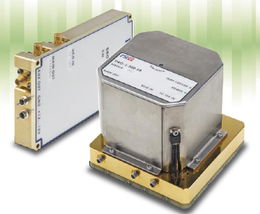
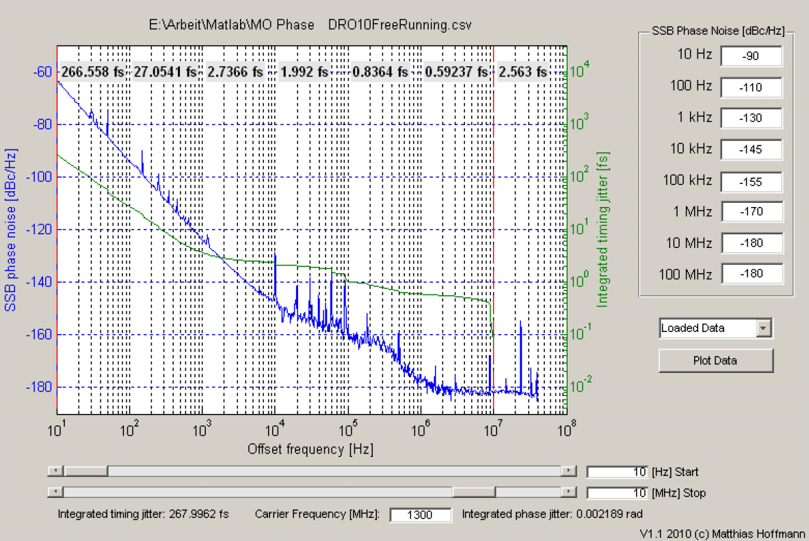
Microwave properties and components
Phase noise spectrum is systems finger print
~ f⁻³
spurious
Inter. filter
Thermal noise floor
S = k_{B}T ~ -174 dBm/Hz
k_{B}= Boltzmann constant
T = Temperature [K]
P₀ = + 10dBm
Lth = 0.5*S/P₀
= 187 dBc/Hz
~ f⁻¹
~ f⁰
Courtesy: M. Hoffmann
Notes:
Before you start editing the slides of your talk change to the Master Slide view:
Menu button “View”, Master, Slide Master:
Edit the following 2 items in the 1st slide:
1) 1st row in the violet header:
Delete the existent text and write the title of your talk into this text field
2) The 2 rows in the footer area: Delete the text and write the information
regarding your talk (same as on the Title Slide) into this text field.
If you want to use more partner logos position them left
beside the DESY logo in the footer area
Close Master View

Slide 24
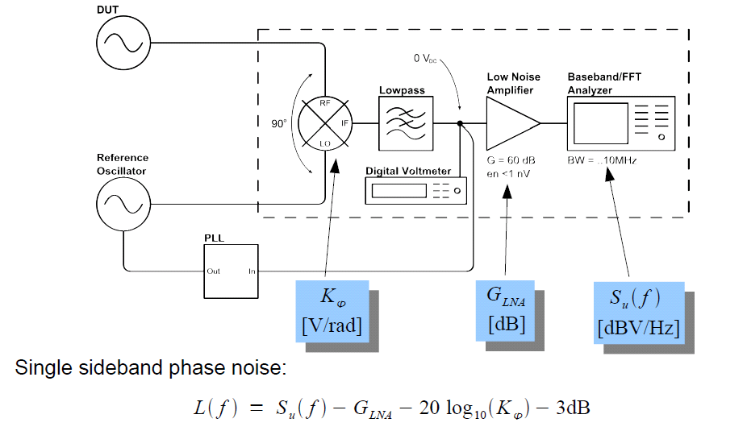
Microwave properties and components
Measurement of absolute phase noise:
Device under test
ϕ_{i}
K_{ϕ}(ϕ_{i}- ϕ_{o})
ϕ_{o}
Courtesy: M. Hoffmann
Notes:
Before you start editing the slides of your talk change to the Master Slide view:
Menu button “View”, Master, Slide Master:
Edit the following 2 items in the 1st slide:
1) 1st row in the violet header:
Delete the existent text and write the title of your talk into this text field
2) The 2 rows in the footer area: Delete the text and write the information
regarding your talk (same as on the Title Slide) into this text field.
If you want to use more partner logos position them left
beside the DESY logo in the footer area
Close Master View

Slide 25
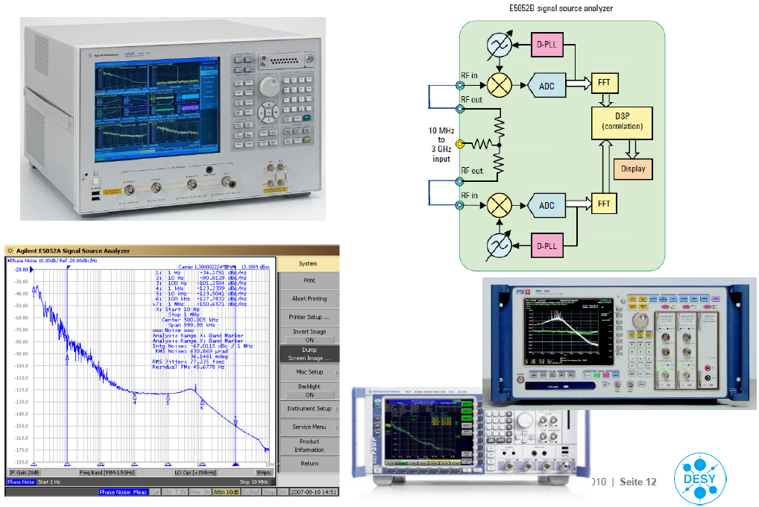
Microwave properties and components
Measurement of absolute phase noise:
2 statistically
independent
measurements
+ corr.
DUT
Courtesy: M. Hoffmann
Notes:
Before you start editing the slides of your talk change to the Master Slide view:
Menu button “View”, Master, Slide Master:
Edit the following 2 items in the 1st slide:
1) 1st row in the violet header:
Delete the existent text and write the title of your talk into this text field
2) The 2 rows in the footer area: Delete the text and write the information
regarding your talk (same as on the Title Slide) into this text field.
If you want to use more partner logos position them left
beside the DESY logo in the footer area
Close Master View

Slide 26

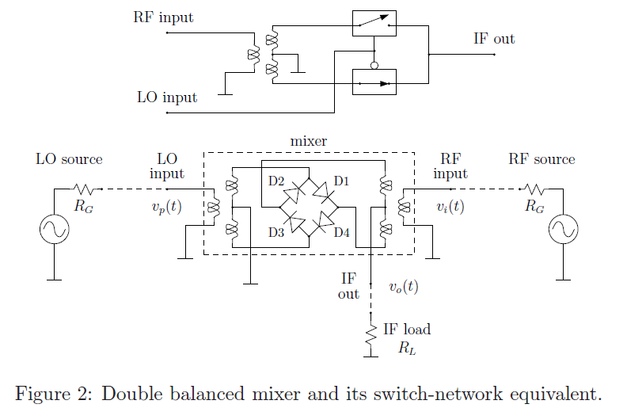
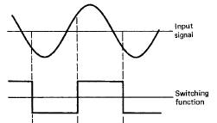

Microwave properties and components
Mixer & phase detector:
RF
LO
GND
IF
→ double the frequency
+ DC offset (if f _{LO} = f _{RF} )
Notes:
Before you start editing the slides of your talk change to the Master Slide view:
Menu button “View”, Master, Slide Master:
Edit the following 2 items in the 1st slide:
1) 1st row in the violet header:
Delete the existent text and write the title of your talk into this text field
2) The 2 rows in the footer area: Delete the text and write the information
regarding your talk (same as on the Title Slide) into this text field.
If you want to use more partner logos position them left
beside the DESY logo in the footer area
Close Master View

Slide 27
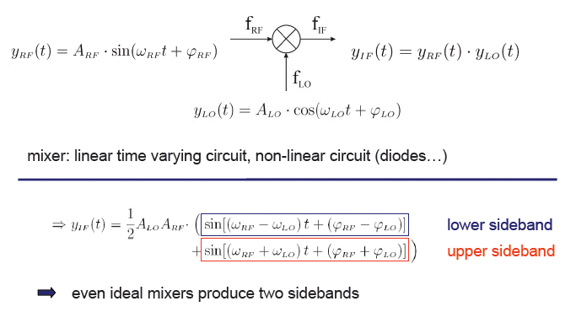
Microwave properties and components
Mixer & phase detector:
If LO and RF frequency equal ⇒ lower sideband at DC, upper sideband at 2f
If phase is 0 deg between LO and RF ⇒ amplitude detector (in phase) I
If phase is 90 deg between LO and RF ⇒ phase detector (in quadrature) Q
Notes:
Before you start editing the slides of your talk change to the Master Slide view:
Menu button “View”, Master, Slide Master:
Edit the following 2 items in the 1st slide:
1) 1st row in the violet header:
Delete the existent text and write the title of your talk into this text field
2) The 2 rows in the footer area: Delete the text and write the information
regarding your talk (same as on the Title Slide) into this text field.
If you want to use more partner logos position them left
beside the DESY logo in the footer area
Close Master View

Slide 28
Microwave properties and components
Mixer & phase detector:
Kd = U/(ϕ_{LO}-ϕ_{RF}) ≈ 300mV/rad
Compromise between noise and linearity :
IP3
Conversion loss
~ 7-10dB
IP2
Active Gilbert-mixers:
Passive Mixers (FET):
+ High conversion gain
+ Low LO drive needed
+ Low LO/RF crosstalk
- Normal NF
- Additional 1/f-noise
+ High linearity
+ Low NF
Large LO drive needed
(additional phase noise)
- Higher LO/RF crosstalk
Non-linearity
Noise floor
Spurious Free
Dynamic Range (SFDRout)
Dynamic Range (DRout)
Noise
Filtering of distortions :
- Intermodulation effects
- Higher harmonics
- Filtering of distortions
Notes:
Before you start editing the slides of your talk change to the Master Slide view:
Menu button “View”, Master, Slide Master:
Edit the following 2 items in the 1st slide:
1) 1st row in the violet header:
Delete the existent text and write the title of your talk into this text field
2) The 2 rows in the footer area: Delete the text and write the information
regarding your talk (same as on the Title Slide) into this text field.
If you want to use more partner logos position them left
beside the DESY logo in the footer area
Close Master View

Slide 29
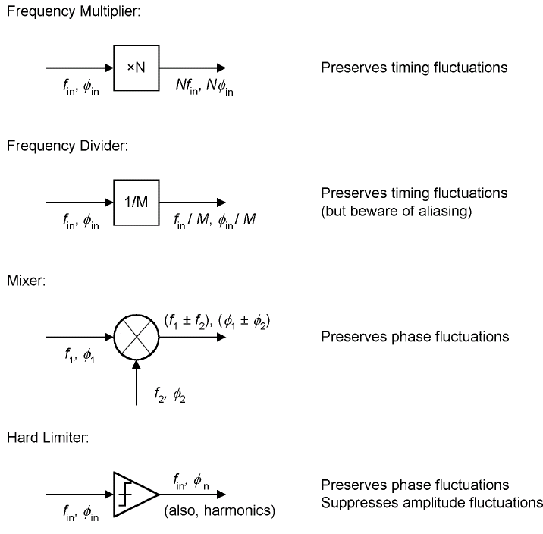
Microwave properties and components
S _{ϕ,out} = 20 log(f_{in}/f_{out}) + S_{ϕ,in}
S _{ϕ,out} = -20 log(f_{in}/f_{out}) + S_{ϕ,in}
S _{ϕ,out} = S_{ϕ1,in} +S_{ϕ2,in}
Remark: IF= |(f1-f2)| << f₁,f₂
large gear ratio = f/IF allows for precision meas.
S _{ϕ,out} = S_{ϕ,in} + (AM→ PM)
Analog to digital:
ADC
f_{in}, φ_{in}
Preserves timing fluctuations
S _{ϕ,out} = S_{ϕ,in} +S_{ϕ,clk}
f_{in}, φ_{in}
Clock
f_{clk}, φ_{clk}
Remark: no IF, no gear ratio!
Notes:
Before you start editing the slides of your talk change to the Master Slide view:
Menu button “View”, Master, Slide Master:
Edit the following 2 items in the 1st slide:
1) 1st row in the violet header:
Delete the existent text and write the title of your talk into this text field
2) The 2 rows in the footer area: Delete the text and write the information
regarding your talk (same as on the Title Slide) into this text field.
If you want to use more partner logos position them left
beside the DESY logo in the footer area
Close Master View

Slide 30
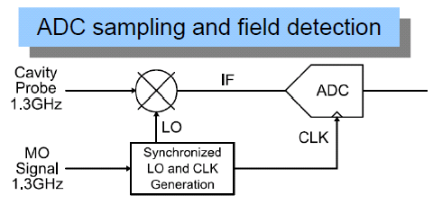
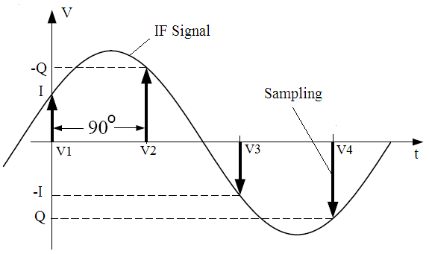
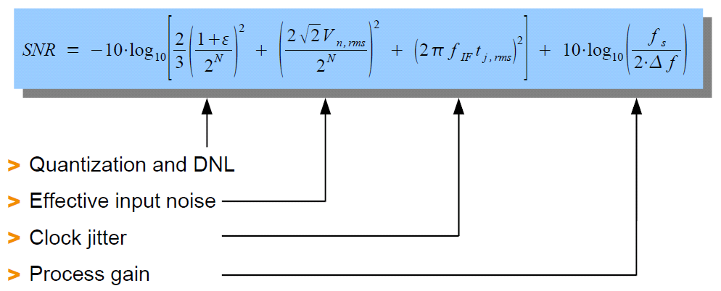
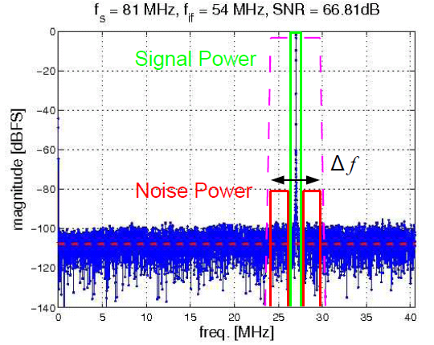
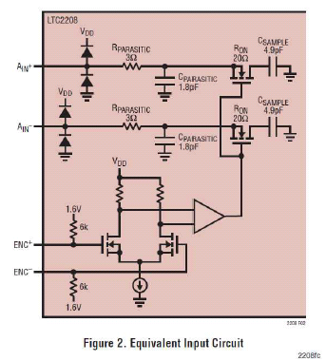
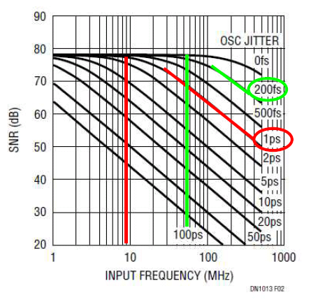
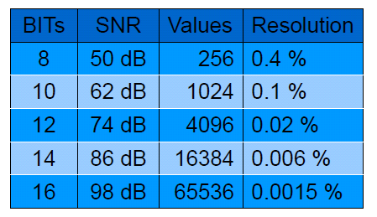
Microwave properties and components
Mixer preserves phase noise
Digital down conversion
Notes:
Before you start editing the slides of your talk change to the Master Slide view:
Menu button “View”, Master, Slide Master:
Edit the following 2 items in the 1st slide:
1) 1st row in the violet header:
Delete the existent text and write the title of your talk into this text field
2) The 2 rows in the footer area: Delete the text and write the information
regarding your talk (same as on the Title Slide) into this text field.
If you want to use more partner logos position them left
beside the DESY logo in the footer area
Close Master View

Slide 31
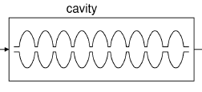
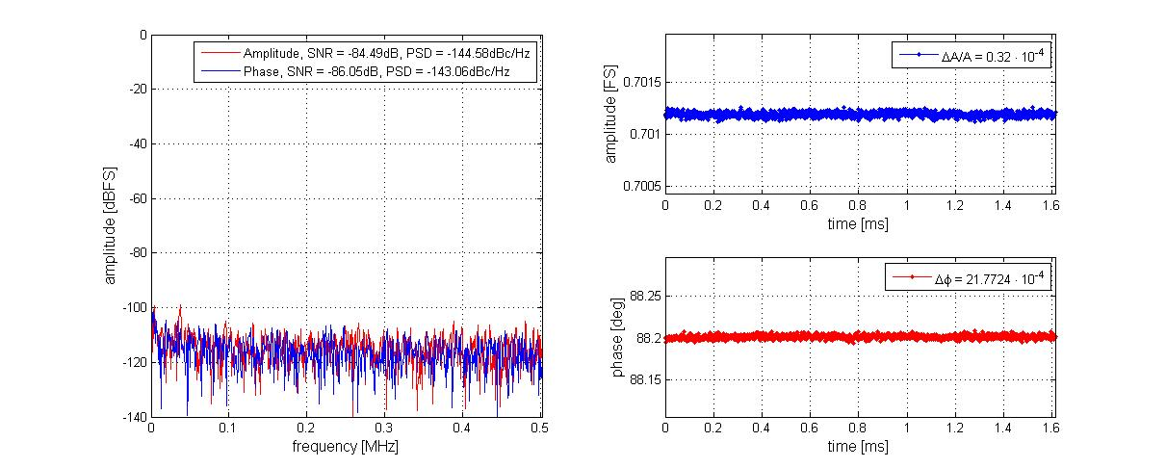
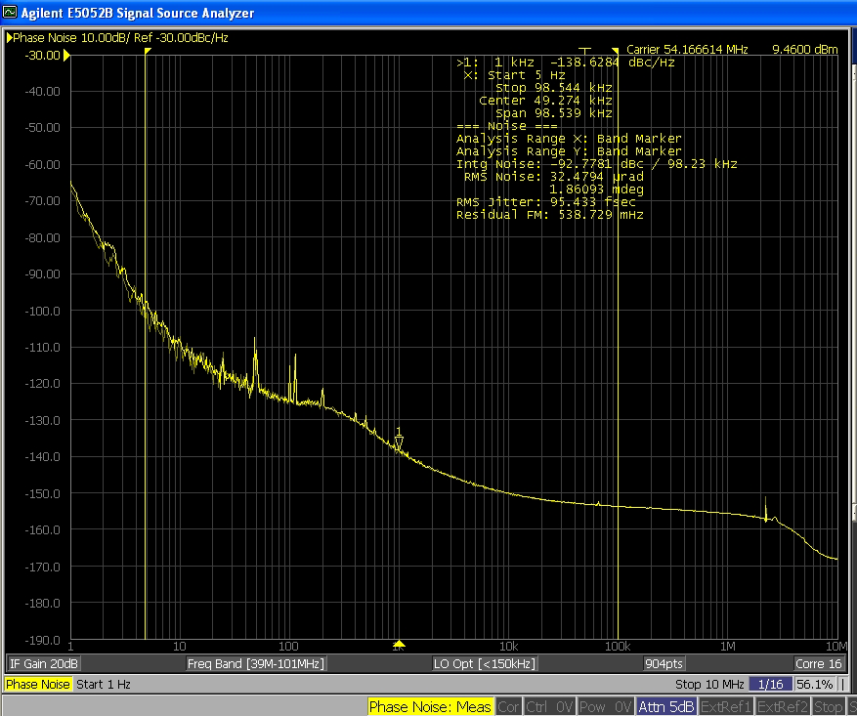
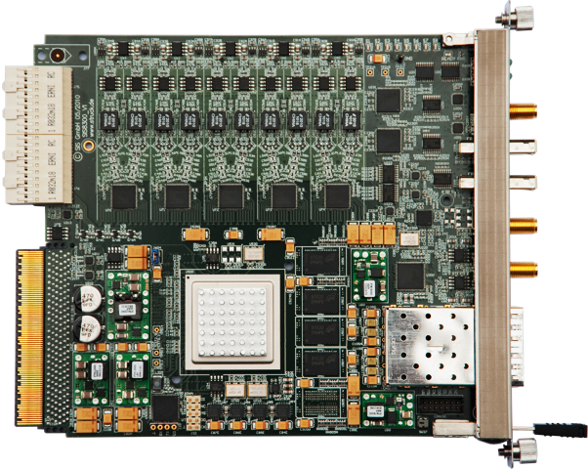
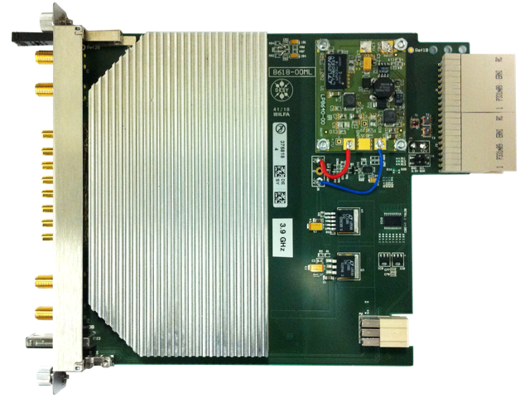
RF field detector arrangements
31
RF receiver developments & noise limitations
Noise balanced (LO/Front-end/ADC)
Resolution: Factor of 5 improved primarily by ADC improvements
Single Channel Receiver
ΔA/A=0.003%
AM
Front-End <-150dBc/Hz
ADC+ DDC -147dBc/Hz
BPF
DDC
CIC Filter
Calibration
LNA
ADC
ΔB=1MHz
Reference
CLK
Intermediate frequency [10MHz, 50MHz]:
Δφ=0.002º
PM
-150dBc/Hz
LO and CLK Generation
Down-converter
10 ch. 16bit ADC
< 0.0018°, 4fs
-150dBc/Hz
LO-Generation
Integrated MicroTCA Crate system
Notes:
Before you start editing the slides of your talk change to the Master Slide view:
Menu button “View”, Master, Slide Master:
Edit the following 2 items in the 1st slide:
1) 1st row in the violet header:
Delete the existent text and write the title of your talk into this text field
2) The 2 rows in the footer area: Delete the text and write the information
regarding your talk (same as on the Title Slide) into this text field.
If you want to use more partner logos position them left
beside the DESY logo in the footer area
Close Master View

Slide 32
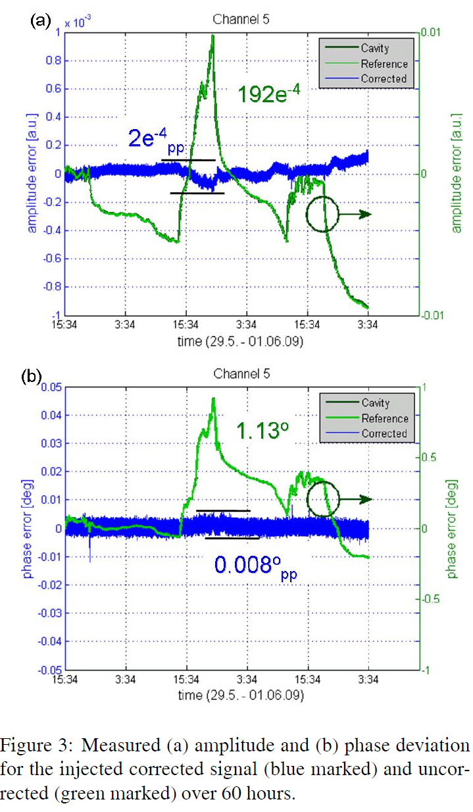
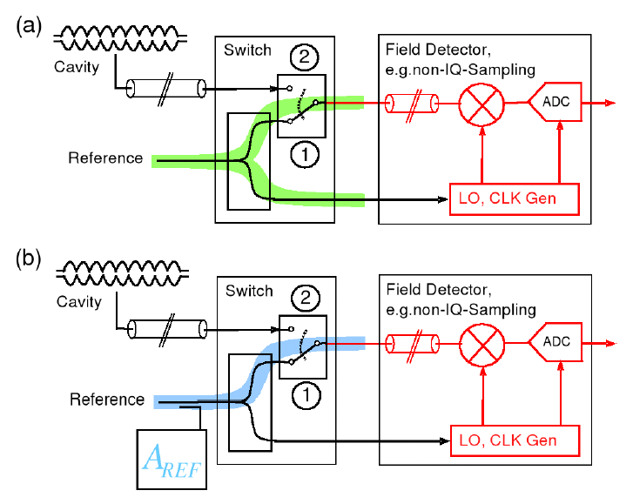
Microwave properties and components
Reference tracking for mixer drift removal
Mixer phase drifts ~ 0.2°/K
Mixer amplitude drifts ~ 0.2%/K
+ dependence on humidity on PCBs
Remark: mixer drift not equal (one PCB, temp.)
Notes:
Before you start editing the slides of your talk change to the Master Slide view:
Menu button “View”, Master, Slide Master:
Edit the following 2 items in the 1st slide:
1) 1st row in the violet header:
Delete the existent text and write the title of your talk into this text field
2) The 2 rows in the footer area: Delete the text and write the information
regarding your talk (same as on the Title Slide) into this text field.
If you want to use more partner logos position them left
beside the DESY logo in the footer area
Close Master View

Slide 33
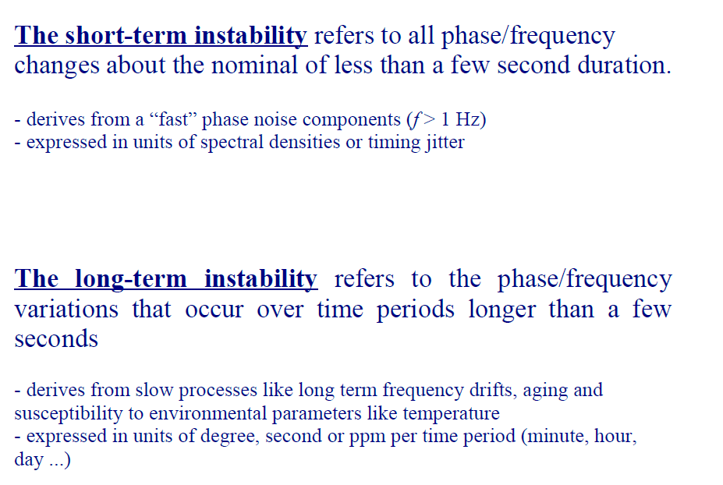
Microwave properties and components
Courtesy: K. Czuba
Notes:
Before you start editing the slides of your talk change to the Master Slide view:
Menu button “View”, Master, Slide Master:
Edit the following 2 items in the 1st slide:
1) 1st row in the violet header:
Delete the existent text and write the title of your talk into this text field
2) The 2 rows in the footer area: Delete the text and write the information
regarding your talk (same as on the Title Slide) into this text field.
If you want to use more partner logos position them left
beside the DESY logo in the footer area
Close Master View

Slide 34
Phase drifts in coaxial cables
Courtesy: K. Czuba, ISE/WUT
Notes:
Before you start editing the slides of your talk change to the Master Slide view:
Menu button “View”, Master, Slide Master:
Edit the following 2 items in the 1st slide:
1) 1st row in the violet header:
Delete the existent text and write the title of your talk into this text field
2) The 2 rows in the footer area: Delete the text and write the information
regarding your talk (same as on the Title Slide) into this text field.
If you want to use more partner logos position them left
beside the DESY logo in the footer area
Close Master View

Slide 35
RF signals essential for electron beam synchr.
RF signal (irrelevant how they are provide) have to transported into create system
Internal calibration scheme can be applied
Many tap points (European XFEL ~ 100-1000)
Rack and create design critical
Courtesy: K. Czuba, ISE/WUT
Notes:
Before you start editing the slides of your talk change to the Master Slide view:
Menu button “View”, Master, Slide Master:
Edit the following 2 items in the 1st slide:
1) 1st row in the violet header:
Delete the existent text and write the title of your talk into this text field
2) The 2 rows in the footer area: Delete the text and write the information
regarding your talk (same as on the Title Slide) into this text field.
If you want to use more partner logos position them left
beside the DESY logo in the footer area
Close Master View

Slide 36
RF Controls
RF controls

Slide 37
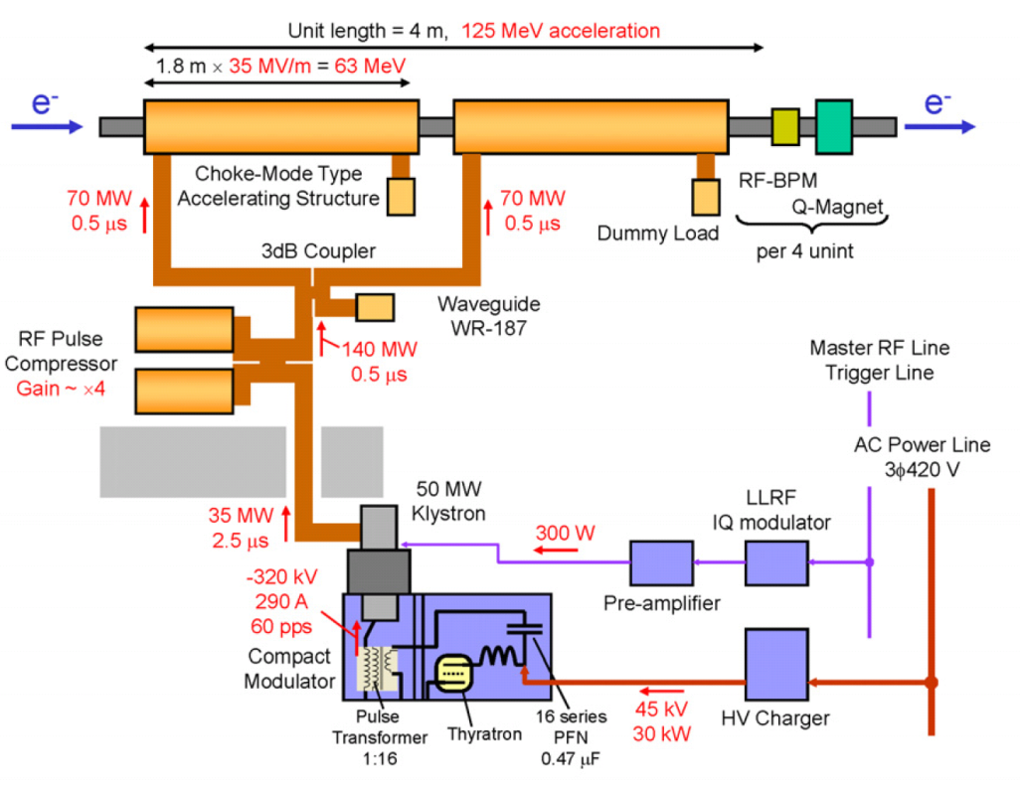
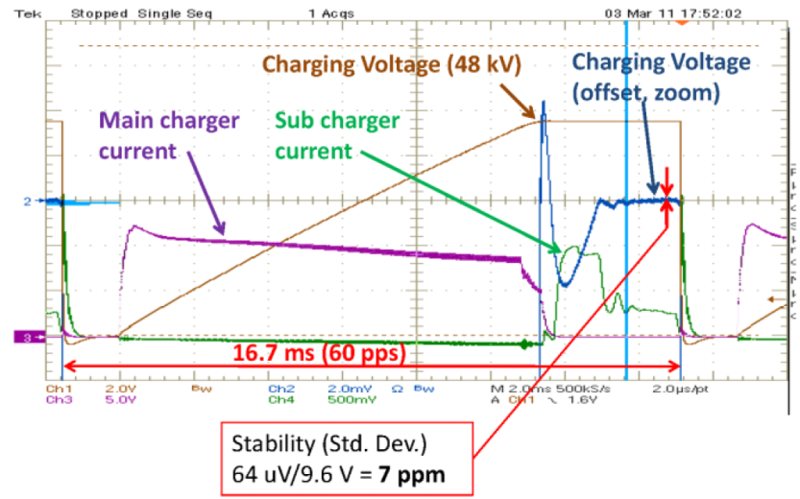
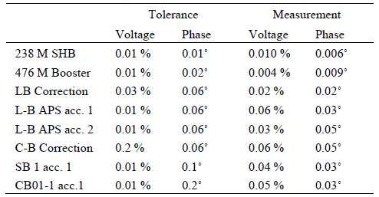
RF control of short RF pulses (NRF)
37
For RF pulse duration ~ 2-3 us
  no intra-pulse FB possible
  feed forward control define RF stability
Main factors:
  LLRF drive signal
    RF reference / PLL
    IQ modulator (vector modulator)
    Preamplifier
  Temperature stability acc. Structure < 0.01K
  Stability of HV modulator
Feedback applied Pulse-to-Pulse
  Using For/Ref/Probe signal to remove
  temp. drifts of cavities/waveguides..
  Multi-cavities ⇒ vector sum control
RF System @ SACLA
T. Inagaki, IPAC11, MOPC018
T. Ohshima, 8th Annual. ACC Society of Japan
dV/V~3⋅10⁻⁴
dφ ~ 0.03°
Notes:
Before you start editing the slides of your talk change to the Master Slide view:
Menu button “View”, Master, Slide Master:
Edit the following 2 items in the 1st slide:
1) 1st row in the violet header:
Delete the existent text and write the title of your talk into this text field
2) The 2 rows in the footer area: Delete the text and write the information
regarding your talk (same as on the Title Slide) into this text field.
If you want to use more partner logos position them left
beside the DESY logo in the footer area
Close Master View

Slide 38
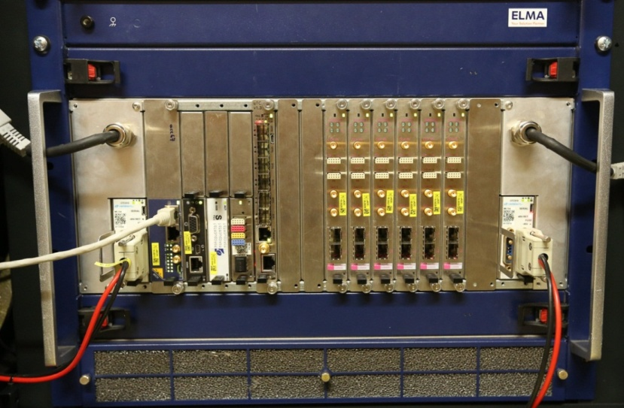
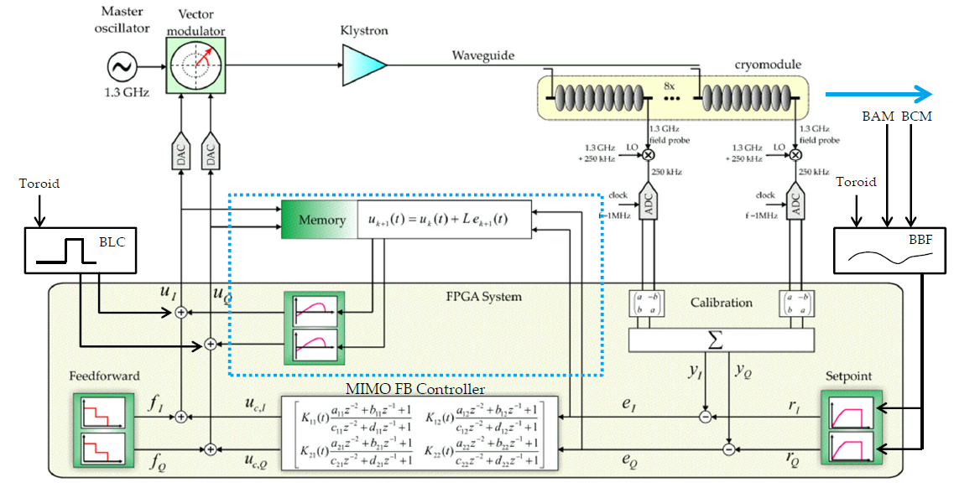
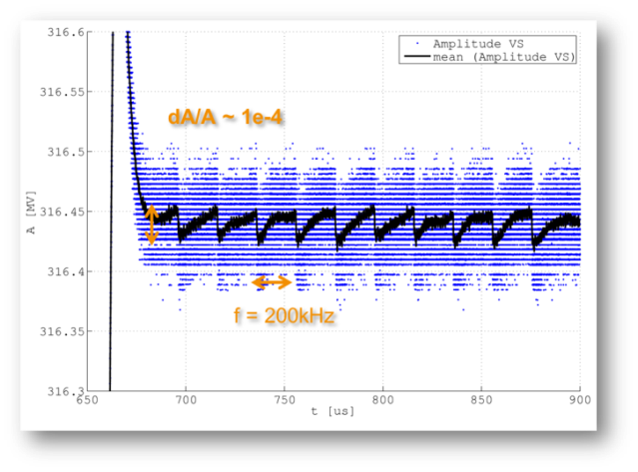
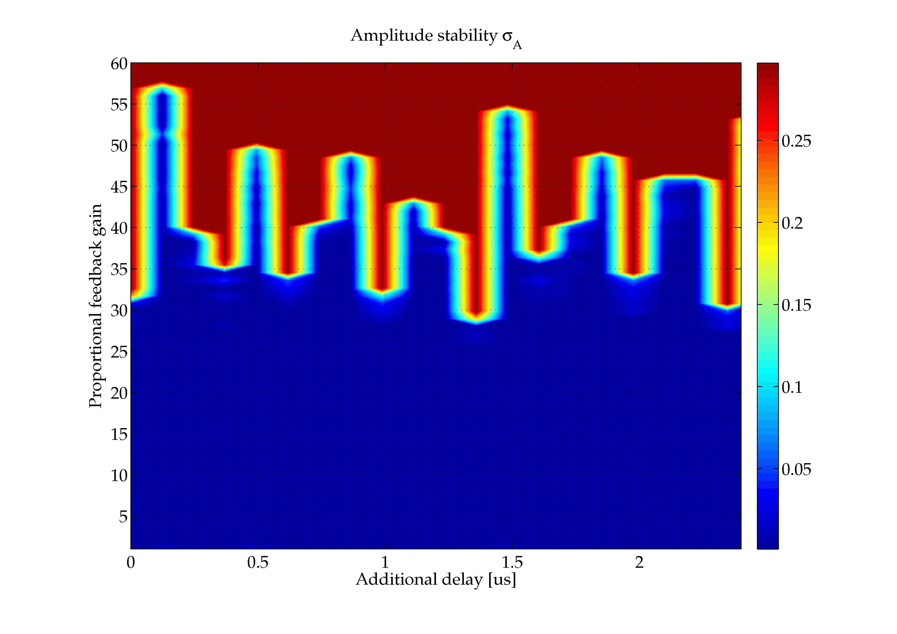
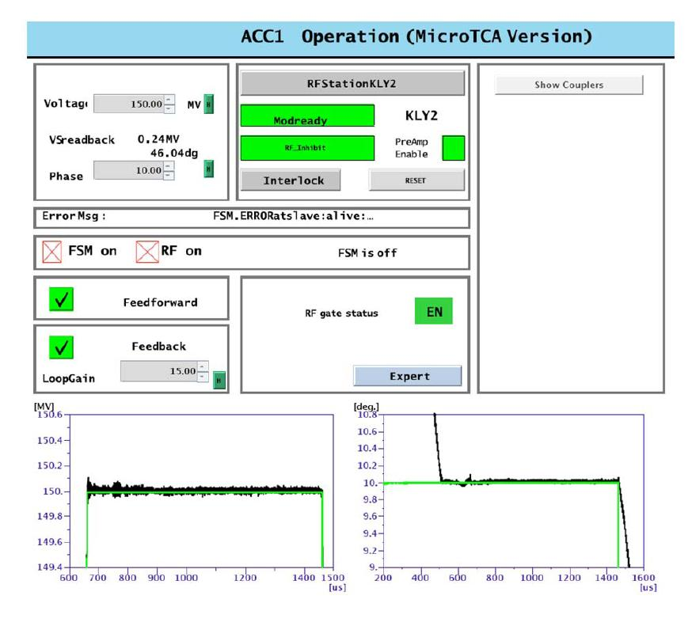
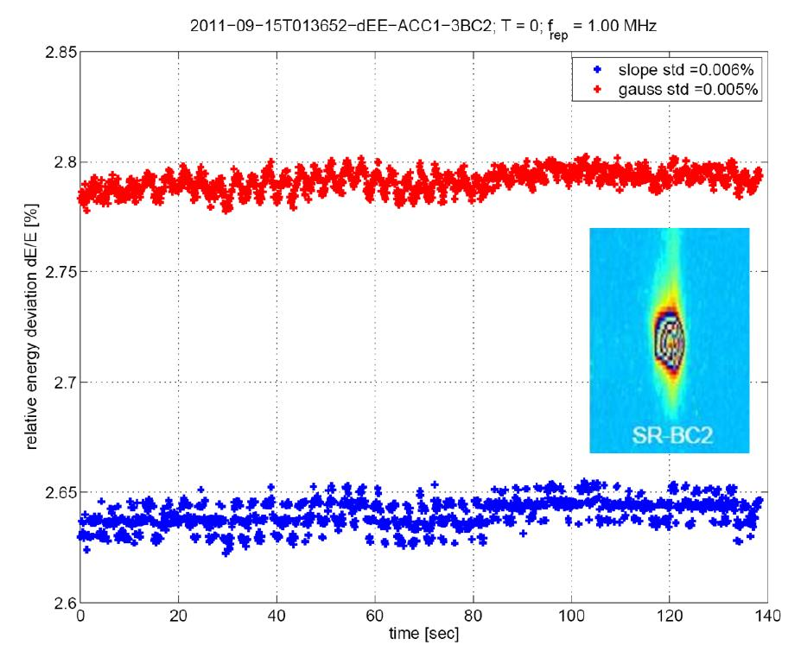
RF control of long RF pulses (SRF)
38
MTCA.4 Shelf: FLASH/E-XFEL
SRF-LLRF feedback control loop
POWER
MODULE
ADC boards
LLRF CTRL
Timing
CPU
MCH
FLASH operation:
E-stability (SR-3DBC2)
New features obs.
Single 1nC bunch transients
1 RF station, 8 cav.
Energy stability
dE/E = 5E-5.
7/9-pi mode instabl.
800us
Notes:
Before you start editing the slides of your talk change to the Master Slide view:
Menu button “View”, Master, Slide Master:
Edit the following 2 items in the 1st slide:
1) 1st row in the violet header:
Delete the existent text and write the title of your talk into this text field
2) The 2 rows in the footer area: Delete the text and write the information
regarding your talk (same as on the Title Slide) into this text field.
If you want to use more partner logos position them left
beside the DESY logo in the footer area
Close Master View

Slide 39
Reference distribution

Slide 40
Synchronization - Reference distribution schemes …
Various approaches:
Δt Δf
=
t f
1) RF distribution
standard
reflectometer
interferometer
SLAC
FLASH
E-XFEL
~
f ~ 100MHz …GHz
LO
~
MO
2) Carrier is optically
f ~ GHz
SwissFEL
MZT
~
3) Carrier is optically + detection
SLAC
FERMI
(LBNL)
SACLA
f ~ 200 THz
4) Pulsed optical source
FERMI
FLASH
E-XFEL
SwissFEL
Δf ~ 5 THz
Mode locked
Laser
OXC
Notes:
Before you start editing the slides of your talk change to the Master Slide view:
Menu button “View”, Master, Slide Master:
Edit the following 2 items in the 1st slide:
1) 1st row in the violet header:
Delete the existent text and write the title of your talk into this text field
2) The 2 rows in the footer area: Delete the text and write the information
regarding your talk (same as on the Title Slide) into this text field.
If you want to use more partner logos position them left
beside the DESY logo in the footer area
Close Master View

Slide 41
Which system is the best ????
RF System
Reliability
CW optical
Performance
Costs
Pulsed system
Notes:
Before you start editing the slides of your talk change to the Master Slide view:
Menu button “View”, Master, Slide Master:
Edit the following 2 items in the 1st slide:
1) 1st row in the violet header:
Delete the existent text and write the title of your talk into this text field
2) The 2 rows in the footer area: Delete the text and write the information
regarding your talk (same as on the Title Slide) into this text field.
If you want to use more partner logos position them left
beside the DESY logo in the footer area
Close Master View

Slide 42
Synchronization – Pulsed optically, overall scheme
EDFL, soliton, Δt~200fs, f=216MHz
SESAM, P > 100mW,
phase noise < 5fs (≥1kHz)
Laser
MLO
Narrow
Band.
MO-RF
Free space distribution
+ EDFA
Distribution
Dispersion comp.,
Polarization contr.,
Collinear bal. opt.
cross-corr.
Optical link
Optical link
Optical link
<5fs
<5fs
<5fs
Other lasers
End-station
Direct
LO-RF
Two color bal.
Opt. cross-corr.
EOMs/
Seeding
Direct/
Interferometer
Laser pulse
Arrival beam/laser
DWC/Kly
FB
A & φ cavity
Desired point-to-point stability ~ 10 fs
Main issue: robustness, stability and maintainability ⇒ Prototype at FLASH
Notes:
Before you start editing the slides of your talk change to the Master Slide view:
Menu button “View”, Master, Slide Master:
Edit the following 2 items in the 1st slide:
1) 1st row in the violet header:
Delete the existent text and write the title of your talk into this text field
2) The 2 rows in the footer area: Delete the text and write the information
regarding your talk (same as on the Title Slide) into this text field.
If you want to use more partner logos position them left
beside the DESY logo in the footer area
Close Master View

Slide 43
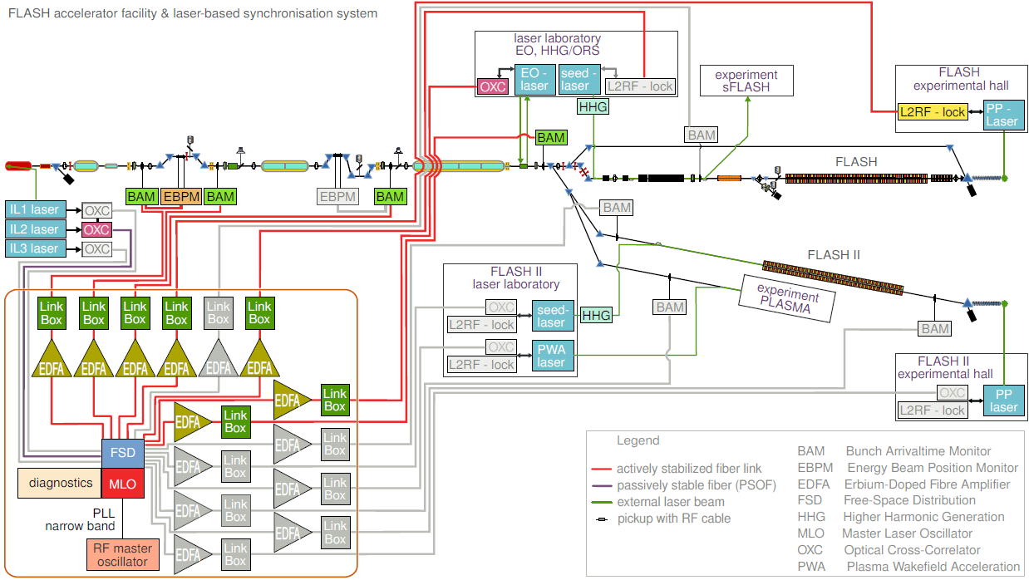
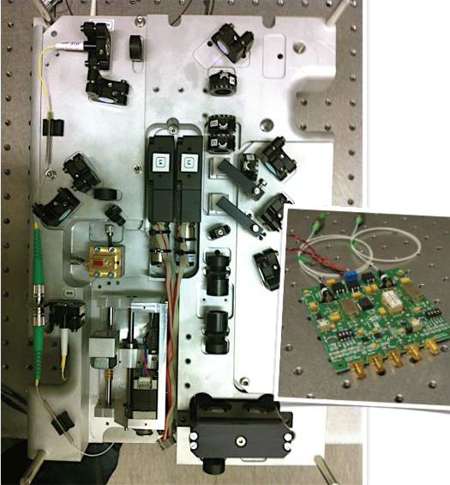
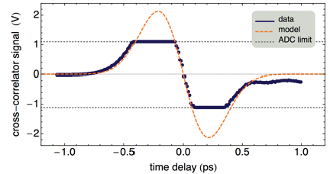
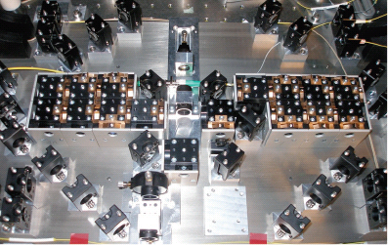
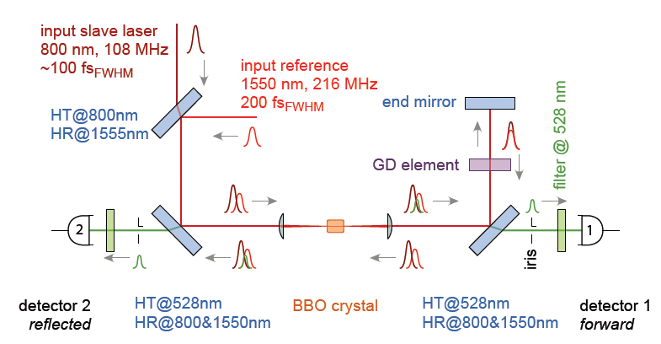
Synchronization – Pulsed optically, example FLASH
Optical synchronization system @ FLASH using mode locked laser
Link stabilization
Master Laser
~ 5fs phase noise
Slop ~ 60as/mV
TiSa opt. cross-corr. ~ 5fs rms

Slide 44
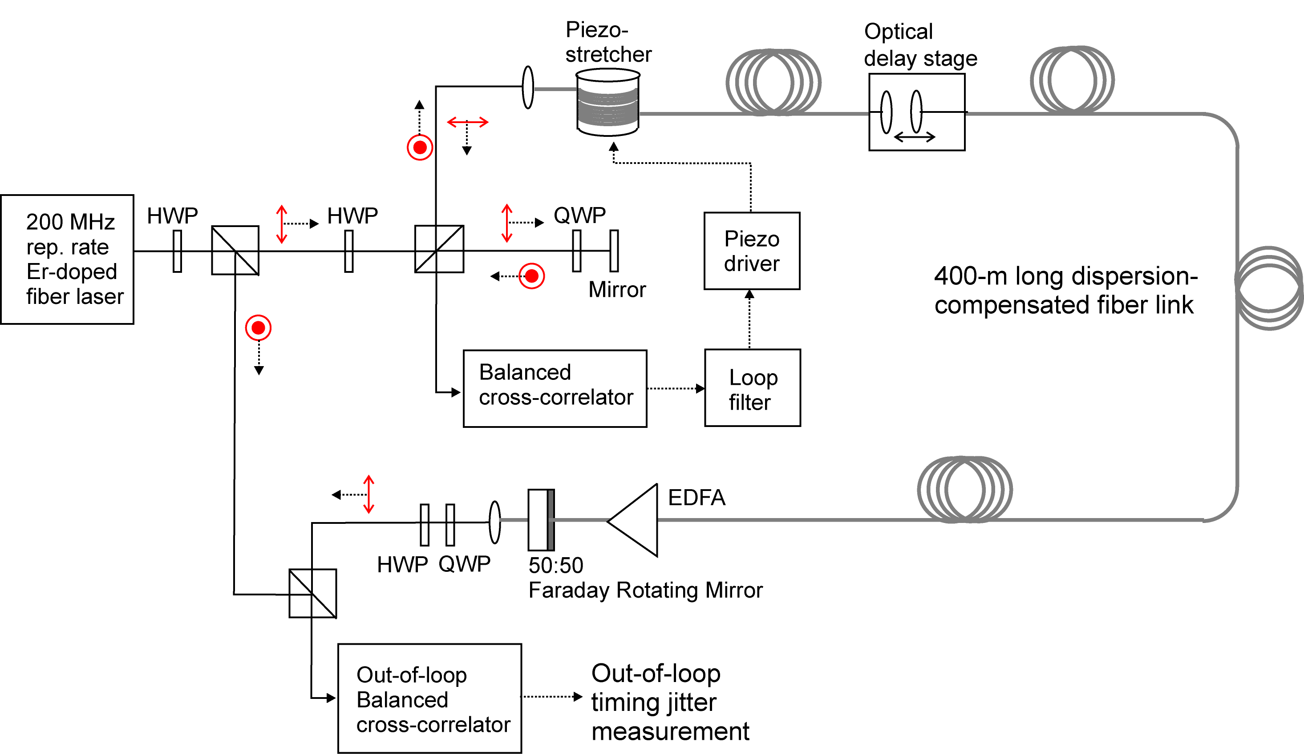
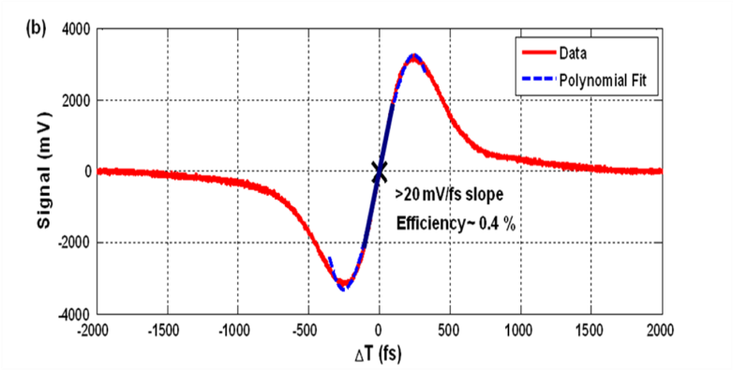
Synchronization – Pulsed optical, fiber link
216 MHz
Er-doped
fiber laser
Balanced optical cross-correlator
Det 2
-
Det 1
J. Kim et al., Opt. Lett. 32, 1044-1046 (2007)
Courtesy: F.X. Kaernter)
Notes:
Before you start editing the slides of your talk change to the Master Slide view:
Menu button “View”, Master, Slide Master:
Edit the following 2 items in the 1st slide:
1) 1st row in the violet header:
Delete the existent text and write the title of your talk into this text field
2) The 2 rows in the footer area: Delete the text and write the information
regarding your talk (same as on the Title Slide) into this text field.
If you want to use more partner logos position them left
beside the DESY logo in the footer area
Close Master View

Slide 45
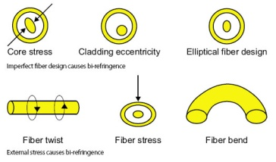
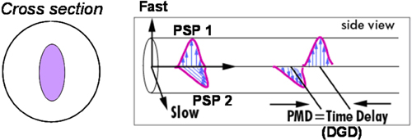

Synchronization – Pulsed optical, link limitations
Drifts instability of long single mode optical fiber links:
⇒ Limitation due to Polarization Mode Dispersion (PMD)
Numerical simulation for XFEL Fibers ~ 50fs/√km
Measurements fiber test bench (Hall 2) PMD ~200fs/√km
In-loop
Out-of-loop
Particular critical for long links…
Options:
Active PMD compensation (large bandwidth)
Polarization Maintain Link (DCF, handling diff.)
Only Link as PM-fiber with SMF appendix
~10fs/h
Correction

Slide 46


Synchronization – Pulsed optical, arrival monitor
Uses optical reference laser pulses (single shot)
Used at FLASH/FERMI/PSI
Key exp. : two BAMs 60m distance
Standard diag. at FLASH
uncorrelated jitter
over 4300 shots:
8.4 fs (rms)

Slide 47





Synchronization – Pulsed optical, RF generation
Time domain
Frequency domain
100fs
Phase noise
Photo Detector
Bandwidth PD
T = 5ns = 1/f_{rep}
f_{rep}
Direct conversion with photo detector (PD)
Low phase noise (to be proven at end-station)
Temperature drifts (0.4ps/C°)
AM to PM conversion (0.5-4ps/mW)
Potential for improvement
(corporation with PSI)
laser pulses
PD
BPF
f = n*f_{rep}
~
~
~
f_{rep}
f = n*f_{rep}
Sagnac loop interferometer
balanced optical mixer to lock RF osc.
insensitive against laser fluctuation
Very low temperature drifts
Results:
f=1.3GHz jitter & drift < 10 fs rms limited by detection
Remark: much easier at hire frequencies …
MZI based balanced RF lock
new scheme, under investigation

Slide 48
Beam based feedback systems
Beam based
Feedback systems

Slide 49



Ultra-Fast beam based feedbacks
Large bunch spacing at FLASH (~ us) allow for intra-bunch feedbacks
Laser
BC2
~
BC3
~
Gun
ACC1
3rd
ACC2
ACC3
ACC4
ACC7
Toroid
A φ
Toroid
A φ
Toroid
φ
A φ
BAM
BAM
BAM
BCM
BAM
BCM
LLRF
LLRF
LLRF
LLRF
LLRF
LLRF
LLRF
LLRF
LLRF
Phase in RF-Gun Ampl. and phase ACC1&ACC39 Ampl and phase ACC23
Exit of linac
& out-of-loop
Improved FPGA algorithm
Loop delay
2011
Upgrade NRF FB cavity
- Latency ~ 0.7us
- Actuator bandwidth:
NRF 0.5–1.0MHz
- Amplifier Power ~1kW
- Goal: < 5fs rms
Latency of system
System Bandwidth
Both intra-train FB on
MIMO controller
Repetitive pkpk deviation < 100fs
2012
< 22 fs rms
~ 12 fs rms
Courtesy: S. Pfeiffer

Slide 50


Fast beam based feedbacks & optical lock of TiSa Laser
Demonstration of synchronization for FEL users experiment
Beam based feedback using Bunch Arrival Monitor & optical lock of TiSa laser
FEL pulse arrival measured with laser based THz streaking (A. Cavalieri)
Residual jitter to be
investigated
(many possible sources!)
33 fs rms
S. Schulz, SPIE13

Slide 51
Thanks for attention

Slide 52





Synchronization – RF Interferometer scheme
Interferometer test setup:
Cable
drift
φ const.
Refl. Output
drift
X 50 reduction 10ps->200fs pkpk
X 500 can be achieved
e.g. considered for REGAE facility
Main issues:
Isolation (coupler)
Parasitic reflection
Limited distance
Careful adjustment (A&φ)
Inst. End 2013
Ed Cullerton, FNAL
Same scheme will be implemented for FLUTE@KIT!
Appropriate scheme
for small facilities

Slide 53


Synchronization – CW optical reflectometer
Early work NLC (J.Frisch), TESLA (K.Czuba), PSI (S. Hunziker)/I-TECH
Noisy RF signal at receiver
Spurious reflections
AM-PM PD conversion
Phase detector drifts
Piezo stretcher
Optical delay line
Rem: Wavelength shift
Instead of phase shifter
IPAC 2010,
primoz.lemut@i-tech.si
Amplitude modulated optical carrier (192THz), f_{mod}~ GHz
Optical signal
RF signal PD
Notes:
Before you start editing the slides of your talk change to the Master Slide view:
Menu button “View”, Master, Slide Master:
Edit the following 2 items in the 1st slide:
1) 1st row in the violet header:
Delete the existent text and write the title of your talk into this text field
2) The 2 rows in the footer area: Delete the text and write the information
regarding your talk (same as on the Title Slide) into this text field.
If you want to use more partner logos position them left
beside the DESY logo in the footer area
Close Master View

Slide 54
Synchronization – Optical Interferometer
1560nm
f = 192THz
+50MHz
CW
fiber
laser
freq.
shifter
FRM
f = 192THz + 100MHz
FRM
100MHz
~
ADC
RF source
Heterodyne beat
clock
4
P ~ (E1 + E2)⋅(E1 +E2)*
3.5
3
E1, E2, P
2.5
2
1.5
1
0.5
0
-0.5
-1
0
0.5
1
time
1.5
Gear ratio: 200THz/100MHz ~ 2e6
5 fs @200THz == 1 rad == 10ns @ 100MHz
Optical fiber length can be determined to fraction of optical wavelength
Measures phase velocity change across entire fiber
Notes:
Before you start editing the slides of your talk change to the Master Slide view:
Menu button “View”, Master, Slide Master:
Edit the following 2 items in the 1st slide:
1) 1st row in the violet header:
Delete the existent text and write the title of your talk into this text field
2) The 2 rows in the footer area: Delete the text and write the information
regarding your talk (same as on the Title Slide) into this text field.
If you want to use more partner logos position them left
beside the DESY logo in the footer area
Close Master View

Slide 55



Microwave properties and components
Mixer & phase detector:
Different response curves when based on digital elements
Example: AD8302, specially low drift, but poor phase noise!
Notes:
Before you start editing the slides of your talk change to the Master Slide view:
Menu button “View”, Master, Slide Master:
Edit the following 2 items in the 1st slide:
1) 1st row in the violet header:
Delete the existent text and write the title of your talk into this text field
2) The 2 rows in the footer area: Delete the text and write the information
regarding your talk (same as on the Title Slide) into this text field.
If you want to use more partner logos position them left
beside the DESY logo in the footer area
Close Master View

Slide 56
Phase lock loop
Phase Lock Loops

Slide 57






Microwave properties and components
Phase locked loops
Phase error θ_{e}=(θ_{i}-θ_{o})
Laplace trans:
Rem1: PLL always has one
integrator since VCO input
controls the frequency not
the phase ⇒ dθ_{o}/dt = Δω = K₀v_{c}
Rem2: To remove phase err. offsets
due to systematic VCO frequency
errors, a second integr. is required
Notes:
Before you start editing the slides of your talk change to the Master Slide view:
Menu button “View”, Master, Slide Master:
Edit the following 2 items in the 1st slide:
1) 1st row in the violet header:
Delete the existent text and write the title of your talk into this text field
2) The 2 rows in the footer area: Delete the text and write the information
regarding your talk (same as on the Title Slide) into this text field.
If you want to use more partner logos position them left
beside the DESY logo in the footer area
Close Master View

Slide 58





Microwave properties and components
Phase locked loops
Gain peaking
Tracked phase noise
Follows reference
Untracked phase noise
Free running
oscillator
Total phase noise
Notes:
Before you start editing the slides of your talk change to the Master Slide view:
Menu button “View”, Master, Slide Master:
Edit the following 2 items in the 1st slide:
1) 1st row in the violet header:
Delete the existent text and write the title of your talk into this text field
2) The 2 rows in the footer area: Delete the text and write the information
regarding your talk (same as on the Title Slide) into this text field.
If you want to use more partner logos position them left
beside the DESY logo in the footer area
Close Master View

Slide 59




Synchronization – Pulsed optical
Locking low-noise microwave oscillator to laser (or visa versa)
RF Oscillator f_{VCO} = n f_{r}, split and delayed
Residual jitter
X2
X1
Out-of-loop
< 2.5fs (1Hz-1MHz)
See: Accelerator 2011, Highlights and Annual Report, DESY
http://www.desy.de/ueber_desy/jahresberichte/index_ger.html
Sketch of effect due to VCO phase shift
No phase error
Residual drift
Out-of-loop
With phase error
Drift < 14fs pkpk (3.8fs rms)

Slide 60



Longitudinal pulse-to-pulse feedback controls
6 parameters for energy (δ) & bunch length (σ)
Typical bandwidth 10Hz @ 120 Hz rep-rate
Meas. Response fct. ⇒ FB matrix
>10Hz … dedicated FB network!
LCLS: sub. additional effort for 120Hz!
V_{mon} = M_{resp}⋅V_{act}
on demand
V_{act,n+1} = V_{act,n} + G⋅(M_{resp}) ⁻¹⋅V_{mon,n}
3-phase
6 time slots
timing system
markers
Example: LCLS, similar FERMI /FLASH with arrival FB.
Courtesy: D. Fairley
L_{BC} = const.
Follows inj.
arrival time drift
φ_{acc} -φ_{b} = const.
Occasional retuning X-phase
Energy jitter due to arrival jitter

