Slide 1
Technology of superfluid helium
Philippe Lebrun & Laurent Tavian
CERN, Geneva, Switzerland
CERN Accelerator School «Superconductivity for Accelerators»
Ettore Majorana Foundation and Centre for Scientific Culture
Erice, Italy, 24 April – 4 May 2013

Slide 2
Contents
Introduction to superfluid helium
Superfluid helium as a technical coolant
Practical cooling schemes
Refrigeration below 2 K
Specific technology for He II systems
Applications

Slide 3
Contents
Introduction to superfluid helium
Superfluid helium as a technical coolant
Practical cooling schemes
Refrigeration below 2 K
Specific technology for He II systems
Applications

Slide 4
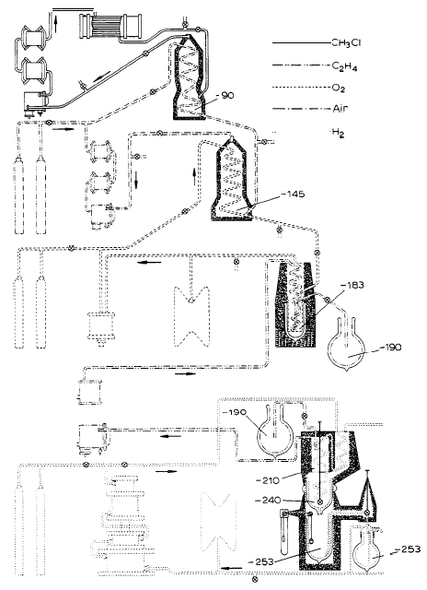
First liquefaction of helium (1908)
Leiden « cascade » to produce liquid hydrogen
Helium liquefaction stage precooled by liquid hydrogen

Slide 5
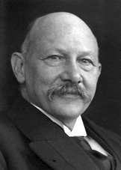

Slide 6
Unsuccessful attempt to solidify helium

Slide 7
Hint of a quantum effect…?

Slide 8
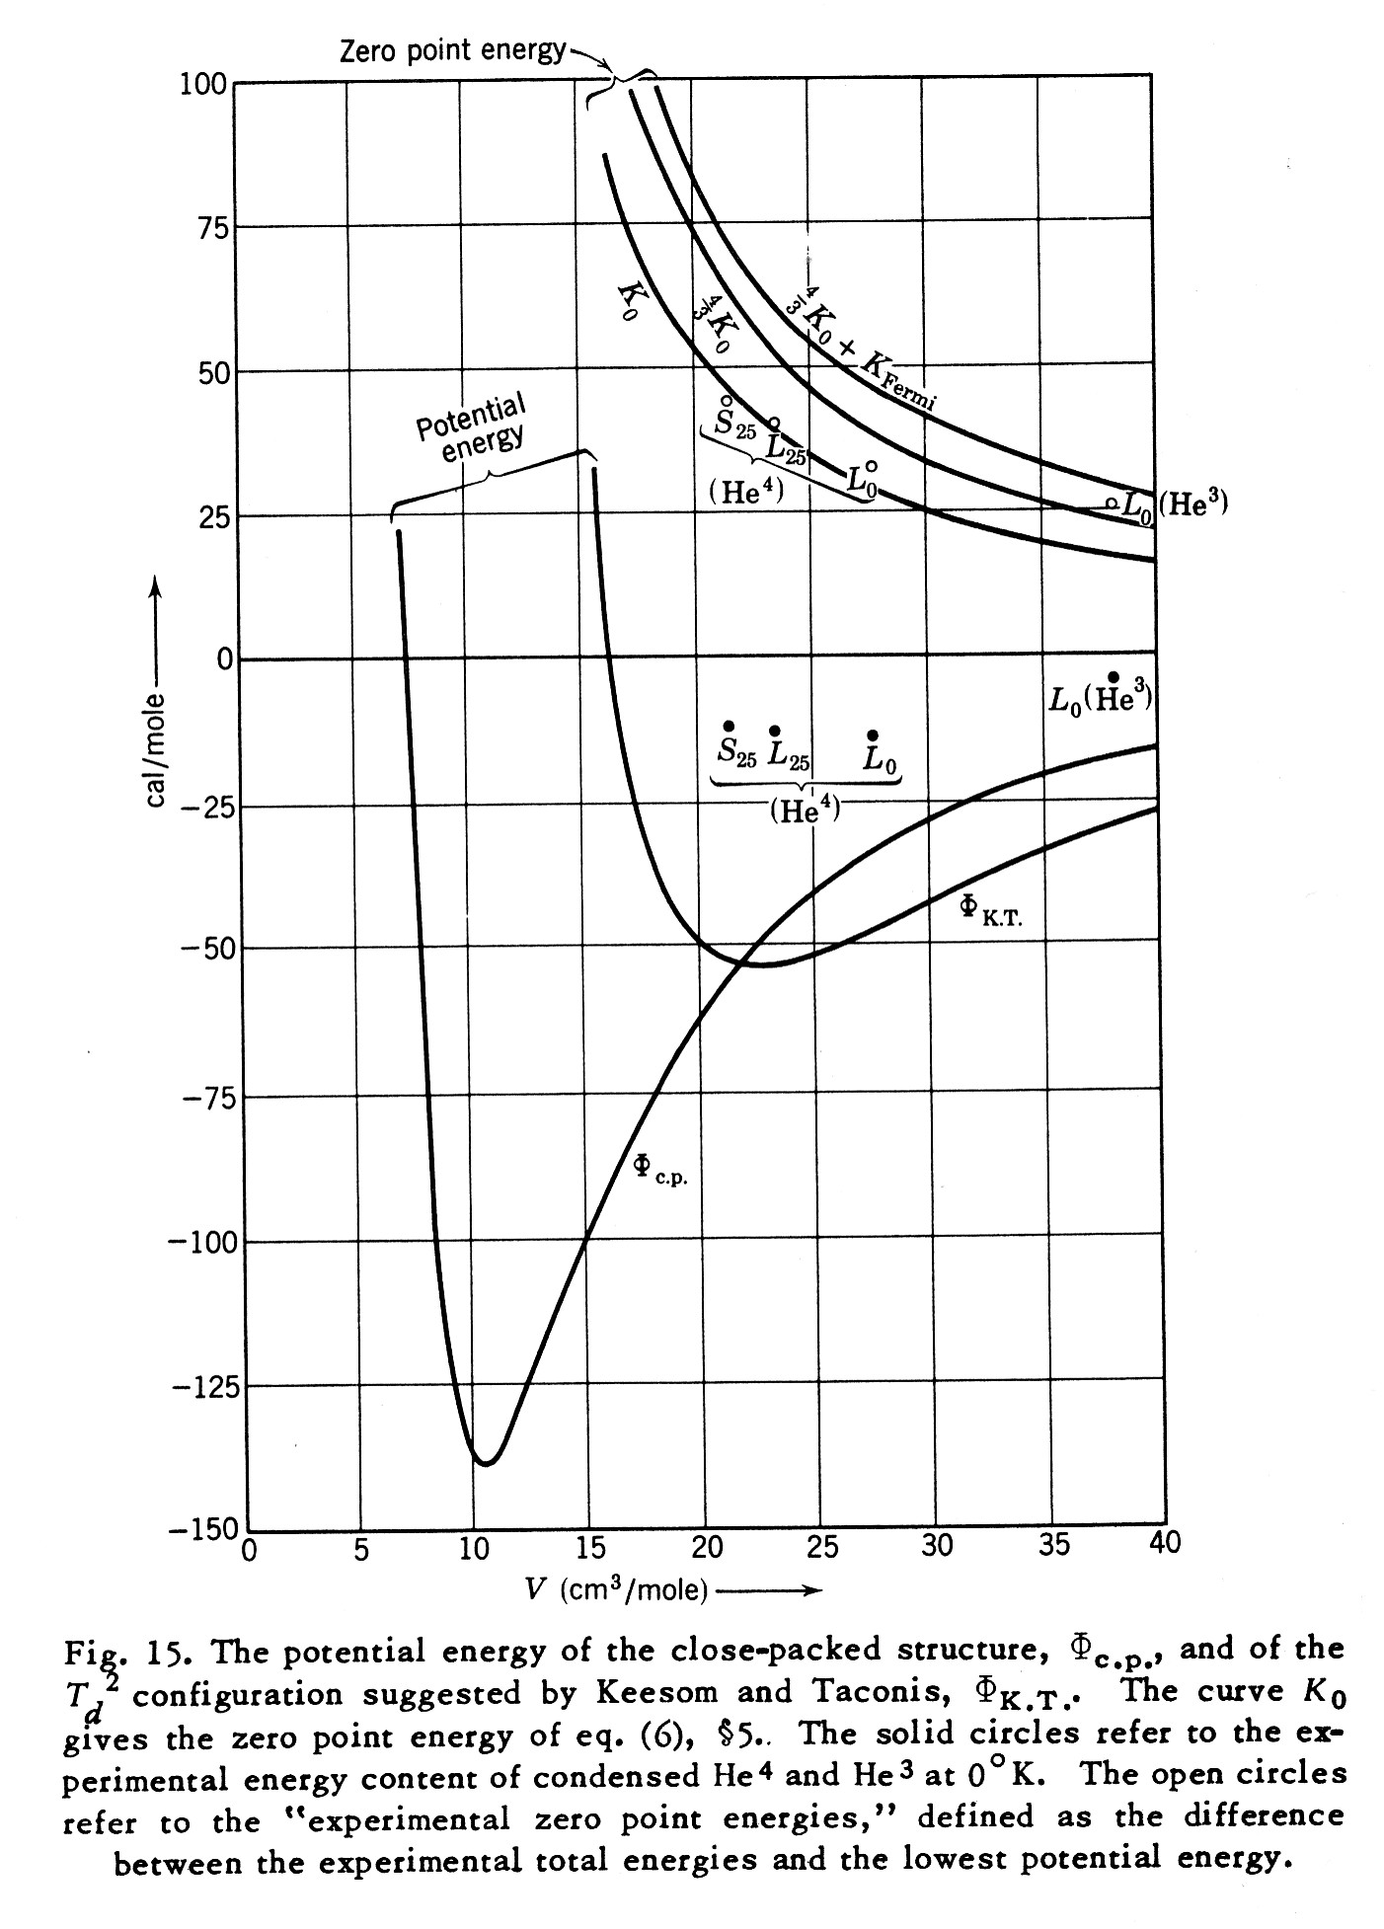
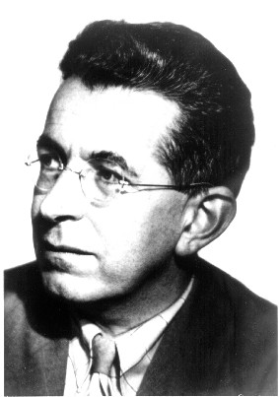
Zero-point (quantum) energy prevents helium from solidifying
F. London

Slide 9
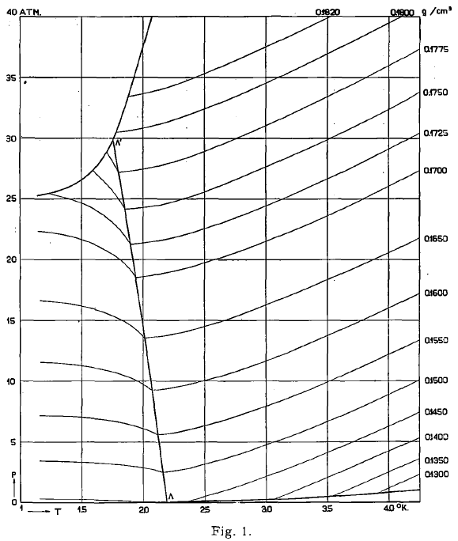
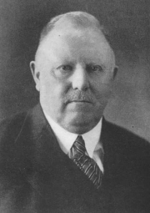
Discovery of He II phase transition (1928)
Helium phase diagram (1933)
W.H. Keesom

Slide 10
Phase diagram of helium
λ line

Slide 11
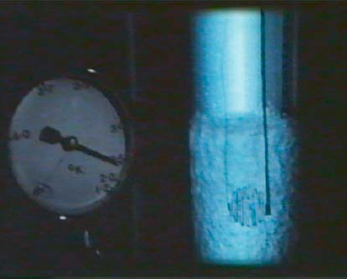
Discovery of superfluidity in He II (1938)
J.F. Allen & A.D. Misener (Cambridge)
P.L. Kapitsa (Moscow)
Vaporization of liquid helium under applied heat load
He I (T=2.4 K)
He II (T=2.1 K)

Slide 12
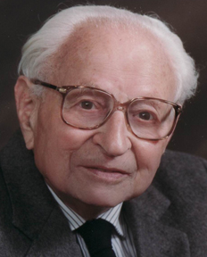
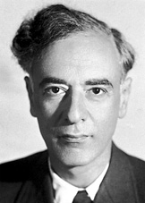
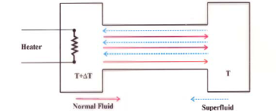
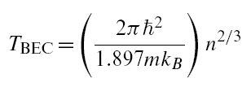
Theoretical approaches to superfluid helium
Fritz London
Laszlo Tisza
Lev Davidovich Landau
Bose-Einstein condensation
Two-fluid model
Quasi-particle description

Slide 13
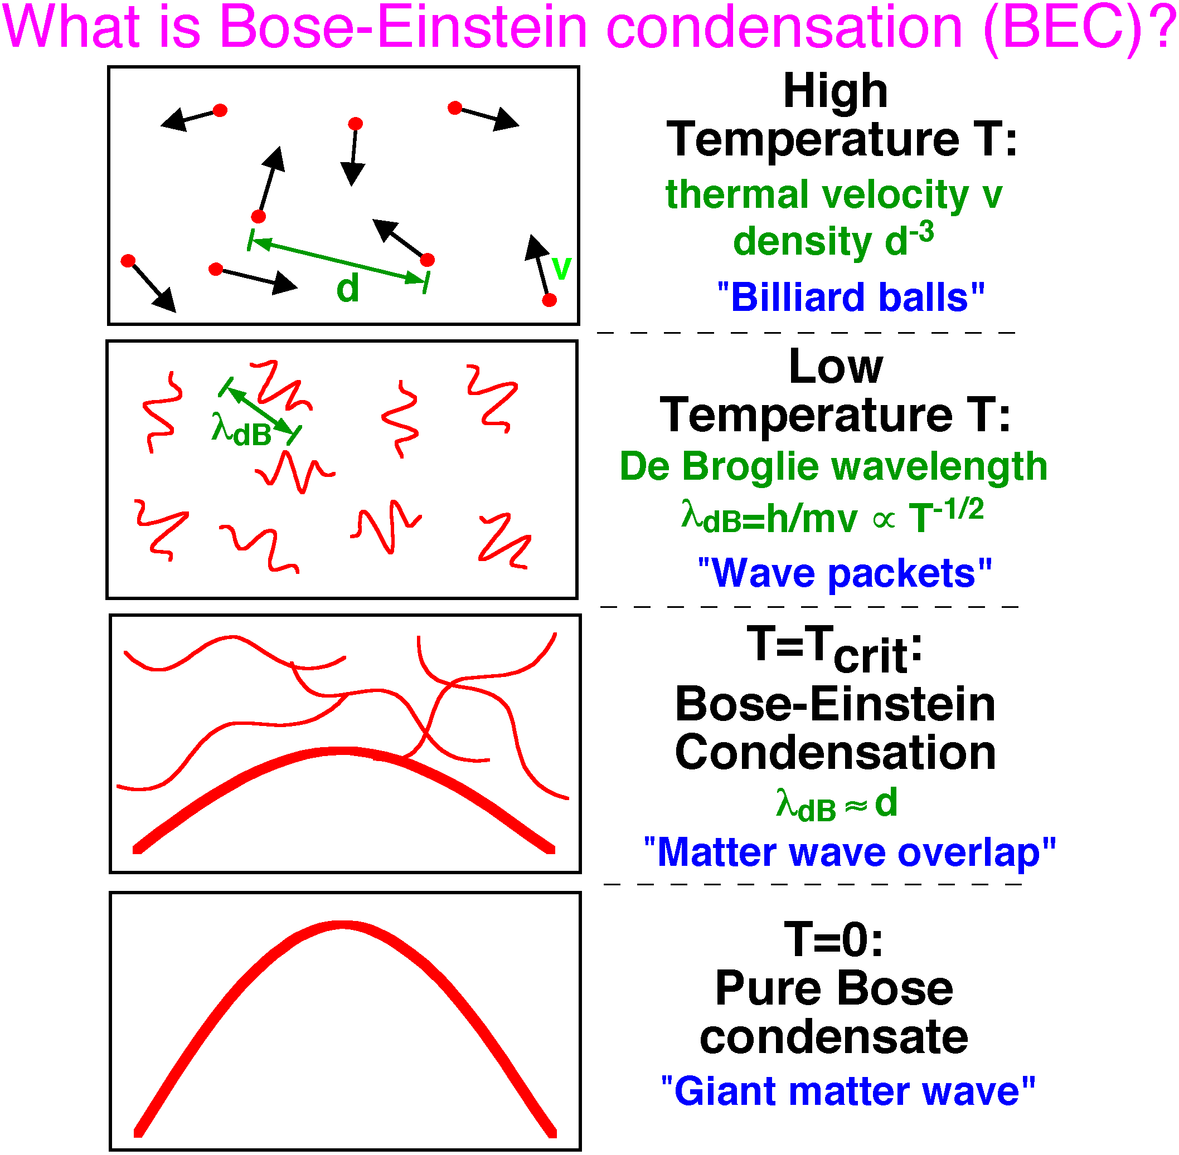
Bose-Einstein condensation in gas of particles

Slide 14
Two-fluid model of He II
Phenomenological model
Two interpenetrating fluids
= ρ_{s} + ρ_{n}
Normal & superfluid fractions varying with T
v = ρ_{s} v_{s} + ρ_{n} v_{n}
s = ρ_{n} s_{n} since s_{s} = 0
All entropy carried by normal component
Physical basis of the two-fluid model
  Collective excitations constitute the normal component (Landau)
  B-E condensate in liquid (Penrose & Onsager)

Slide 15
He II behaviour explained by two-fluid model
Frictionless flow through small channels
  Film flow
  Andronikashvilii experiment
Thermal transport by counterflow
  Laminar
  Turbulent
Thermomechanical effect
Second sound

Slide 16
Contents
Introduction to superfluid helium
Superfluid helium as a technical coolant
Practical cooling schemes
Refrigeration below 2 K
Specific technology for He II systems
Applications

Slide 17
Benefits of He II cooling
Lower the operating temperature
  Achieve higher magnetic field through increase of critical current density of superconductor
  Minimize overall energy dissipation in RF cavities
Enhance heat transfer
  At solid-liquid interface ⇒ conductor cooling
  In the bulk liquid
  ⇒ device/system cooling scheme
  ⇒ calorimetry in isothermal bath

Slide 18
Critical current density of superconductors for high-field magnets

Slide 19
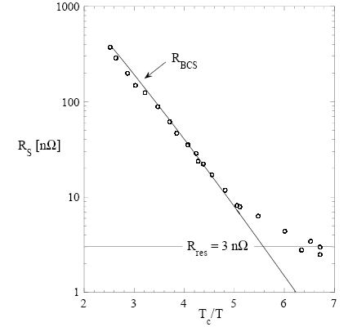
Optimization of operating temperature for superconducting RF cavities
BCS theory R_{BCS} = (A ω² /T) exp (-B T_{c}/T)
For practical materials R_{S} = R_{BCS} + R₀
Refrigeration (Carnot) P_{a} = P (T_{a}/T - 1)
⇒ depending upon ω and R₀, optimum operating temperature for superconducting cavities
Niobium

Slide 20
Enhancement of heat transfer
Low viscosity ⇒ permeation
Very high specific heat ⇒ stabilization
  10⁵ times that of the conductor per unit mass
  2 x 10³ times that of the conductor per unit volume
Very high thermal conductivity ⇒ heat transport
  10³ times that of cryogenic-grade OFHC copper
  peaking at 1.9 K
Full benefit of these transport properties can only be reaped by appropriate design providing good wetting of the superconductors and percolation paths in the insulation, often in conflict with other technical requirements

Slide 21
Specific heat of liquid helium and copper

Slide 22
Equivalent thermal conductivity of He II p
Helium II
Copper OFHC

Slide 23
Solid-liquid interface: Kapitza conductance
Experimental data for Copper (S. Van Sciver, "Helium Cryogenics")
h_{K} ~ T ³
Valid for small heat flux (when ΔT<<T)

Slide 24
Application of high thermal conductivity
Calorimetry in isothermal He II bath
T
For slow thermal transients, the He II bath is quasi-isothermal: a single temperature measurement allows to estimate heat deposition/generation Q'
- at constant P Q' = M_{bath} dH/dt|₁
- at constant V Q' = M_{bath} dE/dt|₁
M_{bath} can be estimated by in situ calibration, using applied heating power W'
- at constant P W' = M_{bath} dH/dt|₂
- at constant V W' = M_{bath} dE/dt|₂
Q'
W'

Slide 25
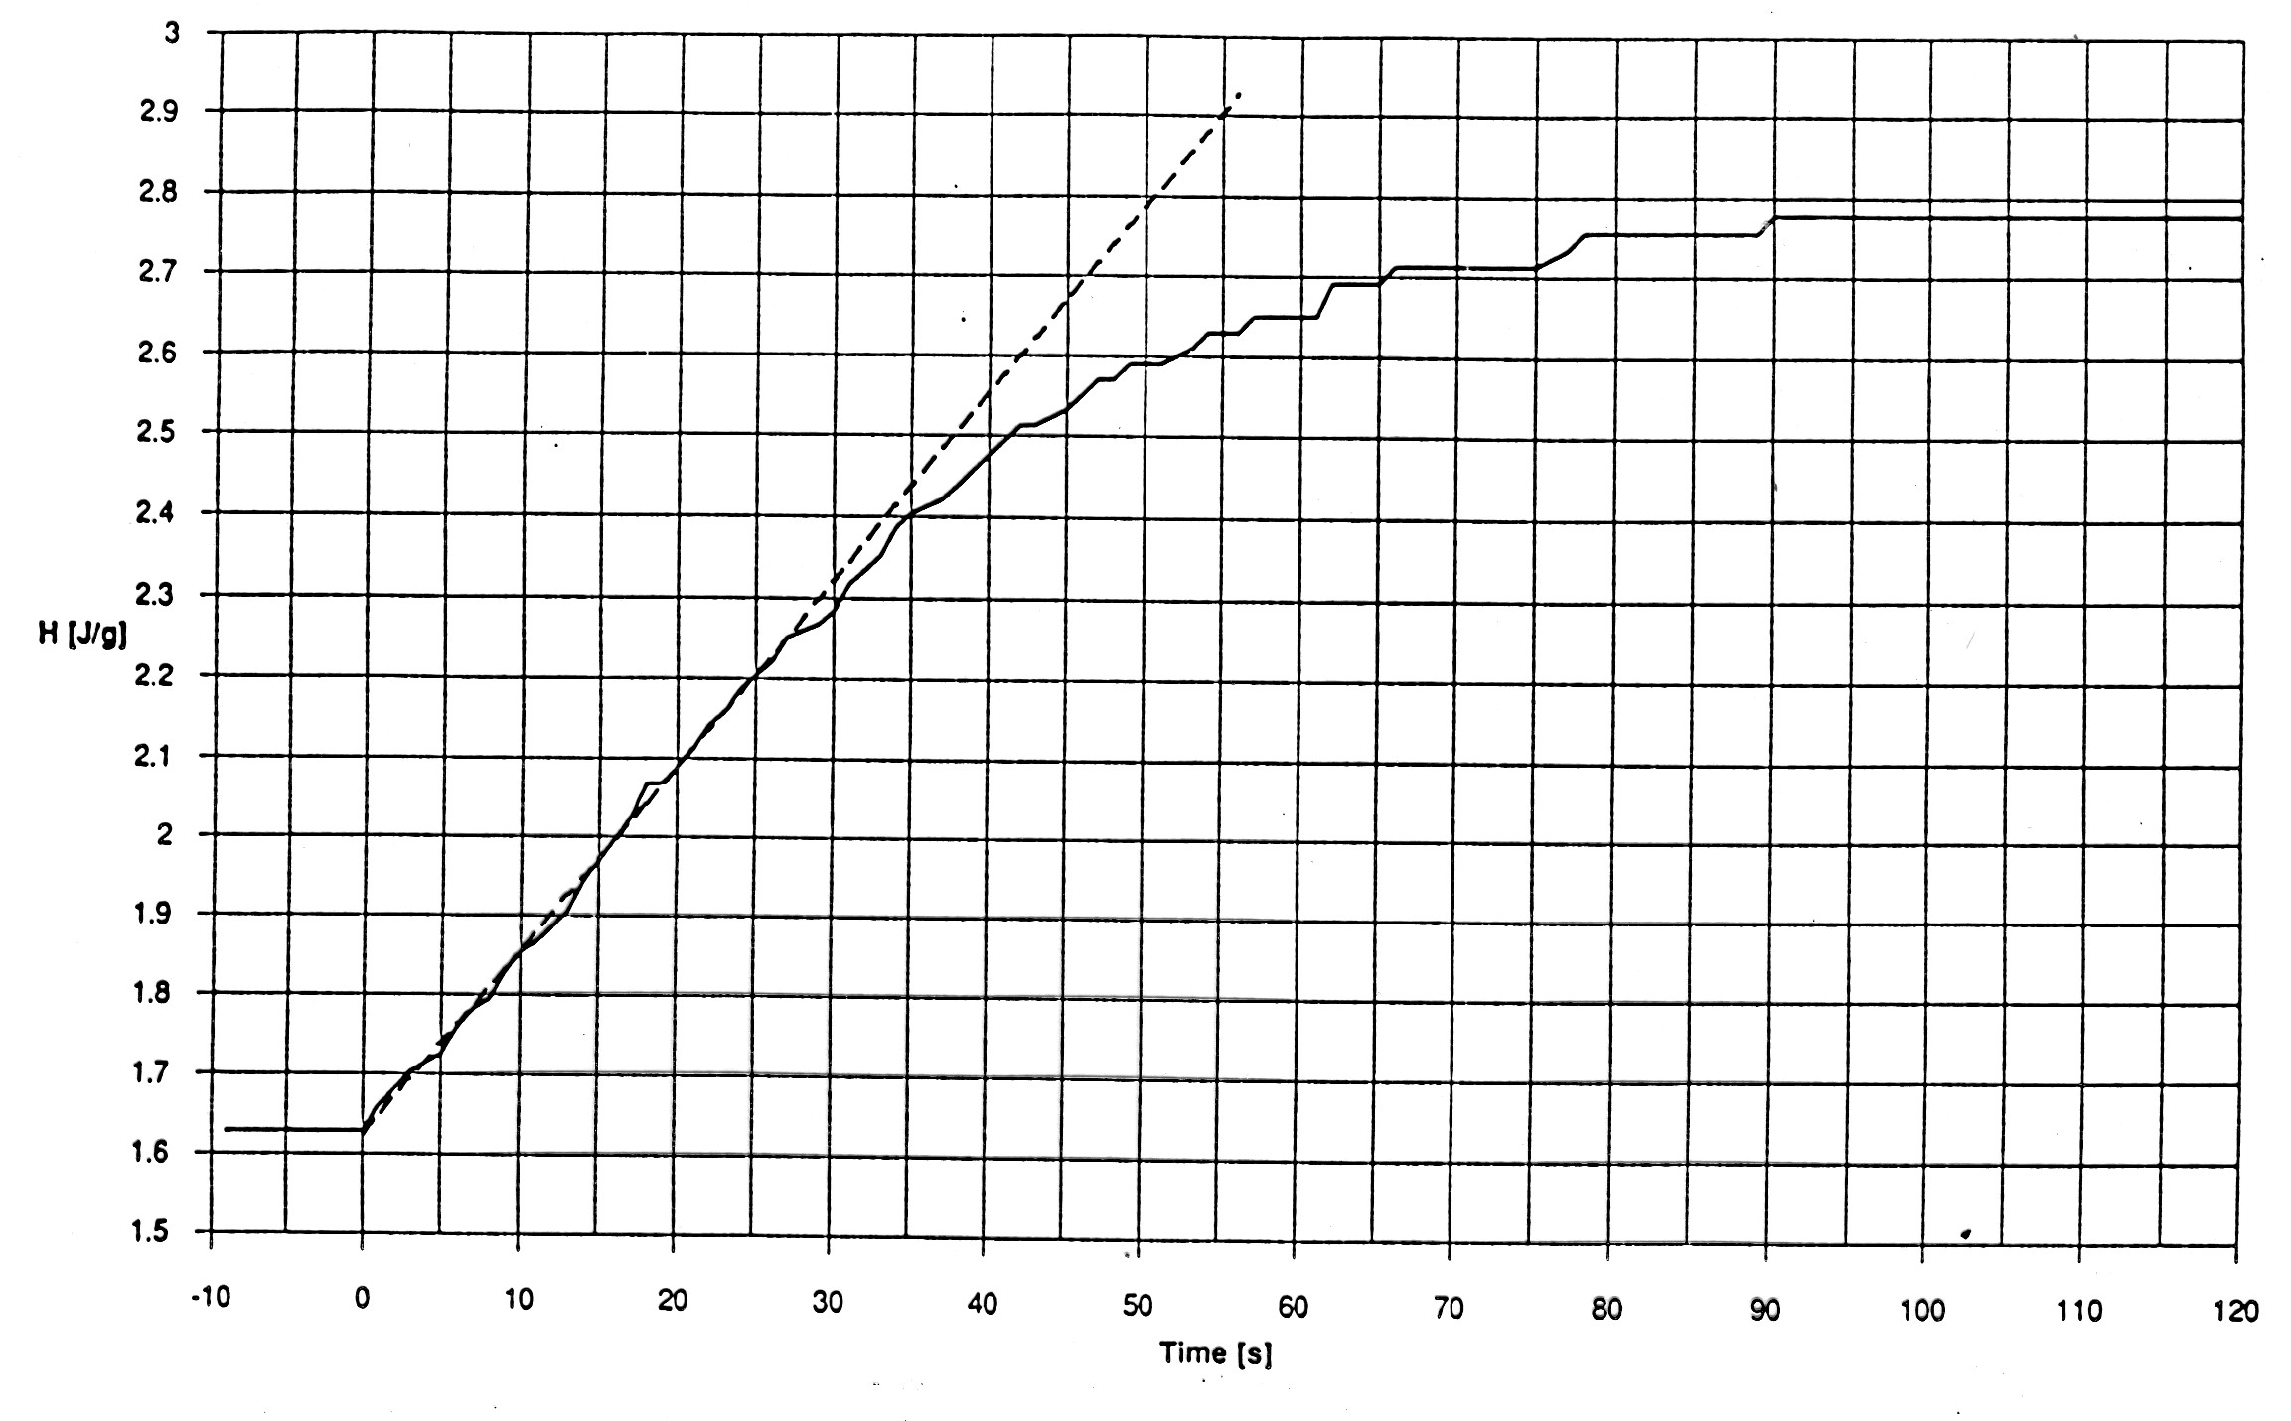
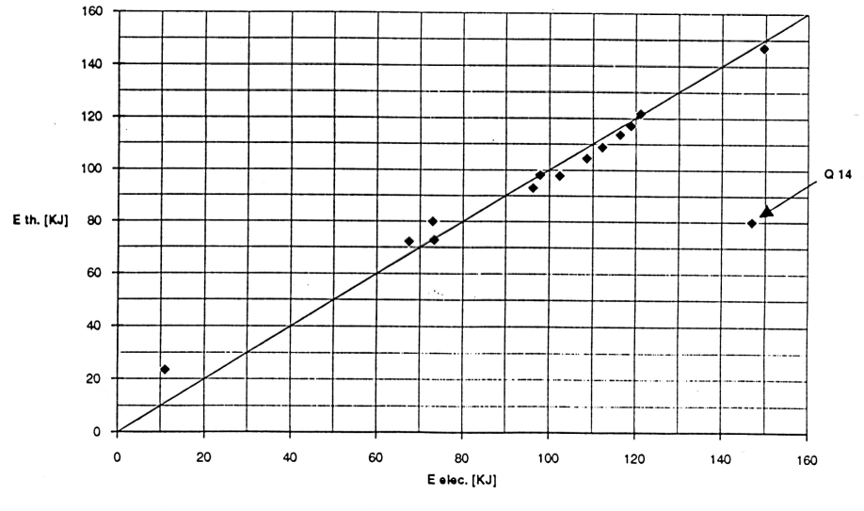
Calorimetry of magnet quench in He II bath
Time evolution of bath temperature
Correlation with electrical measurements

Slide 26
Precision thermometry allows calorimetric detection of faulty joints in LHC at safe powering level
Current | Total (measured) |  | Nominal Splices* | Add. local dissipation | Uncertainty
[A] | [mW/m] | [W] | [W] | [W] | [W]
3000 | 4.4 | 1.0 | 0.4 | 0.6 | 0.6
5000 | 14.9 | 3.2 | 1.1 | 2.1 | 0.6
7000 | 32.2 | 6.9 | 2.1 | 4.8 | 0.6
Local resistance: ~90 nΩ, confirmed by electrical measurement

Slide 27
Pressurized vs saturated He II

Slide 28
Advantages & drawbacks of He II p
Advantages
  limits the risk of air inleaks and contamination in large and complex cryogenic systems
  for electrical devices, limits the risk of electrical breakdown at fairly low voltage due to the bad dielectric characteristics of helium vapour (Paschen curve)
  better stabilizer for heat buffering
Drawbacks
  one more level of heat transfer
  additional process equipment (pressurized-to-saturated helium II heat exchanger)

Slide 29
Paschen curve for gaseous He at 20 °C
e.g., 1.6 kPa pressure and 6 mm gap

Slide 30
Thermal stabilisation in He II s
The corresponding ΔH is 9 mJ/cm³

Slide 31
Thermal stabilisation in He II p
The corresponding ΔH is 280 mJ/cm³
(30 times higher than in He II s)

Slide 32
Contents
Introduction to superfluid helium
Superfluid helium as a technical coolant
Practical cooling schemes
Refrigeration below 2 K
Specific technology for He II systems
Applications

Slide 33
Working with superfluid helium at atmospheric pressure
P atm
P atm
4.2 K
4.2 K
He I
He I
T_{λ}
T_{λ}−ε
T_{λ}
Refri
Refri
He II
He II
T_{λ}−ε
T<<T_{λ}
« Roubeau bath »: He II conduction prevents from lowering the bath temperature well below T_{λ}
« Claudet bath »: restriction in cryostat allows subooling He II bath to temperatures well below T_{λ}

Slide 34
A practical Claudet bath

Slide 35
Conduction cooling in static He II p
Cross-section: A
Length: L
Power:
Heat Flux:
Gorter-Mellink law:
Experimental work of Bon Mardion, Claudet & Seyfert:
    m ≈ 3.4
    tabulation of X(T)
Note 1: this is a non-linear formula for conduction ⇒ use proper units!
Note 2: m = 1 for classical solid conduction (Fourier’s law)

Slide 36
Thermal conduction integral function of He II p

Slide 37
Conduction cooling: a numerical example
A = 1 cm²
L = 1 m = 100 cm (Units!)
T₁ = 1.9 K ➔ X(T₁) = 200
T₂ = 1.8 K ➔ X(T₂) = 360
.
.
.
Then: q^{3.4}.L = 360 - 200 ➔ q^{3.4} = 1.6 ➔ q = 1.15 W/cm²
Comparison with "good solid conductor", e.g. Copper
with k = thermal conductivity at 1.8 K
Cu type | k [W/m.K] | ΔT [K] | L [m] | q [mW/cm²]
OFHC | 120 | 0.1 | 1 | 1.2
DHP | 3 | 0.1 | 1 | 0.03
He II conducts heat 1000 times better than OFHC Cu

Slide 38
Steady-state conduction duct in He II
From 1.80 K to 1.90 K

Slide 39
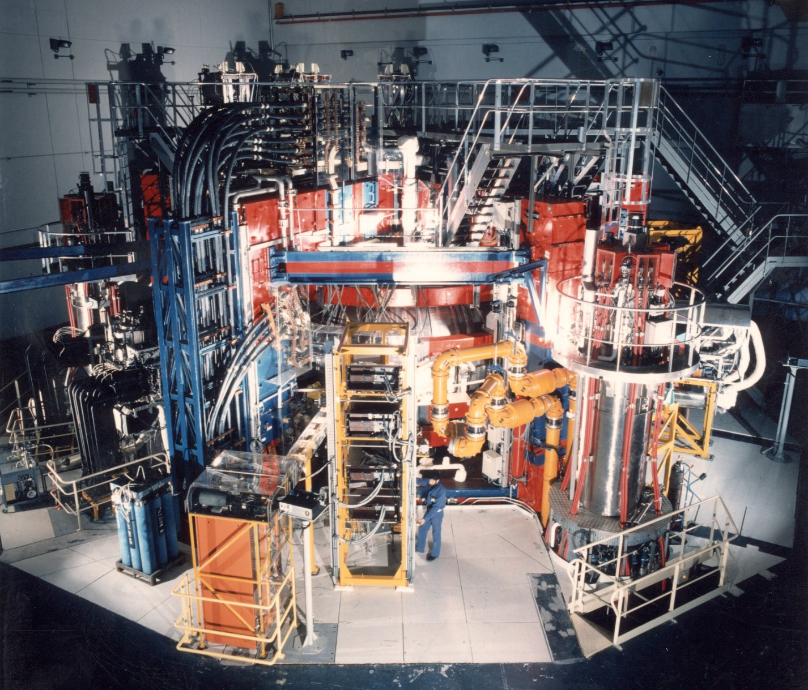
Tore Supra tokamak at CEA Cadarache, France

Slide 40
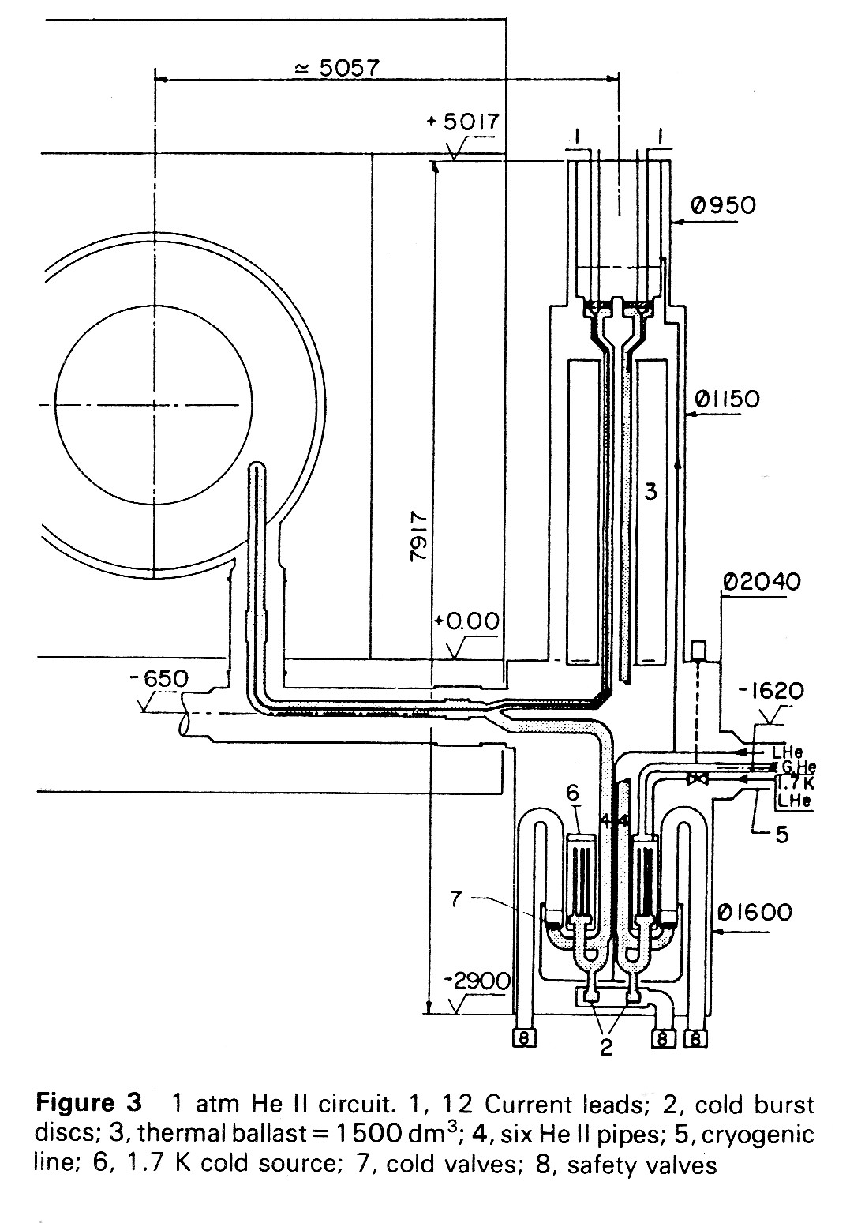
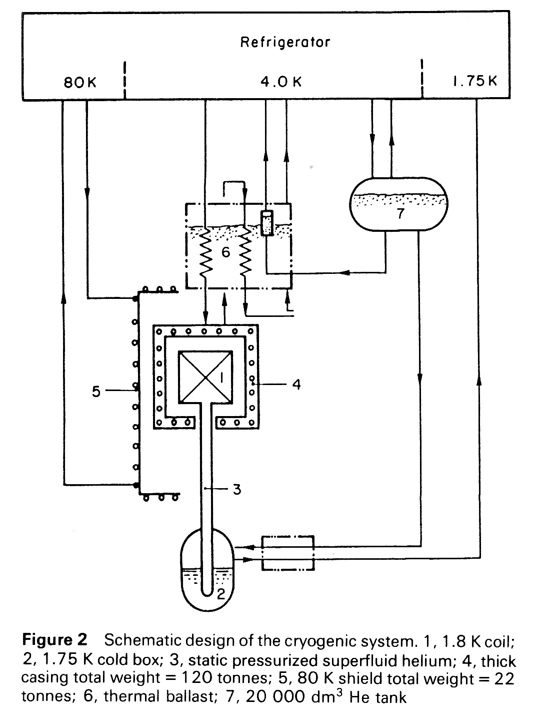
He II p conduction cooling of Tore Supra coils

Slide 41
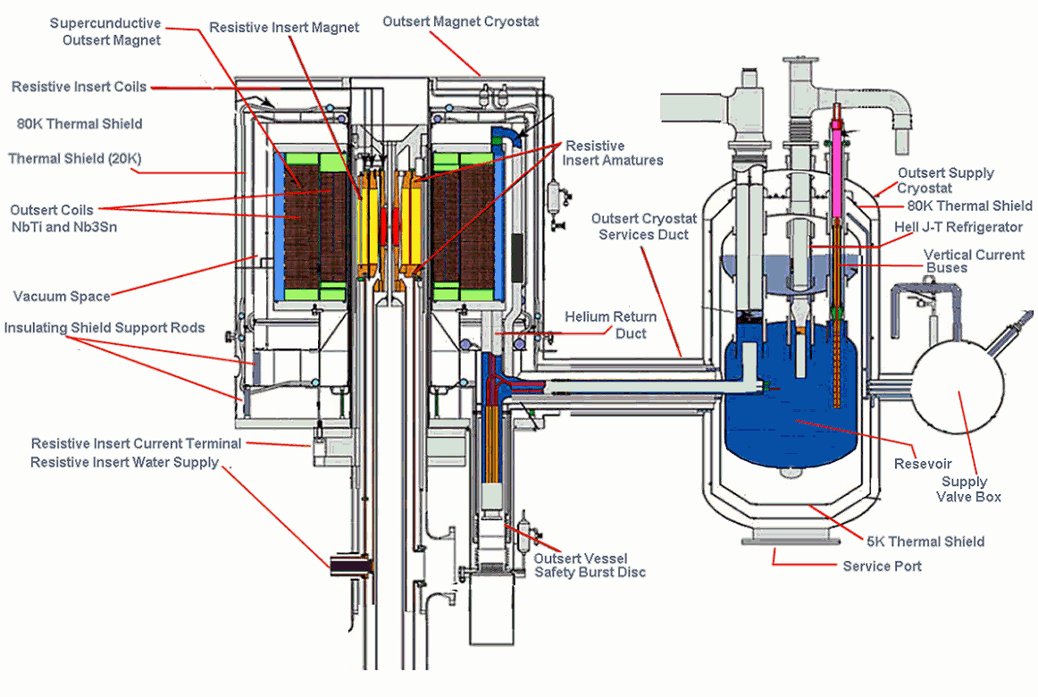
He IIp conduction cooling of 45 T hybrid magnet
NHFML Tallahassee

Slide 42
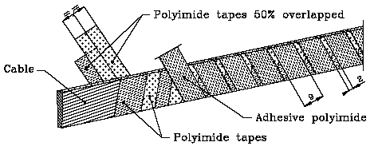
Heat transfer across electrical insulation of LHC superconducting cable
Conduction in polyimide

Slide 43
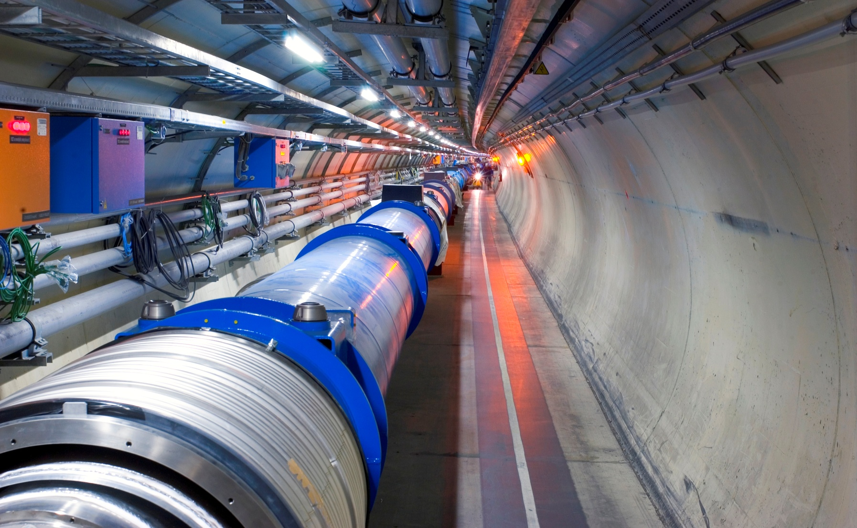
The LHC: 1716 superconducting magnets cooled at 1.9 K in 3 km long strings: how to transport the heat over such distances?

Slide 44
Conduction cooling of accelerator string: the fin problem
Distance : z
Linear heat load: ξ
G-M law applied on dz:
Energy conservation:
➔
then,
➔
Calling Q_{tot} the total heat load on the string of length L:
Hence,

Slide 45
Conduction in He II with linear applied heat load
From 1.80 K to 1.90 K

Slide 46
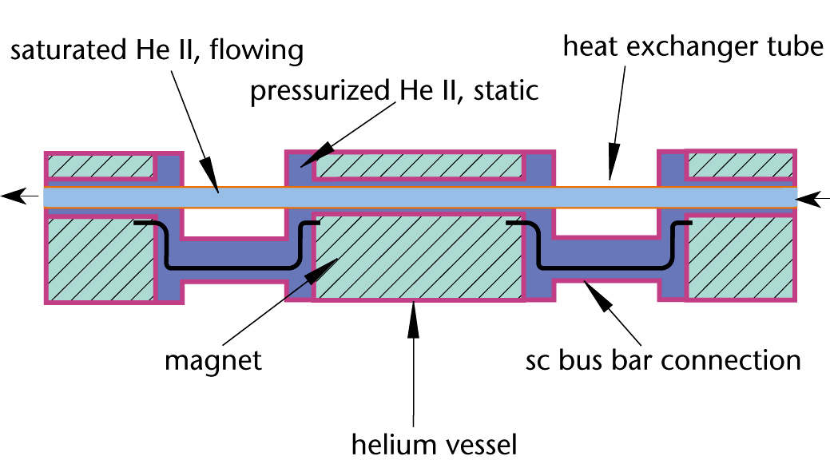
Cooling the LHC magnet strings by two-phase flow of He II s
Monophase
Excellent thermal conductivity
Good dielectric strength
Fixed temperature
Small flow, no pump

Slide 47
Two-phase Flow of Saturated He II
(Mandhane, Gregory & Aziz flow map)

Slide 48
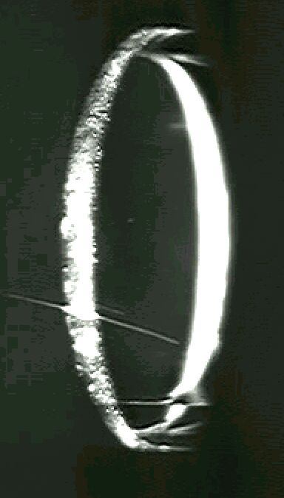
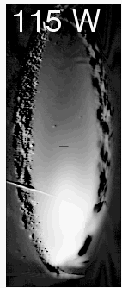
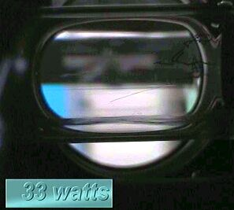
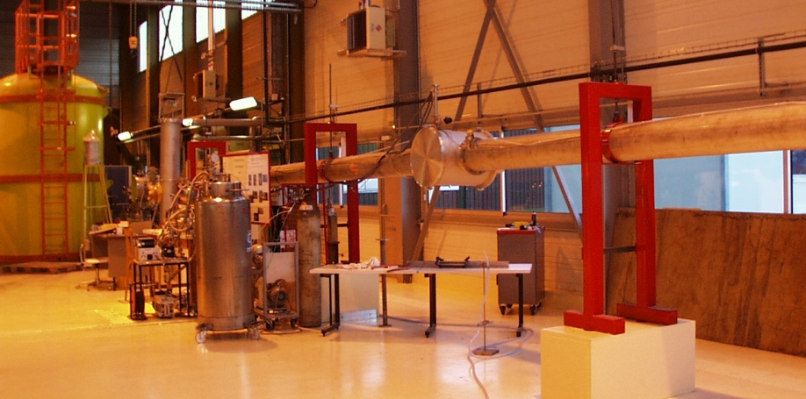
Investigation of two-phase He II s flow
(CEA Grenoble, France)
Phenomenology
Stability
Pressure drop
Heat transfer at wall
LHC nominal operation

Slide 49
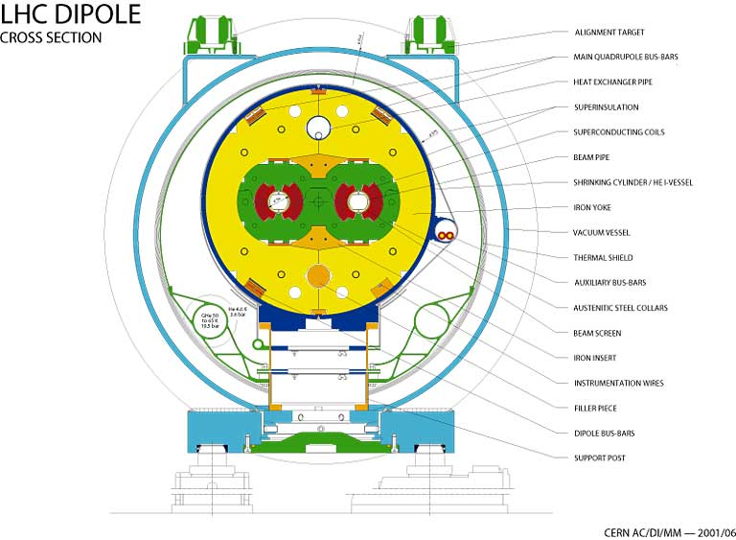
LHC magnet cross-section

Slide 50
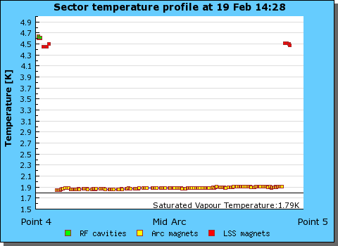
Temperature profile of LHC sector
3.3 km

Slide 51
Contents
Introduction to superfluid helium
Superfluid helium as a technical coolant
Practical cooling schemes
Refrigeration below 2 K
Specific technology for He II systems
Applications

Slide 52
Challenges of power refrigeration at 1.8 K
Compression > 80
Compression of large mass flow-rate of He vapor across high pressure ratio
intake He at maximum density, i.e. cold
Need contact-less, vane-less machine ⇒ hydrodynamic compressor
Compression heat rejected at low temperature ⇒ thermodynamic efficiency

Slide 53
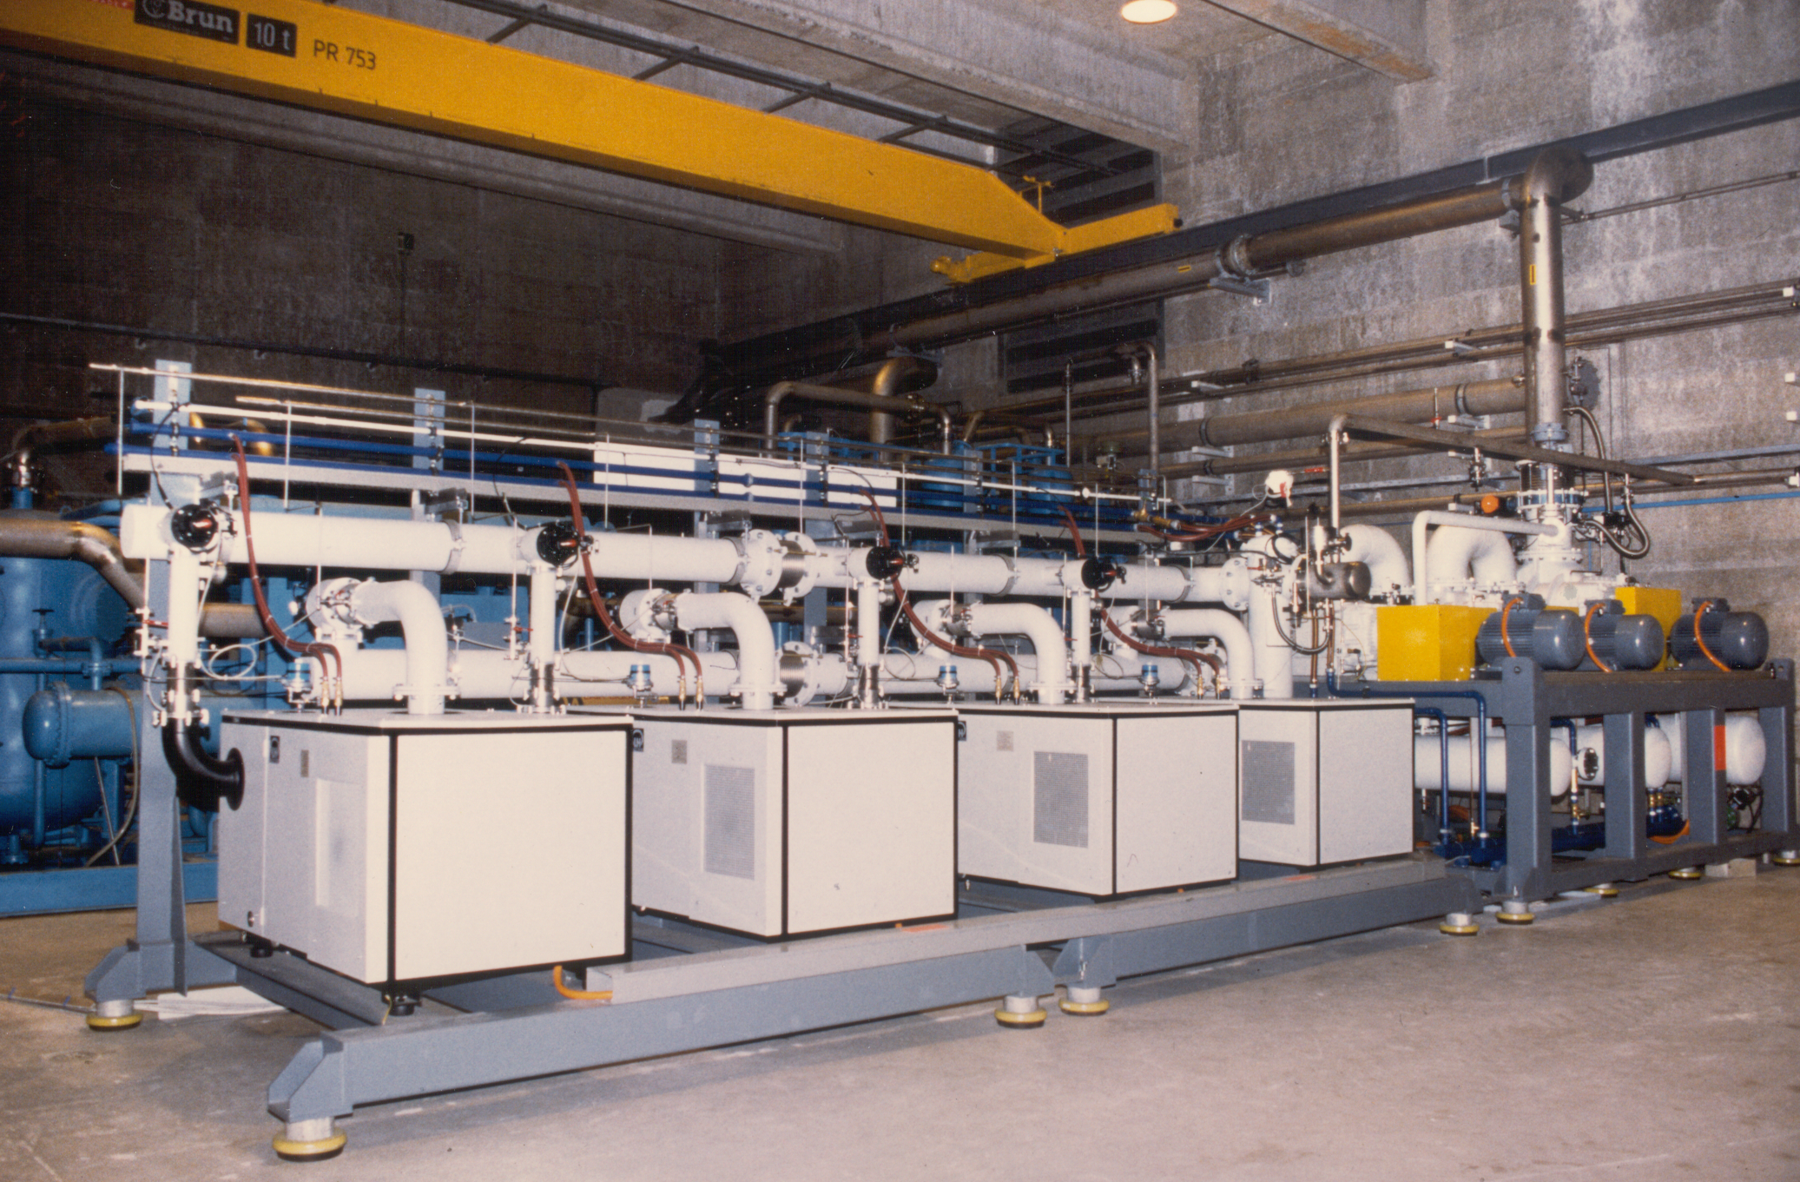
Warm pumping unit for LHC magnet tests
3 stages of Roots + 1 stage rotary-vane pumps
6 g/s @ 10 mbar (1/160 of LHC!)

Slide 54
Operating ranges
of volumetric & hydrodynamic compressors
Speed N1 < N2 < N3
Pressure
ratio
Pressure
ratio
Stall line
N1
N2
N3
Speed limit
N3
N2
N1
Choke line
Flow
Flow
Volumetric (ideal)
Hydrodynamic

Slide 55
Cycles for refrigeration below 2 K
~ 2 kPa
Sub-cooling
heat exchanger
“Warm”
Compression
“Integral Cold”
Compression
“Mixed”
Compression

Slide 56
Flow compliance of “mixed” compression
Flow (variable)
P out (fixed)
P inter
Stall line
N3
Volumetric
Volumetric
N2
Choke line
N1
P inter
Hydrodynamic
P in (fixed)
Flow
For fixed overall inlet & outlet conditions, coupling of the two machines
via P inter maintains the operating point in the allowed range

Slide 57
Simplified flow-schemes of the 1.8 K refrigeration units of LHC

Slide 58
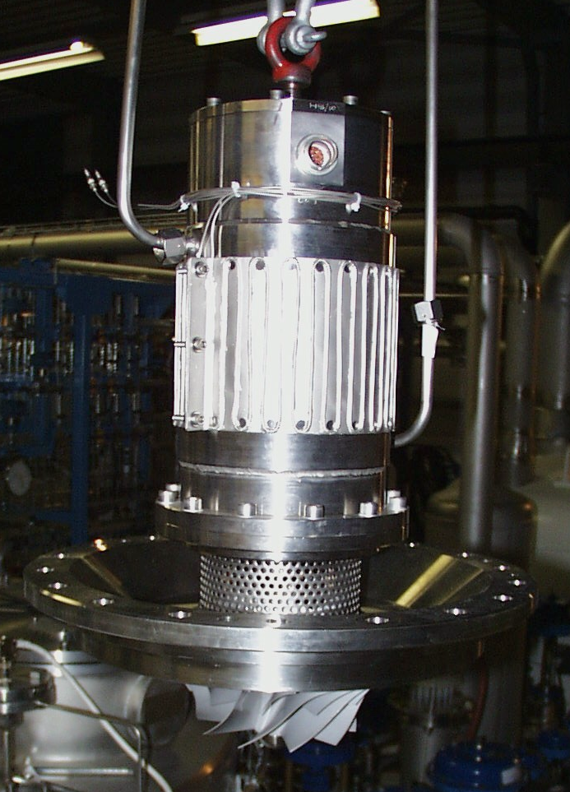
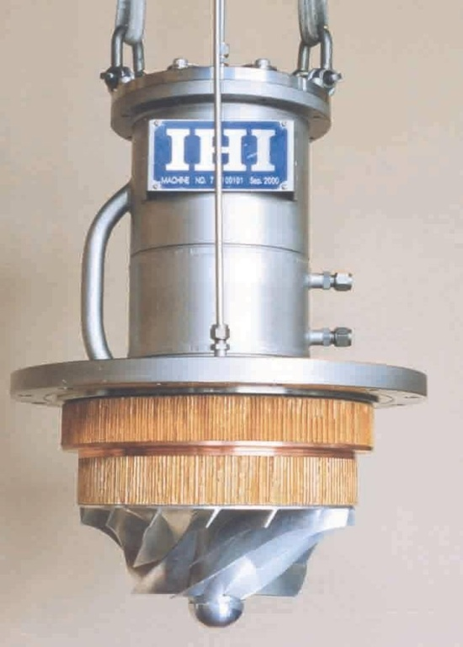
Cold hydrodynamic helium compressors
Air Liquide
IHI

Slide 59
Specific features of LHC cold compressors
Active
magnetic
bearings
3-phase induction
Electrical motor
(rotational speed:
200 to 700 Hz)
300 K under
atmosphere
Fixed-vane
diffuser
Outlet
Spiral volute
Cold under
vacuum
Axial-centrifugal
Impeller (3D)
Pressure ratio
2 to 3.5
Inlet

Slide 60
Performance of LHC cold compressors

Slide 61
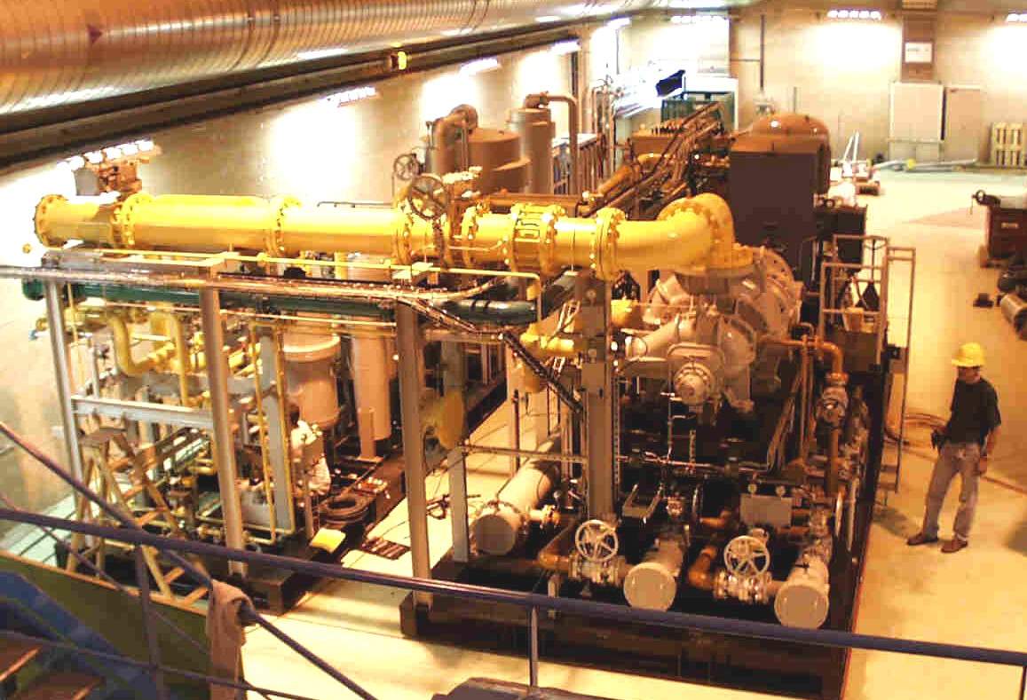
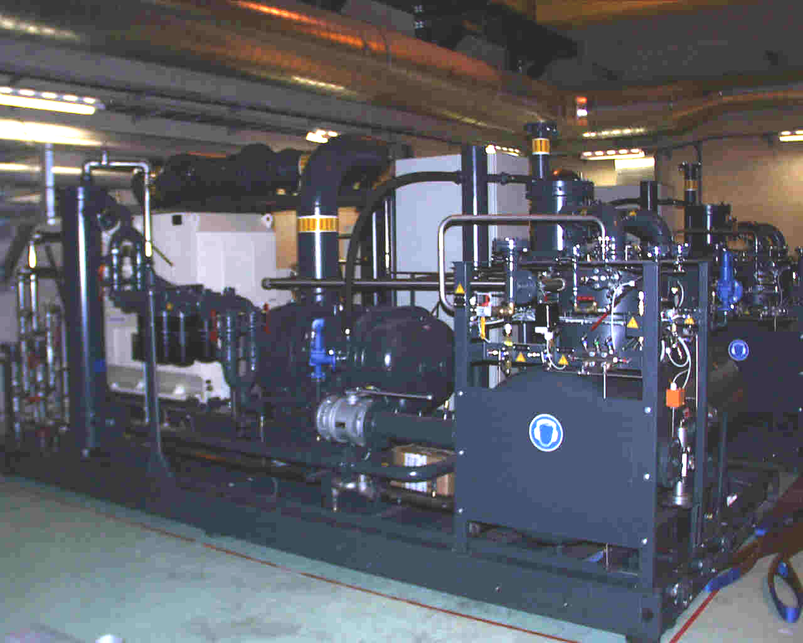
Warm subatmospheric screw compressors
125 g/s @ 0.35 bar
or
2 x 3900 m3/h @ 15 °C
Kaeser
Mycom
125 g/s @ 0.6 bar
or
4600 m3/h @ 15 °C

Slide 62
Isothermal efficiency
of warm subatmospheric compressors
Isothermal
efficiency

Slide 63
C.O.P. of LHC 1.8 K units
4.5 K refrigerator part
1.8 K refrigeration unit part
1000
800
600
COP [W@RT / W@1.8K]
400
200
Carnot Limit
0
Air Liquide
IHI-Linde

Slide 64
Contents
Introduction to superfluid helium
Superfluid helium as a technical coolant
Practical cooling schemes
Refrigeration below 2 K
Specific technology for He II systems
Applications

Slide 65
Efficiency of Joule-Thomson expansion
Sub-cooling efficiency :
Enthalpy of pure liquid
Sub-cooling | T_{1’} [K] | H₃-H₂ [J/g] | H₃-H₀ [J/g] | [%]
without | 4.5 | 12.6 | 23.4 | 54
with | 2.2 | 20.4 | 23.4 | 87

Slide 66
Subcooling before J-T expansion
1’
1
0
3
2
2

Slide 67
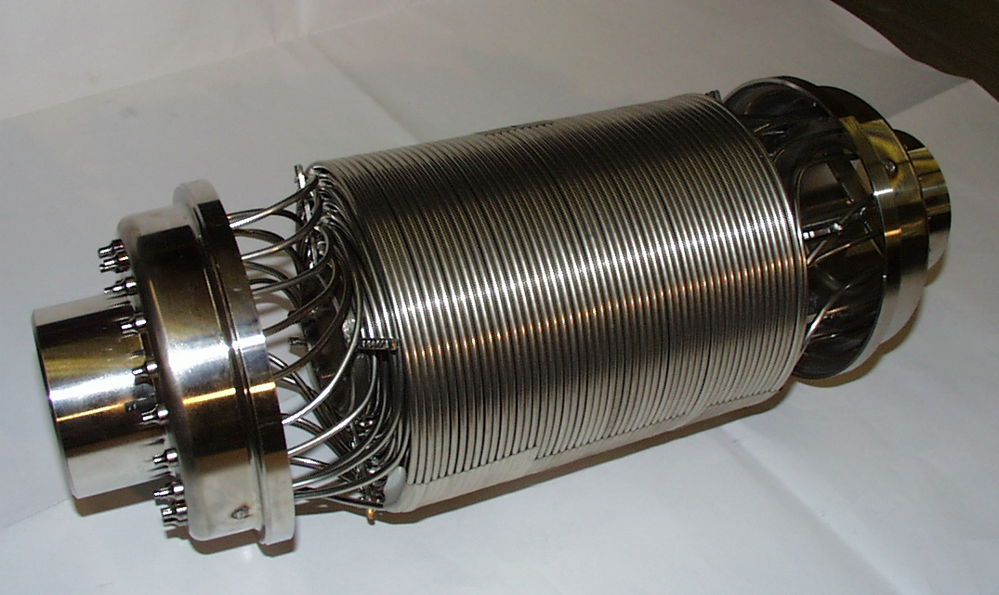
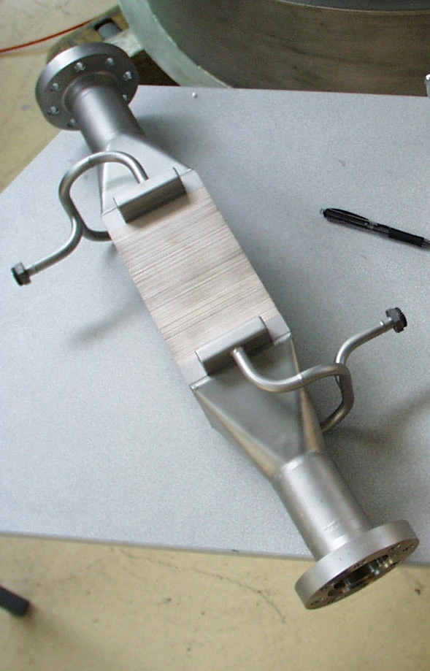
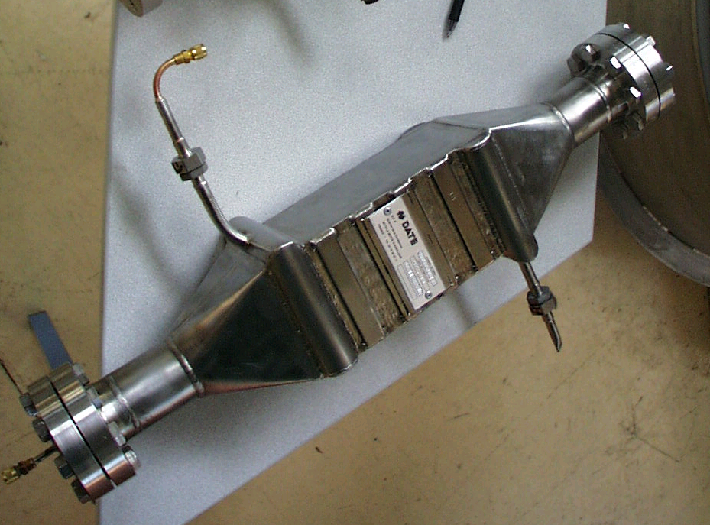
Prototypes of subcooling HX for LHC
Mass-flow: 4.5 g/s
ΔP VLP stream: < 1 mbar
Sub-cooling T: < 2.2 K
SS Coiled Tubes
SNLS
Romabau
DATE
Perforated
Copper Plates
with SS Spacers
Stainless Steel Plate

Slide 68
Protection against air inleaks
Motor shaft of warm sub-atmospheric compressors placed at the discharge side to work above atmospheric pressure.
For sub-atmospheric circuits which are not under guard vacuum or not completely welded, apply helium guard protection on dynamic seal of valves, on instrumentation ports, on safety relief valves and on critical static seals

Slide 69
Contents
Introduction to superfluid helium
Superfluid helium as a technical coolant
Practical cooling schemes
Refrigeration below 2 K
Specific technology for He II systems
Applications

Slide 70
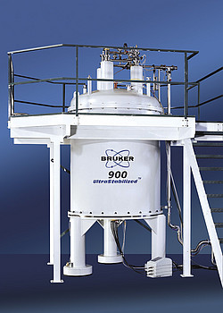
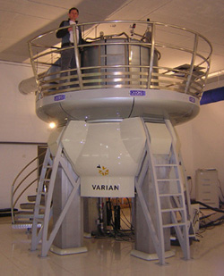
High-field magnets for high-frequency NMR
900 MHz ⬄ 21.2 T

Slide 71

The European X-ray FEL, DESY, Hamburg (Germany)
Very brilliant, ultra-short (100 fs) pulses of X-rays down to 0.1 nm
Based on s.c. e linac
Beam energy 17.5 GeV
Beam power 600 kW
Linac length 1.7 km
928 superconducting RF cavities operated at 2 K
Refrigeration 2.5 kW @ 2 K

Slide 72
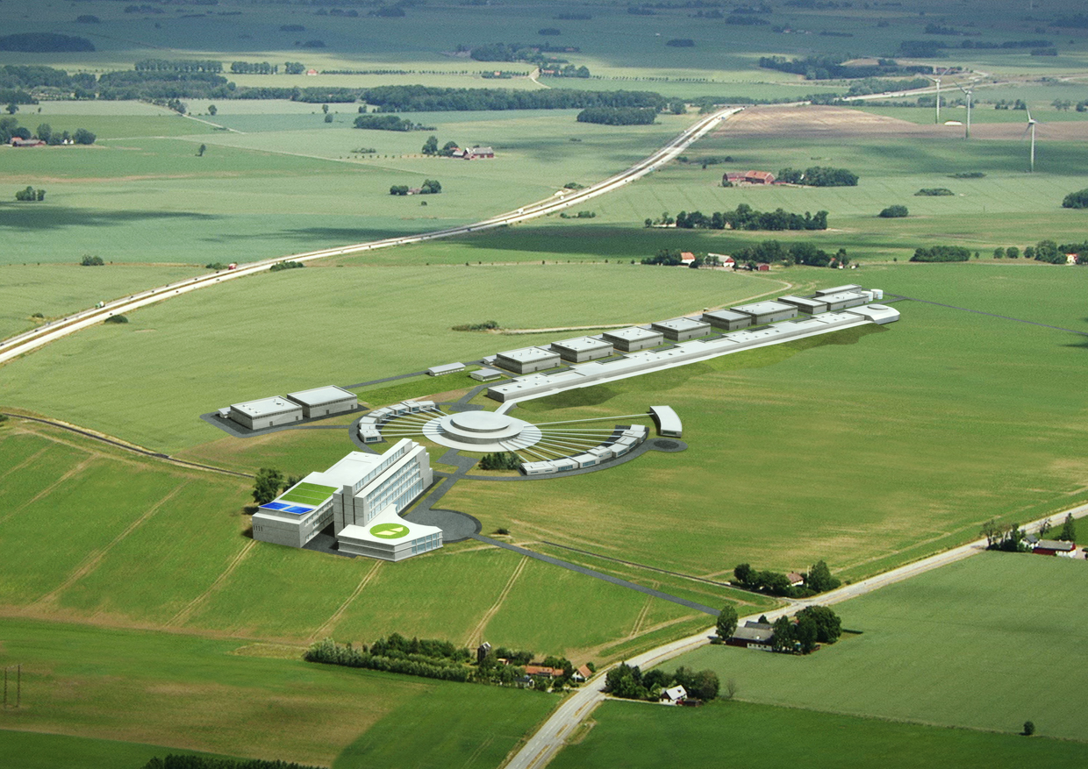

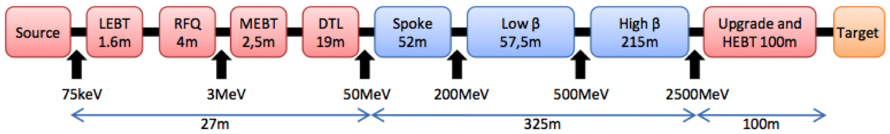
European Spallation Source, Lund (Sweden)
  5 MW long pulse source
    ≤2 ms pulses
    ≤20 Hz
    Protons (H+)
    Low losses
    High reliability, >95%
    2.5 GeV

Slide 73
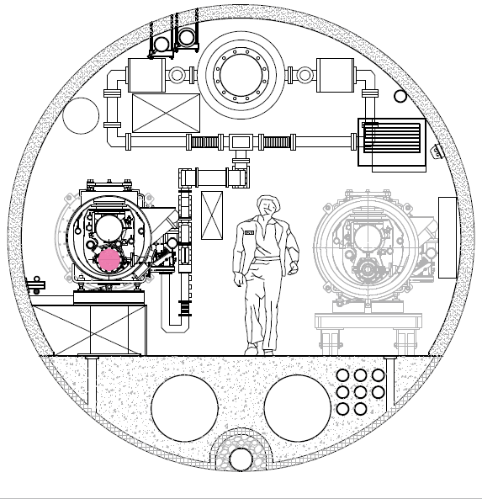
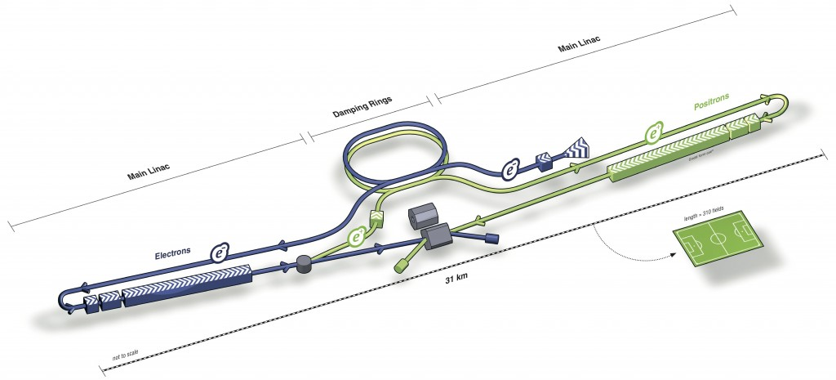
International Linear Collider (ILC)
e+ e- linear collider
Collision energy 500 GeV c.m. initially, later upgrade to ~1 TeV c.m.
Overall length 31 km
Key technology: SC RF cavities
Global Design Effort
No central laboratory
World-wide collaboration
Site-specific studies conducted on sample sites

Slide 74
Conclusion
From a laboratory curiosity and a hot research topic in condensed-matter physics, superfluid helium has become a state-of-the-art cryogen for cooling large superconducting devices such as high-energy accelerators, tokamaks and research magnets
Projects such as TORE SUPRA, CEBAF, SNS and LHC have triggered vigorous development programmes in laboratories and industry concerning flow and heat transfer, refrigeration techniques, instrumentation and engineering
Superfluid helium remains an enabling technology for NMR magnets and future large projects using high-field superconducting devices, e.g. the European X-FEL, ESS, ILC. The unique hydrodynamic properties of the fluid can also be used per se, e.g. in turbulence research

Slide 75
Application range of low-pressure He compressors
~ 20 000 m3/h @ 15 °C

