Slide 1
MAGNETIC DESIGN
Ezio Todesco
European Organization for Nuclear Research (CERN)
Thanks to P. Ferracin and L. Rossi

Slide 2
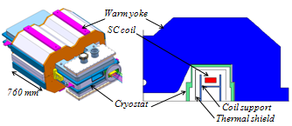
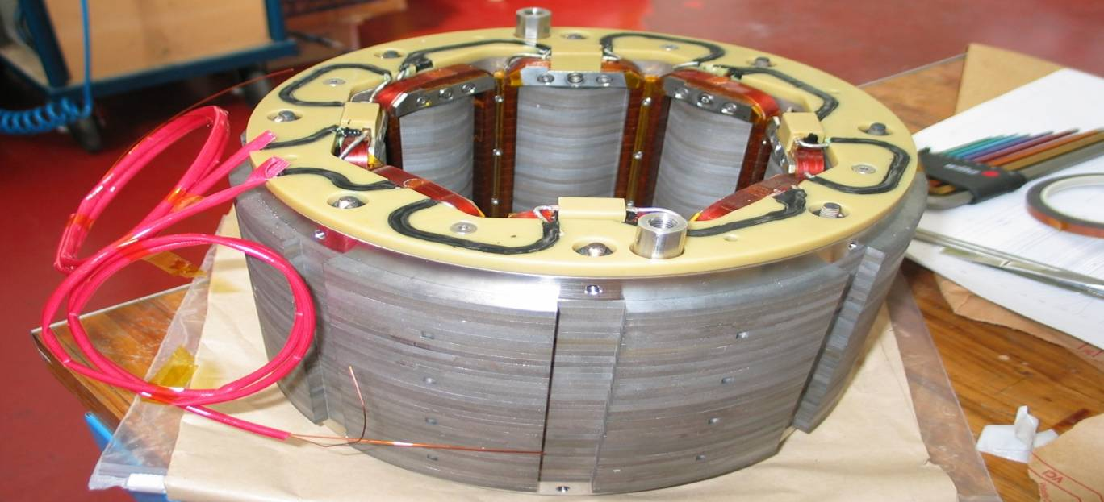
IRON and coil magnets
Iron dominated magnets
  Shape of the field given by the iron
  Winding give the flux
  Limited to 1.8 T by iron saturation
    Winding can be resistive /superconductive
      The supercoductive option os also called superferric – warm or cold yoke
Coil dominated magnets
  Shape of the field given by the conductor position
  Limited by field tolerated by conductor
  Iron gives second order effect (acts as a
  virtual coil, field enhancement)
Low-loss injector magnet,
F. Borgnolutti, et al, MT22 (2012)
Superferric corrector, F. Toral, et al, MT22 (2012)

Slide 3
CONTENTS
Coil lay out and field quality constraints
Field versus coil width, superconductor and filling ratio
  Dipoles
  Quadrupoles
Block design
Iron and persistent currents

Slide 4
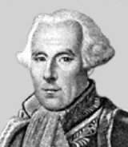
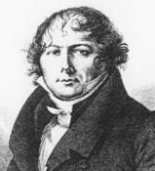
1. FIELD QUALITY CONSTRAINTS
Field given by a current line (Biot-Savart law)
using
  !!!
we get
Félix Savart,
French
(June 30, 1791-March 16, 1841)
Jean-Baptiste Biot,
French
(April 21, 1774 – February 3, 1862)

Slide 5
1. FIELD QUALITY CONSTRAINTS
Now we can compute the multipoles of a current line at z₀
Definition of multipolar expansion
A perfect dipole has b₁=10000, and all others b_{n} a_{n} = 0
  In log scale, the slope of the multipole decay is the logarithm of (R_{ref}/|z₀|)

Slide 6
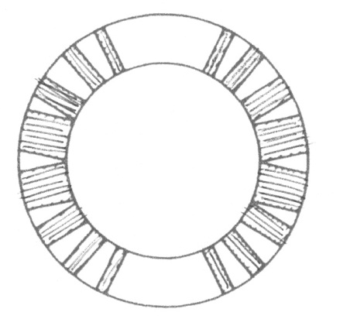
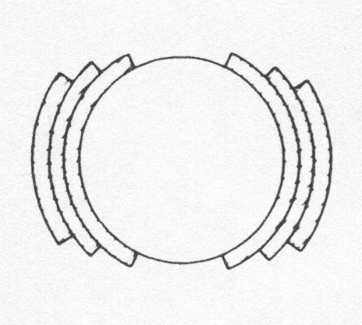
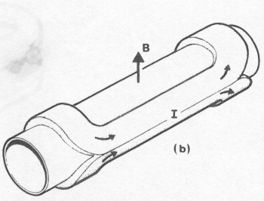
1. FIELD QUALITY CONSTRAINTS
Perfect dipoles
  Cosθ: a current density proportional to cosθ in an annulus – One can prove it provides pure field -
    + self supporting structure (roman arch)
    + the aperture is circular, the coil is compact
    + easy winding, lot of experience
Cable block
wedge
An ideal cosθ
A practical winding with one layer and wedges
[from M. N. Wilson, pg. 33]
A practical winding with three layers and no wedges
[from M. N. Wilson, pg. 33]
Artist view of a cosθ magnet
[from Schmuser]

Slide 7
1. FIELD QUALITY CONSTRAINTS
We compute the central field given by a sector dipole with uniform current density j
  Taking into account of current signs
  This simple computation is full of consequences
  B₁ ∝ current density (obvious)
  B₁ ∝ coil width w (less obvious)
  B₁ is independent of the aperture r (much less obvious)

Slide 8

1. FIELD QUALITY CONSTRAINTS
A dipolar symmetry is characterized by
  Up-down symmetry (with same current sign)
  Left-right symmetry (with opposite sign)
Why this configuration?
  Opposite sign in left-right is necessary to avoid that the field created by the left part is canceled by the right one
  In this way all multipoles except B_{2n+1} are canceled
  these multipoles are called “allowed multipoles”
  Remember the power law decay of multipoles with order
  And that field quality specifications concern only first 10-15 multipoles
    The field quality optimization of a coil lay-out concerns only a few quantities ! Usually b₃ , b₅ , b₇ , and possibly b₉ , b₁₁

Slide 9
1. FIELD QUALITY CONSTRAINTS
Multipoles of a sector coil
  for n=2 one has
  and for n>2
Main features of these equations
  Multipoles n are proportional to sin ( n angle of the sector)
    They can be made equal to zero !
  Proportional to the inverse of sector distance to power n
    High order multipoles are not affected by coil parts far from the centre

Slide 10
1. FIELD QUALITY CONSTRAINTS
First allowed multipole B₃ (sextupole)
  for α=π/3 (i.e. a 60° sector coil) one has B₃=0
Second allowed multipole B₅ (decapole)
  for α=π/5 (i.e. a 36° sector coil) or for α=2π/5 (i.e. a 72° sector coil)
  one has B₅=0
  With one sector one cannot set to zero both multipoles … let us try with more sectors !

Slide 11
1. FIELD QUALITY CONSTRAINTS
Coil with two sectors
  Note: we have to work with non-normalized multipoles, which can be added together
Equations to set to zero B₃ and B₅
  There is a one-parameter family of solutions, for instance (48°,60°,72°) or (36°,44°,64°) are solutions

Slide 12
1. FIELD QUALITY CONSTRAINTS
With one wedge one can set to zero three multipoles (B₃, B₅ and B₇)
What about two wedges ?
  One can set to zero five multipoles (B₃, B₅, B₇ , B₉ and B₁₁) ~[0°-33.3°, 37.1°- 53.1°, 63.4°- 71.8°]
One wedge, b₃=b₅=b₇=0
[0°-43.2°,52.2°-67.3°]
Two wedges, b₃=b₅=b₇=b₉=b₁₁=0
[0°-33.3°,37.1°-53.1°,63.4°- 71.8°]

Slide 13
1. FIELD QUALITY CONSTRAINTS
Limits due to the cable geometry
  Finite thickness → one cannot produce sectors of any width
  Cables cannot be key-stoned beyond a certain angle, some wedges can be used to better follow the arch
One does not always aim at having zero multipoles
  There are other contributions (iron, persistent currents …)
  Codes can estimate and optimize (e.g. ROXIE) – but never lose the feeling of what you are doing ! (more info USPAS Unit 8)
Our case with two wedges
RHIC main dipole

Slide 14
CONTENTS
Coil lay out and field quality constraints
Field versus coil width, superconductor and filling ratio
  Dipoles
  Quadrupoles
Block design
Iron and persistent currents

Slide 15
2. DIPOLES: FIELD VERSUS MATERIAL
AND COIL THICKNESS
The coil width is the main parameter of magnet design
  First decision of the magnet designer: how much superconductor ?
☺ High field
☹ Large coil → $$
☺ Lower current density
😐 Low field
☺ Smaller coil
☹ Larger current density

Slide 16
2. DIPOLES: FIELD VERSUS MATERIAL
AND COIL THICKNESS
Aim: approximate analytical equations for magnetic design
We recall the equations for the critical surface
  Nb-Ti: linear approximation is good
  with s~6.0×10⁸ [A/(T m²)] and B*_{c2}~10 T at 4.2 K or 13 T at 1.9 K
    This is a typical mature and very good Nb-Ti strand
    Tevatron had half of it!

Slide 17
2. DIPOLES: FIELD VERSUS MATERIAL
AND COIL THICKNESS
The current density in the coil is lower
  Strand made of superconductor and normal conducting (∼copper)
    ν_{Cu/noCu} is the ratio between the copper and the superconductor, usually ranging from 1 to 2 in most cases
  If the strands are assembled in rectangular cables, there are voids:
    κ_{w-c} is the fraction of cable occupied by strands (usually ~85%)
  The cables are insulated:
    κ_{c-i} is the fraction of insulated cable occupied by the bare cable (~85%)
The current density flowing in the insulated cable is reduced by a factor κ (filling ratio)
  The filling ratio ranges from ¼ to 1/3
  The critical surface for j (engineering current density) is

Slide 18
2. DIPOLES: FIELD VERSUS MATERIAL
AND COIL THICKNESS
We characterize the coil by two parameters
  γ_{c}: how much field in the centre is given per unit of current density
  λ: ratio between peak field and central field
  We can now compute what is the highest peak field that can be reached in the dipole in the case of a linear critical surface
  Margin: you must stay at a certain distance from the critical surface (typically 80% of j_{ss}, B_{ss})
j=κs(b-B)

Slide 19
2. DIPOLES: FIELD VERSUS MATERIAL
AND COIL THICKNESS
Hypothesis of 60°sector coil:
  This is the easy part – with two sectors a bit more realistic
Ratio peak field/central field: empirical fit (one can make better
a~0.045

Slide 20
2. DIPOLES: FIELD VERSUS MATERIAL
AND COIL THICKNESS
We now can write the short sample field for a sector coil as a function of
  Material parameters c, B*_{c2}
  Cable parameters κ
  Aperture r and coil width w
  Best values: a=0.045 γ_{c0}=6.63×10⁻⁷ [Tm/A]
  for Nb-Ti s~6.0×10⁸ [A/(T m²)] and b~10 T at 4.2 K or 13 T at 1.9 K
(see also Excel file available in material)
Please note: this is a handy estimate, neglecting iron, to have an idea of the trends

Slide 21
2. DIPOLES: FIELD VERSUS MATERIAL
AND COIL THICKNESS
Evaluation of short sample field in sector lay-outs for a different apertures
  Please note that the operational field is ~80% of this value
  Tends asymptotically to b~ 13 T, as b w/(1+w), for w→∞
    Example: LHC coil ~30 mm width, short sample ~10 T, operational ~8 T

Slide 22
2. DIPOLES: FIELD VERSUS MATERIAL
AND COIL THICKNESS
Case of Nb₃Sn – an explicit expression
  An analytical expression can be found using a hyperbolic fit
  that agrees well between 11 and 17 T
  with s~3.9×10⁹ [A/(T m²)]
  and b~21 T at 4.2 K, b~22 T at 1.9 K
  Using this fit one can find explicit expression for the short sample field
  and the constant γ_{c} λ are the same as before (they depend on the lay-out, not on the material)

Slide 23
2. DIPOLES: FIELD VERSUS MATERIAL
AND COIL THICKNESS
Evaluation of short sample field in sector lay-outs for a different apertures
  Tends asymptotically to b~22 T but slowly

Slide 24
2. DIPOLES: FIELD VERSUS MATERIAL
AND COIL THICKNESS
Summary
  Nb-Ti is limited at 10 T
  Nb₃Sn allows to go towards 15 T
  Approaching the limits of each material implies
  very large coil and lower current densities – not so effective
  Operational current densities are typically ranging between 300 and 600 A/mm²
Operational bore field versus coil width
(80% of short sample at 1.9 K taken for models)
Operational overall current density versus coil width
(80% of short sample at 1.9 K taken for models)

Slide 25
2. QUADRUPOLES: GRADIENT VERSUS MATERIAL
AND COIL THICKNESS
Nb-Ti case, κ=0.3
  See appendix

Slide 26
2. QUADRUPOLES: GRADIENT VERSUS MATERIAL
AND COIL THICKNESS
Nb₃Sn case, k=0.33
  About 50% larger gradient for the same aperture

Slide 27
CONTENTS
Coil lay out and field quality constraints
Field versus coil width, superconductor and filling ratio
  Dipoles
  Quadrupoles
Iron and persistent currents
Block design

Slide 28
3. IRON YOKE – WHAT THICKNESS
Iron is mainly used to avoid leaks of flux outside the magnet
  A rough estimate of the iron thickness necessary
  The iron cannot withstand more than 2 T
  Shielding condition for dipoles:
    i.e., the iron thickness times 2 T is equal to the central field times the magnet aperture – One assumes that all the field lines in the aperture go through the iron (and not for instance through the collars)
    Example: in the LHC main dipole the iron thickness is 150 mm
  Shielding condition for quadrupoles:

Slide 29




3. IRON YOKE – IMAGE METHOD
Positive side effect: increase the main field for a fixed current
  Examples of several built dipoles
  Smallest: LHC ∼ 16% Largest: RHIC ∼ 55%
  Lower impact on short sample (a few percent for LHC)
For high field magnet iron gets saturated – mirror approximation not valid, nonlinear effect –computed with FEM (Opera, Ansys, ROXIE)
Iron saturation in RHIC magnet [R. Gupta]

Slide 30
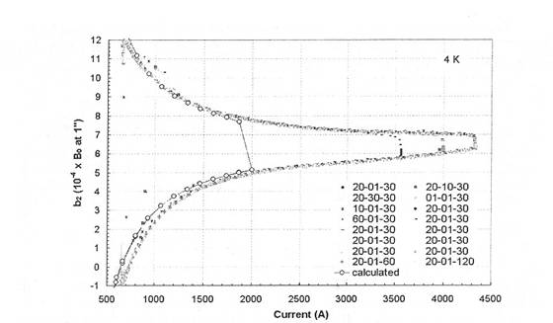
3: PERSISTENT CURRENTS
The filaments get magnetized during a field change
  Since they are superconductive, current flow forever → persistent
  These currents have a large impact at injection on field quality
    Effect proportional to filament size
  One can decide to correct with wedges at injection and have residual at high field or viceversa (depends on the magnet function)
Magnetization for ramping field according to Bean model
Persistent current measured vs computed in Tevatron dipoles - From P. Bauer et al, FNAL TD-02-040 (2004)

Slide 31
CONTENTS
Coil lay out and field quality constraints
Field versus coil width, superconductor and filling ratio
  Dipoles
  Quadrupoles
Iron and persistent currents
Block design

Slide 32
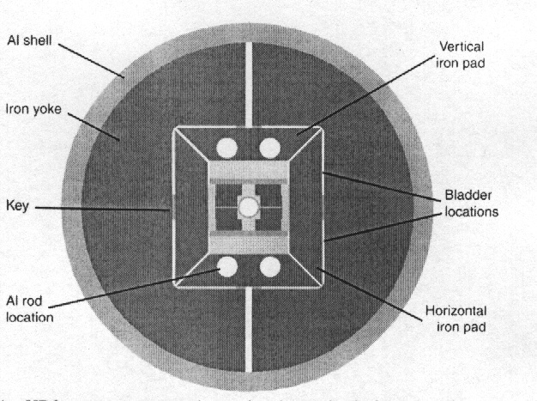
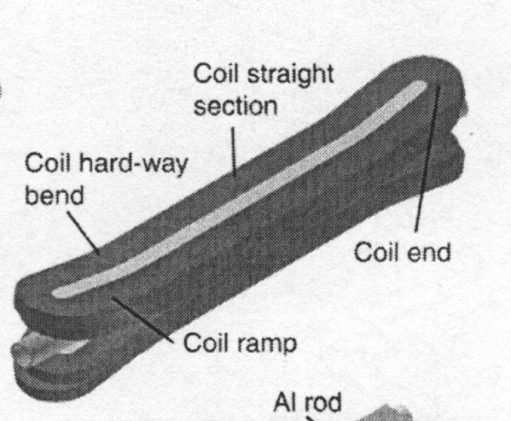
4. OTHER DESIGNS: BLOCK
Block coil (HD2, HD3, Fresca2)
  Cable is not keystoned, perpendicular to the midplane
  Ends are wound in the easy side, but must be flared to make space for aperture (bend in the hard direction)
  Internal structure to support the coil needed
HD2 design: 3D sketch of the coil (left) and magnet cross section (right)
[from P. Ferracin et al, MT19, IEEE Trans. Appl. Supercond. 16 378 (2006)]

Slide 33
4. OTHER DESIGNS: BLOCK
Block coil – HD2 & HD3
  Two layers, two blocks
  Enough parameters to have a good field quality
  Ratio peak field/central field not so bad:
  1.05 instead of 1.02 as for a cosθ with the same
  quantity of cable
  Ratio central field/current density is 12%
  less than a cosθ with the same quantity of
  cable: less effective than cos theta
  Short sample field is around 5% less
  than what could be obtained by a cosθ
  with the same quantity of cable
  Reached 87% of short sample
  Elegant, but mechanical support is an issue

Slide 34
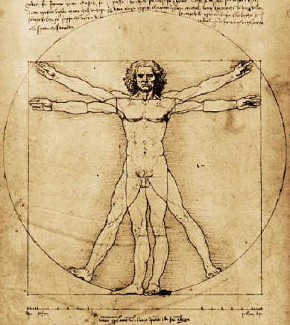

4: BLOCK VS COS THETA
Cos theta coil in Tevatron dipole
Block coil in HD2/3
Square vs circle: Vitruvian man, Leonardo
Square vs circle: Bologna city centre

Slide 35
CONCLUSIONS
Main parameter to choose for a magnet design
  Current density and coil width
  Field quality can be solved with azimuthal layout (some wedges)
    Looks complicate, but it is not
Dipole: field propto coil width and current density
Quadrupole: gradient propto ln(1+w/r) and current density
  In both cases, adding more and more coil is not worth – asymptotic limit – important to know where to stop
    Other factors: protection, mechanics
  Most magnets work with a current density around 500 A/mm²
Cos theta is the workhorse of accelerator magnets
  Block design is interesting but needs more experience

Slide 36
REFERENCES
General magnet design
  R. Wilson “Superconducting magnets”, Oxford press
  P. Schmuser, K. Mess, S. Wolff “Superconducting accelerator magnets”, World Scientific
    USPAS 2012 course H. Felice, P. Ferracin, S. Prestemon, E. Todesco www.cern.ch/ezio.todesco/uspas/uspas.html
Field vs coil width
    L. Rossi, E. Todesco, `Electromagnetic design of superconducting quadrupoles', Phys. Rev. STAB 9 102401 (2006).
    L. Rossi, E. Todesco, `Electromagnetic design of superconducting dipoles based on sector coils', Phys. Rev. STAB 10 112401 (2007).
Codes
  Roxie Ansys Opera

Slide 37
APPENDIX
Quadrupole equations
A gallery of coil lay outs

Slide 38
5. QUADRUPOLES: GRADIENT VERSUS MATERIAL
AND COIL THICKNESS
The same approach can be used for a quadrupole
  We define
  the only difference is that now γ_{c} gives the gradient per unit of current density, and in B_{p} we multiply by r for having T and not T/m
  We compute the quantities at the short sample limit for a material with a linear critical surface (as Nb-Ti)
  Please note that γ is not any more proportional to w and not any more independent of r !
  γ_{c0}=6.63×10⁻⁷ [Tm/A ] also in this case, by chance as in the dipole

Slide 39
5. QUADRUPOLES: GRADIENT VERSUS MATERIAL
AND COIL THICKNESS
The ratio λ is defined as ratio between peak field and gradient times aperture (central field is zero …)
  Numerically, one finds that for large coils λ→∞
  Peak field is “going outside” for large widths a₋₁=0.45 a₁=0.11
RHIC main quadrupole
LHC main quadrupole

Slide 40
5. QUADRUPOLES: GRADIENT VERSUS MATERIAL
AND COIL THICKNESS
We now can write the short sample gradient for a sector coil as a function of
  Material parameters s, b
  (linear case as Nb-Ti)
  Cable parameters κ
  Aperture r and coil width w
  Relevant feature: for very large coil widths w→∞ the short sample gradient tends to zero !

Slide 41
APPENDIX
Quadrupole equations
A gallery of coil lay outs

Slide 42
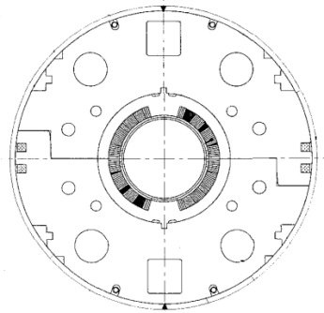
6. A REVIEW OF DIPOLE LAY-OUTS
RHIC MB
  Main dipole of the RHIC
  296 magnets built in 04/94 – 01/96
  Nb-Ti, 4.2 K
  w_{eq}~9 mm κ~0.23
  1 layer, 4 blocks
  no grading

Slide 43
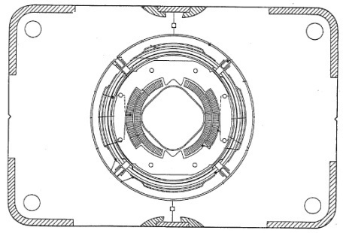
6. A REVIEW OF DIPOLE LAY-OUTS
Tevatron MB
  Main dipole of the Tevatron
  774 magnets built in ∼1980
  Nb-Ti, 4.2 K
  w_{eq}~14 mm κ~0.23
  2 layer, 2 blocks
  no grading

Slide 44
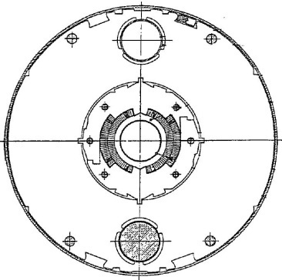
6. A REVIEW OF DIPOLE LAY-OUTS
HERA MB
  Main dipole of the HERA
  416 magnets built in ∼1985/87
  Nb-Ti, 4.2 K
  w_{eq}~19 mm κ~0.26
  2 layer, 4 blocks
  no grading

Slide 45
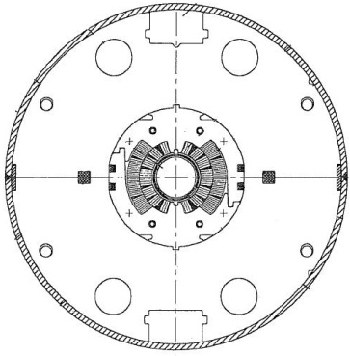
6. A REVIEW OF DIPOLE LAY-OUTS
SSC MB
  Main dipole of the ill-fated SSC
  18 prototypes built in ∼1990-5
  Nb-Ti, 4.2 K
  w_{eq}~22 mm κ~0.30
  4 layer, 6 blocks
  30% grading

Slide 46
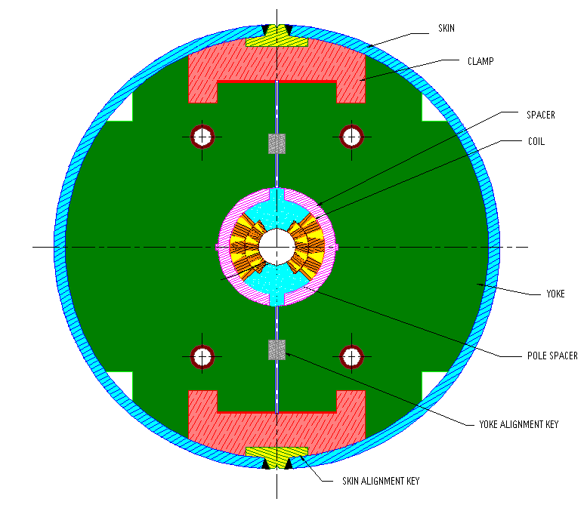
6. A REVIEW OF DIPOLE LAY-OUTS
HFDA dipole
  Nb₃Sn model built at FNAL
  6 models built in 2000-2005
  Nb₃Sn, 4.2 K
  j_{c}~2000 A/mm² at 12 T, 4.2 K
  w_{eq}~23 mm κ~0.29
  2 layers, 6 blocks
  no grading

Slide 47
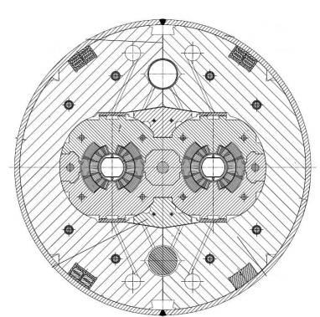
6. A REVIEW OF DIPOLE LAY-OUTS
LHC MB
  Main dipole of the LHC
  1276 magnets built in 2001-06
  Nb-Ti, 1.9 K
  w_{eq}~27 mm κ~0.29
  2 layers, 6 blocks
  23% grading

Slide 48
6. A REVIEW OF DIPOLE LAY-OUTS
FRESCA
  Dipole for cable test station at CERN
  1 magnet built in 2001
  Nb-Ti, 1.9 K
  w_{eq}~30 mm κ~0.29
  2 layers, 7 blocks
  24% grading

Slide 49
6. A REVIEW OF DIPOLE LAY-OUTS
MSUT dipole
  Nb₃Sn model built at Twente U.
  1 model built in 1995
  Nb₃Sn, 4.2 K
  j_{c}~1100 A/mm² at 12 T, 4.2 K
  w_{eq}~35 mm κ~0.33
  2 layers, 5 blocks
  65% grading

Slide 50
6. A REVIEW OF DIPOLE LAY-OUTS
D20 dipole
  Nb₃Sn model built at LBNL (USA)
  1 model built in ???
  Nb₃Sn, 4.2 K
  j_{c}~1100 A/mm² at 12 T, 4.2 K
  w_{eq}~45 mm κ~0.48
  4 layers, 13 blocks
  65% grading

Slide 51
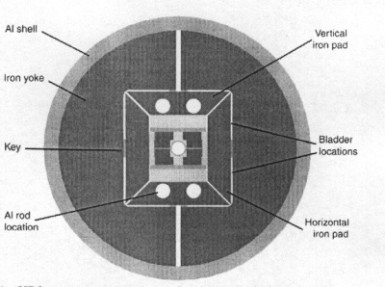
6. A REVIEW OF DIPOLE LAY-OUTS
HD2/3
  Nb₃Sn model being built in LBNL
  2 models to be built in 2008/2013
  Nb₃Sn, 4.2 K
  j_{c}~2500 A/mm² at 12 T, 4.2 K
  w_{eq}~46 mm κ~0.35
  2 layers, racetrack, no grading

Slide 52
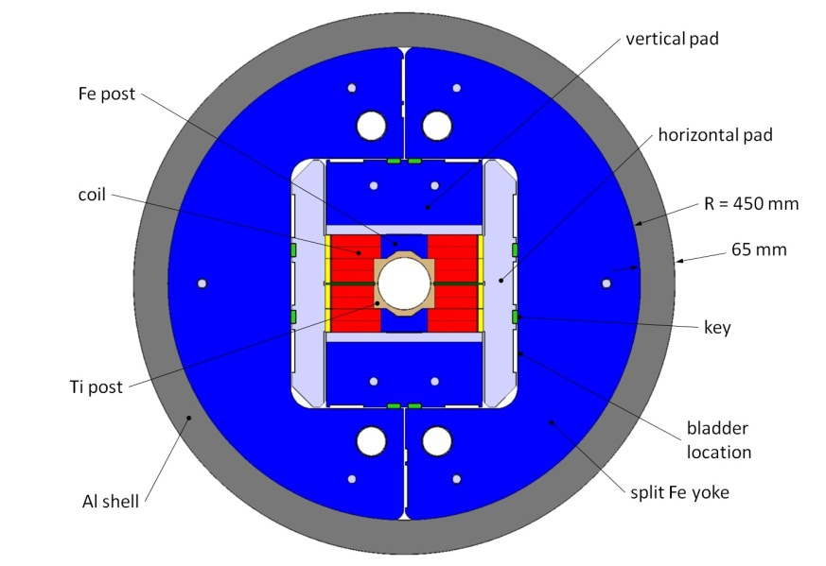
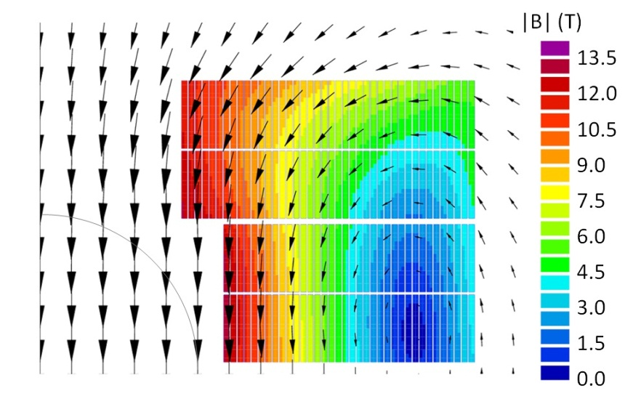
6. A REVIEW OF DIPOLE LAY-OUTS
Fresca2 dipole
  Nb₃Sn test station founded by UE
  cable built in 2004-2006
  Operational field 13 T
  To be tested in 2014
  Nb₃Sn, 4.2 K
  j_{c}~2500 A/mm² at 12 T, 4.2 K
  w_{eq}~80 mm κ~0.31
  Block coil 4 layers

Slide 53
6. A REVIEW OF QUADRUPOLES LAY-OUTS
RHIC MQX
  Quadrupole in the IR regions of the RHIC
  79 magnets built in July 1993/ December 1997
  Nb-Ti, 4.2 K
  w/r~0.18 κ~0.27
  1 layer, 3 blocks, no grading

Slide 54
6. A REVIEW OF QUADRUPOLES LAY-OUTS
RHIC MQ
  Main quadrupole of the RHIC
  380 magnets built in June 1994 – October 1995
  Nb-Ti, 4.2 K
  w/r~0.25 κ~0.23
  1 layer, 2 blocks, no grading

Slide 55
6. A REVIEW OF QUADRUPOLES LAY-OUTS
LEP II MQC
  Interaction region quadrupole of the LEP II
  8 magnets built in ∼1991-3
  Nb-Ti, 4.2 K, no iron
  w/r~0.27 κ~0.31
  1 layers, 2 blocks, no grading

Slide 56
6. A REVIEW OF QUADRUPOLES LAY-OUTS
ISR MQX
  IR region quadrupole of the ISR
  8 magnets built in ~1977-79
  Nb-Ti, 4.2 K
  w/r~0.28 κ~0.35
  1 layer, 3 blocks, no grading

Slide 57
6. A REVIEW OF QUADRUPOLES LAY-OUTS
LEP I MQC
  Interaction region quadrupole of the LEP I
  8 magnets built in ~1987-89
  Nb-Ti, 4.2 K, no iron
  w/r~0.29 κ~0.33
  1 layers, 2 blocks, no grading

Slide 58
6. A REVIEW OF QUADRUPOLES LAY-OUTS
Tevatron MQ
  Main quadrupole of the Tevatron
  216 magnets built in ~1980
  Nb-Ti, 4.2 K
  w/r~0.35 κ~0.250
  2 layers, 3 blocks, no grading

Slide 59
6. A REVIEW OF QUADRUPOLES LAY-OUTS
HERA MQ
  Main quadrupole of the HERA
  Nb-Ti, 1.9 K
  w/r~0.52 κ~0.27
  2 layers, 3 blocks, grading 10%

Slide 60
6. A REVIEW OF QUADRUPOLES LAY-OUTS
LHC MQM
  Low- gradient quadrupole in the IR regions of the LHC
  98 magnets built in 2001-2006
  Nb-Ti, 1.9 K (and 4.2 K)
  w/r~0.61 κ~0.26
  2 layers, 4 blocks, no grading

Slide 61
6. A REVIEW OF QUADRUPOLES LAY-OUTS
LHC MQY
  Large aperture quadrupole in the IR regions of the LHC
  30 magnets built in 2001-2006
  Nb-Ti, 4.2 K
  w/r~0.79 κ~0.34
  4 layers, 5 blocks, special grading 43%

Slide 62
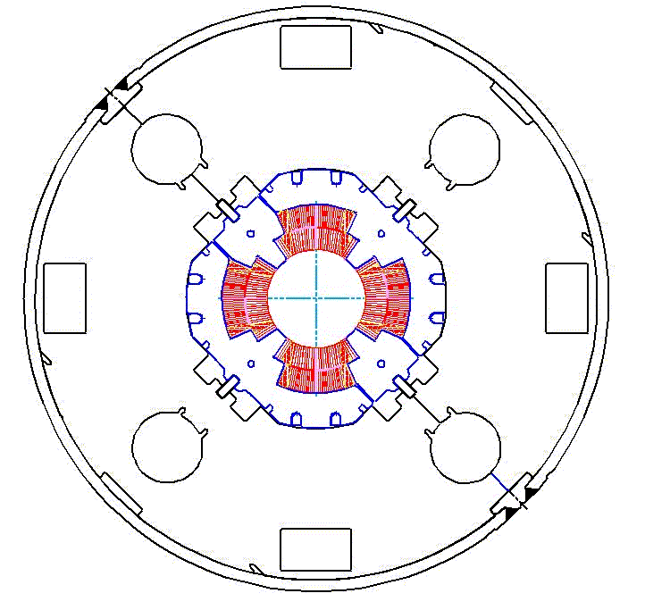
6. A REVIEW OF QUADRUPOLES LAY-OUTS
LHC MQXB
  Large aperture quadrupole in the LHC IR
  8 magnets built in 2001-2006
  Nb-Ti, 1.9 K
  w/r~0.89 κ~0.33
  2 layers, 4 blocks, grading 24%

Slide 63
6. A REVIEW OF QUADRUPOLES LAY-OUTS
SSC MQ
  Main quadrupole of the ill-fated SSC
  Nb-Ti, 1.9 K
  w/r~0.92 κ~0.27
  2 layers, 4 blocks, no grading

Slide 64
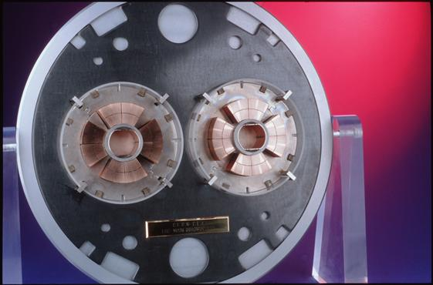
6. A REVIEW OF QUADRUPOLES LAY-OUTS
LHC MQ
  Main quadrupole of the LHC
  400 magnets built in 2001-2006
  Nb-Ti, 1.9 K
  w/r~1.0 κ~0.250
  2 layers, 4 blocks, no grading

Slide 65
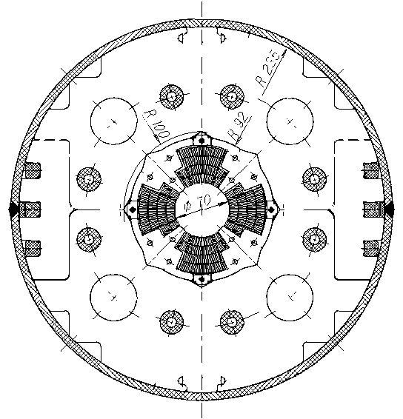
6. A REVIEW OF QUADRUPOLES LAY-OUTS
LHC MQXA
  Large aperture quadrupole in the LHC IR
  18 magnets built in 2001-2006
  Nb-Ti, 1.9 K
  w/r~1.08 κ~0.34
  4 layers, 6 blocks, special grading 10%

Slide 66
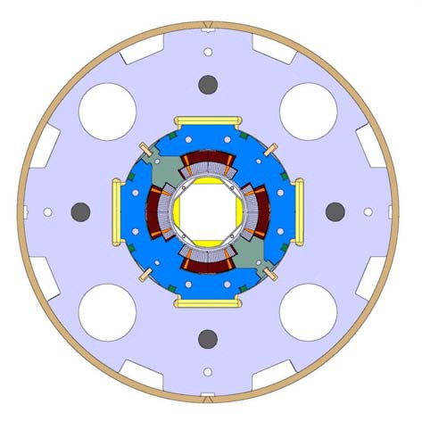
6. A REVIEW OF QUADRUPOLES LAY-OUTS
LHC MQXC
  Nb-Ti option for the LHC upgrade
  LHC dipole cable, graded coil
  2 short models built in 2011-3
  w/r~0.5 κ~0.33 2 layers, 4 blocks

Slide 67




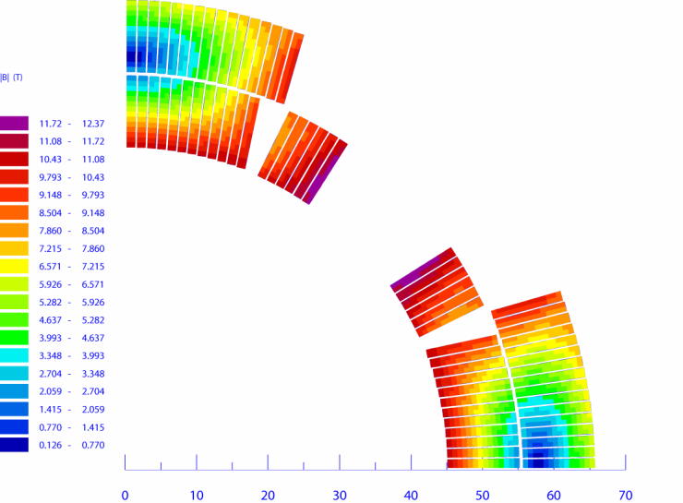
6. A REVIEW OF QUADRUPOLES LAY-OUTS
LARP TQ/LQ
  90 mm aperture Nb₃Sn option for the
  LHC upgrade (IR triplet)
  ~5 short model tested in 2005-2010
    Two structures: collars (TQC) and shell (TQS)
  3 3.4-m-long magnets tested in 2010-13
  w/r~0.5 κ~0.33 2 layers, 3 blocks

Slide 68
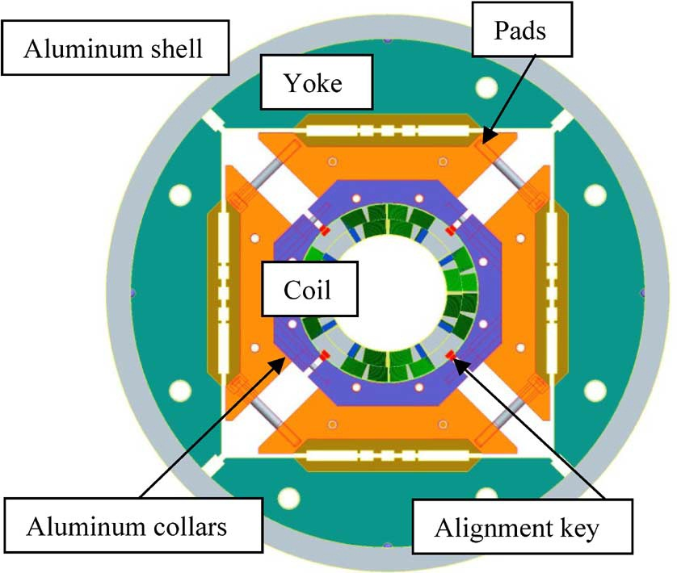
6. A REVIEW OF QUADRUPOLES LAY-OUTS
LARP HQ
  120 mm aperture Nb₃Sn option for the
  LHC upgrade (IR triplet)
  2 short model tested in 2011/2013
  w/r~0.5 κ~0.33 2 layers, 4 blocks

Slide 69
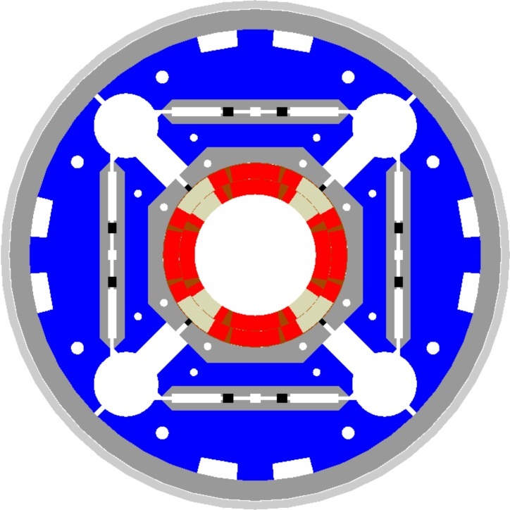
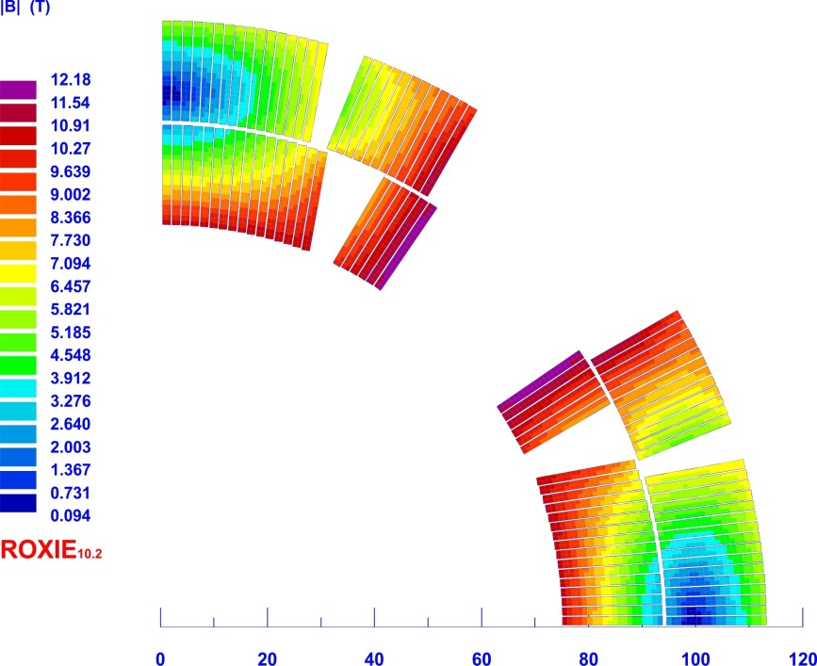
6. A REVIEW OF QUADRUPOLES LAY-OUTS
MQXF
  150 mm aperture Nb₃Sn option for the
  LHC upgrade (IR triplet)
  first short model tested in 2014
  w/r~0.5 κ~0.33 2 layers, 4 blocks

