Slide 1
CAS – Introduction to Accelerator Physics
Collective effects
Part I: Multiparticle systems

Slide 2
Context and outline
Collective effects in the physics of particle accelerators and beam dynamics is yet another very important topic, as it determines the ultimate performance of many machines. These effects become increasingly important as the beam intensities are pushed towards the limits.
In terms of the physics, they are challenging to deal with due to their self-consistent nature – instead of having to handle the particle dynamics within a fixed environment, the particle distribution actually affects and changes the environment, which in turn impacts the particle distribution and so on.
We will have a look at some important collective effects mostly phenomenologically, trying to give an intuitive picture and showing some real world examples. The main topics that we will discuss are:
Multiparticle dynamics
  Moving from single particles to multiparticle systems
Space charge effects
  Direct and indirect and space charge
Wake fields
  Longitudinal and transverse wake fields and impedances
Instabilities
  Coupled bunch and single bunch instabilities in the transverse and the longitudinal planes

Slide 3
We will briefly revise the single particle representation and dynamics and then move to multi-particle systems and their representation. We will discuss some features of multi-particle dynamics in absence of collective effects such as decoherence and filamentation.
Finally, we will look at direct space charge as a first real collective effects.
Part I: Multi-particle effects – direct space charge
  Multi-particle systems and their representation
  Incoherent and coherent motion
  Space charge
  Direct space charge – impact on machine performance

Slide 4
We will briefly revise the single particle representation and dynamics and then move to multi-particle systems and their representation. We will discuss some features of multi-particle dynamics in absence of collective effects such as decoherence and filamentation.
Finally, we will look at direct space charge as a first real collective effects.
Part I: Multi-particle effects – direct space charge
  Multi-particle systems and their representation
  Incoherent and coherent motion
  Space charge
  Direct space charge – impact on machine performance

Slide 5
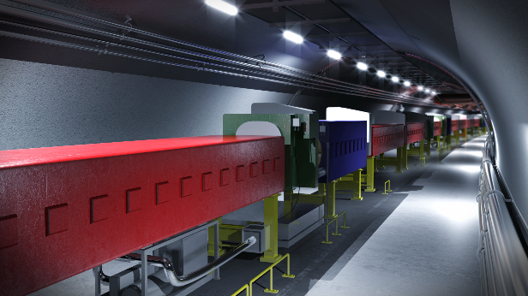
Single particle dynamics
We have already seen and learned about single particle dynamics…
We can say that single particle dynamics treats the interaction of individual particles with external force fields generated by machine elements:
  Slow magnets to generate guiding fields
  Fast magnets for injection and extraction
  RF cavities for bunching and shaping of
  longitudinal phase space
  …
Characteristics of single particle dynamics:
  External force fields
  Independent of any given phase space configuration of multi-particle ensembles!

Slide 6
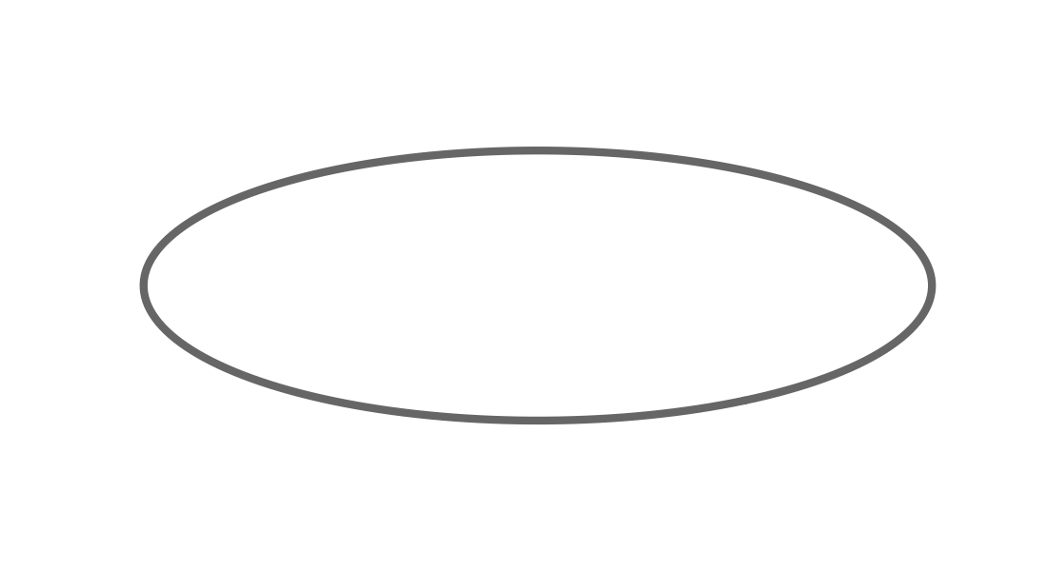





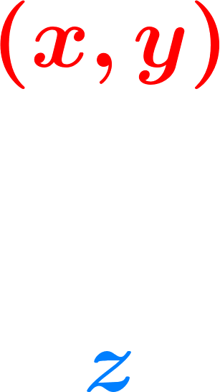

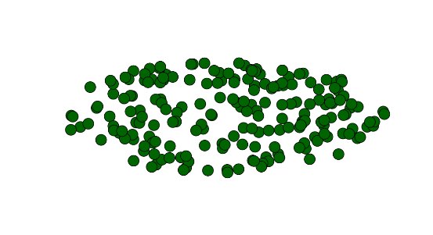
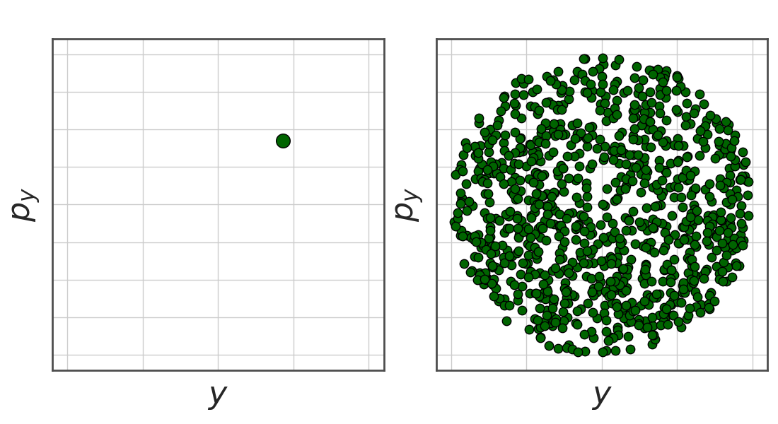

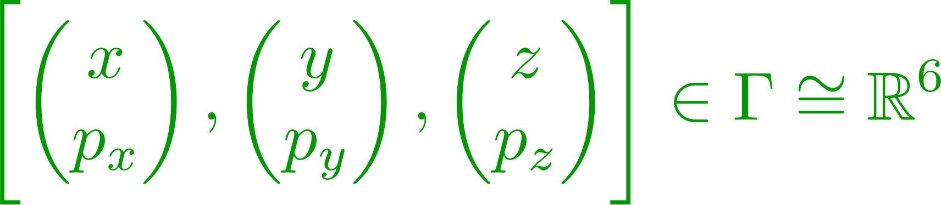
Single particle dynamics – reminder coordinates
Accelerator coordinates:
  Position along the accelerator
  Accelerator circumference
Bunch coordinates
  Position transverse with respect to orbit
  Position longitudinal with respect to reference
Phase space coordinates
  Representation of particles as unique state in phase space

Slide 7
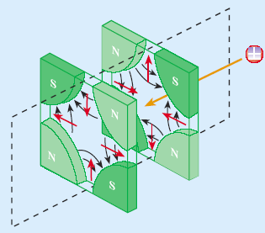
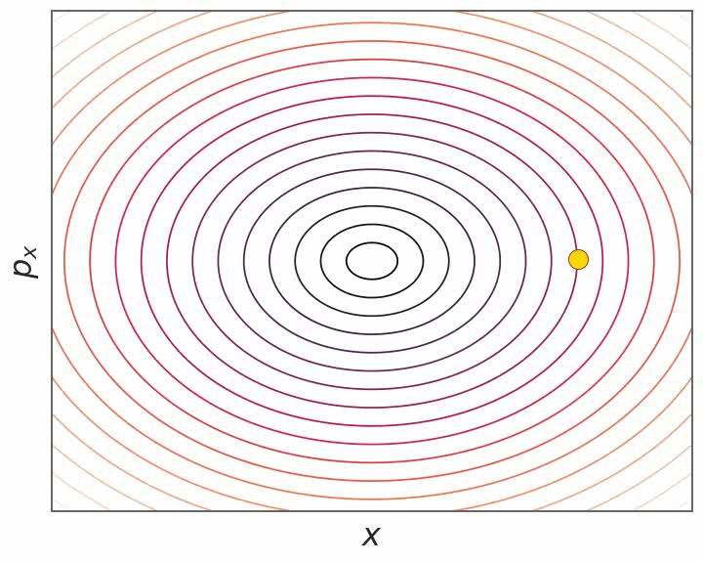
Single particle dynamics – transverse
Characteristics of single particle dynamics:
  External force fields
  Independent of any given multi-particle system phase space configuration!
Examples of single particle dynamics:
  Transverse focusing → Hill’s equation and betatron motion

Slide 8
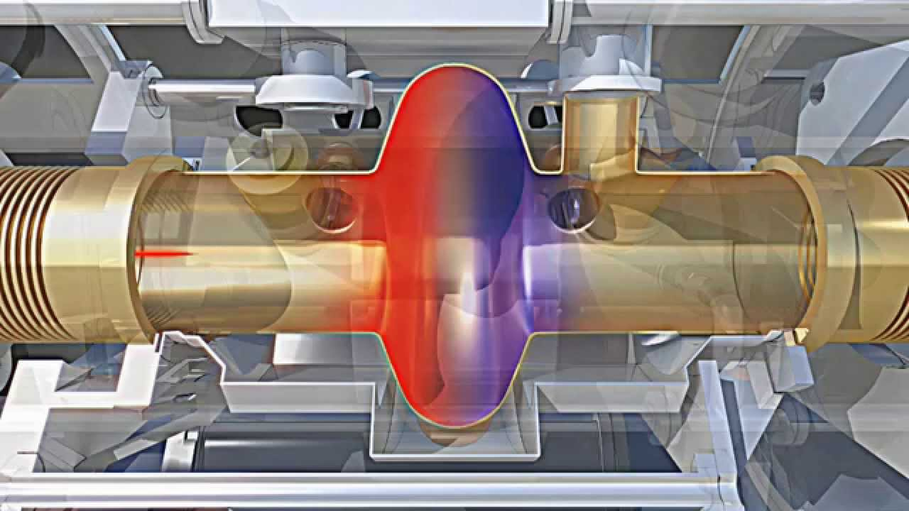
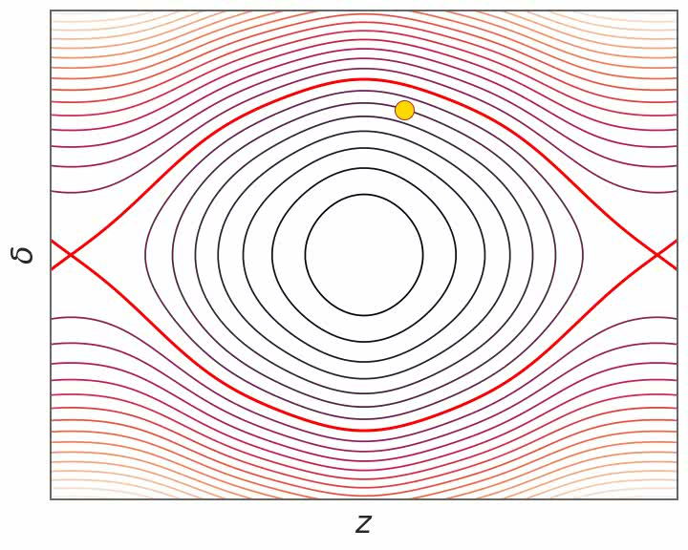
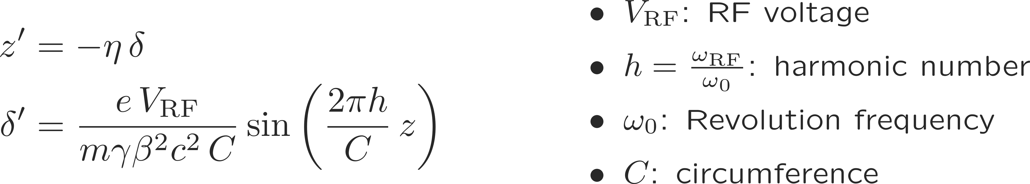
Single particle dynamics – longitudinal
Characteristics of single particle dynamics:
  External force fields
  Independent of any given multi-particle system phase space configuration!
Examples of single particle dynamics:
  Longitudinal focusing → Pendulum equation and synchrotron motion

Slide 9
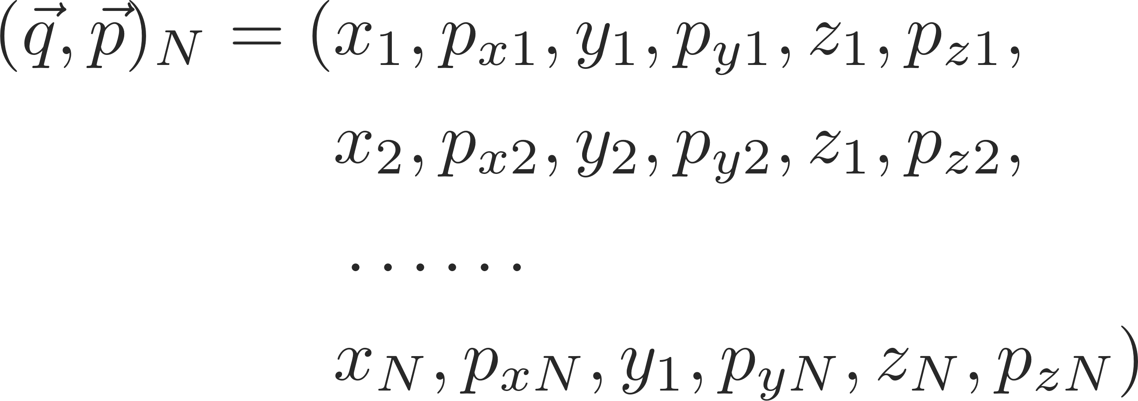

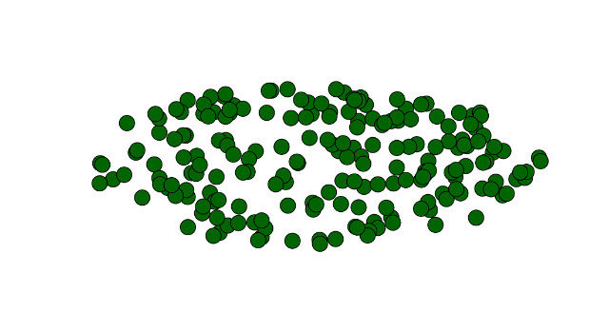
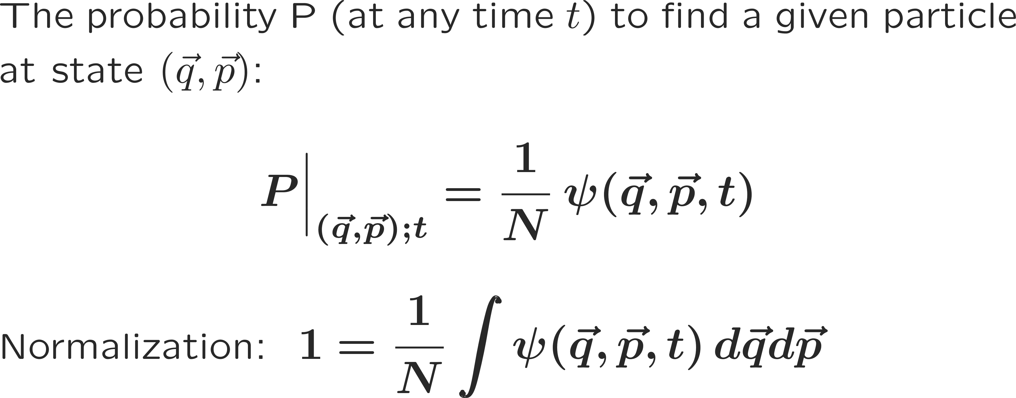
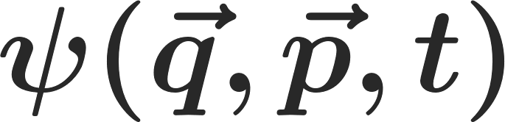
Multi-particle dynamics – state representation (theory)
Representation of a single particle state:
Representation of a multi-particle state:
The multi-particle state is conveniently represented by a probability density function Ψ – which neglecting correlations can be reduced (BBGKY) to the single particle distribution function

Slide 10
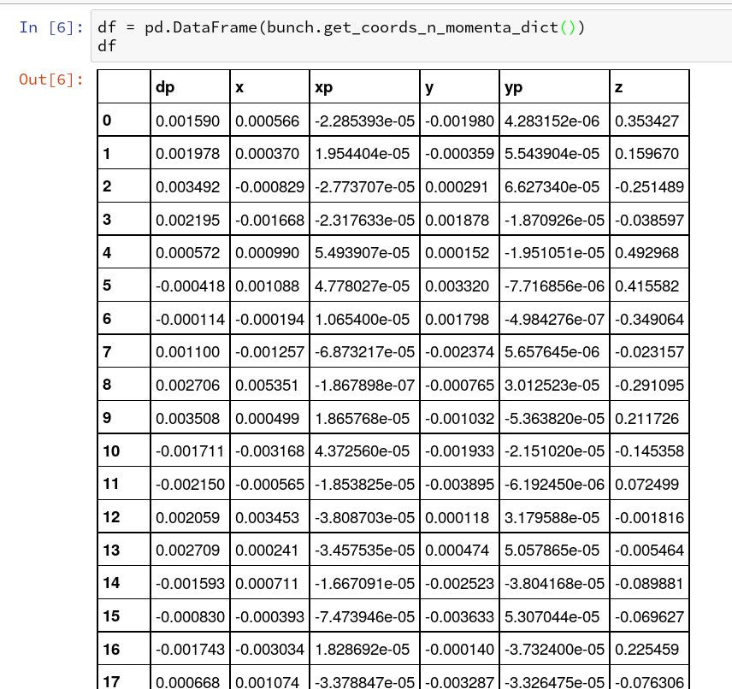
Multi-particle dynamics – state representation (numerics)
Representation of a single particle state:

Slide 11
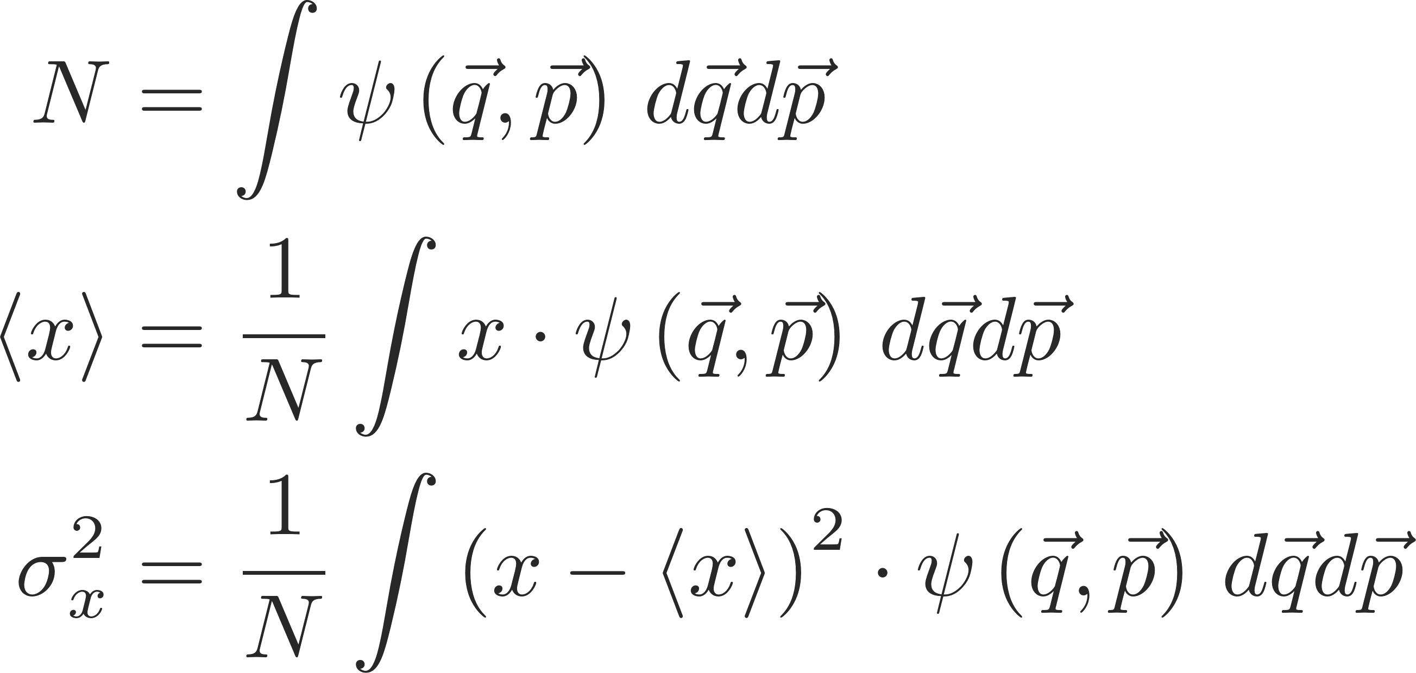
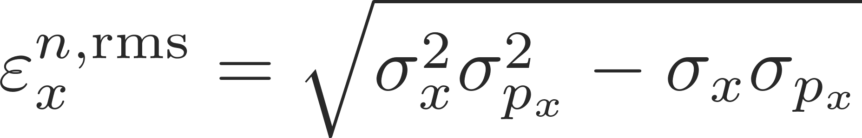
Multi-particle dynamics – state representation
Representation of a single particle state:
A multi-particle ensemble is characterized by its macroscopic statistical properties, i.e.:
One of the most important parameters to characterize the quality of a particle bunch is the (normalized) statistical emittance – it is a measure of the particle bunch size in phase space.

Slide 12
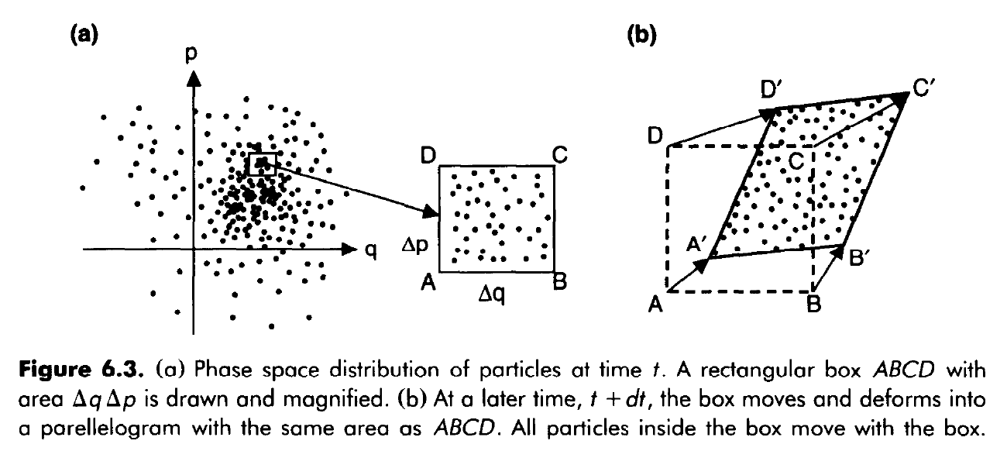
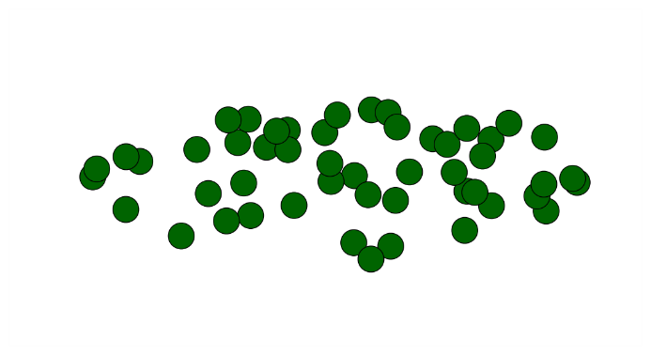
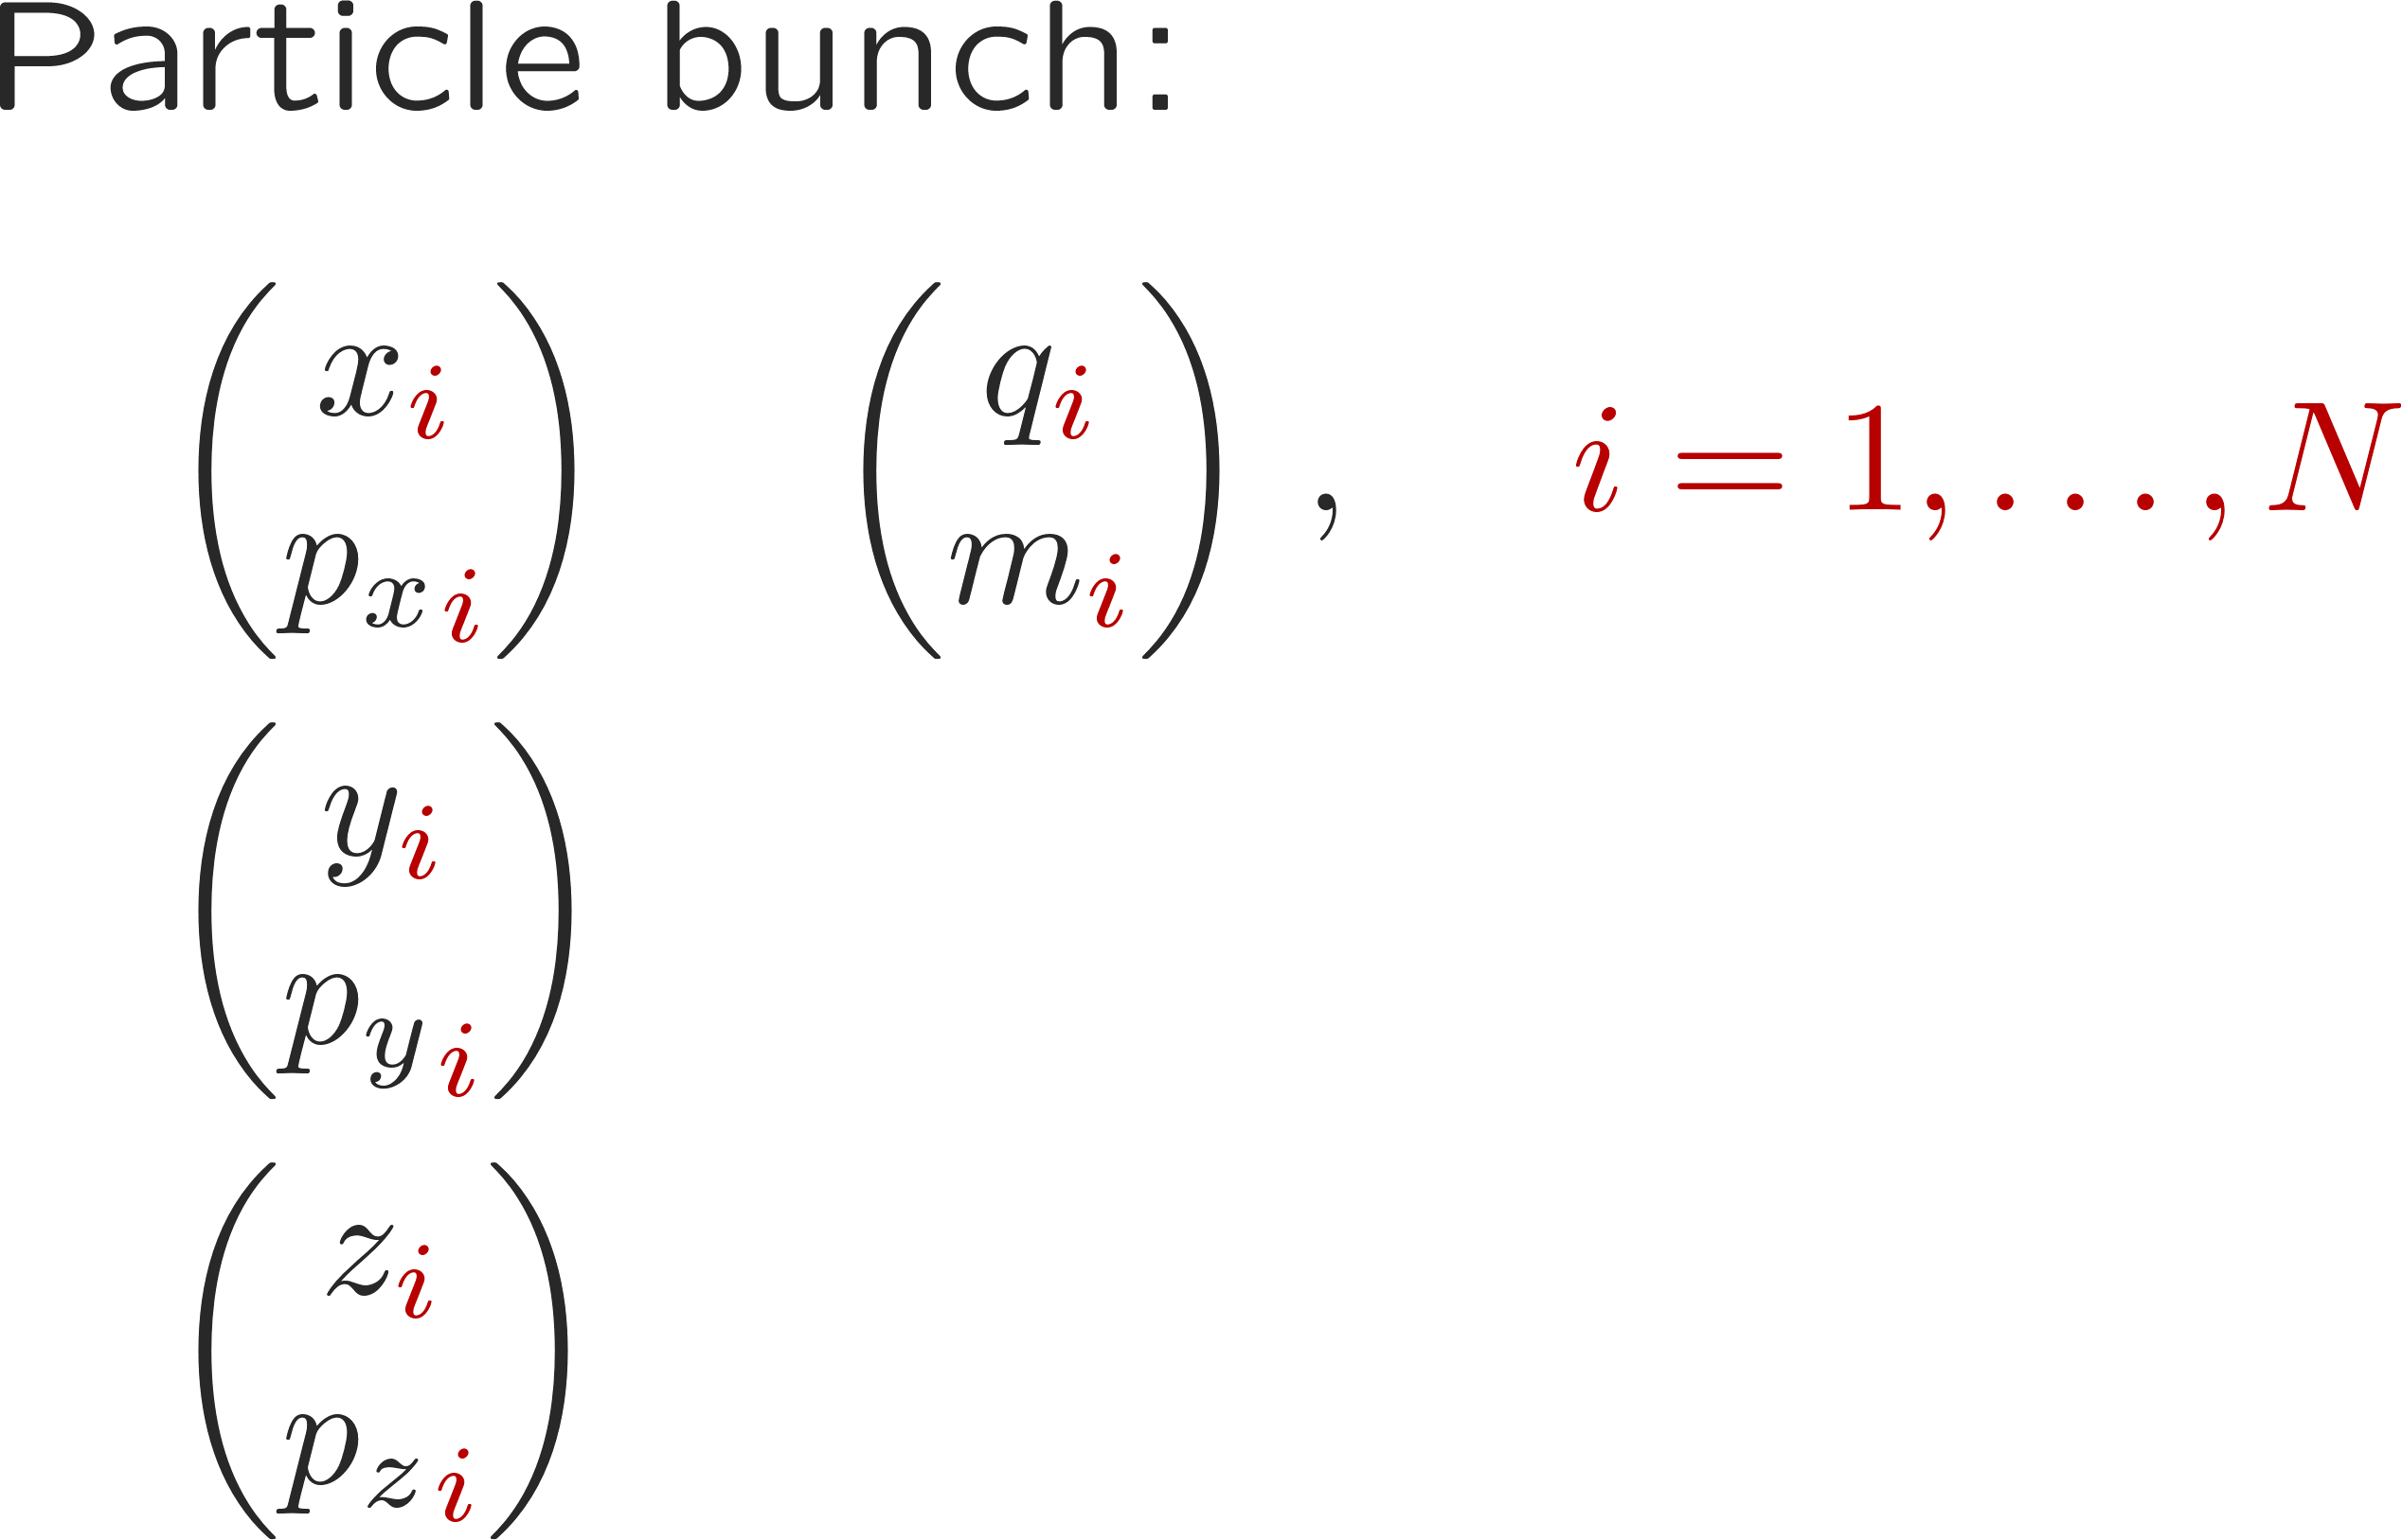
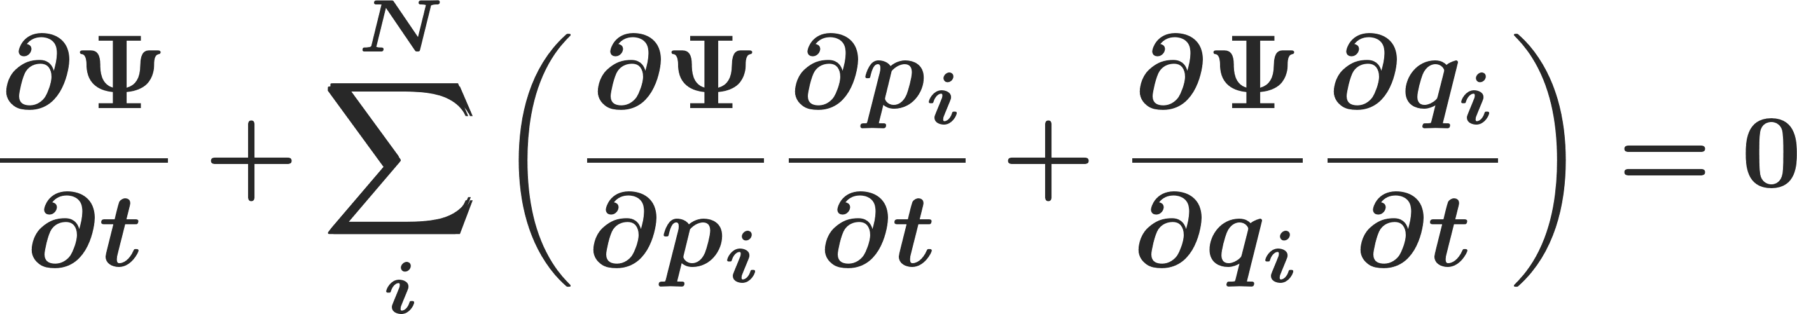
Remark: multi-particle dynamics – Liouville’s theorem
Interestingly enough, in an accelerator environment, the multi-particle system has a very restricted form of motion: the multi-particle system moves in phase space like an incompressible fluid
Liouville’s Theorem*:
i.e., the occupied phase space volume remains constant.
Representation of a multi-particle ensemble in phase space
Particlenumber
Phase space
coordinates
(*) Follows from just two physics assumptions:
Conservation of number of systems
Hamilton equations of motion

Slide 13
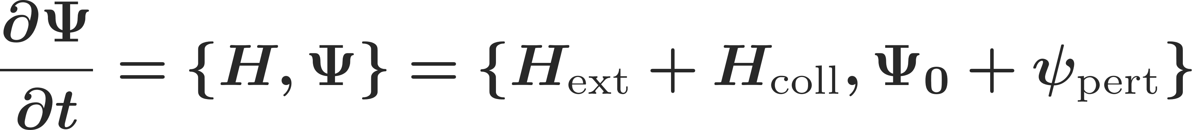
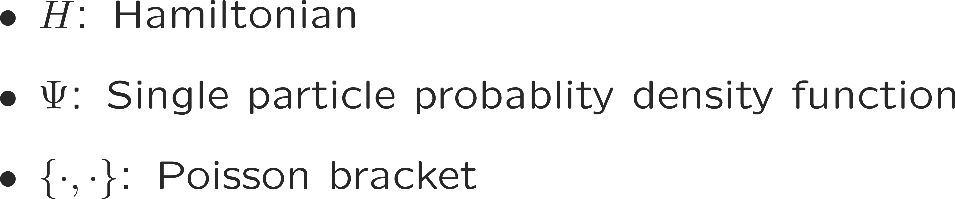
Remark: multi-particle dynamics – Liouville’s theorem
Interestingly enough, in an accelerator environment, the multi-particle system has a very restricted form of motion: the multi-particle system moves in phase space like an incompressible fluid
Liouville’s Theorem*:
i.e., the occupied phase space volume remains constant.
Representation of a multi-particle ensemble in phase space
From Liouville’s theorem, we can immediately write down the Vlasov equation which often forms the basis of any analytical computations of collective effects:
Particlenumber
Phase space
coordinates
(*) Follows from just two physics assumptions:
Conservation of number of systems
Hamilton equations of motion

Slide 14
We have very briefly reviewed single particle representation and dynamics in a particle accelerator. We have then introduced the concept of multi-particle systems and their representation in phase space.
Two very fundamental and important points are the definition of the statistical emittance as a measure of the particle bunch quality and Liouville’s theorem which describes the motion of a multi-particle system in phase space.
Let’s now discuss some peculiarities of multi-particle system dynamics – in particular, we will discuss incoherent and coherent motion. We will not yet be touching collective effects.
Part I: Multi-particle effects – direct space charge
  Multi-particle systems and their representation
  Incoherent and coherent motion
  Space charge
  Direct space charge – impact on machine performance

Slide 15
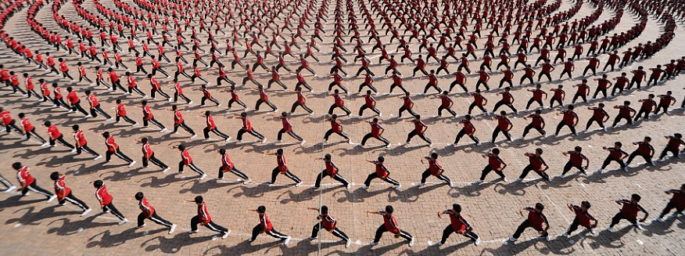
Incoherent vs. coherent motion
When considering multi-particle systems we need to differentiate between incoherent ("microscopic") and coherent ("macroscopic") motion
Coherent motion

Slide 16
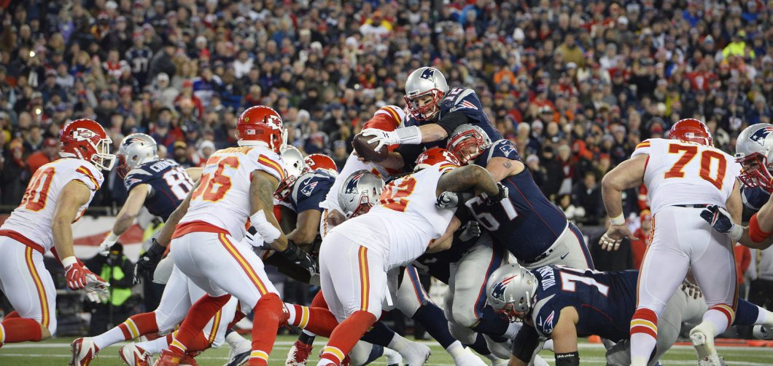
Incoherent vs. coherent motion
When considering multi-particle systems we need to differentiate between incoherent ("microscopic") and coherent ("macroscopic") motion
Incoherent motion
Coherent motion

Slide 17
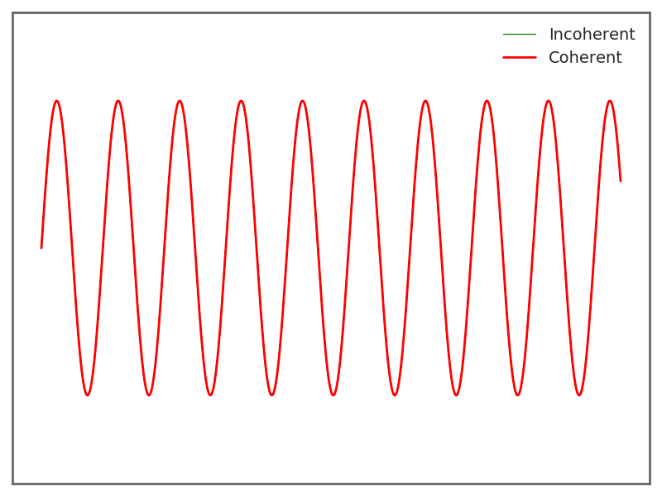
Incoherent vs. coherent motion – model
A single particle
→ incoherent is identical to coherent motion
Coherent – macroscopic quantities:

Slide 18
Incoherent vs. coherent motion – model
Five particles – in phase
→ incoherent is same as coherent motion
Coherent – macroscopic quantities:

Slide 19
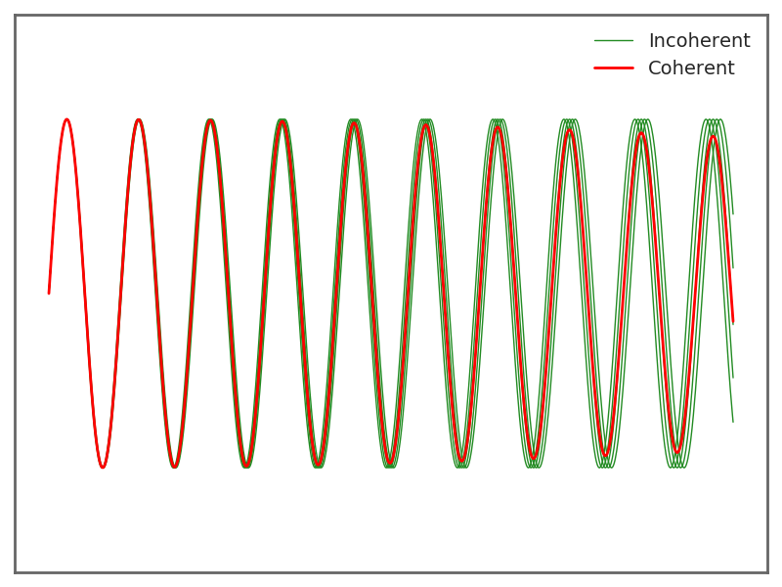
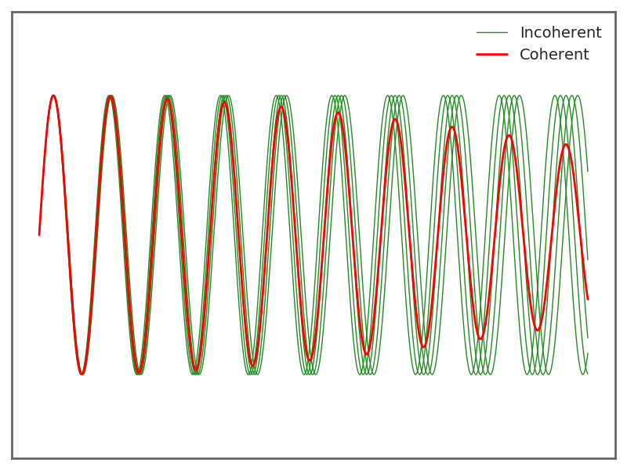
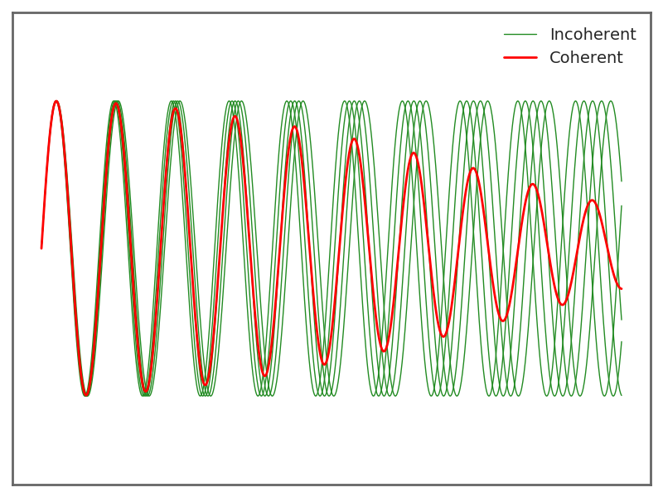
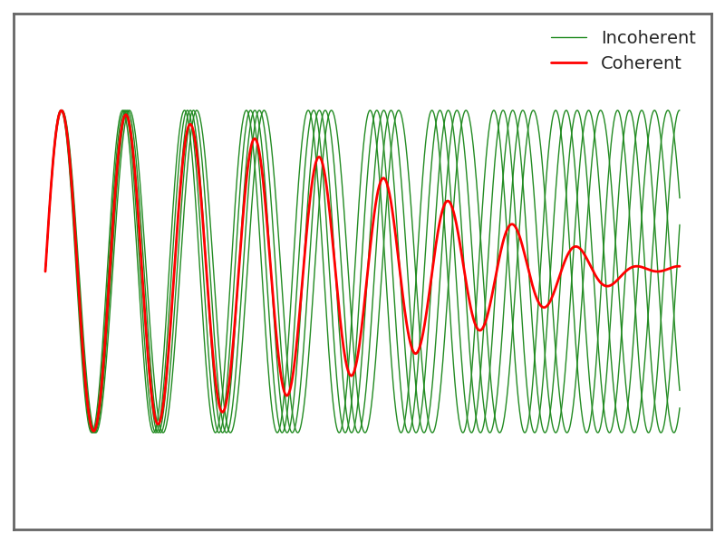
Incoherent vs. coherent motion – model
Five particles – in phase but detuned
→ decoherence of coherent motion
Coherent – macroscopic quantities:

Slide 20
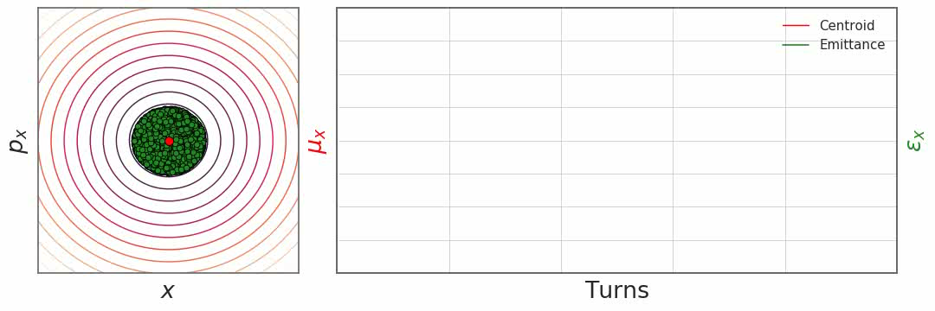
Incoherent vs. coherent motion – simulation
Let’s observe a system of five hundred particles:
  Although each and every individual particle performs more or less large oscillations around the orbit, a coherent motion is hardly visible – for a matched injection.

Slide 21
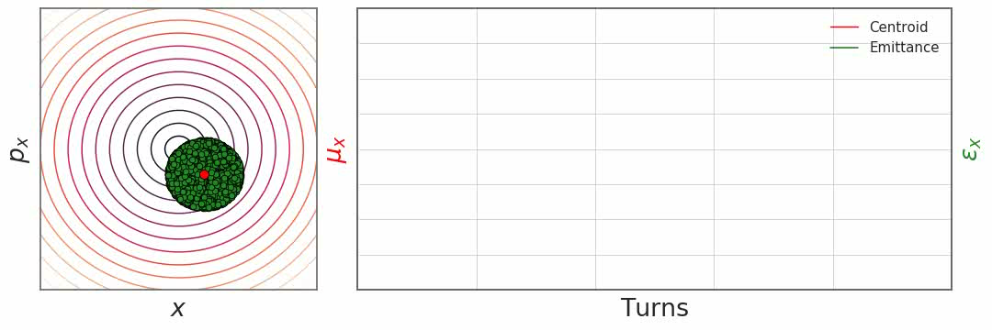
Incoherent vs. coherent motion – simulation
Let’s observe a system of five hundred particles:
  For an offset injection, all particles move around the orbit at a constant tune and, at the same time, a clear and strong coherent motion is observed.

Slide 22
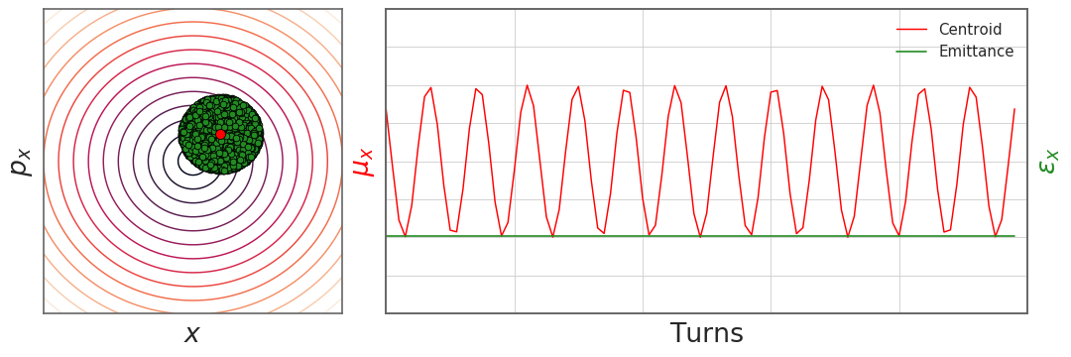
Incoherent vs. coherent motion – simulation
Let’s observe a system of five hundred particles:
  For an offset injection, all particles move around the orbit at a constant tune and, at the same time, a clear and strong coherent motion is observed.

Slide 23
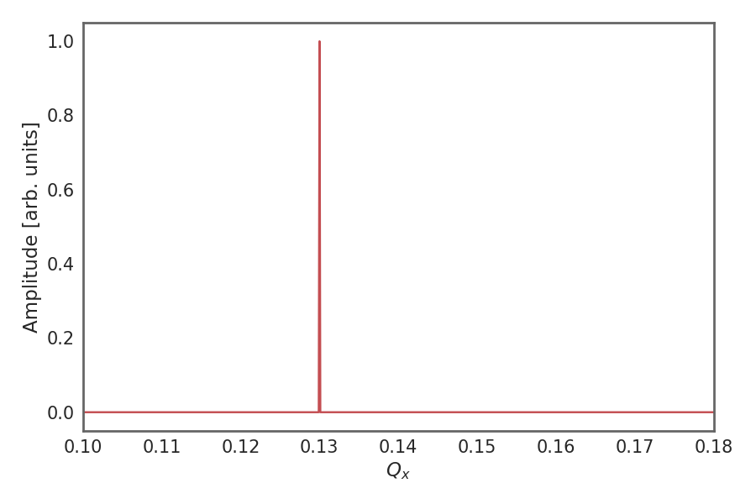
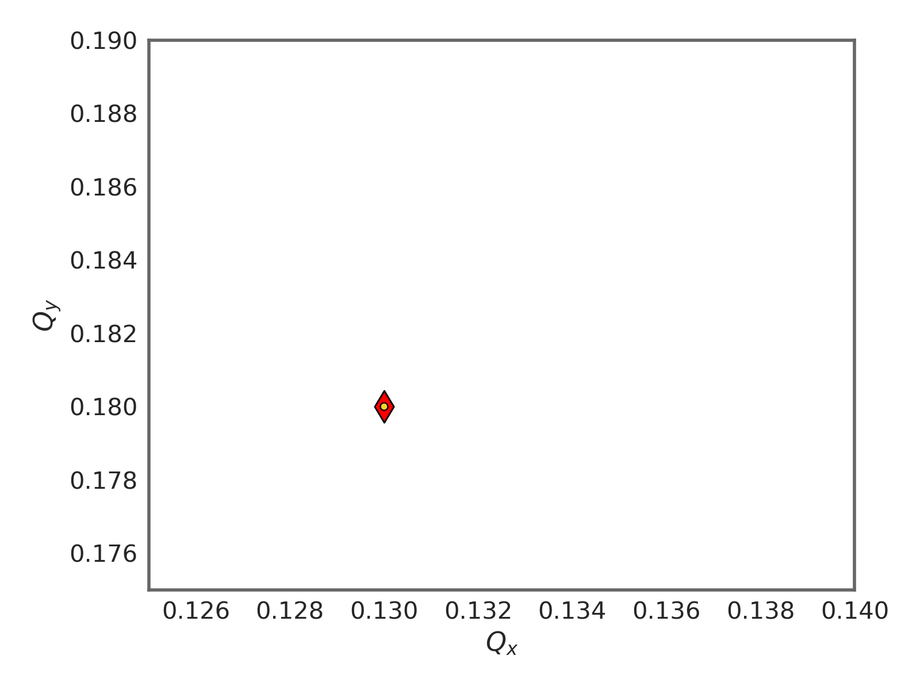
Incoherent vs. coherent motion – simulation
Let’s observe a system of five hundred particles:
  When offset, all particles move around the orbit at a constant tune and a clear and strong coherent motion is observed.
A frequency analysis of the coherent (red) line shows a clear single tune line
A frequency analysis of each particle shows that all particles are oscillating at the same tune – together with the coherent line.

Slide 24
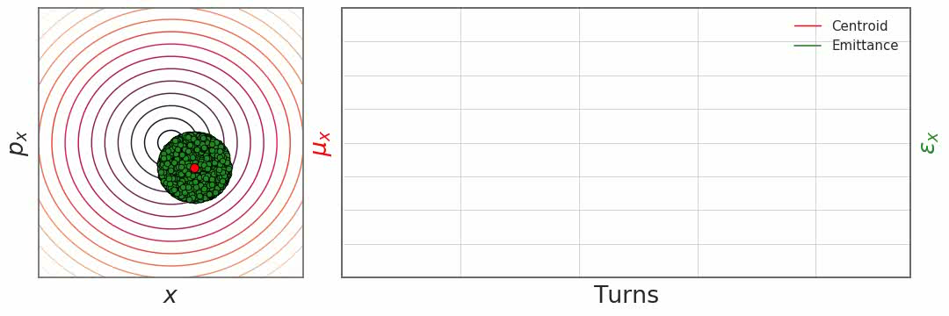
Incoherent vs. coherent motion – simulation
Let’s observe a system of five hundred particles:
  When offset and in the presence of non-linearities (detuning with amplitude), all particles move around the orbit at different tunes. As a consequence, we can observe filamentation of the bunch in phase space. The bunch decoheres and the emittance increases.

Slide 25
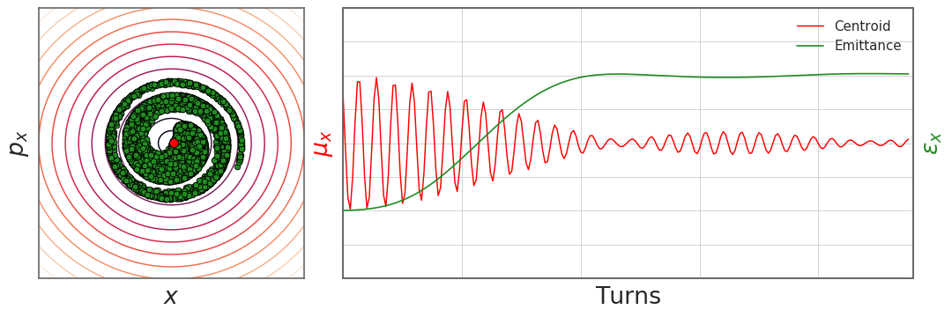
Incoherent vs. coherent motion – simulation
Let’s observe a system of five hundred particles:
  When offset and in the presence of non-linearities (detuning with amplitude), all particles move around the orbit at different tunes. As a consequence, we can observe filamentation of the bunch in phase space. The bunch decoheres and the emittance increases.

Slide 26
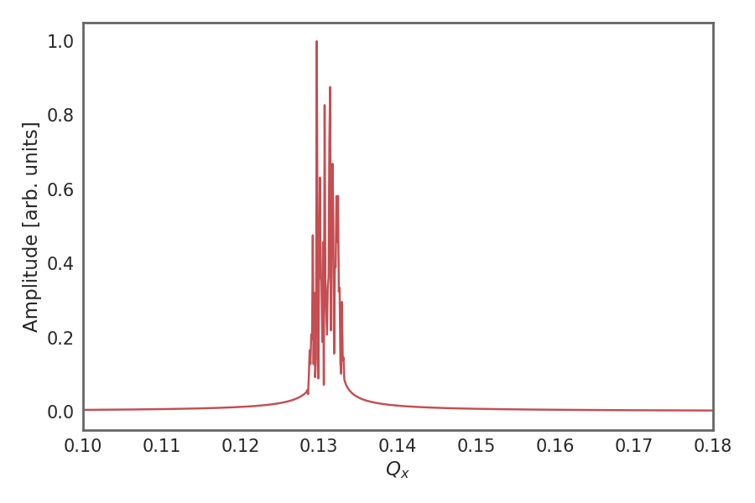
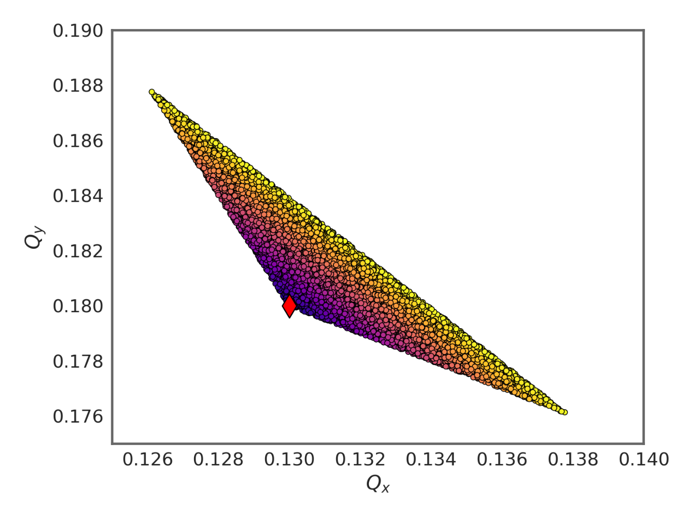
Incoherent vs. coherent motion – simulation
Let’s observe a system of five hundred particles:
  When offset and in the presence of non-linearities (detuning with amplitude), all particles move around the orbit at different tunes. As a consequence, we can observe filamentation of the bunch in phase space. The bunch decoheres and the emittance increases.
A frequency analysis of the coherent (red) line shows a strong spread of several tune lines
A frequency analysis of each particle shows that all particles are oscillating at different tunes – dispatching from the coherent tune and forming the tune footprint in tune space

Slide 27
Sources and impact of transverse nonlinearities
We have learned or we may know from operational experience that there are a set of crucial machine parameters to influence beam stability – among them chromaticity and amplitude detuning
Chromaticity
  Controlled with sextupoles – provides chromatic shift of bunch spectrum wrt. impedance
  Changes interaction of beam with impedance
  Damping or excitation of headtail modes
Amplitude detuning
  Controlled with octupoles – provides (incoherent) tune spread
  Leads to absorption of coherent power into the incoherent spectrum → instability mitigation
Of course, to study intensity effects, these need to be included in our model – fortunately, this is pretty simple!

Slide 28
We have seen the difference between incoherent and coherent motion. For single particles, these are identical. However, for multi-particle systems and their dynamics there are important differences.
In this context, we have seen effects such as decoherence, filamentation and emittance blow-up. We have learned about the concept of the tune footprint.
So far, we have never taken into account any interaction among the particles. We have therefore not yet seen any collective effects. We will now look at a first collective effects which is intuitively very natural to grasp: the direct space charge effect.
Part I: Multi-particle effects – direct space charge
  Multi-particle systems and their representation
  Incoherent and coherent motion
  Direct space charge
  Direct space charge – impact on machine performance

Slide 29
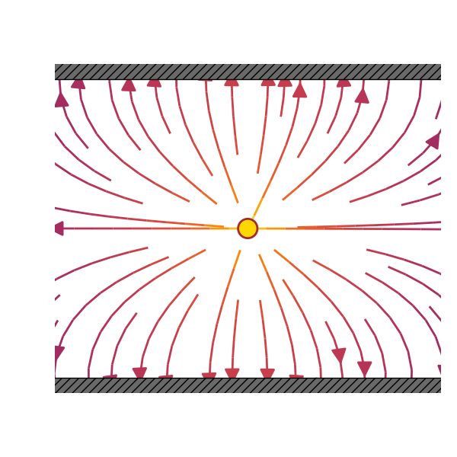
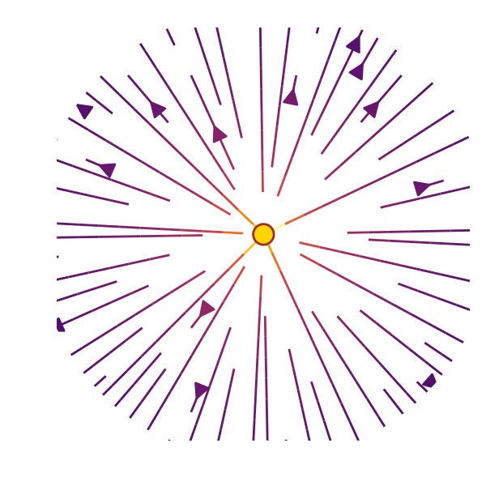
Single particle dynamics – reminder coordinates
A beam of charged particles induces electromagnetic fields when circulating inside the vacuum chamber.
These self induced fields depend on:
  beam current (intensity) and particle distribution (← collective forces!)
  geometry and material of the surrounding vacuum chamber and machine elements
When we talk about space charge we think about
Space charge effects:
cause tune shifts (transverse and longitudinal both incoherent (direct) and coherent (direct and indirect))
can result in longitudinal instability (negative mass instability)
Direct space charge:
Interaction of charged particles in free space
Indirect space charge:
Interaction with image charges and currents induced in perfect conducting walls and ferromagnetic materials close to the beam pipe

Slide 30
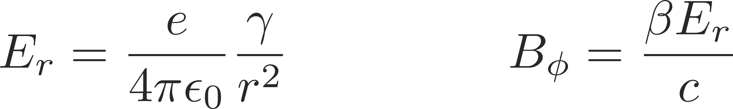
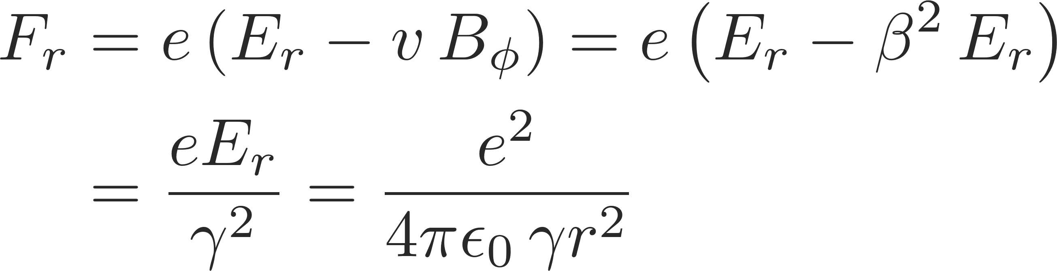
Two point charges with same velocity
Consider two point charges with the same charge q and with same velocity v₁=v₂=v on parallel trajectories
  In the rest frame, we know already the electric and magnetic fields generated by a “source” particle.
  The force on the “test” particle is given by the Lorentz force.
The attractive magnetic force tends to compensate the repulsive electric force
  At rest the two particles experience only the repulsive Coulomb force
  When travelling with velocity v the particles represent two parallel currents which attract each other by the induced magnetic field
  The forces become equal at the speed of light and thus cancel
Using the correct Lorentz transforms one can compute the fields in the lab frame generated by a source particle with velocity v
→ Lorentz force acting on the test particle

Slide 31
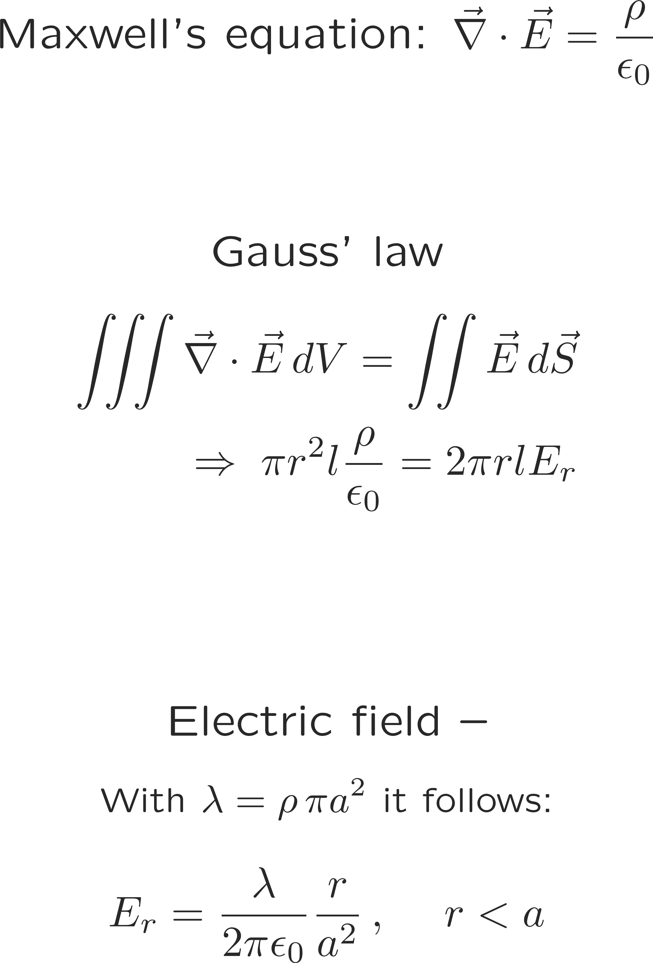
Example: coasting beam with uniform charge density

Slide 32
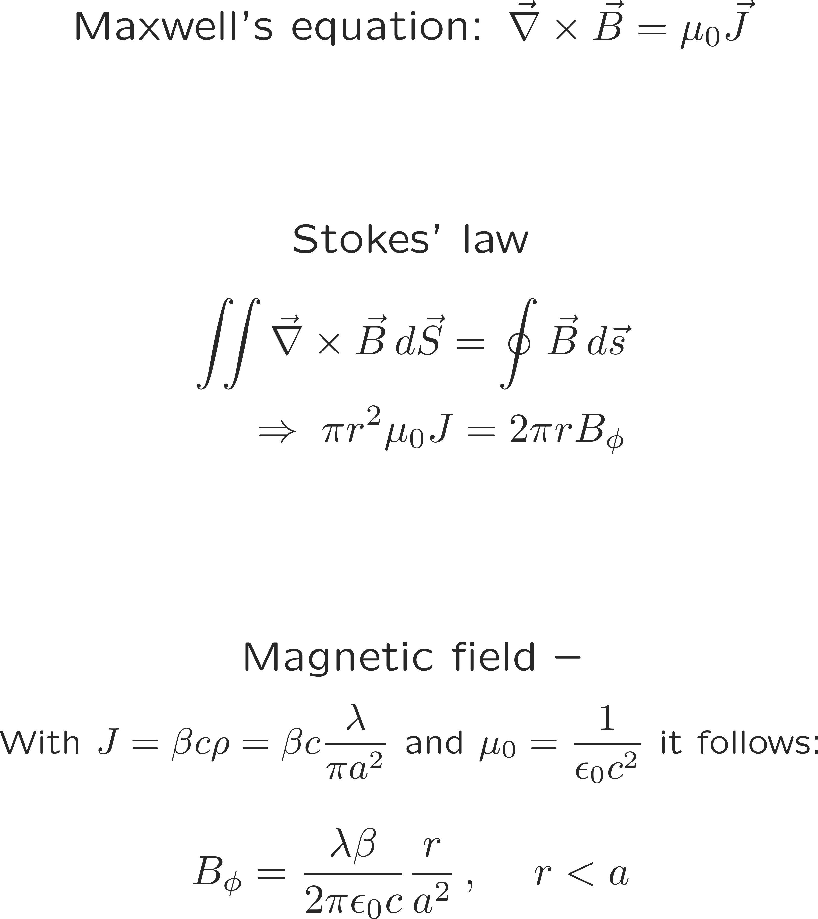
Example: coasting beam with uniform charge density

Slide 33
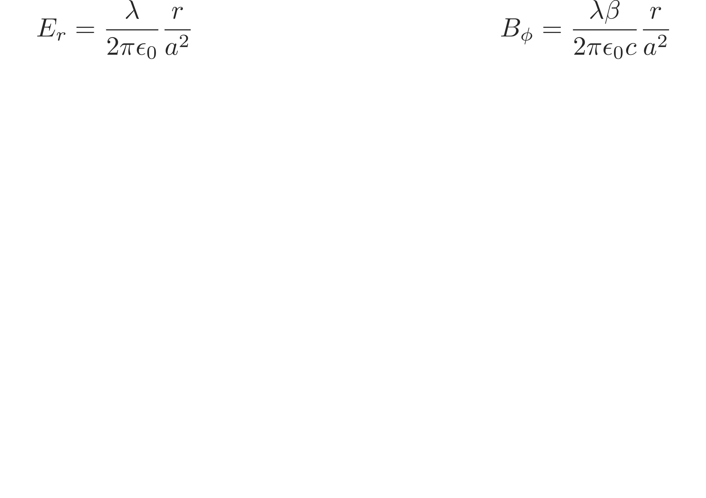
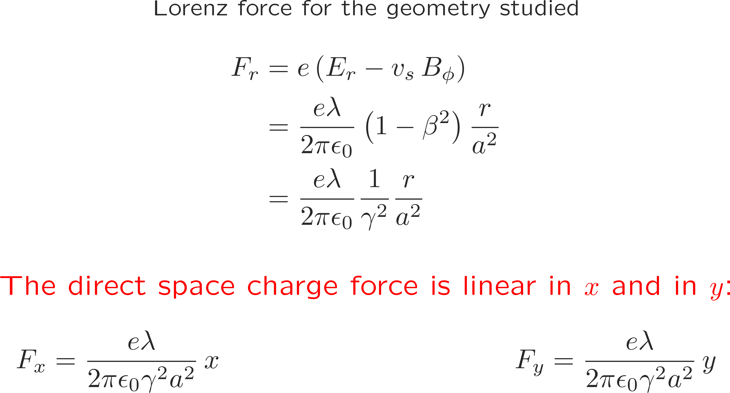
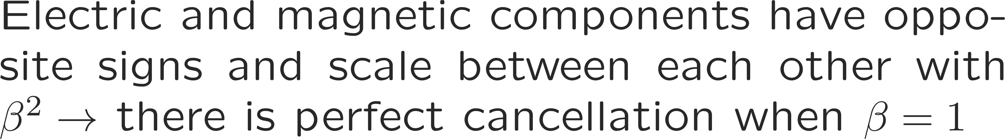
Example: coasting beam with uniform charge density

Slide 34
Example: coasting beam with uniform charge density
Direct space charge is like a defocusing quadrupole…
… however, direct space charge is always defocusing in both planes, while quadrupole is focusing in one and defocusing in the other plane

Slide 35
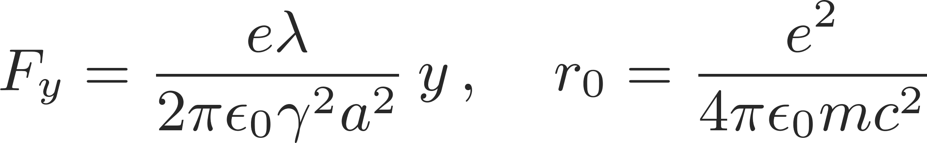

Direct space charge tune shift
Since the uniformly charged coasting beam acts like an additional quadrupole, it will contribute to the normal transverse focusing with an additional quadrupole focusing term:
  Hill’s equation
  Extra focusing term:
  Tune shift:
Linear force Classical particle radius
Tune shift of a particle subject to the direct space charge fields of a uniform charge distribution

Slide 36




Direct space charge tune shift
After some reshuffling we notice some of the fundamental properties of the direct space charge tune shift:
is negative, because space charge transversely always defocuses
is proportional to the line density and thus to the number of particles in the beam
decreases with energy like $1/(βγ^{2})$ (when expressed in terms of normalized emittance) and therefore vanishes in the ultra-relativistic limit
does not depend on the local beta functions or beam sizes but is inversely proportional to the normalized emittance (here the emittance includes all particles!)
The direct space charge force for a beam with uniform charge distribution is linear in x and y
→ results in a direct space charge tune shift
We derive the general expression for the space charge induced tune shift in the vertical plane
Linear force Classical particle radius
Generalized Hill’s equation

Slide 37
We have seen space charge as a first real collective effect. We learned that there is the direct and the indirect space charge effect. We looked at the case of a circular uniformly charged coasting beam to study an example of the direct space charge effect. We learned that the induced direct space charge fields induce tune shifts on witness particles.
Let’s see now what are the implications of such direct space charge tune shifts and why these are usually bad for the stable operation of an accelerator.
Part I: Multi-particle effects – direct space charge
  Multi-particle systems and their representation
  Incoherent and coherent motion
  Space charge
  Direct space charge – impact on machine performance

Slide 38
Coasting beam tune shifts
without space charge
with space charge
uniform distribution
with space charge
Gaussian distribution
+
+
particles in the tails
zero intensity working point
Q_{y}
Q_{y}
Q_{y}
tune shift
tune spread!
particles in the center
Q_{x}
Q_{x}
Q_{x}
All particles have the tunes Q_{x} and Q_{y} determined by the machine quadrupoles
All particles have the tunes Q_{x} and Q_{y} determined by the machine quadrupoles and the linear defocusing from space charge
Particles have a different tunes, since the space charge defocusing depends on the particles’ amplitude
The tune shift is largest for particles in the beam center

Slide 39
Coasting beam tune shifts
without space charge
with space charge
uniform distribution
with space charge
Gaussian distribution
+
+
Note: the maximum space charge tune shift in a Gaussian beam distribution is stronger compared to the detuning in a uniform beam distribution when considering similar beam sizes due to the higher particle density in the beam core!
particles in the tails
zero intensity working point
Q_{y}
Q_{y}
Q_{y}
tune shift
tune spread!
particles in the center
Q_{x}
Q_{x}
Q_{x}
All particles have the tunes Q_{x} and Q_{y} determined by the machine quadrupoles
All particles have the tunes Q_{x} and Q_{y} determined by the machine quadrupoles and the linear defocusing from space charge
Particles have a different tunes, since the space charge defocusing depends on the particles’ amplitude
The tune shift is largest for particles in the beam center

Slide 40
Coasting vs. bunched – Gaussian
In beams with Gaussian transverse distribution we observed already for coasting beams with constant line density a tune spread due to the nonlinear force and the resulting dependence on the transvers particle amplitude
In case a Gaussian beam is also bunched, an additional tune spread is induced by the variation of the line density
  The tune footprint is also called the space charge necktie due to its shape
Q_{y}
Particles close to the peak line density (often in the bunch center) will have the largest tune spread
Q_{x}

Slide 41
Coasting vs. bunched – Gaussian
In beams with Gaussian transverse distribution we observed already for coasting beams with constant line density a tune spread due to the nonlinear force and the resulting dependence on the transvers particle amplitude
In case a Gaussian beam is also bunched, an additional tune spread is induced by the variation of the line density
  The tune footprint is also called the space charge necktie due to its shape
Q_{y}
The tune spread is reduced for particles
further away from the peak line density
Q_{x}

Slide 42
Coasting vs. bunched – Gaussian
In beams with Gaussian transverse distribution we observed already for coasting beams with constant line density a tune spread due to the nonlinear force and the resulting dependence on the transvers particle amplitude
In case a Gaussian beam is also bunched, an additional tune spread is induced by the variation of the line density
  The tune footprint is also called the space charge necktie due to its shape
Q_{y}
The tune spread is reduced for particles
further away from the peak line density
Q_{x}

Slide 43
Coasting vs. bunched – Gaussian
In beams with Gaussian transverse distribution we observed already for coasting beams with constant line density a tune spread due to the nonlinear force and the resulting dependence on the transvers particle amplitude
In case a Gaussian beam is also bunched, an additional tune spread is induced by the variation of the line density
  The tune footprint is also called the space charge necktie due to its shape
Q_{y}
The tune spread is reduced for particles
further away from the peak line density
Q_{x}

Slide 44
Coasting vs. bunched – Gaussian
In beams with Gaussian transverse distribution we observed already for coasting beams with constant line density a tune spread due to the nonlinear force and the resulting dependence on the transvers particle amplitude
In case a Gaussian beam is also bunched, an additional tune spread is induced by the variation of the line density
  The tune footprint is also called the space charge necktie due to its shape
Q_{y}
The tune spread is reduced for particles
further away from the peak line density
Q_{x}

Slide 45
Coasting vs. bunched – Gaussian
In beams with Gaussian transverse distribution we observed already for coasting beams with constant line density a tune spread due to the nonlinear force and the resulting dependence on the transvers particle amplitude
In case a Gaussian beam is also bunched, an additional tune spread is induced by the variation of the line density
The longitudinal variation of the transverse space-charge force due to the line density fills the gap until the zero-intensity working point
The tune of individual particles is modulated by twice the synchrotron period
  The tune footprint is also called the space charge necktie due to its shape
Q_{y}
For bunched beams the tune spread
is as big as the maximum tune shift!
Q_{x}

Slide 46

Brightness limitation due to space charge
A space charge tune spread beyond 0.5 can barely be tolerated without excessive emittance blow-up and/or particle loss due to resonances
  Dipole errors in the machine excite the integer resonances (Q=n)
  Quadrupole errors excite the half integer resonances (Q=n+1/2)
  Higher order resonances can be excited due to sextupoles and multipole errors
Imagine that a beam with a tune spread of beyond 0.5 is injected

Slide 47
Brightness limitation due to space charge
A space charge tune spread beyond 0.5 can barely be tolerated without excessive emittance blow-up and/or particle loss due to resonances
  Dipole errors in the machine excite the integer resonances (Q=n)
  Quadrupole errors excite the half integer resonances (Q=n+1/2)
  Higher order resonances can be excited due to sextupoles and multipole errors
Imagine that a beam with a tune spread of beyond 0.5 is injected
Particles in the beam core will cross the integer resonance resulting in emittance blow-up and a reduction of the tune spread

Slide 48
Brightness limitation due to space charge
A space charge tune spread beyond 0.5 can barely be tolerated without excessive emittance blow-up and/or particle loss due to resonances
  Dipole errors in the machine excite the integer resonances (Q=n)
  Quadrupole errors excite the half integer resonances (Q=n+1/2)
  Higher order resonances can be excited due to sextupoles and multipole errors
Imagine that a beam with a tune spread of beyond 0.5 is injected
Particles in the beam core will cross the integer resonance resulting in emittance blow-up and a reduction of the tune spread
Particles in the beam tails can be pushed onto the half integer resonance resulting in losses due to aperture restrictions

Slide 49
In this lecture, we have learned about the dynamics and the representation of multiparticle systems. We have seen how we differentiate between incoherent and coherent motion. Linked to this, we looked at the phenomenon of filamentation with decoherence and emittance blow-up.
We also discussed a first collective effect – direct space charge. We saw that direct space charge leads to an incoherent tune shift and the characteristic tune footprint.
Next, we will now look into some of the mitigation methods for direct space charge and then discuss some of the effects of indirect space charge.
Part I: Multi-particle effects – direct space charge
  Multi-particle systems and their representation
  Incoherent and coherent motion
  Space charge
  Direct space charge – impact on machine performance

Slide 50

End part 1

Slide 52
Backup

