Slide 1
Case study 5
RF cavities: superconductivity and thin films, local defect…
Group A5
M. Martinello
A. Mierau
J. Tan
J. Perez Bermejo
M. Bednarek

Slide 2
Content
Thin Niobium film
Bulk Niobium
Modelling a step at grain boundary
Thermal and RF model

Slide 3
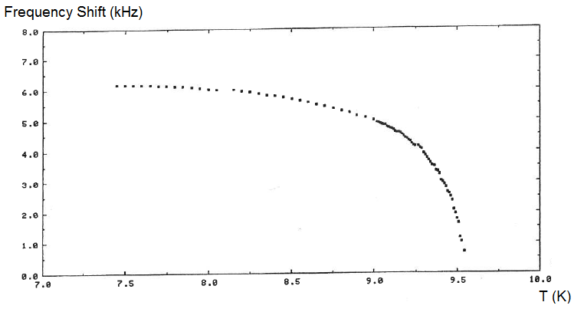
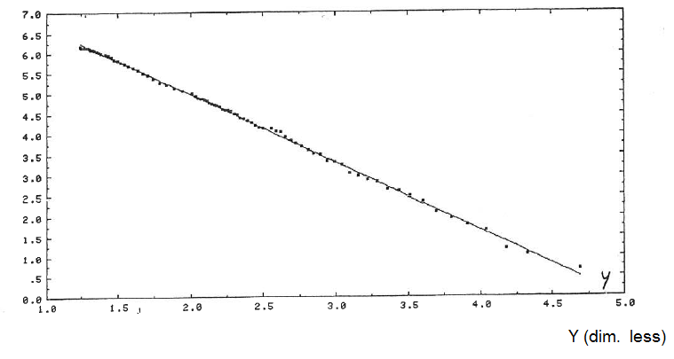
Thin Niobium Film [1]
F₀=1.3GHz
G=270
Frequency shift during cooldown. Linear representation is given in function of Y, where Y = (1-(T/T_{C})⁴)^{-1/2}
Δf=6 kHz
9.5K
From 9.5K and below, there is an increase of Cooper pairs density = the Nb film becomes superconducting
Evalutate the penetration depth using the Slater formula
Bulk Nb : λ_{L} = 36 nm
The difference might be explained by the large number of grains on thin Nb films = lower density of Cooper pairs n_{s} => larger London penetration depth.
In the classical two-fluid model we have

Slide 4
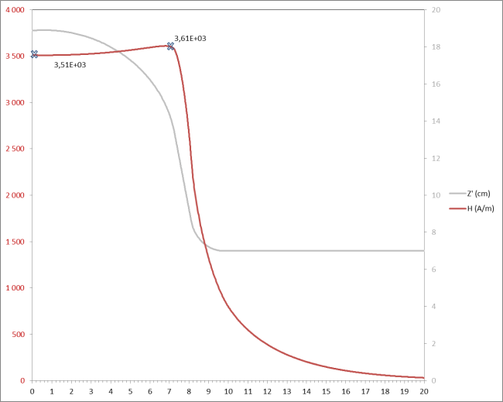
Thin Niobium film [2]
Hot spot
H=4000 A/m for E=1.2MV/m
R_{s_defect} = 2mΩ
V_{cavity} = 5.36 10⁻³ m³ (ellipsoid)
3E9
1.5E9
multipactor
L_{cav}/2=8cm
1.2MV/m
Degradation of Q₀ at 1.2MV/m due to a “hot spot” : the dissipated power increases, hence lower Q. The hysteresis might be due to a irreversible degradation of the local defect.
Multipactor may explain the larger slope later.
*
If the hot spot has been observed at 7.3cm, the surface of the defect would be the same (same H)
Another origin of the hot spot there could be multipacting.

Slide 5
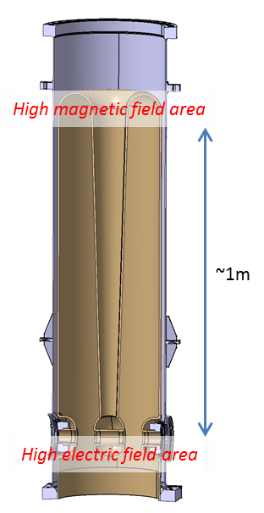
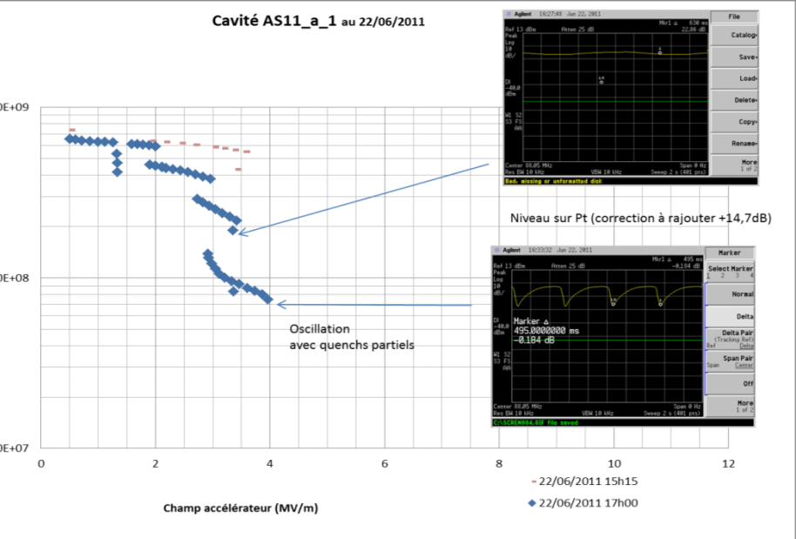
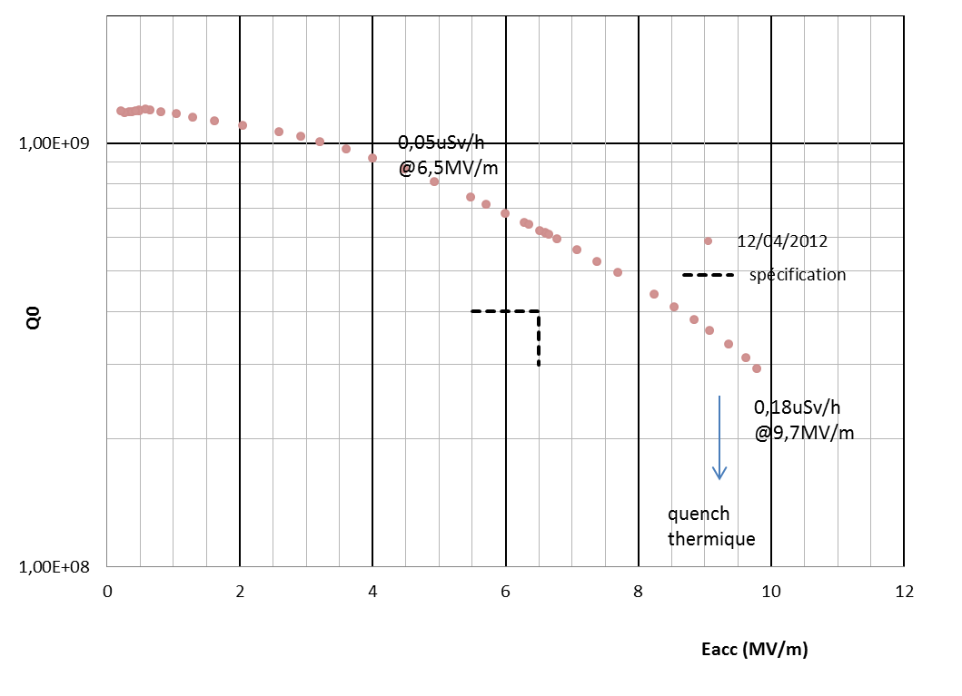
Dissipation in Bulk Niobium
After 40 µm etching
1E9
1E8
1e7
After 150 µm etching
2 4 6 8 10 MV/m
The first Q_switch is likely due to multipacting
At higher E field levels, electron emission might take place :
Some emitter sites are activated at E_{applied}=2MV/m :
with a local field enhancement coefficient of 500, electric field reaches E_{local} = 500 E_{applied} = 1GV/m
which is enough of getting significant (dark) current (exponential Fowler-Nordheim law)
The second etching (150μm removed) was efficient (smoother surface) for removing the surface defects

Slide 6
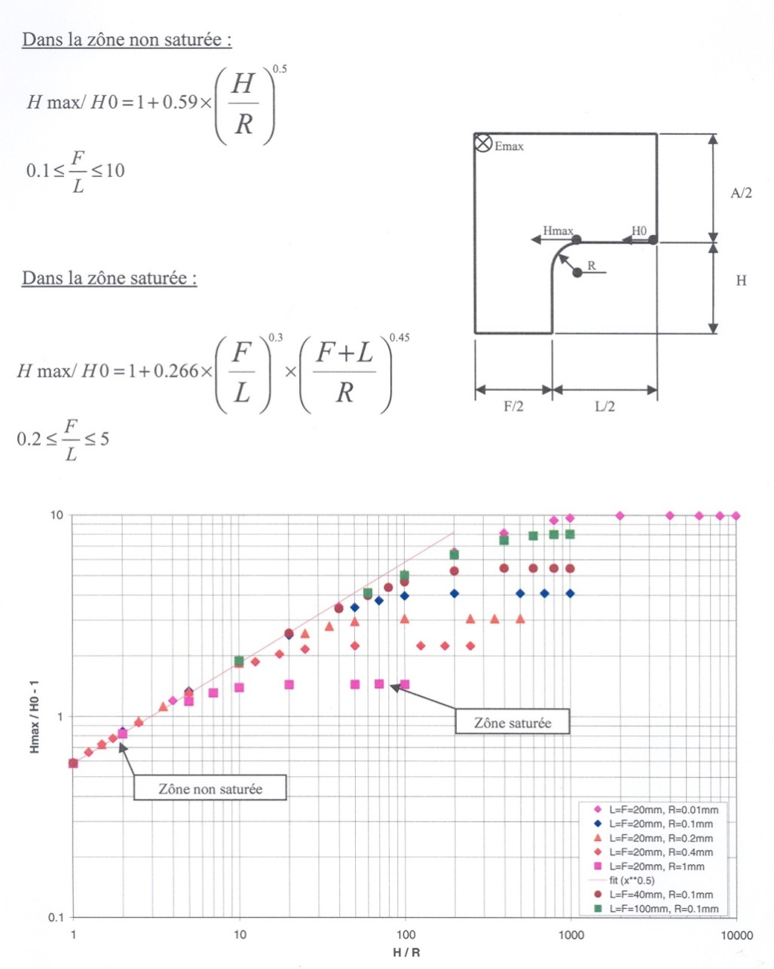
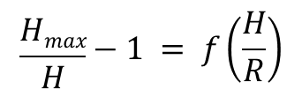
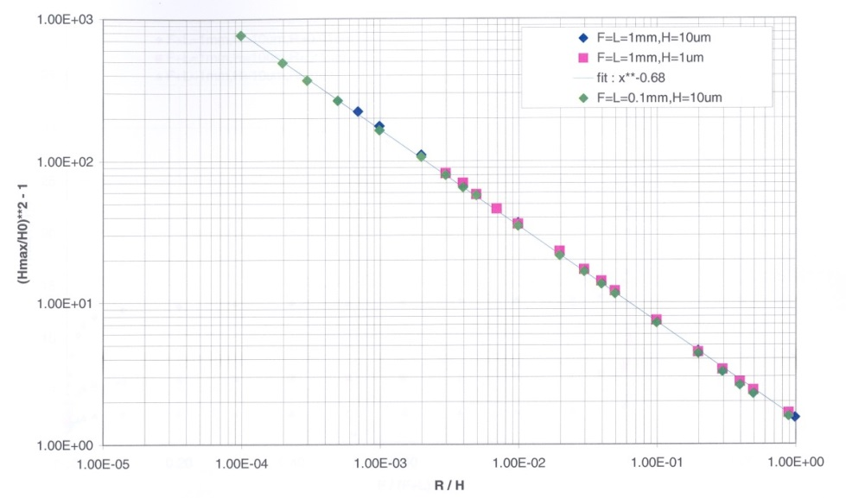
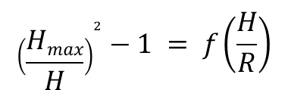
Modelling a step @ grain boundary
EM model
H_{max}
H₀
R
L
H
L
F
Saturated zone
H_{max}/H₀-1
From this model we deduce the followings:
The larger the radius R, the smaller the enhancement factor: i.e. Hmax is close to Hc => larger stored energy
Defects with large lateral dimension L quenches at lower applied field => lower stored energy
At high field level, the radius of the defect has the major contribution lower the radius R => larger Pd
In the case the defect is a hole instead a bump (F<< L) then H_{max} =H₀ => the defect has no influence on the cavity
Non saturated zone
H/R

Slide 7
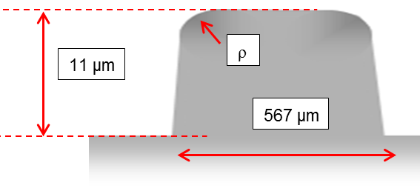
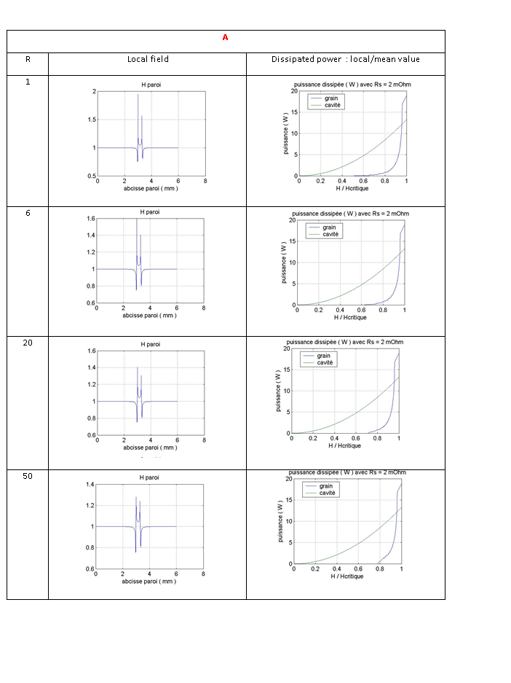
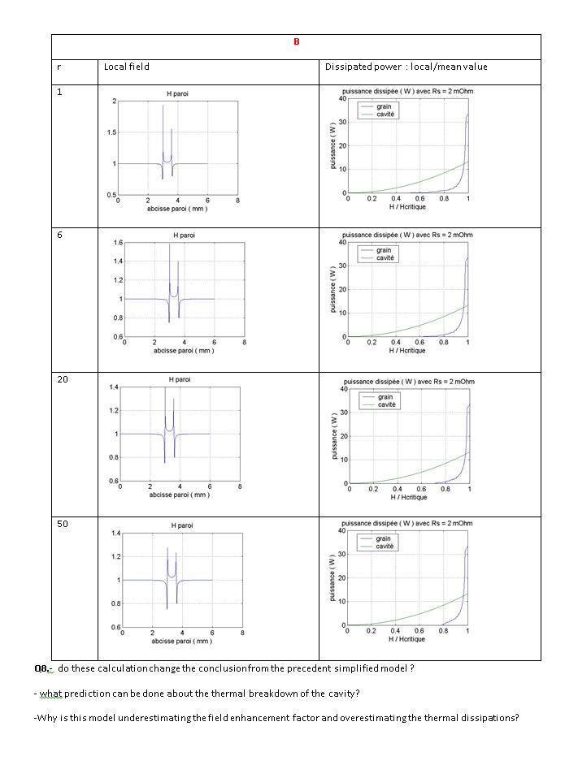
A
Modelling a step @ grain boundary
Realistic dimensions
B
RF only
284 μm
2
1
0.5
1.6
1
0.6
1.6
1
0.6
20
1.4
1
0.6
40
Pd[W]
Pd[W]
0 H/Hc 1
0 H/Hc 1

Slide 8
Modelling a step @ grain boundary
Realistic dimensions
A
B
284 μm
ρ=50μm
ρ=1μm
ρ=1μm
This model shows that larger grains produce more power dissipation, whatever ρ.
A smaller radius ρ leads to a higher field enhancement, as expected.
But small and large ρ give the same power dissipation ( in contradiction with the previous exercise)
BUT this is not in agreement with real life, where it has been shown that
larger grains seems to be less susceptible to FE.
Higher thermal conductivity at low temperatures
Higher purity ( RRR=600 )
The dissipated power does not increase dramatically with sharper edges => underestimation of the field enhancement factor
Larger grain size should lead to a better thermal dissipation through the bulk => this model shows the opposite and overestimates the maximum dissipated power.

Slide 9
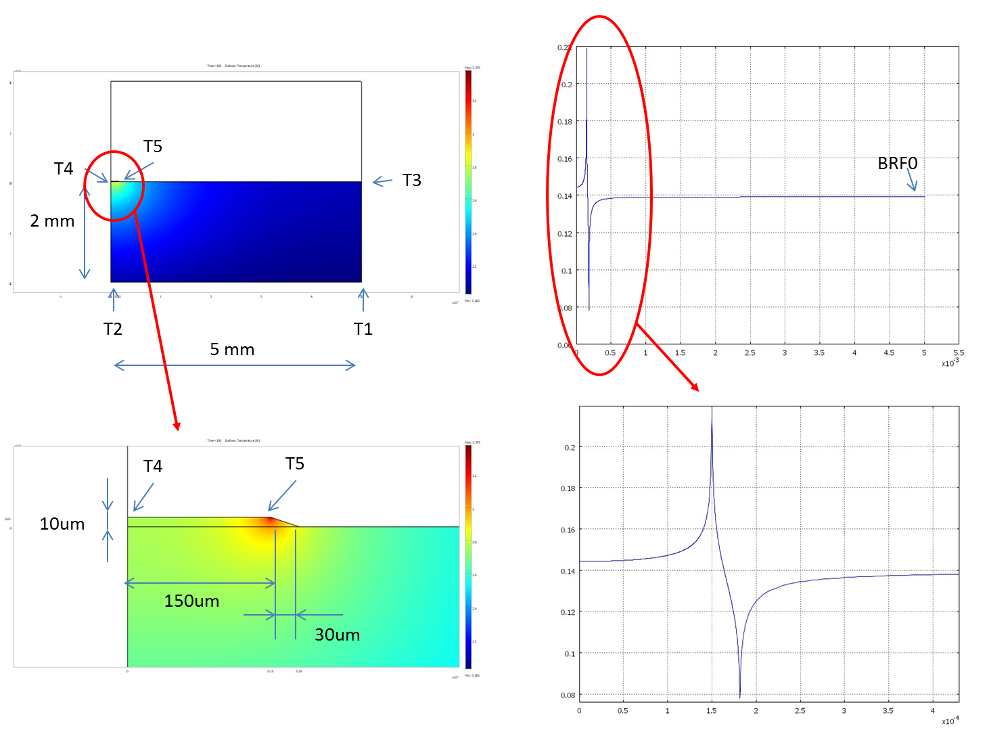
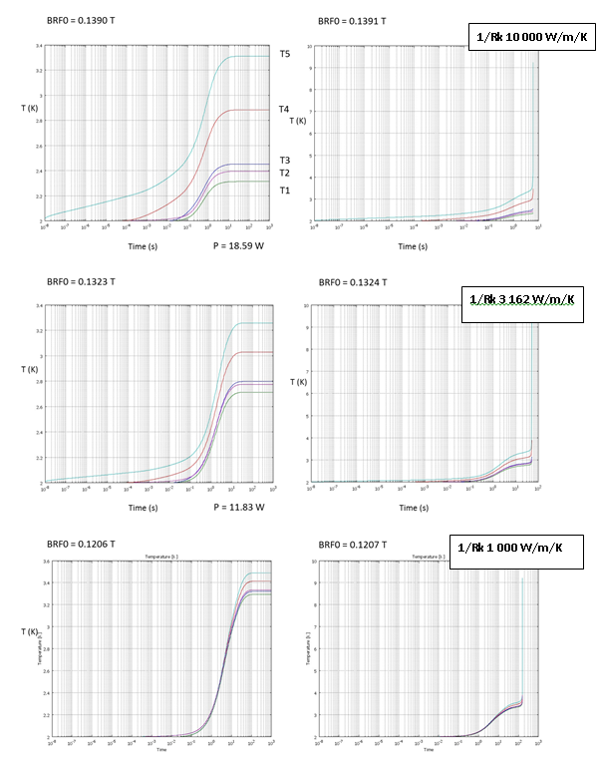
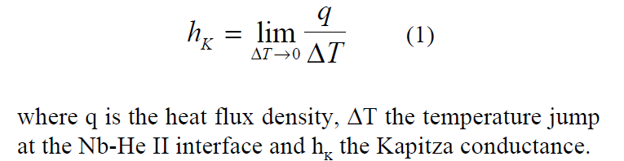
Thermal + RF model
3.4
3
2
B₀ = 0.1390 T B₀ = 0.1391 T
B₀
T
3.4
3
2
B₀ = 0.1323 T B₀ = 0.1324 T
T
Increasing Kapiza conductance
3.6
3
2
B₀ = 0.1206 T B₀ = 0.1207 T
T

Slide 10
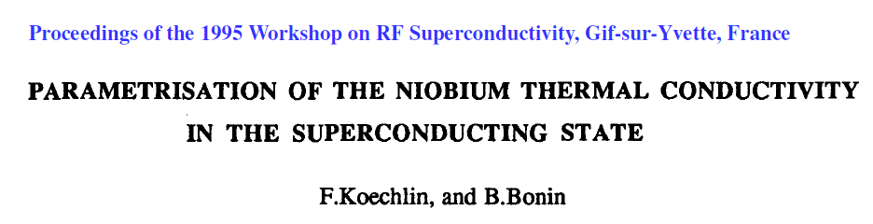
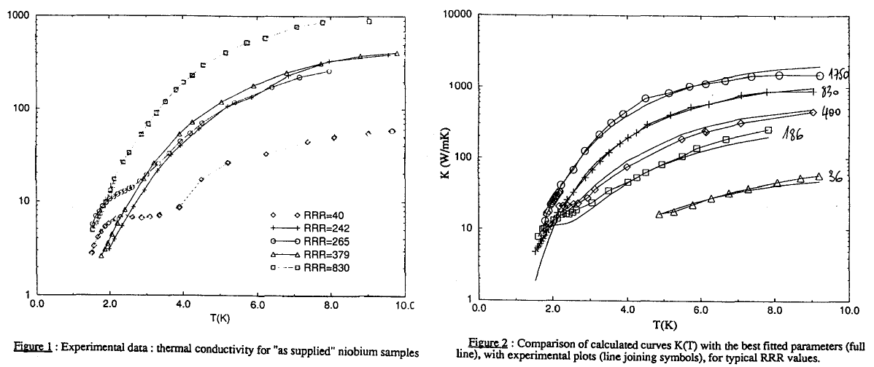
Thermal + RF model
This model shows that the heat exchange at the cavity/He interface is better with higher Kapiza conductance:
the hot spot in the cavity is more localized
the temperature spread is larger
the quench occurs at higher B field
If κ is temperature dependent, i.e κ increases with T:
T5 ‘ < T5 (better thermal conduction with the bulk)
T1’ > T1 (poorer thermal conduction with the bulk)
the temperature spread is smaller.
RRR increases with increasing Nb purity, and hence the thermal conductivity
We can apply higher B field before quenching

