Slide 1
Status of the Upgrade to the CLS Injection Linac
Installing the ScandiNova Solid State Modulators
Grant Bilbrough – Canadian Light Source

Slide 2
Background
Work Done
The ScandiNova Modulator
Work That Remains
Future Shutdowns

Slide 3
Background
The Canadian Light Source (CLS) is a third generation synchrotron that received initial funding in 1999. First beam was stored in 2004.

Slide 4
Background
At the time funding was received there existed a facility that was the precursor to the CLS called The Saskatchewan Accelerator Lab (SAL)
SAL had been in existence since the 1960’s.

Slide 5
Background
The CLS was to use as much of the SAL infrastructure as possible to help with its start up.
This included retrofitting the linac to become the electron source for the CLS

Slide 6
Background
In 1999/2000 the linac modulators were retrofitted to run at 1Hz from the original 180 Hz (or 360 Hz) system
Except where modifications were required most of the equipment was retained
Gun is from 1980
Linac has sections from the 60’s and 80’s
Klystrons are XK5’s originally designed for/by SLAC in the 60’s

Slide 7
Work Done
Modulator room gutted with 3 cabinets that held 6 modulators removed
Klystrons removed but will be reused
RF Source removed but will be reused
Phase shifters removed but will be reused

Slide 8
Modulator Room
The Modulator room just as tear out starts

Slide 9
Clean Out

Slide 10
Clean Out

Slide 11
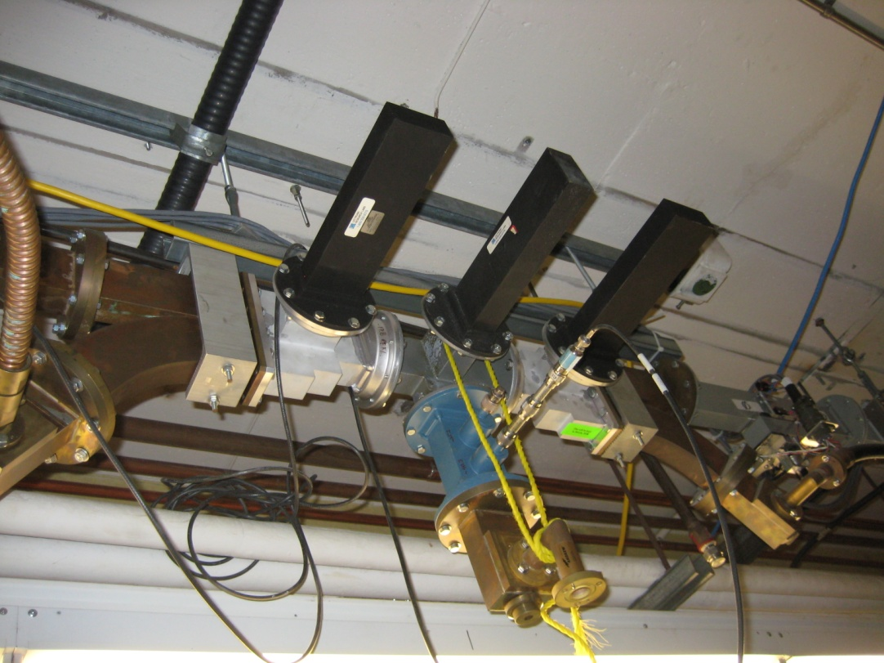
Waveguides and Phase Shifters

Slide 12
Power Supplies
Blue-thyratron driver controls
2 knobs with gauges-thyratron filament and reservoir controls
Blue on top-core bias PS
2 bigger knobs-klystron filament control

Slide 13
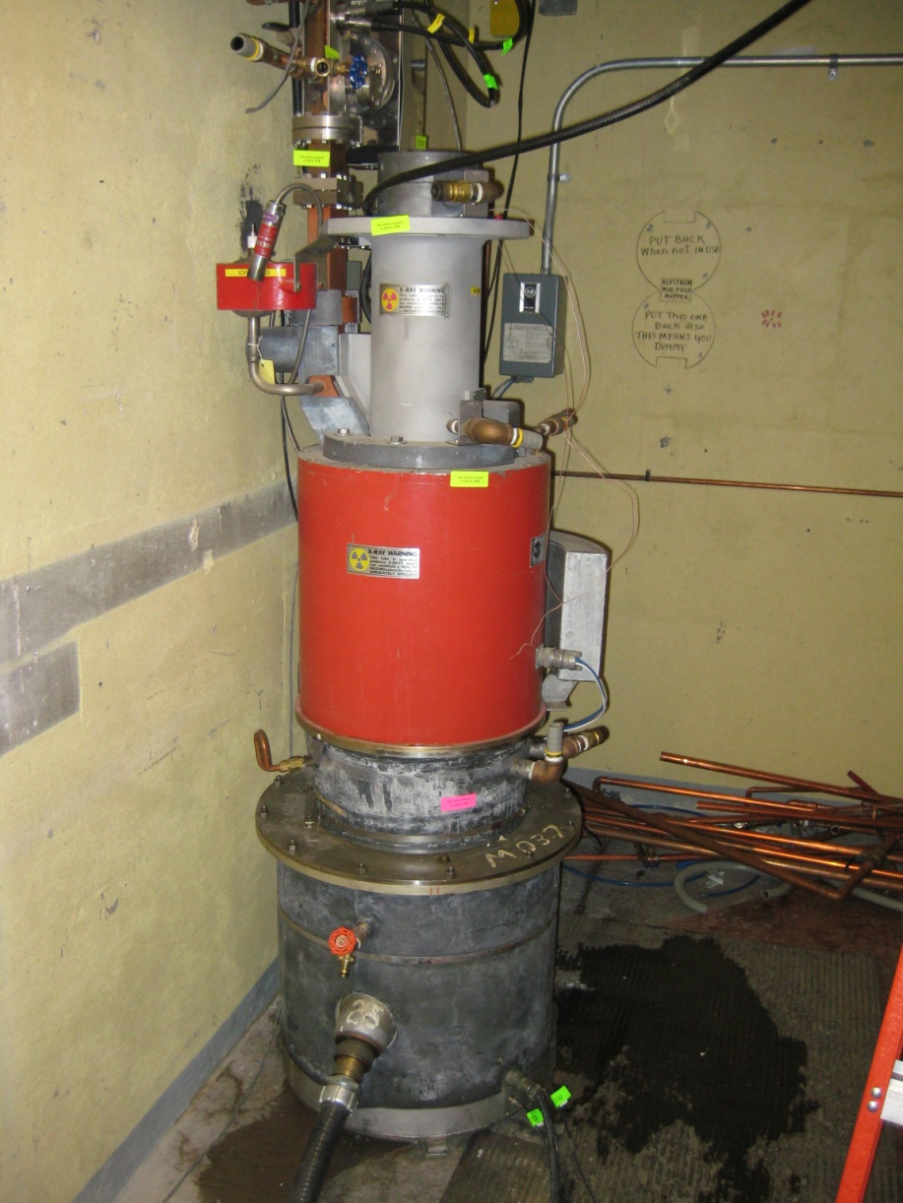
Klystrons (2 of 6)

Slide 14
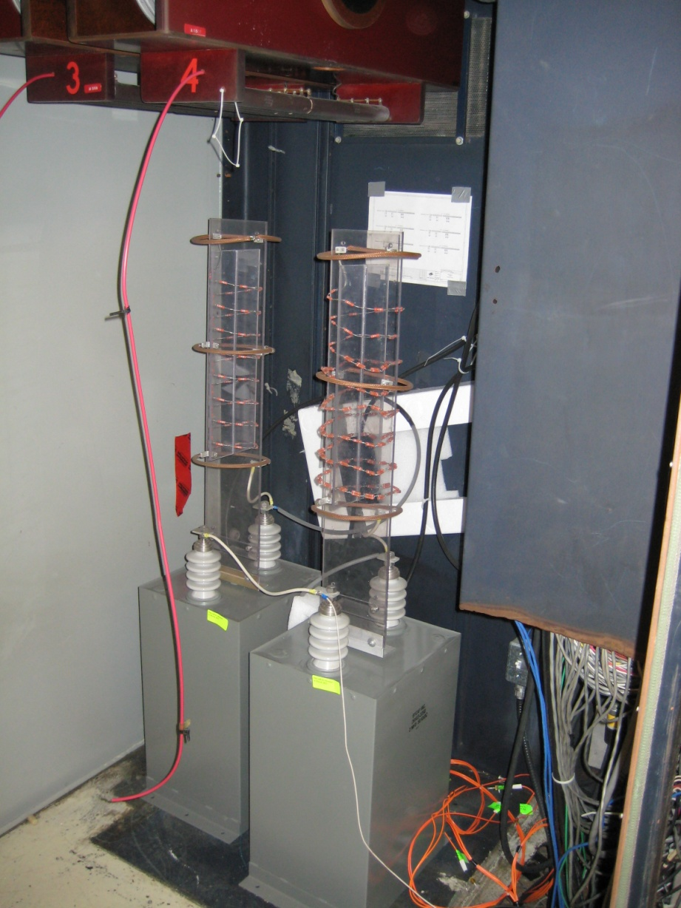
Inside the Modulators
End-of-line current transformers
High voltage filter circuitry

Slide 15
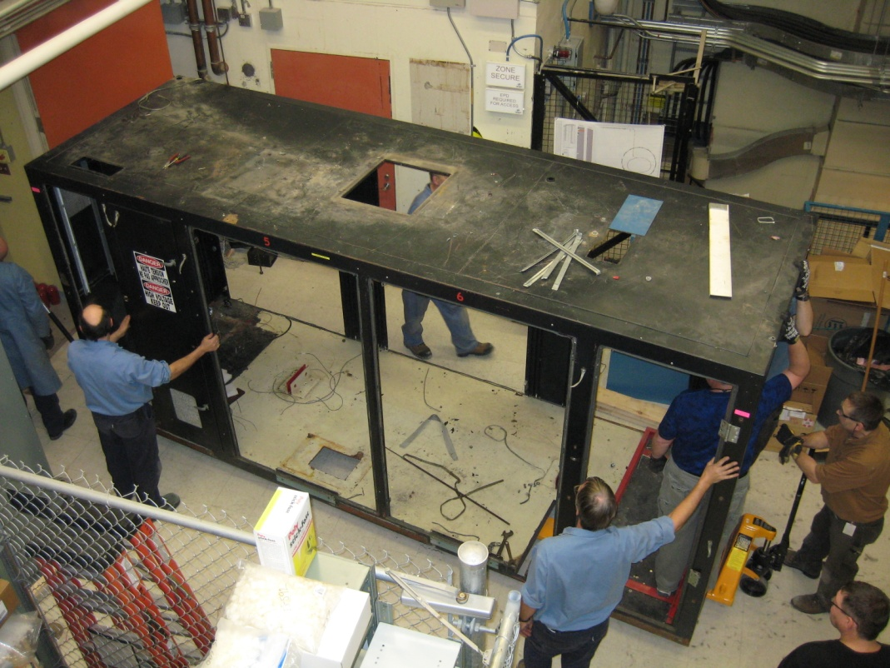
Empty Cabinet
First cabinet of three removed by the end of day one!
March 2, 2011

Slide 16
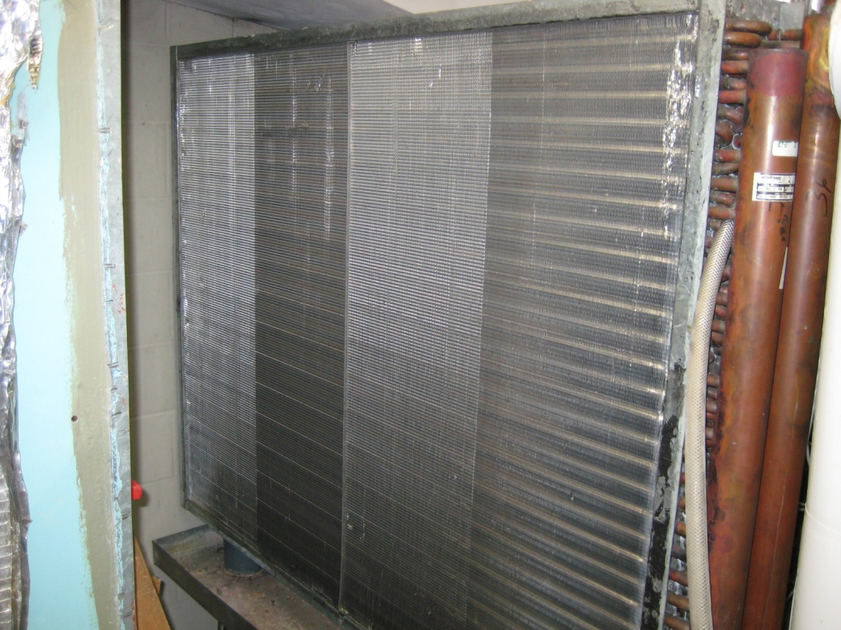
AHU’s Above Mod Room

Slide 17
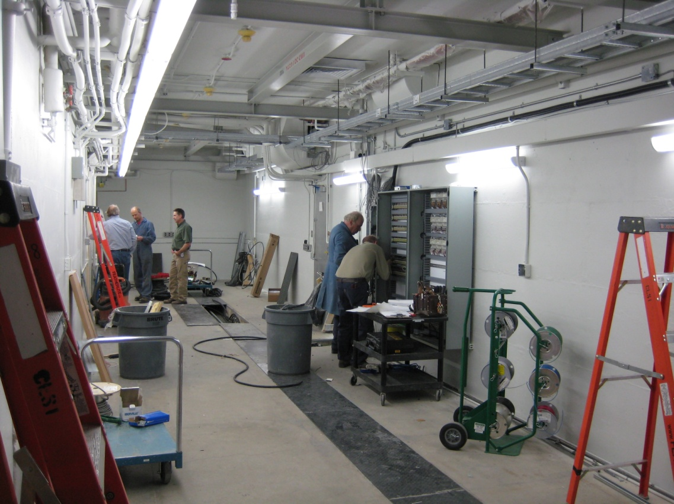
Modulator Room
An empty modulator room with control panels being added to it.
March 24, 2011

Slide 18
The ScandiNova Modulator
Replaces PFN with 30 solid state IGBT’s
IGBT’s discharge at around 1000 V
Each IGBT fires directly to a special, “split core” pulse transformer
IGBT’s NOT stacked in series
Transformer basically collects the primary voltage and steps it up a factor of ~10x
(30 IGBT)*(1000 V)*10 = 300 kV

Slide 19
The ScandiNova Modulator
IGBT’s
Control Screen
HVPS
Height:1480 mm
Depth:1390 mm
Width: 1730 mm

Slide 20
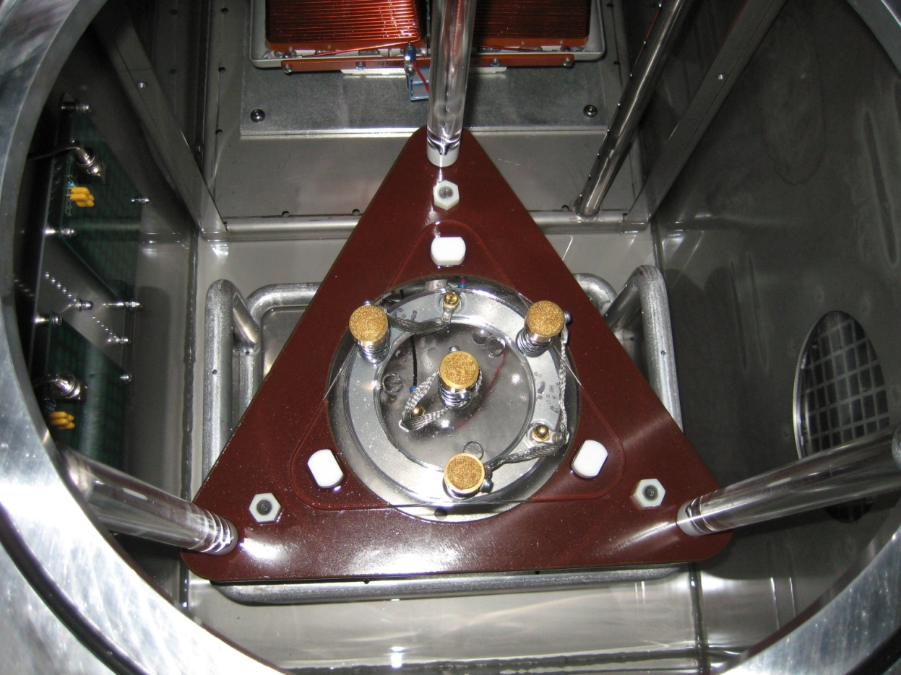
Klystron and Socket in Modulator

Slide 21
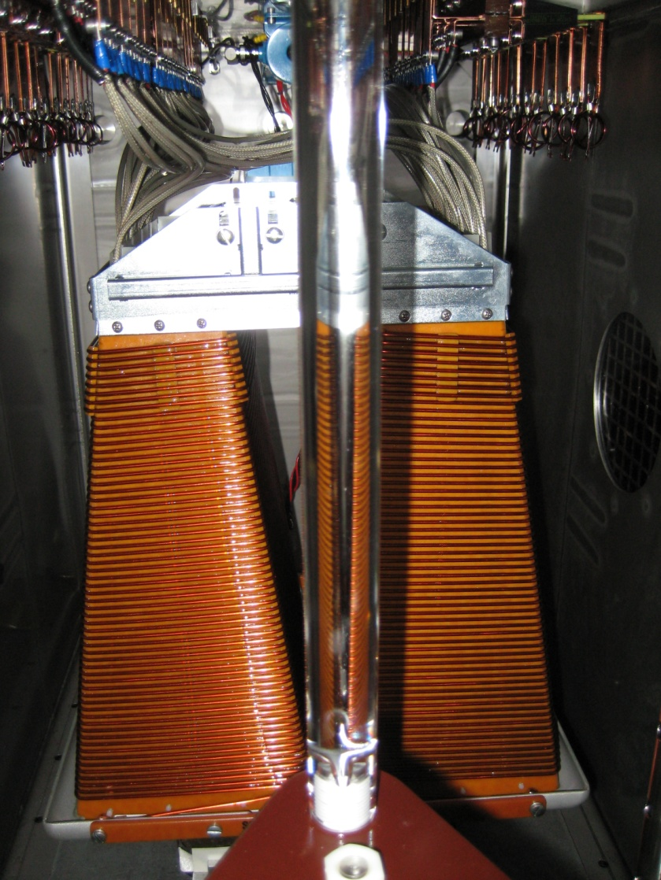
Connections and Transformer

Slide 22
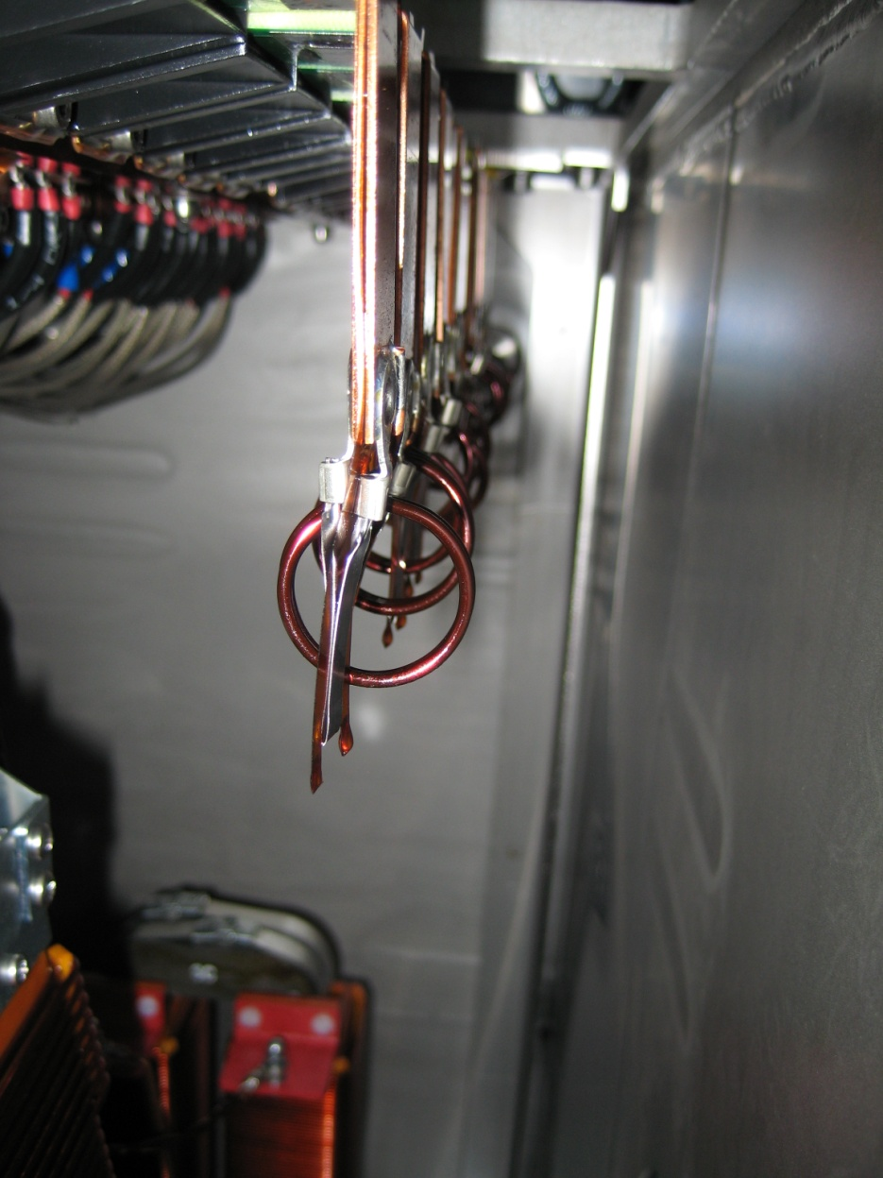
Tuning Circuits
Tuning circuits compensate for droop in the pulse resulting in a flatter pulse top

Slide 23
Operator Interface (Local)

Slide 24
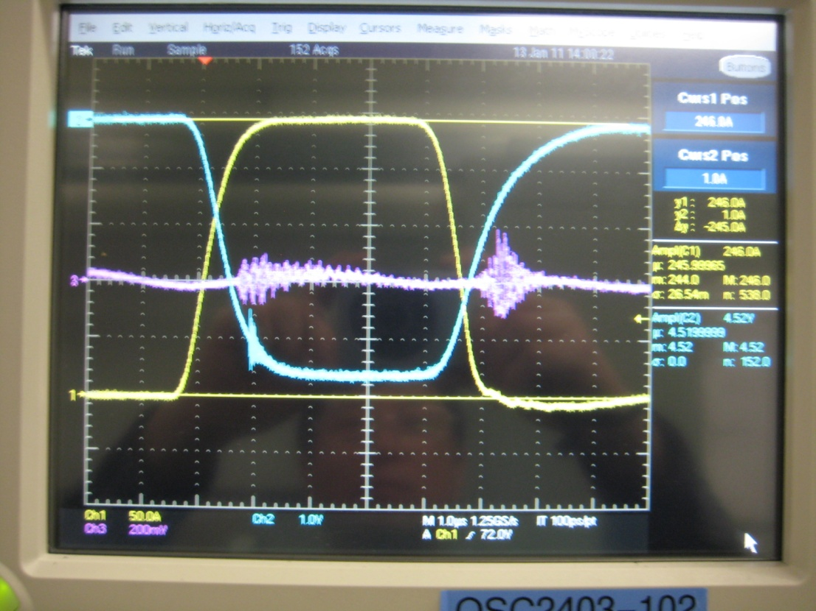
Pulse Shapes
These two pulse traces are from two different klystrons each with slightly different perveances.

Slide 25
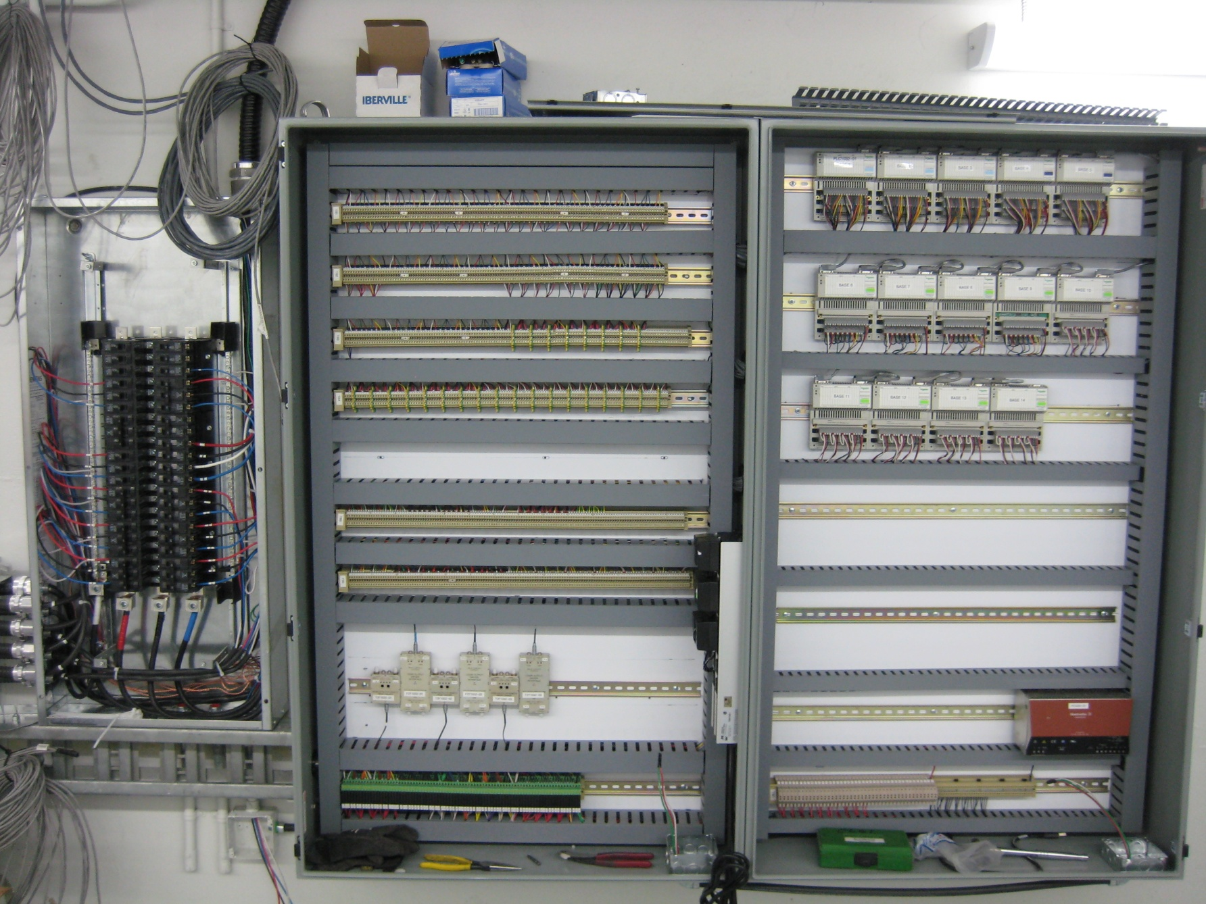
Work Remaining
Modulator placement
Controls wiring
Cooling water
Power
Waveguide runs
Pumps and controllers

Slide 26
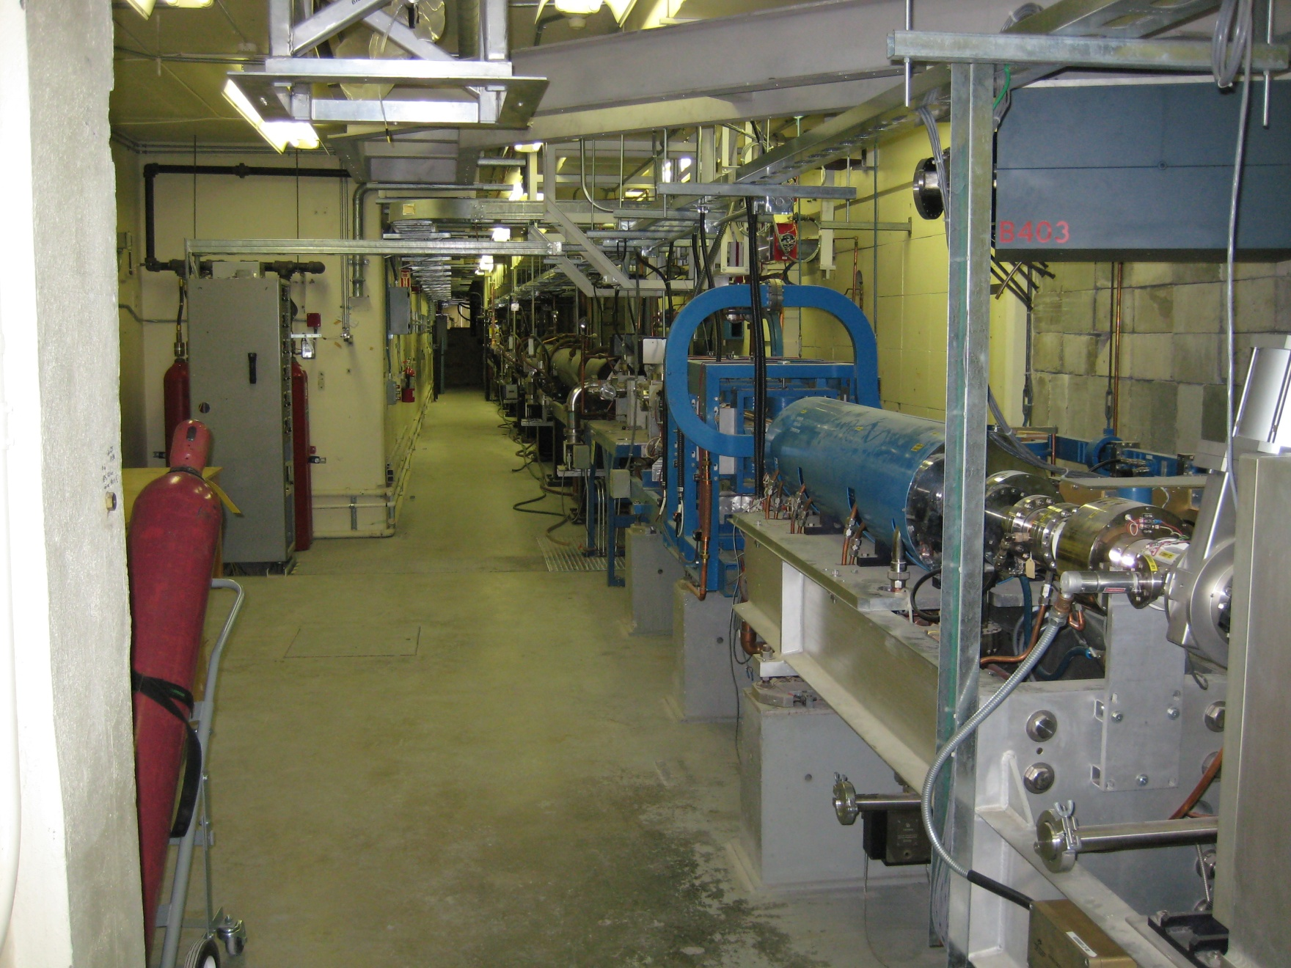
Future Shutdowns
Rebuild linac
4 new sections (of 6 total)
New vacuum system
New water system
New quad triplets (x2)
New beam diagnostics

Slide 27
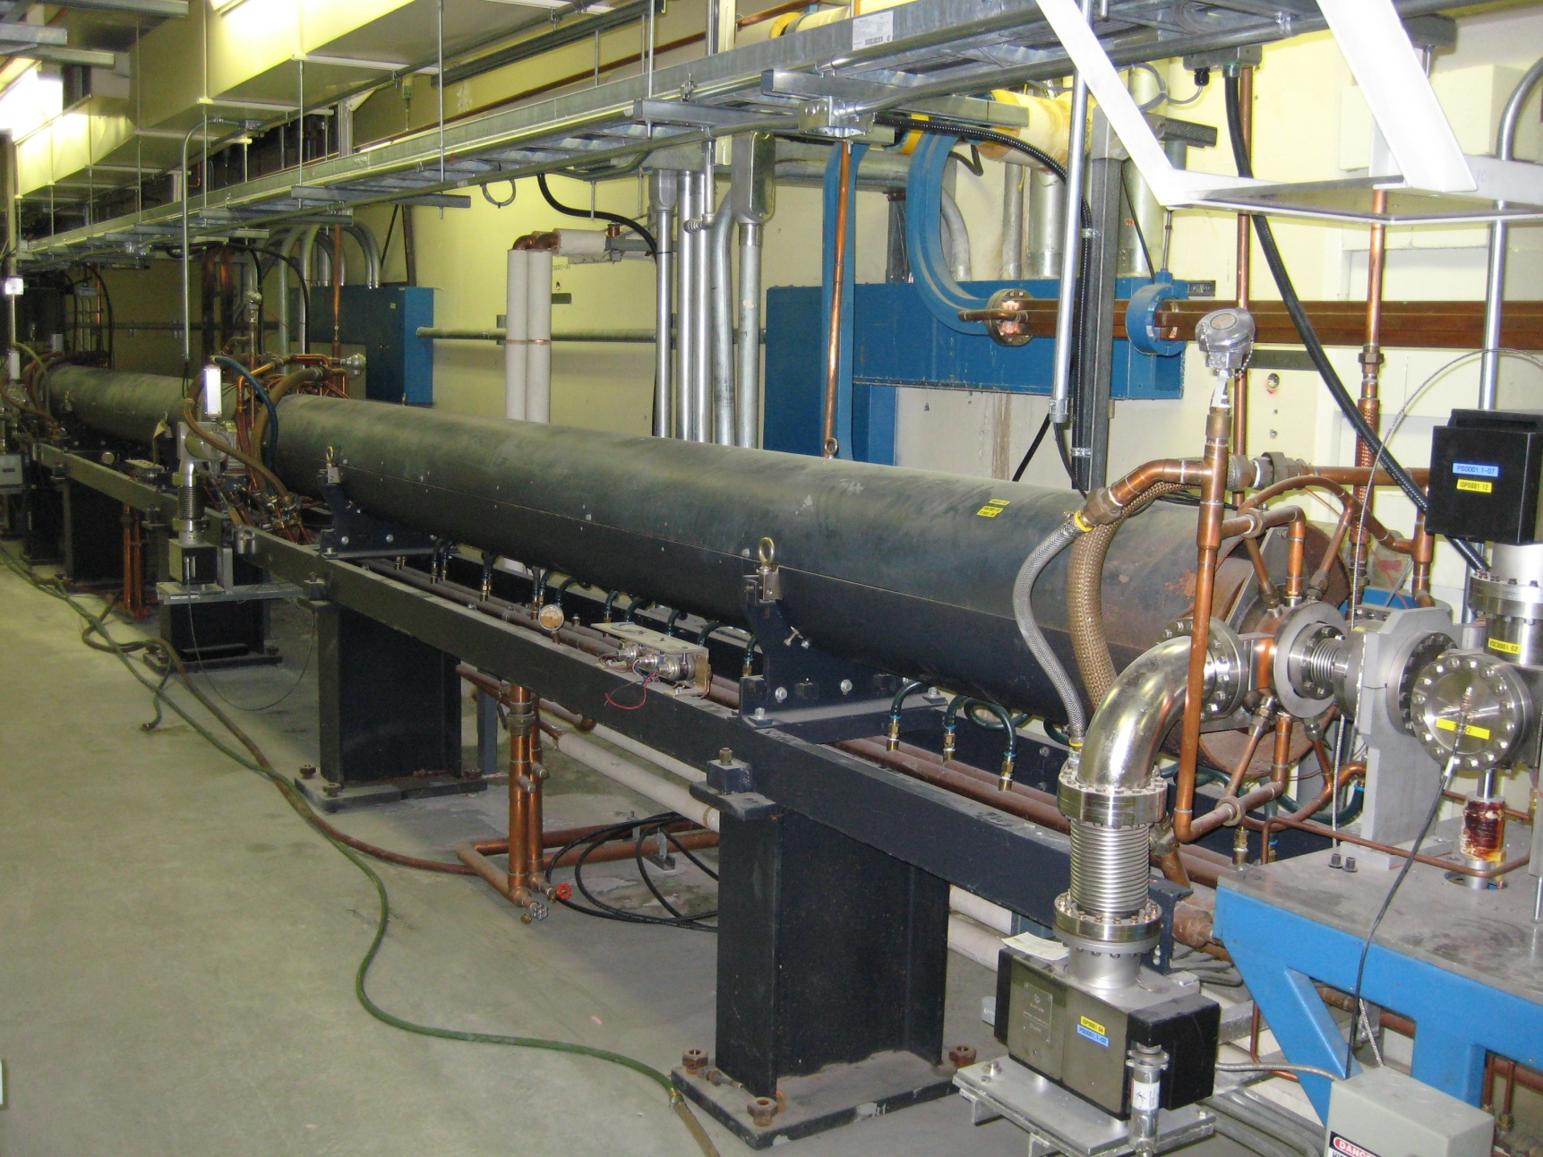
Future Shutdowns
New Linac RF Drive
New phase shifters
Rearrange RF distribution

Slide 28
Ready to Go

Slide 29
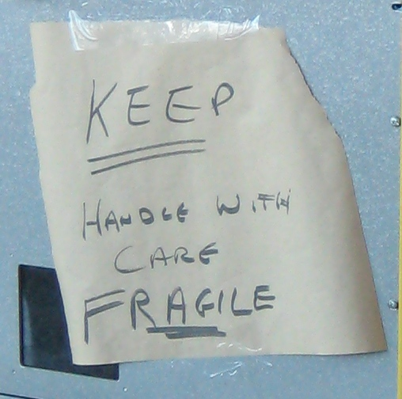
And Finally…

