Slide 1
Cryostat Design
Vittorio Parma
CERN
Technology Department,
Magnets, Superconductors and Cryostats Group
CERN Accelerator School «Superconductivity for Accelerators»
Ettore Majorana Foundation and Centre for Scientific Culture Erice, Italy, 24 April – 4 May 2013

Slide 2
Content
Introduction to cryostats
Cryostat requirements
Heat transfer for cryostats:
  Solid conduction
  Residual gas conduction
  Radiation, MLI protection, thermal shielding
Cryogenics
Heat intercepts
Insulation vacuum and construction issues
Mechanical considerations and construction codes
Supporting systems
Over-pressure safety issues
1st hour
2nd hour

Slide 3
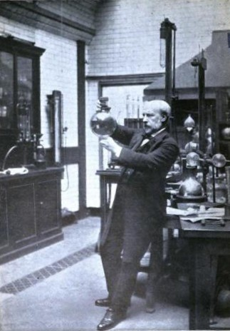
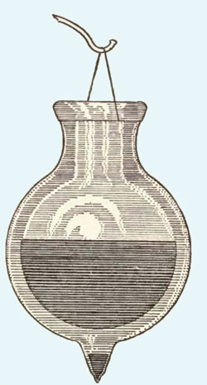
A bit of History
Cryostat (from cryo meaning cold and stat meaning stable): “a device used to maintain at cryogenic temperatures samples or devices mounted within the cryostat”
Dewar invents the “dewar”, 1892, London
A dewar: the first performing cryostat
  silvered, double-walled, glass vacuum vessel to contain cryogenic liquids
  J.Dewar: 1st liquefaction of H₂ in 1897
  …but did not manage liquefaction of He, achieved by H.Kamerlingh Onnes in 1908
Glassblowers: the “enabling technology” of the epoque:
  J.Dewar did not patent his invention…
  H.K.Onnes created the “Leidse Instrumentmakersschool” (still existing!), and industrialized cryostats
Sir James Dewar (1842-1923)

Slide 4
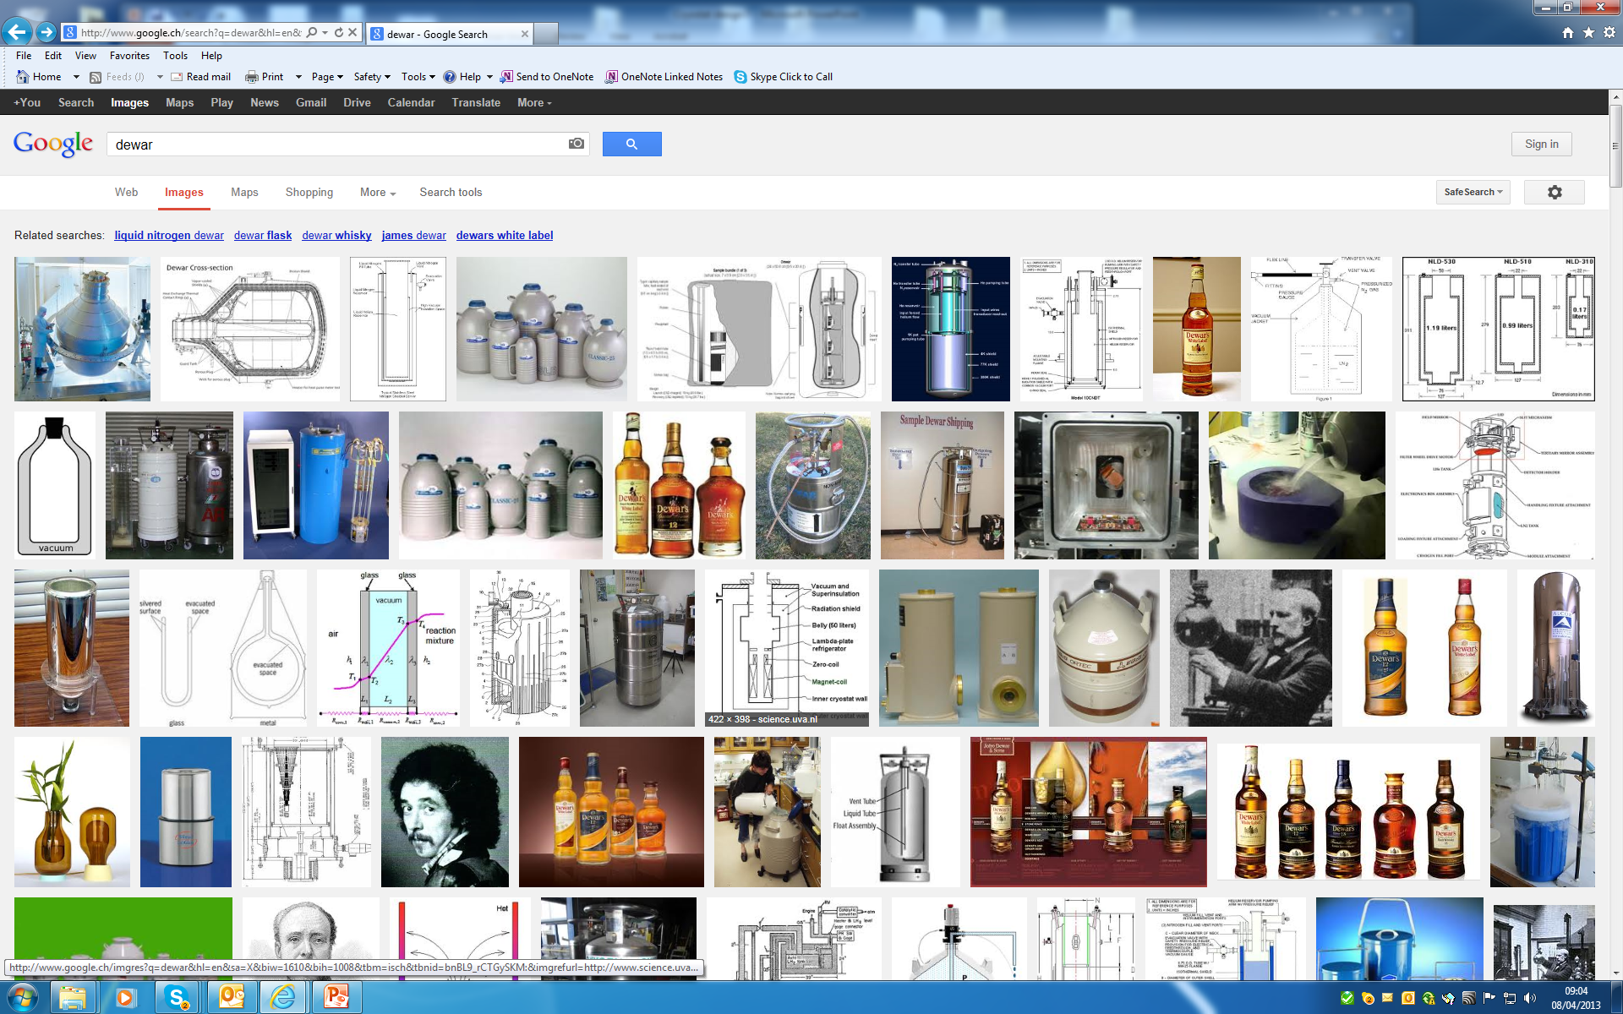
Dewars on “Google images”

Slide 5
Applications
Cryostats
Liquid storage/transport
SC devices for accelerators
Test cryostats
Accelerator devices
SC devices for medical applications
Commercial vertical test cryostat
SC magnet cryostats
SCRF cavities cryostats
Specific vertical test cryostats

Slide 6
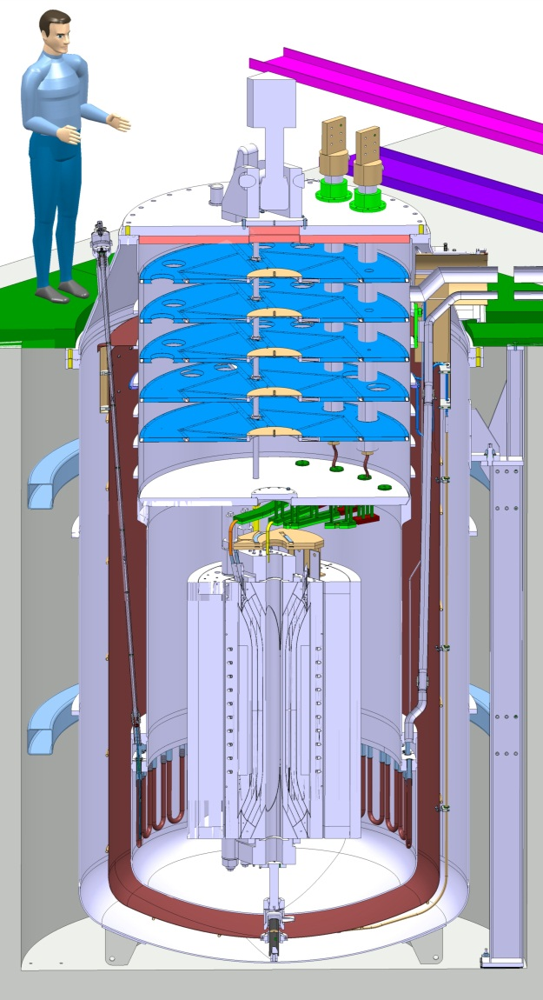
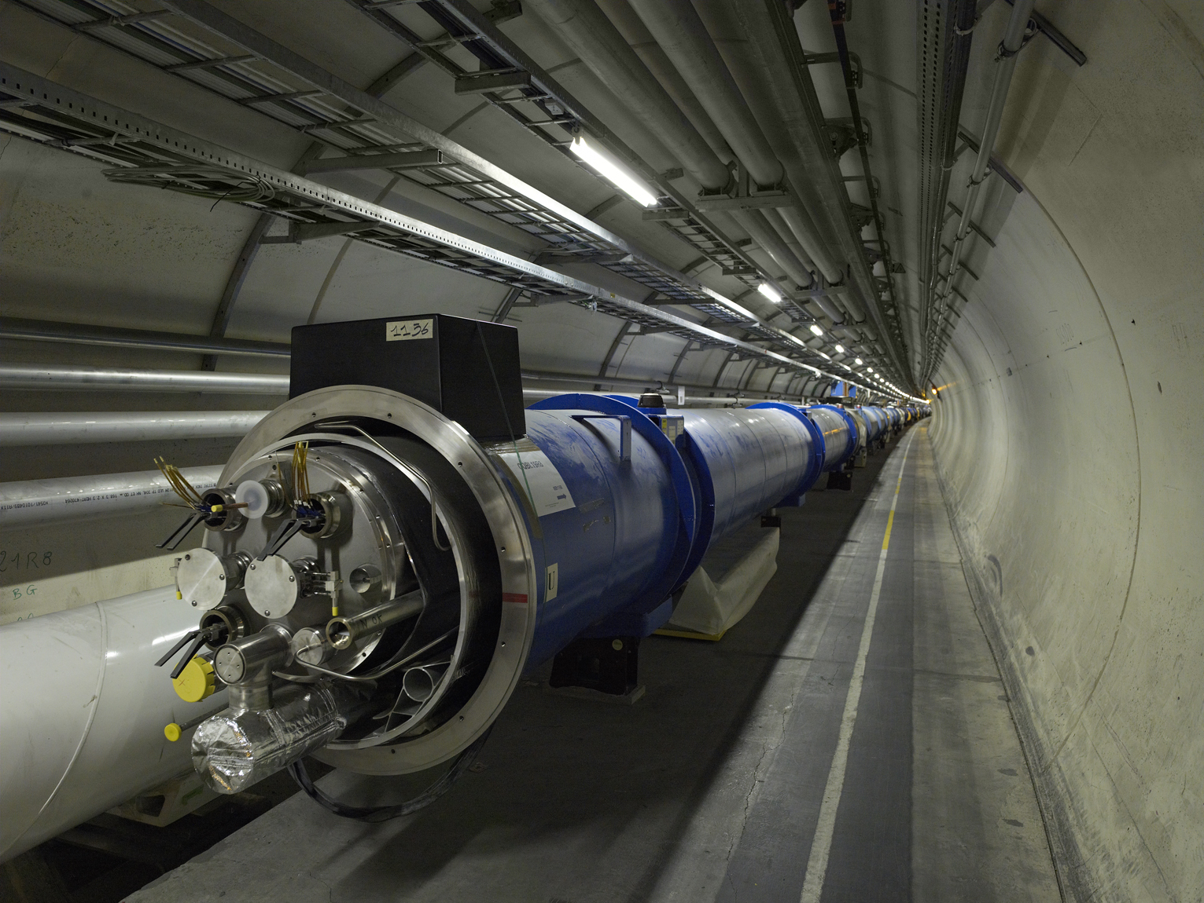
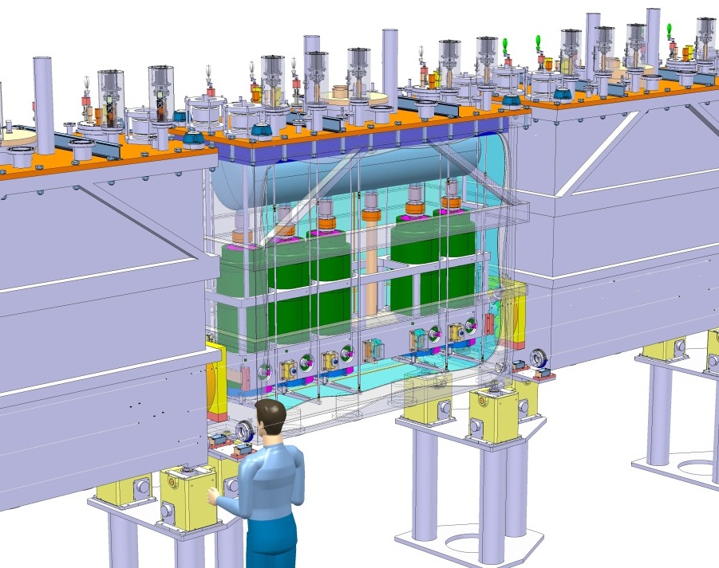
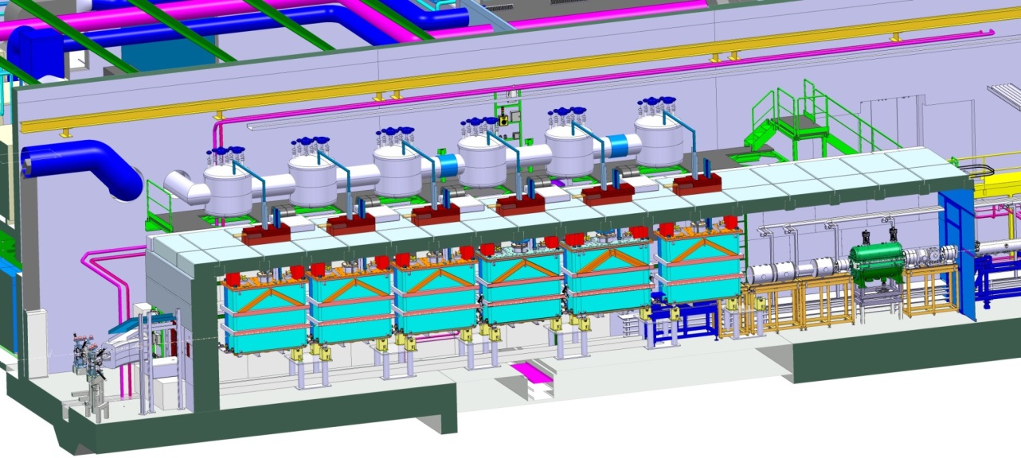
A few examples at CERN
The LHC cryostats
The High Field Magnet test cryostat
The HIE Isolde cryo-modules

Slide 7
Cryostats for SC devices for accelerators:
A multidisciplinary activity
Heat Transfer
Superconductivity
Mechanics
Cryostat
Design
System
Integration
Cryogenics
Vacuum

Slide 8
Cryostat requirements

Slide 9
Functions
Two main functions:
Mechanical housing of cryogenic devices (supporting systems):
  Supporting of (sometimes heavy) SC devices
  Accurate & reproducible positioning (almost always)
  Precise alignment capabilities (SC devices in accelerators)
Thermal efficiency of the cryostat (heat loads as low as possible):
  Cooling capability (SC device, thermal shields and heat intercepts)
  Insulation vacuum (SC devices “hidden” in vessels)
  Thermal radiation shielding (screens, MLI)
  Low heat conduction (low thermal conductivity materials)
Often conflicting, → calls for trade off design solutions
Many other complementary functions…:
  Integration of cryogenic equipment (ph.separators, valves, etc.)
  Cryogenic cooling piping and interfaces to cryoplant
  Integration of Beam instrumentation (e.g.BPMs, BLMs,etc.)
  Instrumentation wires feed-throughs (control/diagnostics)
  magnetic shielding from/to environment (e.g. SCRF cavites, magnets)
  Maintainability (access ports)
  Handling and transport features
  …

Slide 10
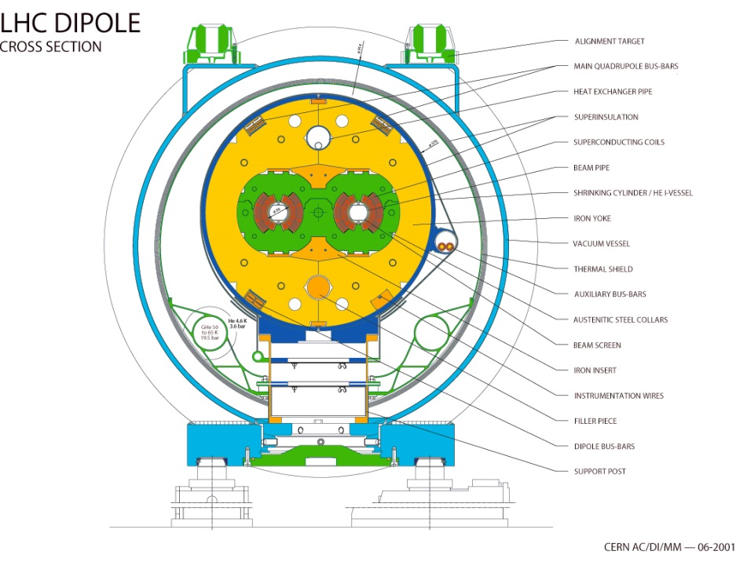
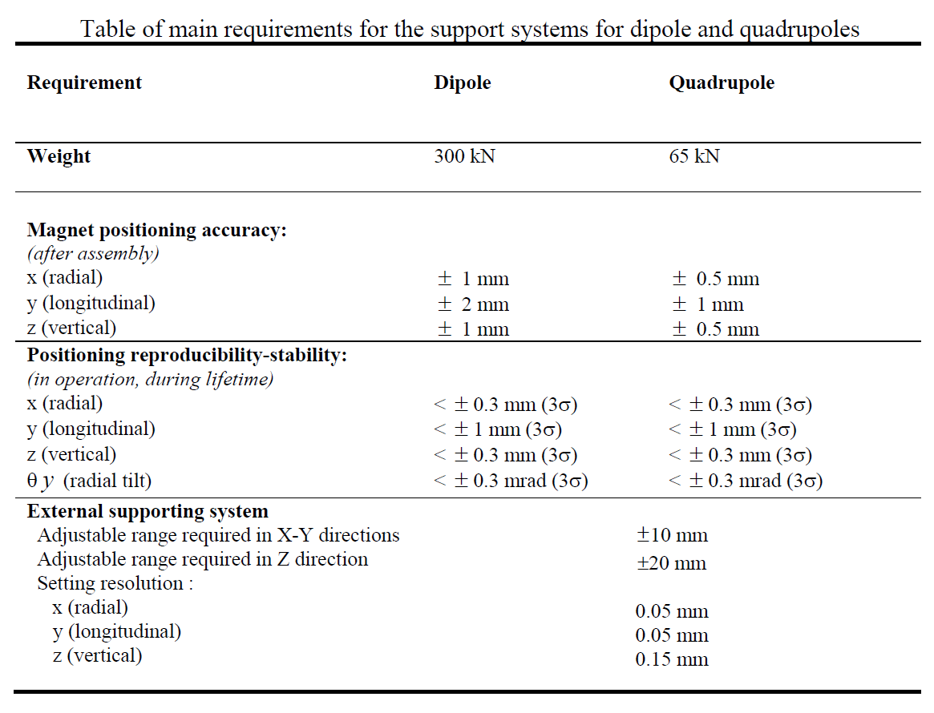
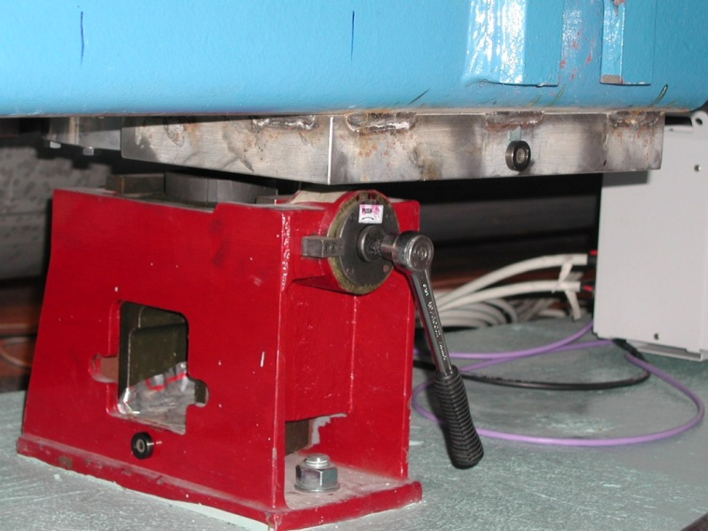
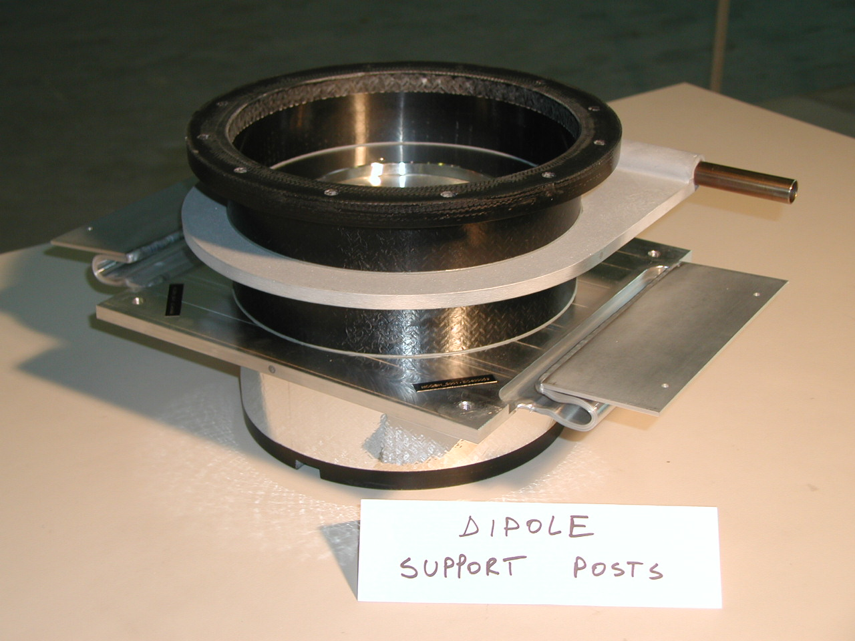
Mechanical Housing example of LHC
LHC Main Cryostat
(Cross-Section)
Alignment targets
Vacuum Vessel
Magnet Support Posts (GFRE)
External supports (jacks)
Low heat in-leaks support posts
Alignment jacks under a dipole

Slide 11
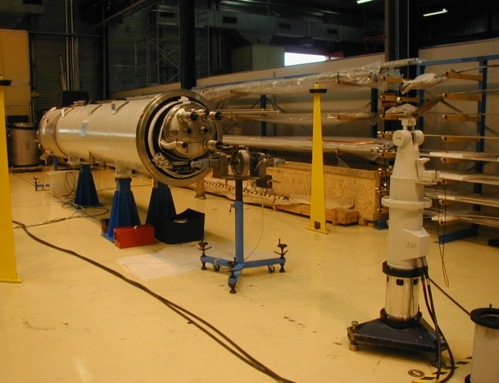
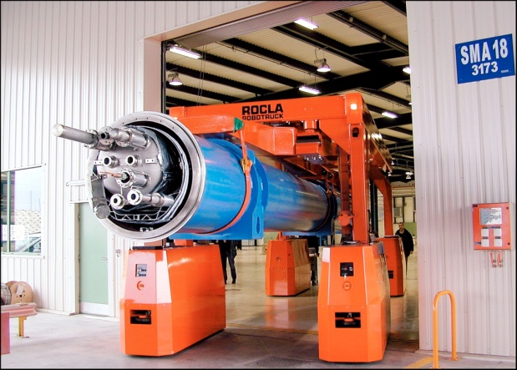
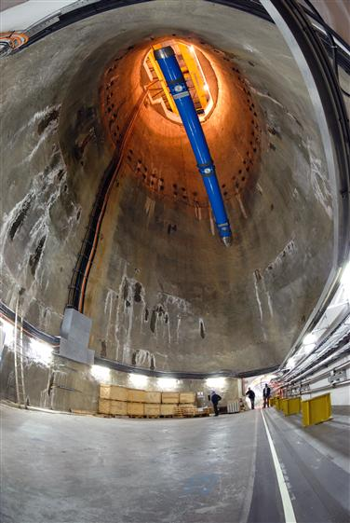
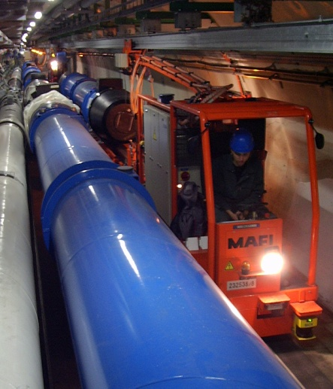
Geometrical Stability: survey measurements
Cold mass stability w.r.t. fiducials measurements on 20 cryo-dipoles
After transport to the tunnel
Transversal movements
Cryo-dipole
Survey measurements
with laser tracker
Mean: +0.1mm; St.dev.: 0.17mm
Vertical movements
Cryo-dipole
Mean: +0.08mm; St.dev.: 0.11mm
ROCLA vehicle
Quad CM positional stability and reproducibility at cold
Tunnel transportation
100 m descent to the tunnel

Slide 12
Thermal efficiency
Cooling of SC device:
Ensure operating T: cryo scheme, fluid distribution and heat transfer. Strongly coupled to cryoplant and cryo distribution system
Heat loads management:
External heat in-leaks
  Radiation
  Residual gas conduction
  Solid conduction
Internal heat sources:
  Joule heating (SC magnet splices)
  BCS residual resistance (RF cavities)
Beam-induced heat:
  Synchrotron radiation
  Beam image currents
  Photoelectrons (e-cloud)
  Mitigation measures:
  70 K shielding, MLI
  Vacuum < 10⁻⁴ Pa
  Low conductivity materials (non metallic), heat intercepts
  Special brazing (resistance < a few nΩ)
  Q enhancement, pulsed operation
  5-20 K beam screens
  Cu plated beam screens
  5-20 beam screens
static
dynamic

Slide 13
Thermal efficiency example of LHC
HeII
LHC budgeted distributed steady-state heat loads [W/m]
Temperature | 50-75 K | 4.6-20 K | 1.9 K LHe | 4 K VLP
Static heat inleaks* | 7.7 | 0.23 | 0.21 | 0.11
Resistive heating | 0.02 | 0.005 | 0.10 | 0
Beam-induced nominal** | 0 | 1.58 | 0.09 | 0
Total nominal | 7.7 | 1.82 | 0.40 | 0.11
* no contingency
** Breakdown | nominal
Synchrotron radiation | 0.33
Image current | 0.36
Beam-gas Scattering | 0.05
Photoelectron | 0.89

Slide 14
Heat Transfer for cryostats

Slide 15
Heat transfer: General
Solid conduction:
Thermal radiation:
(with and without MLI)
Viscous gas conduction and natural convection: (Negligible with good insulation vacuum, < 10⁻⁴ Pa)
Gas conduction: molecular regime
Between cylinders:

Slide 16
Thermal conduction

Slide 17
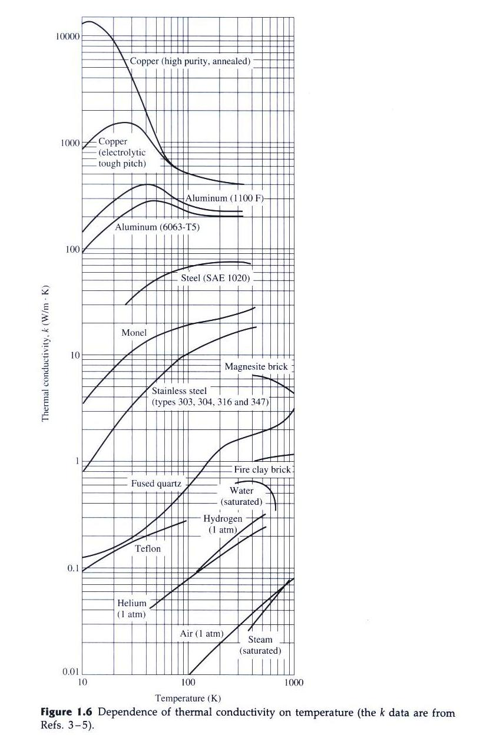
Thermal Conduction
When a T gradient exists in a body, there is a heat transfer from the high T region to the low T region (Fourier Law):
Tc
Tw
For one-dimensional problems (ex. a bar or tube):
k is the thermal conductivity (W/mK⁻¹), normally a function of P,T, material structure, non-homogeneity, anisotropy (ex. Composite materials).
k is strongly T-dependent and non-linear at low T
“good conductors” vs. “poor conductors” → k range ~ 5 orders of magnitude
Note: sometimes conductivity denoted by λ.

Slide 18
Thermal conductivity in solids (& metals)
The conductivity is attributed to the movement of conduction electrons (“electron gas”), ke, and the effects of phonon lattice vibrations, kl.
e-
N+
In metals, the electron contribution dominates.
The movement of conduction electrons is impeded by scatter: interactions with phonons, and interactions with impurities/imperfections. We can introduce thermal resistivities:
Therefore for metals, the conductivity can be expressed as:
And has a maximum conductivity:
Therefore, for metals:
Kmax shifts at higher T with increasing impurity (see coppers and aluminiums )
The maximum vanishes for highly impure alloys (see steels) and in these cases impurity scattering dominates phonon scattering, thus at T < RT:
For metals, from electron conduction theory and analogy with electrical diffusion → Wiedemann-Franz law :
  Good agreement at T<< and T>> RT
  Better agreement from T<< to T>> with increasing impurities
  Electrical resistivity (ρ_{e}) easier to measure than thermal conductivity

Slide 19
Thermal conductivity for Aluminium alloys

Slide 20
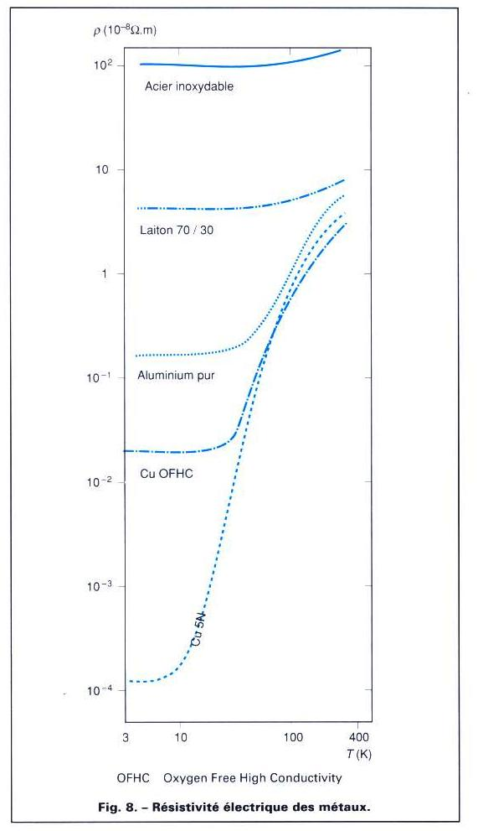
Electrical resistivity for some metals

Slide 21
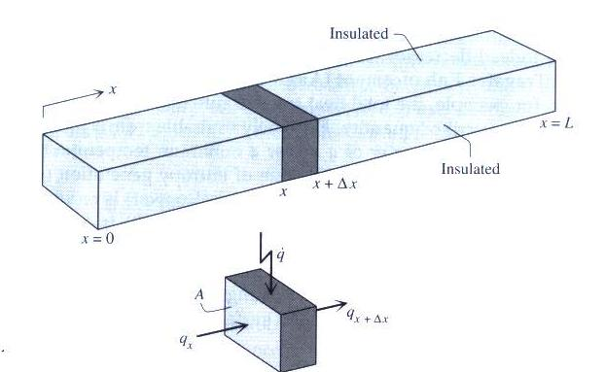
The conduction equation
(unidirectional case)
(Fourier law of heat conduction)
(change of internal energy)
Longitudinal
conduction
Internal
heat
generation
Thermal
inertia
Or, if k ~ const.with T and introducing α thermal diffusivity:
α allows evaluating the characteristic propagation time τ of a thermal

Slide 22
No local heat deposition and steady-state
If k constant with T:
If k = k(T):
(Linear solution)
Thermal conductivity
Integral (conductance)
T
For impure metals (ex.steels) at low T:
T₀
T_{L}
(quadratic solution)
L
x

Slide 23
Electrical network analogy
The inverse of the thermal conductance → thermal resistance:
a) For constant k:
b) For variable k, define an average value k_{AV}:
In both cases we can recognize an analogy with the electrical resistance (replace q with I, T with V):
We can therefore model a complex thermal conductivity problem by elementary thermal resistances Ri, and solve the network by using Kirckhoff’s laws.

Slide 24
Thermal conductivity data for selected materials

Slide 25
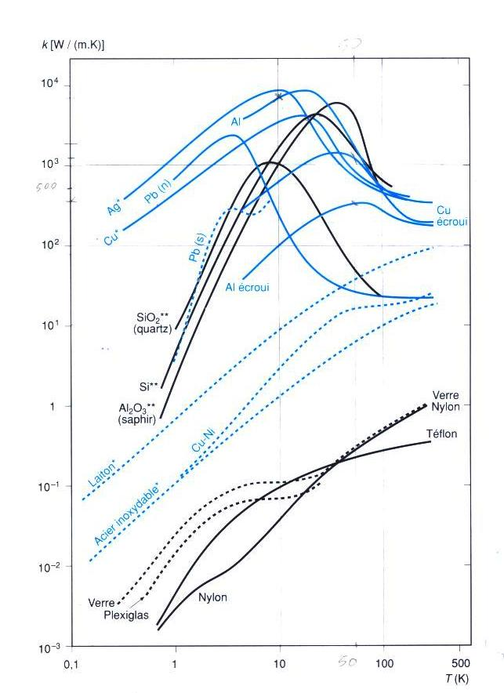
Thermal conductivity of various materials
Spans over about 5 orders of magnitude

Slide 26
Thermal conductivity integrals (conductance) for some materials [W/m]
4.2K
Tw
Qc
Highest T (Lowest T =4.2 K) | 20 K | 80 K | 290 K
OFHC Copper | 11000 | 60600 | 152000
DHP Copper | 395 | 5890 | 46100
Aluminium 1100 | 2740 | 23300 | 72100
Aluminium 2024 | 160 | 2420 | 22900
Stainless steel AISI 304 | 16,3 | 349 | 3060
Typical Glass-fiber/Epoxy Composite G-10 | 2 | 18 | 153

Slide 27
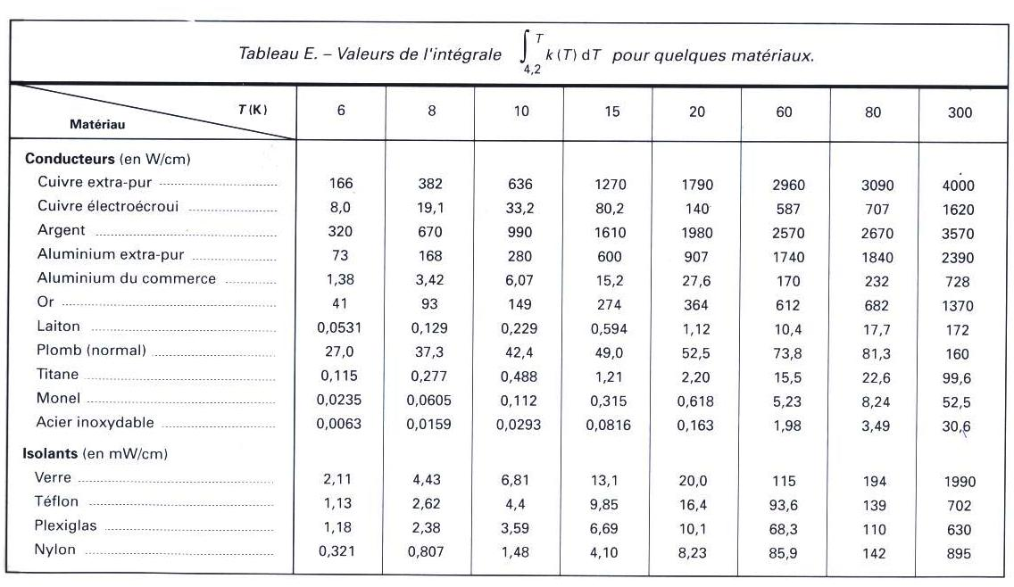
…more conductivity integrals

Slide 28
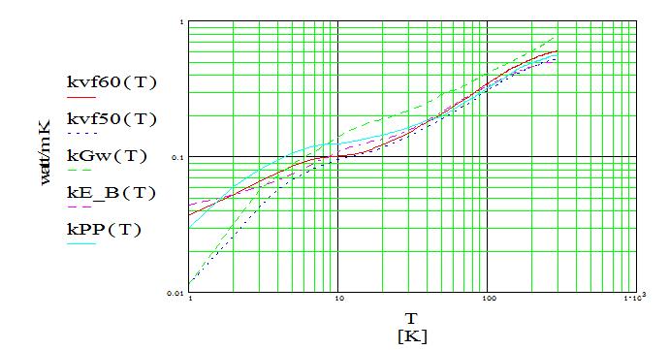
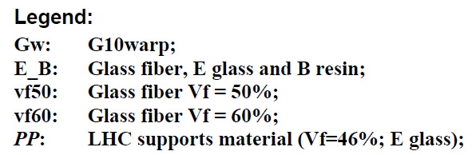
Thermal conductivity in composite materials
Generally non-conductors (little electron conduction), essentially phonon driven
Anisotropic structure, (fibers/matrix) with constituents-specific thermal conductivity properties
Generally homogeneous at macroscopic scale, but non-homogeneous at microscopic level (interface effects)
Conductivity highly depends on:
  Material (fiber) orientation
  Ratio between fibre and matrix (Vf)
For Glass-fiber/epoxy matrix composites (of wide interest in cryostat applications):
Glass is the “conductive” material and also the “structural” constituent
Epoxy is the “isolating” material and also the “less structural” constituent
Vf typically around 40-60%
Conductivity calculation difficult, opt for experimental measurements
Conductivity measurement of candidate GFRE materials for LHC supports

Slide 29
Thermal conduction with uniform heat deposition
To
x
Beam of length L, thickness t, width w;
beam thermalized on one side at To
uniform heat deposition from one side, q (W/m2)
considering k constant with T
Boundary conditions: a) for x= 0 T=To (heat sink); b) q=0 for x=L (isolated tip)
Integrating and imposing the 2 boundary conditions:
T
T_{L}
T₀
practical interest:
calculate thickness
of a thermal shield
L
x

Slide 30
Residual Gas Conduction
λmolecule << d → Viscous regime
λmolecule >> d → Molecular regime
Viscous regime:
  At High gas pressure
  Classical conduction (q = - A k(T) dT/dx) with k independent of pressure
  but natural convection must be included
Molecular regime:
  At low gas pressure
  Kennard’s law
  Conduction is proportional to P
  Ω depends on gas species (for helium Ω = 2.13 W/m2.Pa.K)
  α(T) → accommodation coefficient depending on gas species, T1, T2 and surface geometry (applicable for flat parallel surfaces, coaxial cylinders and spheres)
T1
T2 (>T1)
d
λmolecule = mean free path
Accommodation coefficient α_{i}
Temp. [K] | Helium
300 | 0.3
80 | 0.4
20 | 0.6
4 | 1

Slide 31
Thermal Radiation

Slide 32
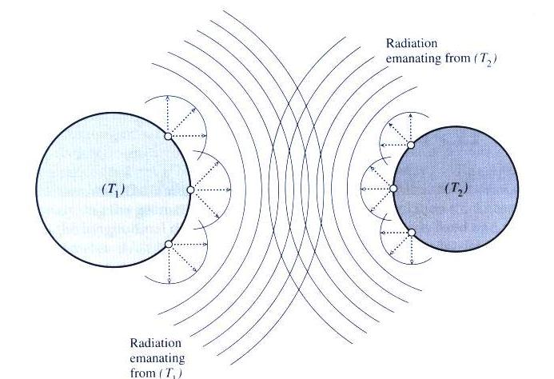
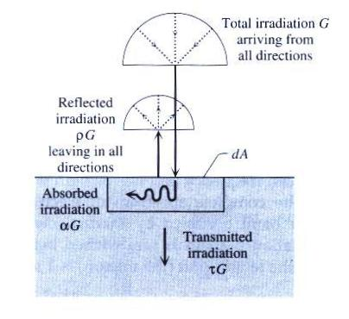
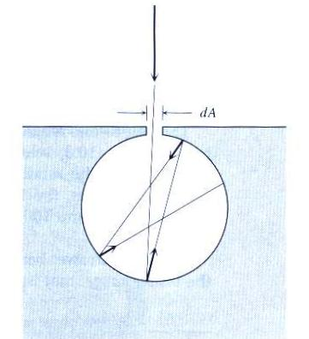
Thermal Radiation
Practical interest for cryostats shielding:
every gap acts as a black surface (example: 1 cm² gap
exposed to a 293 K surface (e.g. vac.vessel with ɛ = 0.2)
receives ~10 mW
Black surface: α = 1

Slide 33
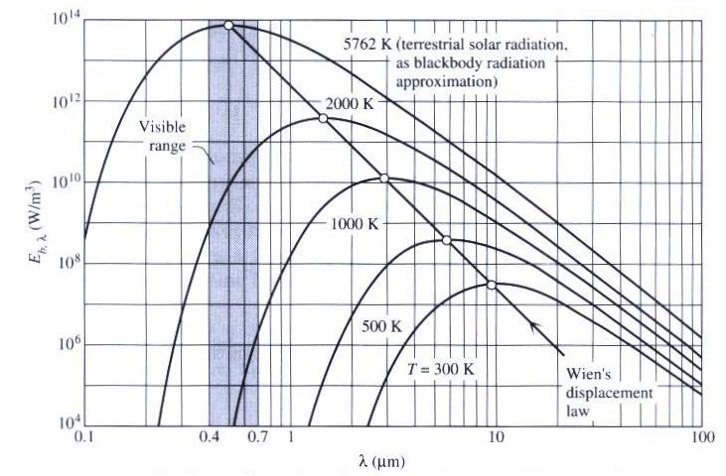
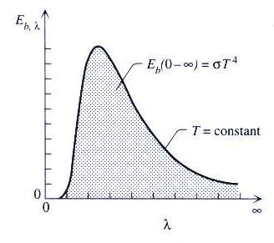
Black body radiation
Emissive power (monochromatic)
In cryogenics: far infrared region:
(emissivity not necessarily related to surface appearance)
Total emissive power (integrating over λ):
In practice: a blackbody at 293 K emits ~ 420 W/m²:

Slide 34
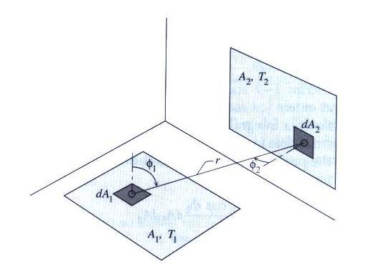
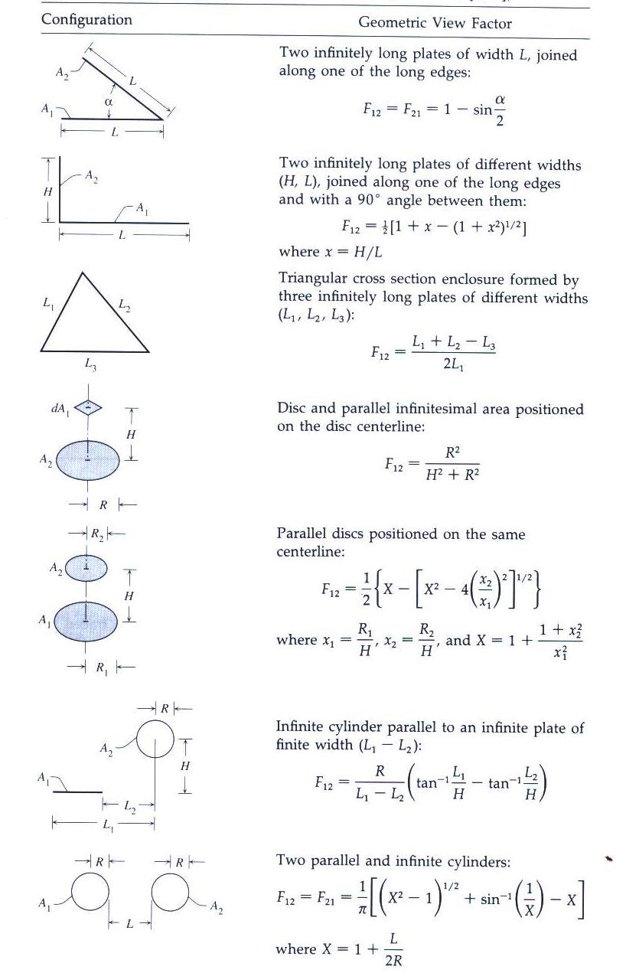
Radiation heat exchange between black bodies
Radiation from A1 to A2:
Radiation from A2 to A1:
Radiation balance between A1 and A2:
Note:

Slide 35
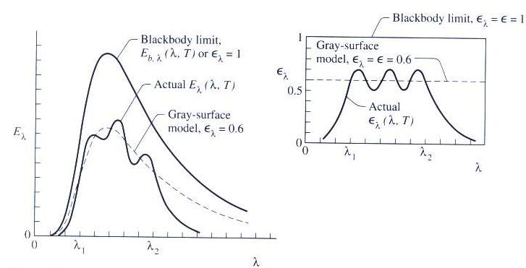
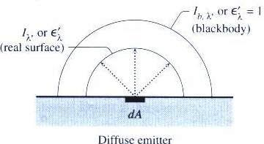
Non-black surfaces: the diffuse-gray model (real surfaces)
Diffuse-gray emitter (good approximation for real surfaces)
Total hemispheric emissivity:
(Note: @ cryo temp. ε is strongly T dependent)
Similar considerations can be made for adsorptivity and reflectivity
The Diffuse-gray model:
  Gray
  A diffuse emitter, absorber and reflector
  Opaque (no transmittivity)

Slide 36
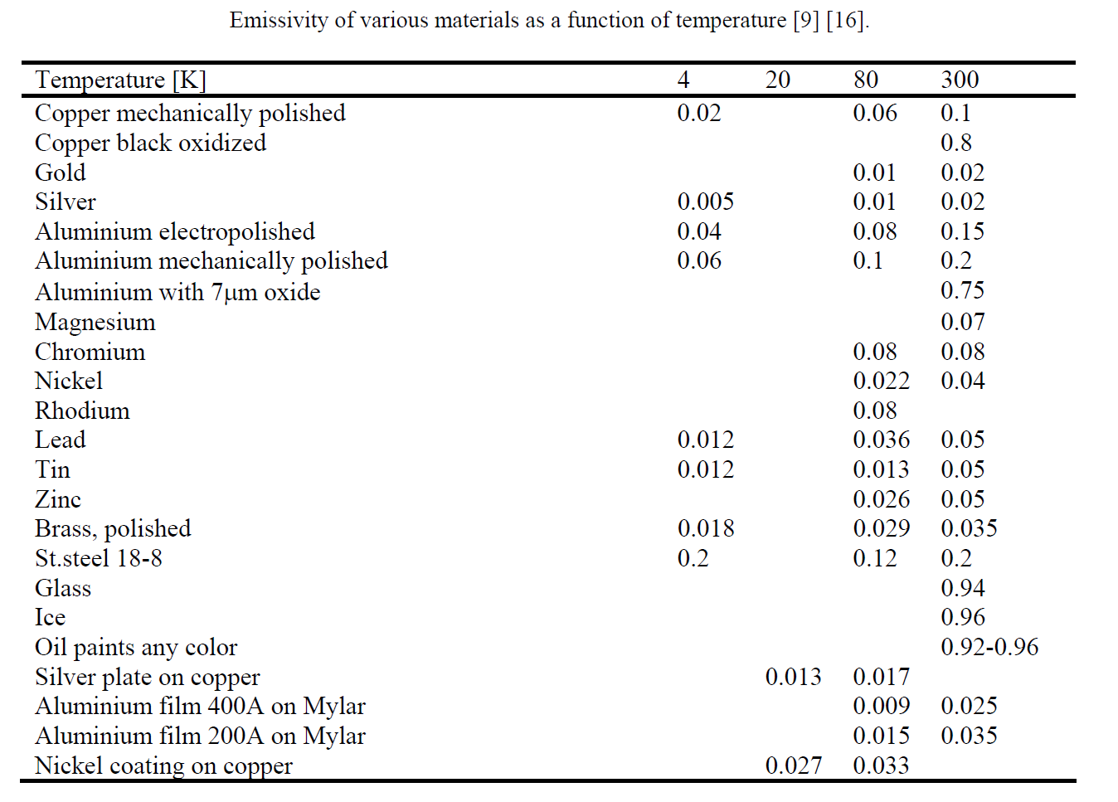
Emissivity of various materials as a function of T
0.1
(R.B.Scott, Cryogenic Engineering, (Van Nostrand, New York, 1959; Y.S.Touloukian, Thermophysical Properties of Matter, (Plenum Press, New York, 1995))
Strong T dependence (quasi proportional to T)
Emissivity reduces with T
At cryogenic temperatures low emissivity in the far infrared is not necessarily related to surface brilliance

Slide 37
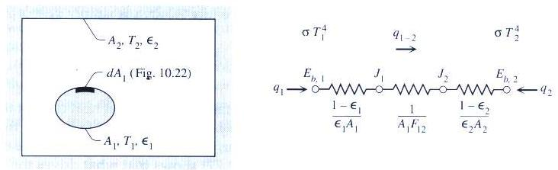
Radiation between 2 diffuse-gray enclosures
Radiation balance between A1 and A2:
For 2 enclosed cylinders or spheres (not necessarily concentric!):
A1
A2
  Hints to reduce heat load in a cryostat:
  Reduce A2 (vac.vessel as small as possible)
  Small emissivities: ε1 reduced by low T; ε2 at RT & moderated by A1/A2

Slide 38
Radiation between 2 diffuse-gray flat plates
Radiation balance between A1 and A2 (A1=A2=A):
T1
T2 (<T1)

Slide 39
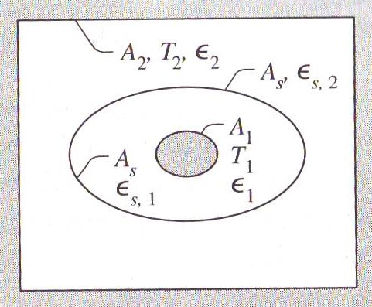
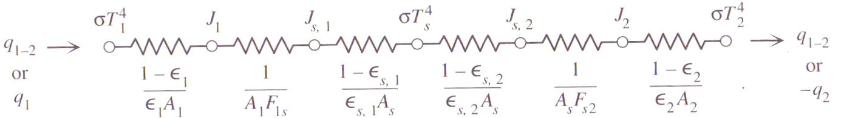
Radiation with an intermediate floating shield
Radiation balance between A1 and A2:
A1 to S gap
S to A2 gap
For flat surfaces approximation, and same ɛ, it becomes :
→ ½ of the rate without shield (see previous slide)
  Hint: to reduce heat loads in a cryostat:
  - Add one (or more) intermediate shields

Slide 40
Multi Layer Insulation (MLI)

Slide 41
MLI principle
Tw
Tc < Tw
Low emissivity of aluminium layer
Multi-layer to enhance radiation protection:
  multi reflection of radiation…
Minimal thermal conductivity between reflective layers: interposing of isolating layers
  Reduced inter-layer thermal conduction heat loads
Enhanced performance @ low T → use actively cooled shield
  Lower emissivity of reflective material layers @ low T
  Reduce radiation from inner-most layers, cooled at T of shield
  Extract heat @ thermal shield T → more efficient heat extraction
Warm wall
Colder wall (actively cooled
thermal shield)
Q_{c}
Q_{r}
Reflective film
Insulating spacer

Slide 42
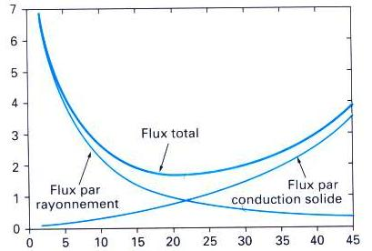
MLI:
How many reflective layers (N)?
Radiation vs. conduction, two conflicting phenomena
Radiation reduces as 1/N
Conduction is proportional to packing density (N/mm)
Packing density should be limited → typically ~ 25 N/cm
  Avoid “compressed” blankets, do not put as much MLI as possible…
  Do not forget space allocation for MLI blankets
  Consider differential thermal contractions wrt support (Al shields, cold mass…): blankets must remain loose at cold
Arbitrary units
Total heat flow
Radiation
Conduction
No. layers/cm

Slide 43
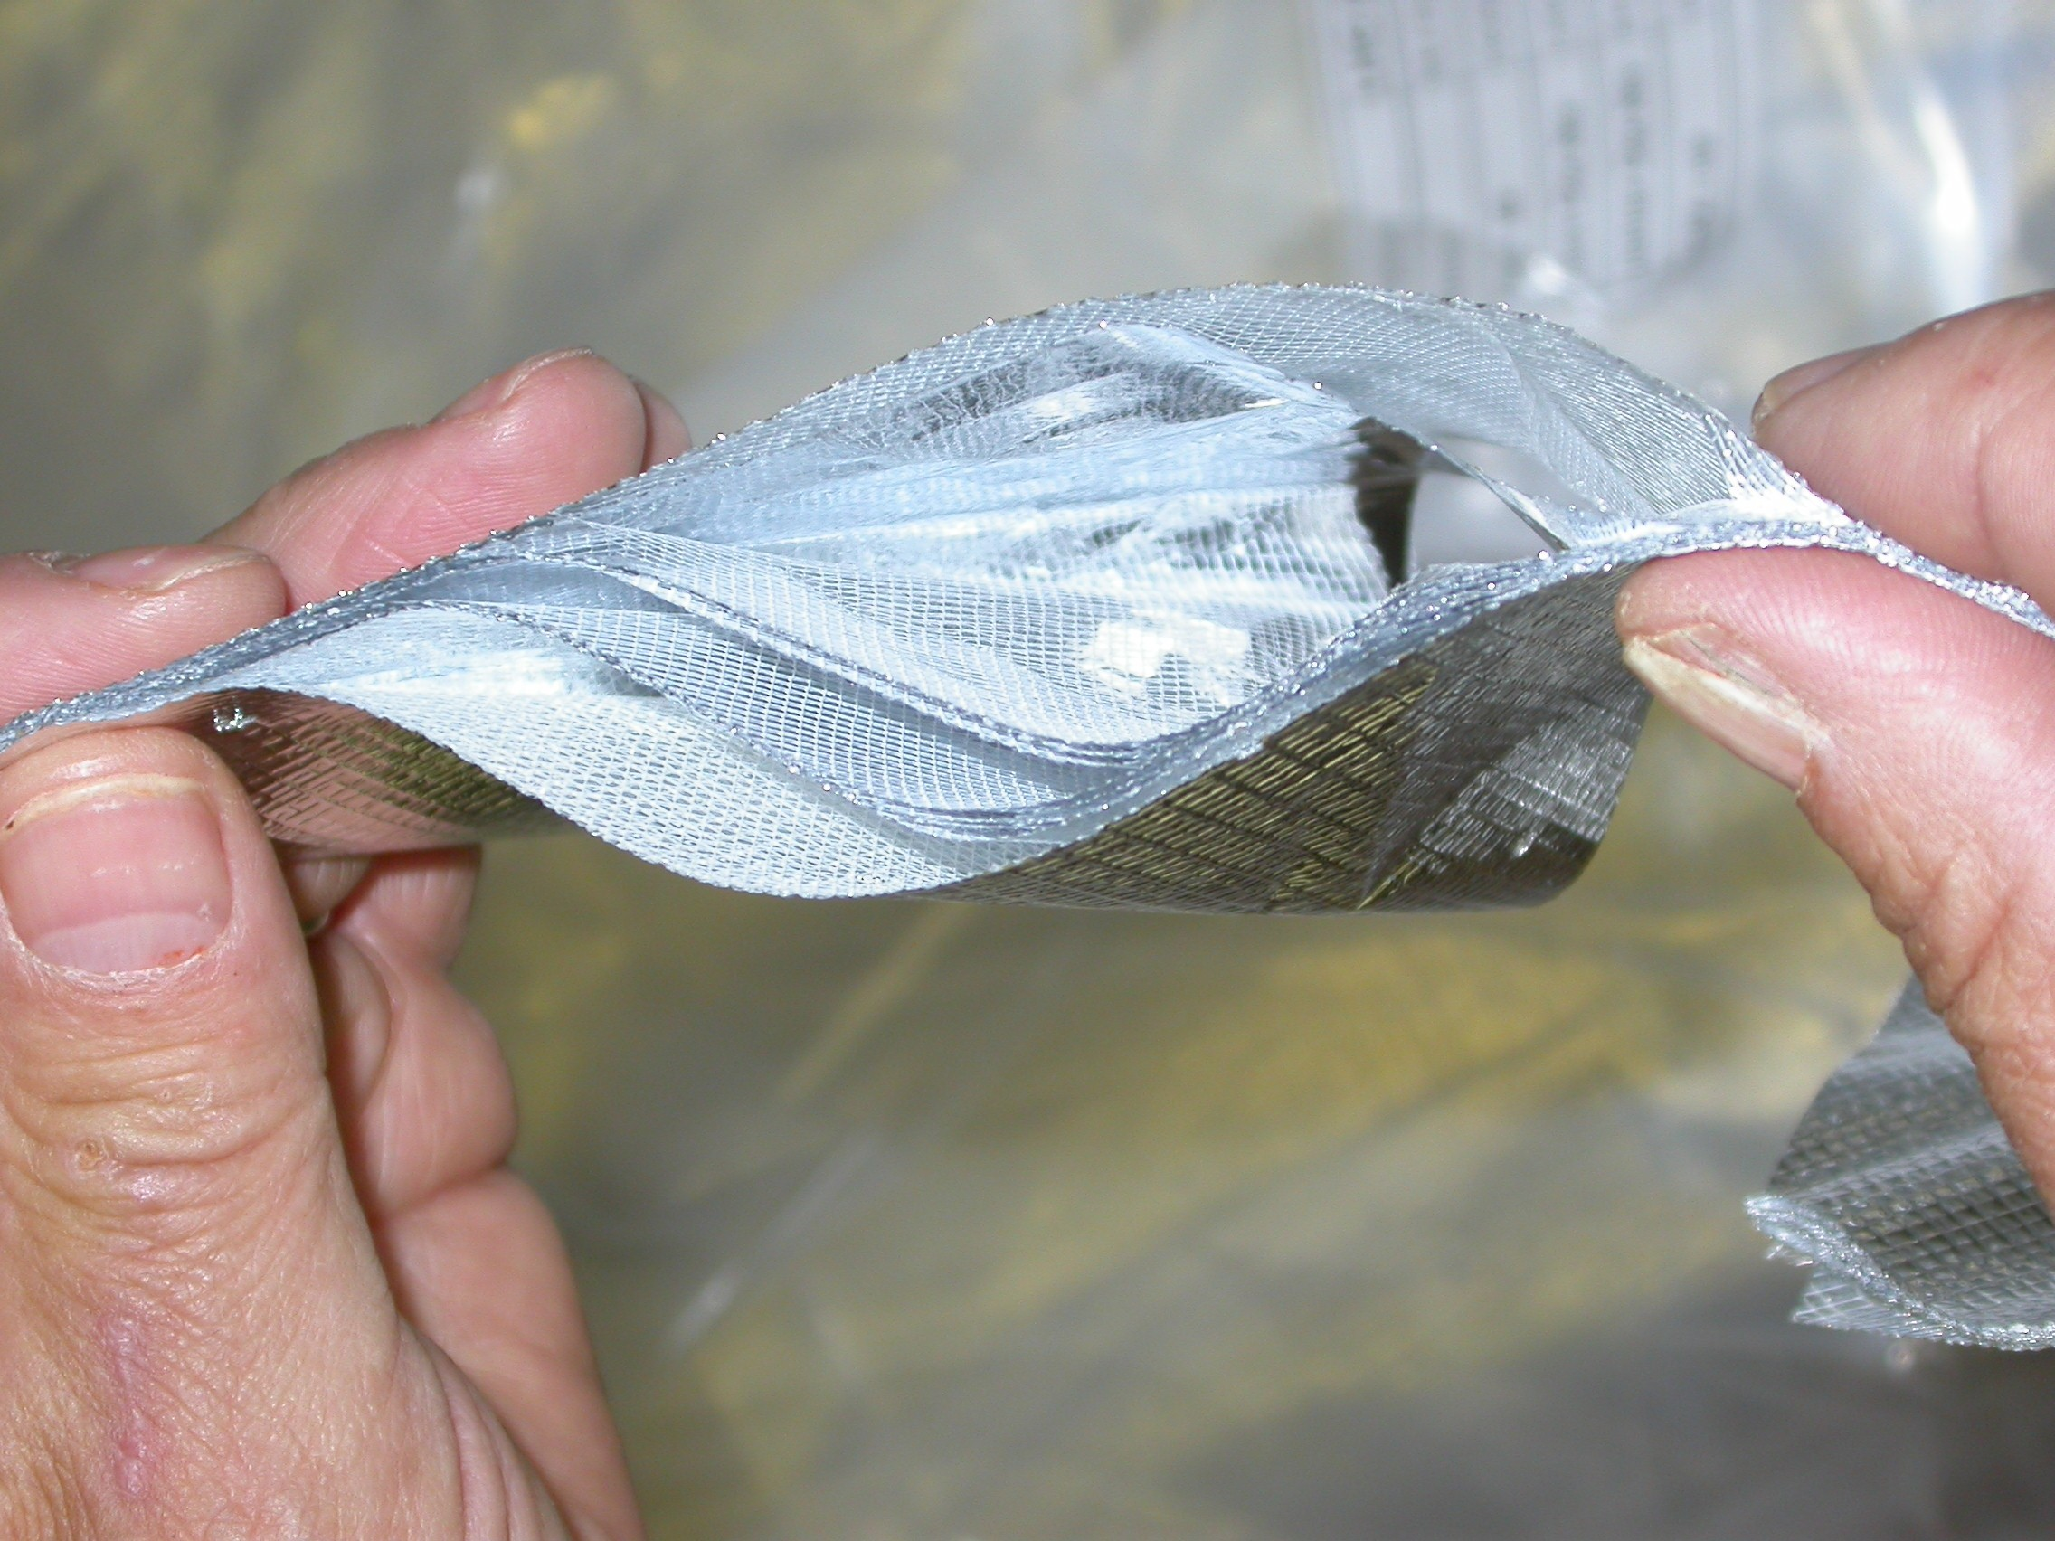
Multi Layer Insulation (MLI): a simplified calculation model
A simplified model:
  Radiation reduction
  Solid conduction
N = No. of reflective layers
α, β = average thermal conductivity
and emissivity constants of the MLI system
(obtained experimentally. For LHC cryostats:
α=1.401 10⁻⁴, β=3.741 10⁻⁹)
Q_{c}
1
2
Q_{r}
Reflective film
Insulating spacer
Considering the complexity of the phenomena
Involved, an experimental characterisation of MLI
performance, in particular for large machines, must
be made. However, abundant literature data available.

Slide 44
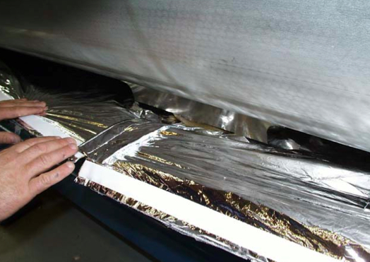
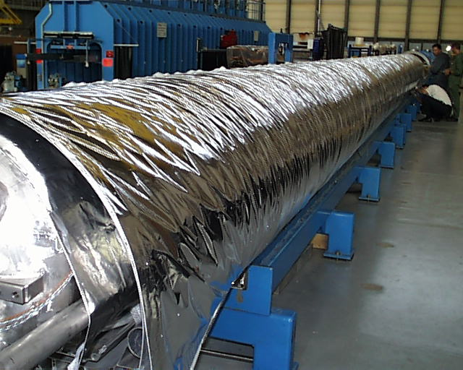
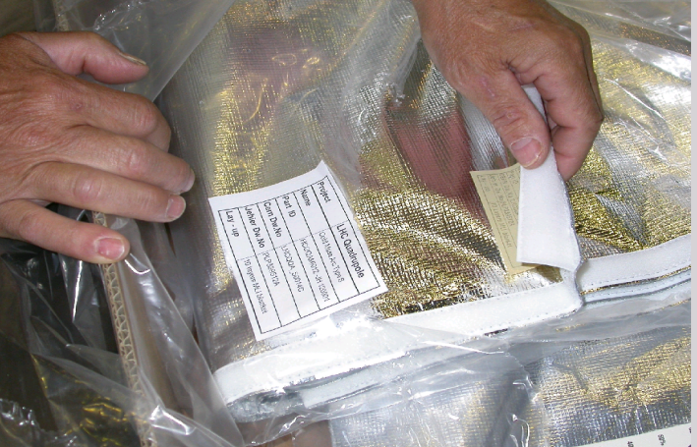
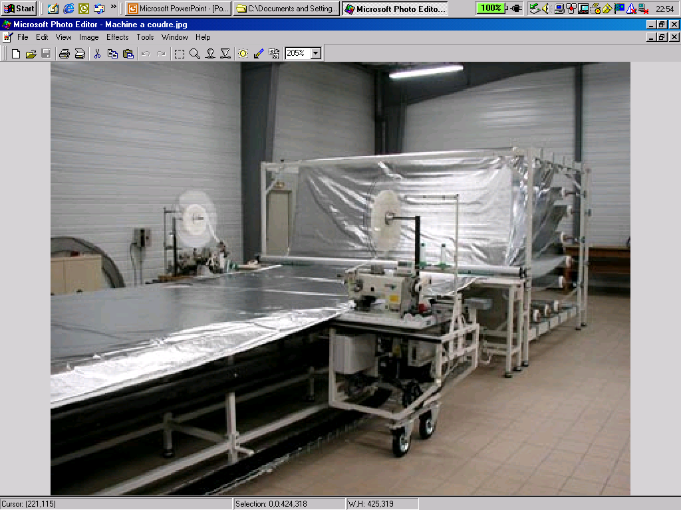
LHC Multi Layer Insulation (MLI)
Velcro™ fasteners (inner side)
Features:
1 blanket (10 reflective layers) on cold masses (1.9 K)
2 blankets (15 reflective layers each) on Thermal Shields (50-65 K)
Reflective layer: double aluminized polyester film
Spacer: polyester net
Stitched Velcro™ fasteners for rapid mounting and quality closing
Velcro™ fasteners
Blanket manufacturing
1 blanket on CM, 2 on thermal shield

Slide 45
Measured thermal performance on LHC

Slide 46
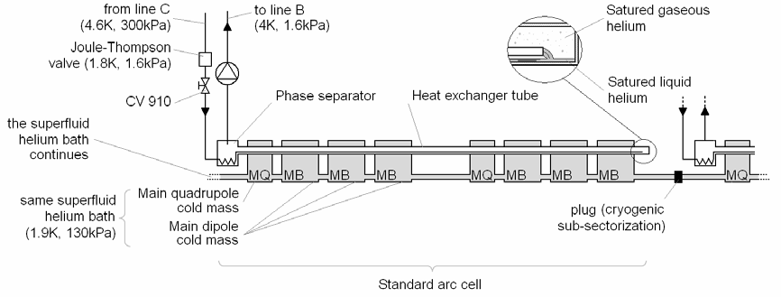
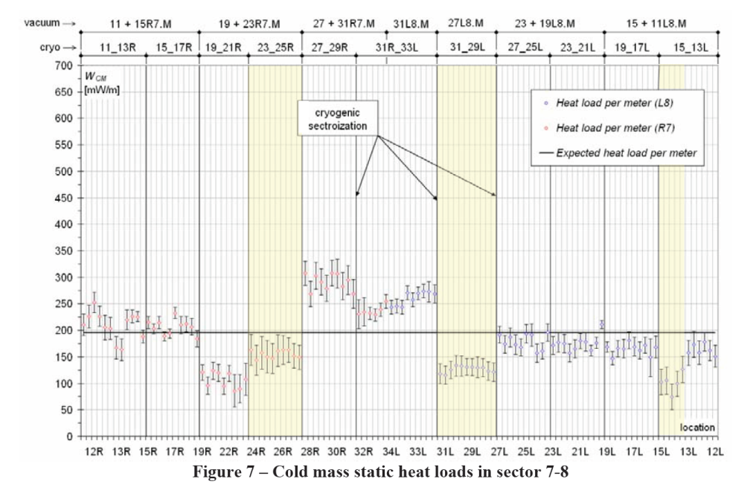
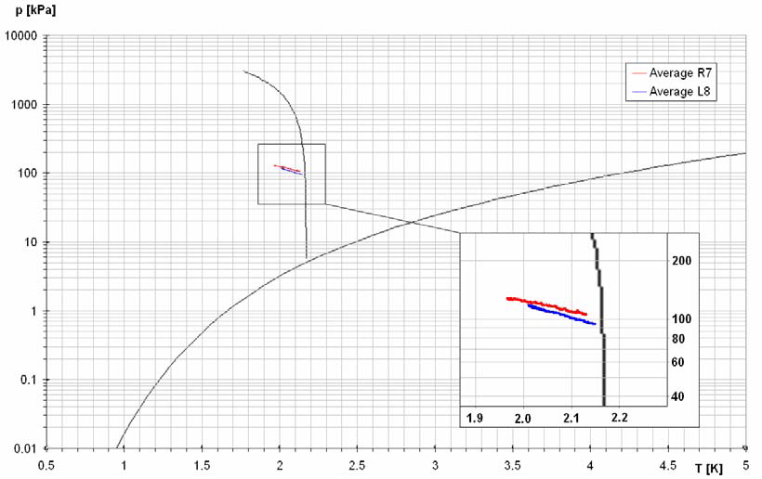
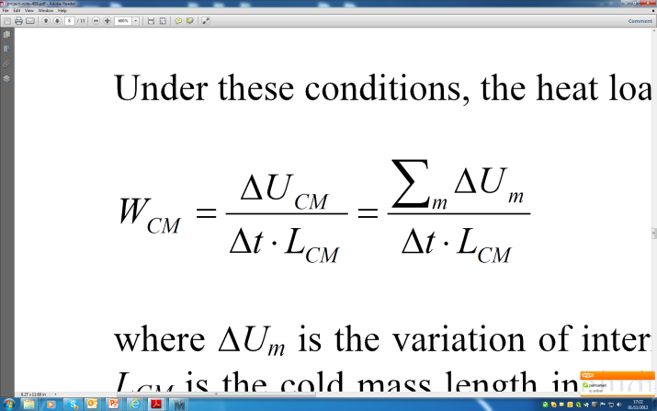
LHeII calorimetric measurements of 1.9 K static heat loads in LHC
Static HL natural warm-up of cryogenic subsector after stop in cooling
Schematic of a standard arc cell, a common superfluid helium bath of 106 m cooled by a unique heat exchanger tube.
Change of internal energy
Length of string of magnets
Average heat load to cold mass (10 MLI layers) ~ 0.2 W/m
Rescaled on cold mass surface and subtracting solid conduction contributions (lab tests on components) :
10 layers MLI between 50K and 1.9 K → ~ 0.054 W/m²
→ Practical figure: 50 mW/m²
Transformation in p-T helium phase diagram during warm up
C. Maglioni, V. Parma: “Assessment of static heat loads in the LHC arc, from the commissioning of sector 7-8”, LHC Project Note 409, 2008.

Slide 47
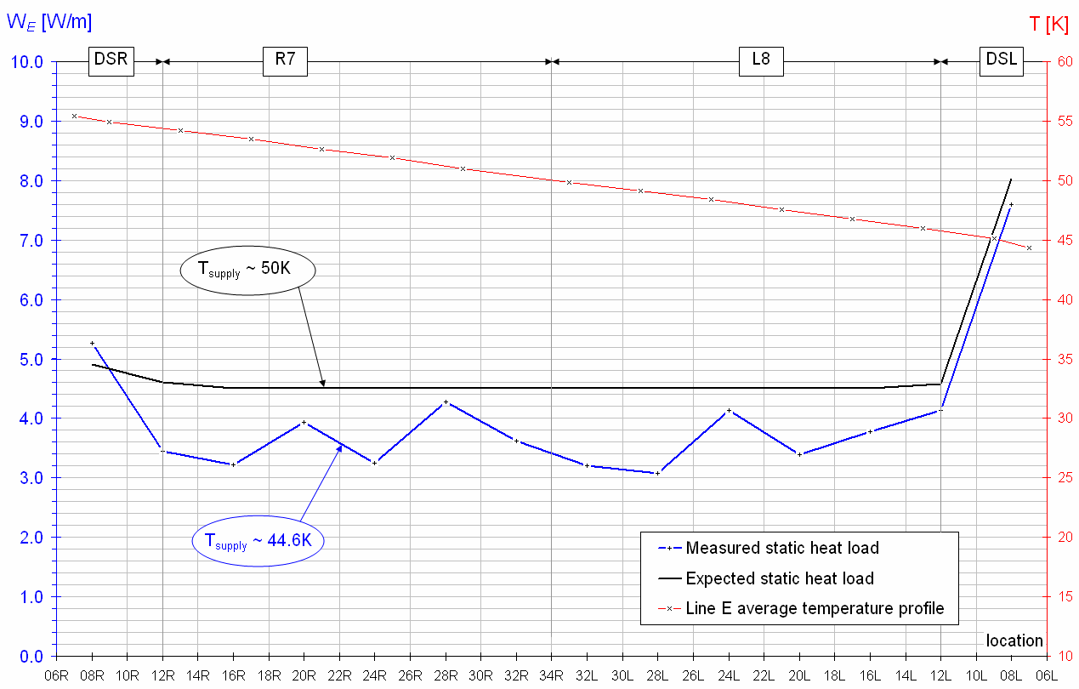
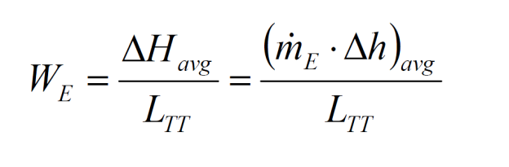
Non-isothermal cooling of LHC thermal shield (2’700 m)
[W/m]
Helium flow (measured)
Δh
Specific enthalpy change
(T measurements and He properties)
L^{TT}
Distance between T sensors
Thermal shield static heat load profile along sector 7-8
Average heat load @ 50K of ~ 4 W/m
Thermal shielding with MLI (30 layers)
Rescaled on cold mass surface and subtracting solid conduction contributions (lab tests on components):
30 layers MLI between 300K and 50 K → ~ 1 W/m²
→ Practical figure: 1 W/m²

Slide 48
Numerical application on the LHC Cryostat

Slide 49
Application to an LHC-like cryostat
heat loads HL will be calculated for a 1-m cryostat unit length
Vacuum vessel diameter: 1m (A_{VV}= π x 1= 3.14 m²)
Cold mass diameter: 0.6 m (A_{CM}= π x 0.6 = 1.88 m²)
T cold mass: 2 K
T vac.vessel: 293 K
Budgets: HL_{CM} ~ 0.2 W/m; HL_{TS} ~ 5 W/m

Slide 50
a) Bare cold mass
Emissivity cold mass: ε_{CM} = 0.12
Emissivity vac.vessel: ε_{VV} = 0.2
HL_{CM} = 63 W
Budget for LHC is ~0.2 W → HL too high

Slide 51
b) Cold mass wrapped with 1 layer of Al foil
Emissivity of Al foil (at 2 K): ε_{CM} = 0.06
HL_{CM} = 40 W
→ HL still too high

Slide 52
c) Cold mass wrapped with 30 layers of MLI
HL from 290 K with 30 MLI layers (calculated with MLI formula): 1.2 W/m²
HL_{CM} = 1.2x1.88= 2.3 W
→ HL still 1 order of magnitude too high

Slide 53
d) Addition of thermal shield actively cooled
Thermal shield diameter: 0.8 m (A_{TH}= = π x 0.8 = 2.51 m²)
Thermal shield at intermediate T → 80 K
Emissivity of Al (at 80 K): ε_{TS} = 0.1
HL_{CM} = 0.26 W
→ Close to budget
HL_{TS} = 79 W
→ too high (Budget for LHC is 5 W)

Slide 54
e) Wrapping of MLI around thermal shield
HL from 290 K with 30 MLI layers 1.2 W/m²
HL_{CM} = 0.26 W
→ Close to budget
HL_{TS} = 1.2x2.51= 3.01 W
Within budget for LHC (5 W)

Slide 55
f) Adding 1 Al foil around cold mass
Emissivity of Al foil (at 2 K): ε_{CM} = 0.06
HL_{CM} = 0.18 W
→ within budget (0.2 W)
HL_{TS} = 3.01 W
Within budget (5 W)

Slide 56
g) What in case of bad vacuum (He leaks)?
→ Residual gas molecular conduction:
From table, for He at 2 K: α_{CM}=1, for He at 80K α_{TH}=0.4 → α = 0.47
for He, Ω = 2.13 W/m².Pa.K
For 1 Al foil on cold mass, in case of degraded vacuum:
For P = 10⁻³ Pa (10⁻⁴ mbar):
(still quite good vacuum)
For P = 10⁻¹ Pa (10⁻² mbar):
(degraded vacuum)
Exceeds budget
2 orders or magnitude higher than
budget!!

Slide 57
h) Add MLI around the cold mass
10 MLI layers on cold mass
Using measured data
  In good vacuum (<10⁻³Pa): 50 mW/m²
  Under degraded vacuum (~10⁻¹ Pa): ~2W/m²
HL_{CM} = 1.88x0.05 = 0.09 W
(HL_{TS} = 3.59 W)
HL even lower
HL_{CM} = 1.88x2 = 3.8 W
MLI cuts residual conduction by 4 !!
Important note: MLI on helium vessels also necessary to reduce by about 7 condensation heat fluxes in case of accidental cryostat venting with air (bare surface: q ~4 W/cm² ; 10 layers of MLI: q ~0.6 W/cm² )

Slide 58
Summarizing
Case | 2K heat loads | 80 K heat loads
a) Bare Cold mass | 63 W | N.A.
b) Cold mass with 1 Al foil | 40 W | N.A.
c) Cold mass with 30 MLI layers | 2.3 W | N.A.
d) 1 thermal shield at 80K, no MLI | 0.26 W | 79 W
e) 30 MLI layers on thermal shield | 0.26 W | 3.01 W
f) As e) + 1 Al foil on cold mass | 0.18 W | 3.01 W
g) As f) but degraded vacuum | up to 15 W (10⁻¹ Pa) | > 3.01 W
h) +10 MLI layers on cold mass | 0.09 W in good vac. 3.5 W in deg.vac. | 3.59 W > 3.59

Slide 59
What about a second actively cooled shield?
Experimental program for LHC cryostat in the late nineties (Cryostat Thermal Model, CTM)
A 20 K active cooled screen with 10 MLI layers
An estimated saving of up to ~0.15 W/m at 1.9 K
but the an equivalent increase at the 5-20 K level (~5 times less costly)
Overall electrical power saving: ~ 100 Wel/m
Additional hardware (line, MLI, supports,etc) → higher capital cost
Additional assembly complexity
Breakeven only after ~10 years of operation
For LHC we decided to keep 1 active shield at 70K
70 K cooling
5-20 K cooling
The Cryostat Thermal Model

Slide 60
Thermal shield: what thickness ?
Aluminium shield, in Al 5052
Actively cooled by 1 cryo line at 80K
→ Average conductivity: k = 80 W K⁻¹m⁻¹
Uniform heat deposition:
HL_{TS}= 3.59 W → q = 3.59/(0.8x1x π) = 1.43 W/m²
Calculate thickness with the requirement:
Azimuthally quasi iso-thermal shield:
  ΔT_{max}= T_{max}-T_{min} ≈ 5 K
Remembering the formula yielding ΔT_{max}:
Replacing L by ½ circumference of diameter D (Tmax opposite to cryo line):
T_{max}
T_{min}
Cooling
line
(for LHC, 2.5mm thick Al 1100 equivalent)

Slide 61
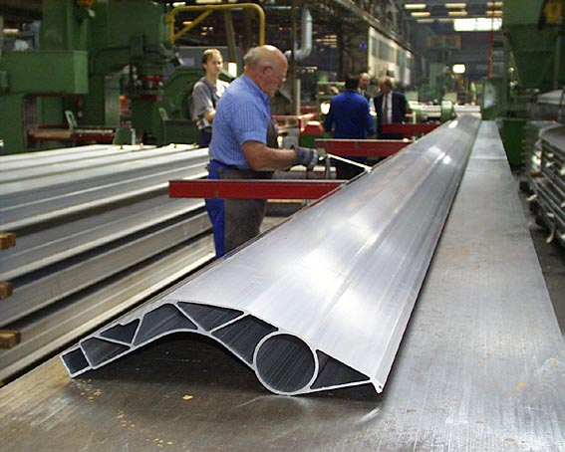
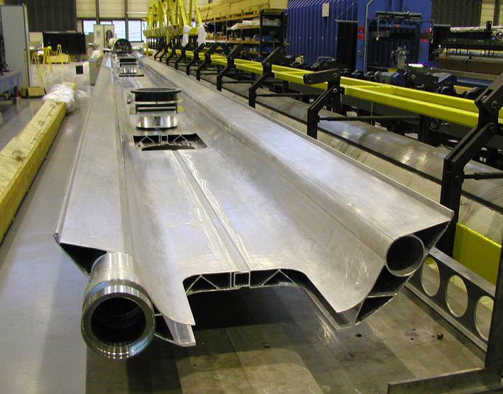
LHC thermal shields
Aluminium alloy 6063 extrusions and 1100 top sheets
LHC Main Cryostat
(Cross-Section)
Al 1100 sheets
He cooling (50-65K)
Al 6063 extrusions

Slide 62
Heat transfer to cryogenic fluids

Slide 63
2 main mechanisms of interest for cryostats
Vaporisation in pool boiling (2-phase)
  Latent Heat (LH) of vaporisation
  Isothermal cooling (T constant if P constant)
Vaporisation under 1 W heat load
Cryogen | Latent Heat (at 1tm) [kJ/kg] | [mg/s] | [l/h] (liquid) | [l/min] (gas NTP)
Helium | 21 | 48 | 1.38 | 16.4
Nitrogen | 199 | 5 | 0.02 | 0.24
Vapor
Forced internal (tube) convection of single-phase fluid:
  Non-isothermal cooling: enthalpy change of fluid
  Depends from thermo-hydraulics of the flow (see next slide)
  Used in cooling of thermal shields (supercritical He)
T_{in}
T_{out}
U
For more cooling mechanisms see dedicated lectures

Slide 64
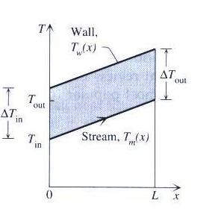
Forced Convection Heat Transfer
D
U
L
Forced flow of coolant fluid in round tube cooling lines
Considering hydro-dynamically and thermally fully developed flow
Uniform wall heat flux (linear T profiles)
Case of a Thermal
Shield
Convection heat transfer from wall to fluid:
Enthalpy balance along the line L:
Reynolds No.:
ReD>2000 → turbulent flow,
ReD<2000 → laminar flow
Nusselt No.:
For laminar flow:
For turbulent flow, NuD=f(ReD, Pr):

Slide 65

Frictional pressure drop in a tube
Pressure drop along tube

Slide 66
Cryogenics considerations

Slide 67

Helium as a coolant
Pressurized He II, Magnets: LHC, Tore Supra
Pressurized He I, Magnets, HERA, Tevatron
Saturated He II, SRF: CEBAF, TTF, SNS, EXFEL, ESS, ILC
Pool boiling He I, SRF: HERA, LEP, KEKB
Supercritical helium: cooling of thermal shielding
Property | Units | ⁴He | N₂
Boiling T (at 1 atm) | K | 4.2 | 77.3
Critical temperature | K | 5.2 | 126.1
Critical pressure | 10⁵ Pa | 2.23 | 33.1
Latent Heat of evaporation (at 1 atm) | kJ/kg | 21 | 199
Enthalpy between T boiling and 300K | kJ/kg | 1550 | 233
Liquid density (boiling at 1 atm) | kg/m3 | 125 | 810
Saturated vapor density (at 1 atm) | kg/m3 | 17 | 4.5
Gas density (at 1 atm 273.15K) | kg/m3 | 0.18 | 1.25
Liquid viscosity (at boiling T) | μPa.s | 20 | 17

Slide 68
Refrigeration efficiency (Carnot principle)
A refrigerator extracts a heat flow at a temperature below ambient and rejects it at a higher temperature (normally ambient)
The Carnot cycle defines the minimum mechanical work/power (i.e. Maximum Coefficient of Performance, COP) which depends only on Tw and Tc
All real machines have a lower efficiency (irreversibilities), expressed in fraction of COP
Tw
Qw
Work (W)
Qc
Tc
Carnot cycle
T
reversible isothermal
Fluid | T [K] | Carnot factor (W/Qc) [W/W] (considering Tw=293K)
LN2 | 77 | 2.8
LH2 | 20.4 | 13.4
LHe | 4.2 | 68.4
LHe | 1.8 | 161.8
Tw
W
Tc
reversible adiabatic (isoentropic)
S

Slide 69

Efficiency for large cryoplants
State-of-the-art figures for large cryo-plants (LHC-like, ~18 kW @ 4.5K):
COP @ 2 K → ~ 15% Carnot (990 W_{el}/W_{th})
COP @ 4.5 K → ~ 30% Carnot (210 W_{el}/W_{th})
COP @ 50 K → ~ 30% Carnot (16 W_{el}/W_{th})

Slide 70

He Liquefaction: conversion to 4.5K isothermal capacity
Refrigeration: recondensing cold vapours
  Limited use of cryogenic power at boil-off (latent heat of evaporation)
  Simpler cryoplant
Liquefaction: precooling + recondensing cold vapours
  Availability of cold vapours enthalpy up to RT
  Added complexity
He refrigeration He Liquefaction
W =T₀ [Q_{c}/T_{c} – Q_{c}] = T₀ ΔS_{c} – Q_{c}
(combining 1st & 2nd principle of thermodynamics, and introducing entropy)
W_{liq} =T₀ Δs_{cond}–Q_{cond} + T₀ ΔS_{precool} – Q_{precool} = T₀ ΔS_{cond}– ΔH_{cond}+ T₀ ΔS_{precool} – ΔH_{precool}
W _{condensation}
W _{Pre-cooling}
For T₀ = 300 K, and S, H tables → W_{liq} = 6,600 W per 1 g/s of He liquef.
Take 66 W_{el}/W_{th} as minimum specific refrigeration work @ 4.5 K (Carnot):
→ 1 g/s of liquefied He (6,600 W) is equivalent to ~100 W_{th} @ 4.5 K

Slide 71
Thermally efficiency solid conduction: heat intercepts, helium vapour cooling

Slide 72



Solid conduction in cryostats
LHC Main dipole
Solid conduction paths:
Supporting systems
Current leads
RF main coupler
Beam tubes Cold-to-Warm (CWT) transitions
Instrumentation feed-throughs
Necks (vertical cryostats)
Magnet Support Posts (GFRE)
Current leads
LHC instrumentation capillary at assembly
CWT SPL cryomodule
Neck

Slide 73
Solid conduction and heat intercepts
Tw=293K
A
simple solid conduction
L
Tc=2K
1 heat intercept at optimal distance
Minimizing using cost factors:
C₁ = 16 w/w
C₂ = 210 w/w
C₃ = 990 w/w
L₁
A
Q @ 80K
L
→ L₁
2 heat intercepts at optimal distance
L₁
A
Q @ 80K
L₂
L
Q @ 8K
→ L₁, L₂

Slide 74
LHC supports
Cold mass interface flange: 2 K
5-10 K heat intercept
50-65 K heat intercept
Two intercepts, 5K & 75K
GFRE composite
column
One intercept, 75K
Vacuum vessel
Interface flange: 293 K
No intercepts
4-mm thickness, single-part composite column (integrating interface flanges)
Manufactured by Resin Transfer Moulding (RTM):
  Suited to a large-scale industrial production (4’700 units)
  High reproducibility in thermo-mechanical properties

Slide 75

Vapour cooling in solid conduction
Vapour cooled wall
Assuming perfect exchange (T gas = T wall)
Tw
A
If , which is the residual heat to the bath, is equivalent to the evaporation (i.e. self-sustained):
L
x, T(x)
@ T_{l}
Reduced heat conduction in self-sustained helium cooling for selected technical materials
attenuation factor (w.r.t. solid conduction)
Large enthalpy in He vapours (1550 kJ/kg from 4.2K to 300K) → usable cooling capacity

Slide 76




Vapour cooled RF coupler for SPL
RF couplers with He gas cooled double walled tube
When RF is on, a distributed vapour cooling is essential to contain distributed RF heating (local heat intercepting can hardly provide efficient cooling)

Slide 77
Vapour cooling of current leads
Tw
A
conduction
cooling
(efficiency 0 < f < 1)
resistance heating
L
x+dx, T(x+dx)
With:
I, current in the lead
Cp(T), specific heat
f = 0 → no cooling
f = 1 → perfect heat exchange (T(x) lead=T(x) vapour)
x, T(x)
@ T_{l}
For current lead material following the Wiedmann-Franz law (most metals and allows, Cu for example):
ρ(T) and k(T) are correlated! (good electrical conductors are also good thermal conductors)
Minimising heat in-leaks is independent of material choice for normal conducting materials
Substituting in the above equation and integrating it for variable f efficiencies…(next slide)

Slide 78


Heat load to bath per unit current
No cooling
47 W/kA
Perfect cooling
1.04 W/kA
Example of off-the-shelf lead from AMI
(current rating up to 10 kA)
Enhancing thermal performance can be achieved with materials which do not follow the WF law
High Temperature Superconductors, for example, have zero resistivity and are relatively bad thermal conductors up to high temperatures. → more in specific lecture

Slide 79
End of 1st Part…

Slide 80
Insulation vacuum and construction aspects

Slide 81
Leaks
Units:
A leak is a throughput, normally given symbol q_{L}
Common units are:
  mbar.l/s atm.cc/s torr.l/s Pa.m³/s (SI unit)
  With a leak rate of 1 mbar.l/s a volume of 1 litre will change in pressure by 1 mbar in 1 second
  Units of mbar.l/s equivalent to atm.cc/s
    Eg immersed in water:
    A leak of 1 atm.cc/s would produce a bubble of 1 cm³/s
    A leak of 10⁻³ atm.cc/s would produce a bubble of 1 mm³/s
Flux through a leak will be different depending on the prevailing conditions (temperature, pressure, gas type)
Unless otherwise stated, a ‘standard helium leak rate’ in mbar.l/s implies:
  Helium as tracer gas,
  Under vacuum test,
  Helium at 1 bar_{abs} and 100% concentration
  System at 20 °C.

Slide 82

Leak tightness
No vacuum vessel is leak-tight, nor need it be
Define the satisfactory leak rate needed to remain within the needed pressure in a given time:
Normally 2 sources of pressure increase: leaks and outgassing
leak +
outgassing
leak
outgassing

Slide 83
Cryopumping: cryo-condensation
2-4.5 K surfaces have high pumping speed & capacity
Gas species have very low saturation vapour pressure except helium
Without helium leaks, equilibrium pressures < 10-6 mbar are obtained
→ helium leaks are the real issue

Slide 84

MLI outgassing
Outgassing in cryostats is normally dominated by MLI outgassing
For an LHC insulation vacuum sector (80 m³, 250 m²/m length of MLI, 214m length) exposed to ambient air for several weeks, we obtain ~ 1 e-3 mbar at RT after ~ 200 hrs pumping (S = 100 l/s). Equivalent to ~ 2 e-10 mbar.l/s/cm2 of MLI.

Slide 85
Insulation vacuum and heat loads from residual gas conduction
Insulation vacuum is about minimising heat transfer due to residual gas conduction (wrt to radiative and conductive heat transfer)
Only helium leaks can degrade the vacuum
Determine the maximum acceptable degraded helium pressure for cryostat (only helium matters for LHC)
  For LHC → ~ 10-4 mbar (10-2 Pa)
LHC dipole Cryostat Test Model results

Slide 86
LHC Strategy
Consider no mechanical pumping on insulation vacuum during operation
Determine maximum helium degraded vacuum pressure → 10-2 Pa
Determine helium cryosorption capacity of cold surfaces
  For LHC ~ 100 mbar.l of helium @ 1 e-4 mbar per 214 m of cryostat
Determine the leak rate that will saturate the cold surfaces of 1vacuum sector after 200 days of LHC operation → < 5 10-6 mbar.l/s
Use fixed turbos during thermal cycles and as ‘backup’ in case the tightness specification cannot be immediately reached
Apply cold/warm correlation for leak rates (considered to be up to x1000 at cold) → < 5 10-9 mbar.l/s per vacuum sector
Allocate higher levels of leak tightness to sub-assemblies and components in one same vacuum sector → down to < 10-11 mbar.l/s
→ These very low levels of leak tightness on steel metal work and welded piping assemblies are extremely challenging for construction and testing, especially for large industrial productions (e.g. LHC)

Slide 87

Leak detection - Common methods
TEST METHOD
Flux in atm.cm³/s or mbar.l/s
Bubble test
Over pressure
Pressure
variation
Over pressure
Under vacuum
Sniffing
halogens or H₂N₂
Over pressure
Helium mass
spectrometer
Over pressure (sniffing)
Under vacuum
Residual gas
analyser
Under vacuum
10²
10¹
10⁰
10⁻¹
10⁻²
10⁻³
10⁻⁴
10⁻⁵
10⁻⁶
10⁻⁸
10⁻¹⁰
10⁻¹²
Courtesy of P.Cruikshank

Slide 88


He leak detection methods
Sniffer
in helium
cloud
Sniffing
(leak localisation)
He
5 bar
He
Leak Detector
helium
Vacuum
(leak detection)
Vacuum
Helium
pistol
Q
Part
to test
q = helium flux in mbar. l/s
He
Leak Detector
Courtesy of P.Cruikshank

Slide 89



Leak detection with clam-shell
A practical detection method for
circumferential welds
Pumping of reduced volumes
Particularly interesting for helium polluted circuits (e.g. magnets cold tested in helium)
Clam-shells for pipe geometries for LHC

Slide 90



Welding
Tungsten inert gas welding
Tungsten Inert Gas (TIG) and Metal Inert Gas Welding (MIG) are the most commonly used processes in cryostat fabrication
Qualification of welding procedures and personnel required to fulfil mechanical requirements imposed by pressure vessel codes
Design of welded seams must be carefully chosen to avoid sources of impurities and defects
Non-destructive testing is often necessary
Metal inert gas welding

Slide 91


Design of vacuum facing welds

Slide 92







Design of pressure bearing welds
EN 13445-3 annex A is a good reference for designing pressure bearing welds. EN 1708-1 is also a very useful hamonised standard. Some examples:
Longitudinal welds
Circular welds
Flat ends
Nozzles

Slide 93
Welders and procedures qualification
 | Steel | Aluminium
Welding procedure approval | EN ISO 15614-1:2004 Specification and qualification of welding procedures for metallic materials - Welding procedure test - Arc and gas welding of steels and arc welding of nickel and nickel alloys | EN ISO 15614-2:2005 Specification and qualification of welding procedures for metallic materials - Welding procedure test - Arc welding of aluminium and its alloys
Qualification of welders | EN 287-1:2004 Qualification test of welders - Fusion welding - Steels | EN ISO 9606-2:2004 Qualification test of welders - Fusion welding - Aluminium and aluminium alloys
Qualification of welding operators | EN 1418:1998 Welding personnel - Approval testing of welding operators for fusion welding and resistance weld setters for fully mechanized and automatic welding of metallic materials

Slide 94





Some typical mistakes causing leaks
Flexible hose
Same weld including braid/ring/bellows → separate weld functions
Flanges made of cold rolled material
Leak through material inclusions → QA of raw materials, or 3-D forged flanges (but expensive!)
Sheet metal work vessel
Leak through material crack → QA of raw materials,

Slide 95


Brazing
Often the only solution to join different materials (ex: copper to stainless steel; stainless steel to ceramics…)
Vacuum brazing (no flux required) gives the most reliable joints, but at a cost
Thorough cleaning after brazing with flux is mandatory. Poor cleaning often results in the development of leaks in stainless steel due to corrosion!
Useful standards for brazing specification and execution:
Example of flame brazed stainless steel to copper transition for a thermal shield cooling circuit
EN 13134:2000 Brazing - Procedure approval
EN 13133:2000 Brazing - Brazer approval
EN 12797:2000 Brazing - Destructive tests of brazed joints
EN 12799:2000 Brazing - Non-destructive examination of brazed joints
EN ISO 18279:2003 Brazing - Imperfections in brazed joints

Slide 96
Mechanical considerations

Slide 97

Thin shells under internal pressure

Slide 98



Radial buckling under external pressure
Non-linear phenomenon. Actual critical pressure depends on initial imperfections: Safety factor needed!
Buckling critical pressure for a thin tube of infinite length
A conservative rule of thumb for stainless steel tubes under vacuum:
If we use a safety factor of 3:
Alternatively, we need to add reinforcements
Example:
r = 500 mm
t > 18.5 mm

Slide 99





LHC dipole Vacuum Vessels
Main features:
Pipeline standard size: 36-inch OD (1013 mm), 12-mm thick, low carbon steel (DIN GS-21 Mn5) tubes
St. steel extremity flanges
Material resilience: > 28 J/cm2 at -70ºC
Forged cradles, welded rings reinforcements
Dimensional stability:
  Stress relieving
  Final machining to achieve tolerances at interface
Production:
1250 units
2 firms
4 yrs of production
Stress relieving
Forged cradle
Out-doors storage at CERN
Final lathe machining
3-D dimensional control in Industry

Slide 100

Pressure vessel codes regulations
Pressure European Directive 97/23/EC (PED) is obligatory throughout the EU since 2002
  Applies to internal pressure ≥ 0.5 bar
  Vessels must be designed, fabricated and tested according to the essential requirements of Annex 1 (Design, safety accessories, materials, manufacturing, testing, etc.)
  Establishes the conformity assessment procedure depending on the vessel category, which depends on the stored energy, expressed as Pressure x Volume in bar.L
Category | Conf. assessment module | Comment
SEP | None | The equipment must be designed and manufactured in accordance with sound engineering practice. No CE marking and no involvement of notified body.
I | A | CE marking with no notified body involvement, self-certifying.
II | A1 | The notified body will perform unexpected visits and monitor final assessment.
III | B1+F | The notified body is required to approve the design, examine and test the vessel.
IV | G | Even further involvement of the notified body.
For vessels with non-dangeroureous gases (cryogenic liquids are treated as gas)

Slide 101
Harmonised codes and standards
Harmonised standards give presumption of comformity with the PED, within their scope. Uselful codes for cryostat design and fabrication:
  EN 13458-1:2002 Cryogenic vessels - Static vacuum insulated vessels - Part 1: Fundamental requirements
  EN 13458-2:2002 Cryogenic vessels - Static vacuum insulated vessels - Part 2: Design, fabrication, inspection and testing + EN 13458-2:2002/AC:2006
  EN 13458-3:2003 Cryogenic vessels - Static vacuum insulated vessels - Part 3: Operational requirements + EN 13458-3:2003/A1:2005
  EN 13445-1:2009 Unfired pressure vessels - Part 1: General
  EN 13445-2:2009 Unfired pressure vessels - Part 2: Materials
  EN 13445-3:2009 Unfired pressure vessels - Part 3: Design
  EN 13445-4:2009 Unfired pressure vessels - Part 4: Fabrication
  EN 13445-5:2009 Unfired pressure vessels - Part 5: Inspection and testing
  EN 13445-8:2009 Unfired pressure vessels - Part 8: Additional requirements for pressure vessels of aluminium and aluminium alloys
Other codes such as the French CODAP or the American ASME Boiler and Pressure Vessel Code can be used, but proof of conformity is at the charge of the manufacturer

Slide 102
Useful material standards for cryostats
Plates and sheets | • EN 10028-1:2007+A1:2009 Flat products made of steels for pressure purposes - Part 1: General requirements • EN 10028-3:2009 Flat products made of steels for pressure purposes - Part 3: Weldable fine grain steels, normalized • EN 10028-7:2007 Flat products made of steels for pressure purposes - Part 7: Stainless steels
Tubes | • EN 10216-5:2004 Seamless steel tubes for pressure purposes - Technical delivery conditions - Part 5: Stainless steel tubes • EN 10217-7:2005 Welded steel tubes for pressure purposes - Technical delivery conditions - Part 7: Stainless steel tubes
Forged blanks | • EN 10222-1:1998 Steel forgings for pressure purposes - Part 1: General requirements for open die forgings • EN 10222-5:1999 Steel forgings for pressure purposes - Part 5: Martensitic, austenitic and austenitic-ferritic stainless steels
Castings | • EN 10213:2007 Steel castings for pressure purposes
Pipe fittings | • EN 10253-4:2008 Butt-welding pipe fittings - Part 4: Wrought austenitic and austenitic-ferritic (duplex) stainless steels with specific inspection requirement
Bars | • EN 10272:2007 Stainless steel bars for pressure purposes
Aluminium | • EN 12392:2000 Aluminium and aluminium alloys – Wrought products – Special requirements for products intended for the production of pressure equipment (choose materials included in the list given in EN 13445-8 section 5.6)

Slide 103


Design stresses for some materials
Design stresses for plates less than 12 mm thick applicable to membrane stress (safety factor 1.5 included) according to EN 13445-3
For stainless steels:
Material | R_{p1.0} (MPa) | f (MPa) | f_{test} (MPa)
1.4306 (304L) | 240 | 160 | 228
1.4435/1.4404 (316L) | 260 | 173 | 247
1.4406/1.4429 (316LN) | 320 | 213 | 304
AW 5083-O/H111 |  | 83
For aluminium-magnesium alloys:
Material | R_{p1.0} /R_{m} (MPa) | f (MPa) | f_{test} (MPa)
AW 5083-O/H111 | 125/270 | 83 | 119

Slide 104
Best practices
Using a coherent set of standards throughout the lifecycle of the cryostat is the simplest and safest approach. As an example when using only EN harmonised standards:
  Error margins of pressure relief devices are taken into account in the design rules
  The design rules are only applicable if the material has enough ductility
  Materials certified for pressure vessels have measured minimum fracture toughness
  Safety factors included in buckling formulae take into account shape imperfections up to the allowable tolerances layed out in the manufacturing section of the standards
  The extent of welding inspection must be compatible with the joint coefficient used in thickness calculations
  Coherence of test pressure and testing procedure with the design rules

Slide 105
Thermo-mechanical considerations

Slide 106

Thermal expansion of some metals

Slide 107

Thermal expansion of some plastics

Slide 108
Thermal stress: 3 cases
ΔT
A) Restrained component
B) Assembly of different materials
ΔT
Material 1: α1, E1, A1
restrain
Material 2: α2, E2, A2
C) Different cooling ΔT₁(t) ≠ ΔT₂(t) (different material diffusivity or different cooling)
ΔT₁(t)
Material 1: α1, E1, A1
restrain
ΔT₂(t)
Material 2: α2, E2, A2

Slide 109
Supporting systems

Slide 110
Supporting system
Mechanical housing of cryogenic devices (supporting systems):
  Supporting of (sometimes heavy) devices
  Accurate & reproducible positioning (almost always)
  Precise alignment capabilities (SC devices in accelerators)
Many solutions available:
  Tie rods
  Suspended posts
  Compression posts
  …other
Each having specific advantages/drawbacks depending on:
  SC device’s weight and cryostat assembly methods
  Vacuum vessel external supporting (supported? Suspended?)
  Adjustment of cold mass inside vacuum vessel
  …
For the LHC, the compression posts were preferred because of :
  Heavy cold masses (~30 tons!) → supported on jacks on tunnel floor
  Cryostat assembly based on sliding (or rolling through) of cold mass standing on supports
  No need for adjustment, magnets individually fiducialised and machine aligned w.r.t. external cryostat-mounted fiducials

Slide 111


LHC dipole cryostat assembly
Assembly bench
Pulling through sliding on vacuum vessel

Slide 112
LHC Supporting system
The design is a trade-off between 2 conflicting requirements:
High flexural stiffness (for mechanical stability) → thick and bulky structure
Low heat in-leaks → thin and slender structure and low conductivity material
→ Flexural stiffness/conductivity is an interesting figure of merit in the choice of the material
F
(F is mainly the result of
interconnect forces
and gravity component)
(The acceptable x and θ
are alignment requirements)
θ
x
Q
(Q is to be within budget)

Slide 113
Choice of the material
St.steel → interesting below 20K
G10 and Ultem 2300 → preferable at 20K < T < 300K
Other interesting material: Carbon-fiber Epoxy → also interesting below 20 K (not shown in diagram)
For LHC, a Glass-fiber Epoxy Composite (GFRE) was chosen:
Good conductivity/flexural stiffness
Widely available on the market → cost effective for large production (5000 units!)
…but a specific thermal conductivity validation campaign was needed.

Slide 114
LHC supporting system
No. of supports, spacing and positions:
  2 support posts whenever possible:
    Isostatic: well known forces on cold mass/supports/vacuum vessel, not conditioned by handling
    Optimise spacing to minimize vertical sag
  Add 3rd support post if necessary for long cold masses:
    Limit vertical sag to acceptable values (cold mass straightness)
    Hyper-static: precautions when handling, use of specific girders
  Position of support posts on vacuum vessel:
    Always above the external jacks → direct load transfer from cold mass to ground, hence the vacuum vessel is unstressed (only vacuum loads).

Slide 115
The LHC vacuum vessel, a 3 supports solution

Slide 116
Longitudinal thermal contractions
Cold mass, thermal shield, support posts and vacuum vessel must be free with each other to cope with longitudinal thermal contractions
One fixed point per each component
Leave plays to cope with all extreme T cases (ex. Cold mass cold, thermal shield warm)
Guided sliding of cold mass onto vacuum vessel
Flexible thermalisations anchors
(example of an LHC special quadupole)
Fixed post
Sliding posts
Δl _{cold mass}= 30 mm (10m x 3mm/m)
Δl _{thermal shield}= 40 mm (10m x 4 mm/m)

Slide 117

Other solutions
HERA Dipole

Slide 118

Other solutions
RHIC Dipole

Slide 119


Other solutions
Tesla/TTF/ILC cryomodule
RF coupler (with bellows)
Fixed support
Invar longitudinal positioner
Sliding support
Inertia beam
External supports (jacks)

Slide 120

Other solutions
SNS high beta cryomodule
“Space-frame” and tie rods

Slide 121


Other solutions
SPL
cryomodule
Vacuum vessel
Double tube of the power coupler as main support
Inter-cavity support ensures alignment

Slide 122
Pressure relief protection systems

Slide 123
Pressure relief protection systems
Cryostats include large cold surfaces, inventory of cryogenic fluids, sometimes large stored energy (e.g. energized magnets)
  a potentially unstable energy storage which will tend to find a more stable state of equilibrium
  Through a thermodynamic transformation which can be sudden and uncontrolled with a dangerous increase of pressure
Protect personnel (burns, ODH) and equipment (direct and collateral damage)
Risk hazards:
  Sources of pressure:
    Compressors connected to cryo lines
    Connection to higher pressure source (e.g. HP bottles)
    Heating of “trapped” volumes (typically in a circuit between valves) during warm-ups
    Helium leak to insulation vacuum, with consequent increased conduction/convection heat loads to cryogenic liquid vessels
    Cryo-condensed air leaks on cold surfaces and consequent pressure increase and increased conduct/convection heat loads during warm-ups
    Heating/vaporization of cryogens from sudden release of stored energy in SC device (e.g. quench or arcing in a SC magnet circuit)
    Uncontrolled air/nitrogen venting of insulation vacuum with sudden condensation on cold surfaces
    Uncontrolled release of cryogenic fluid to higher T surfaces (thermal shield and vacuum vessel), and consequent pressure increase and increased of conduction/convection heat loads to cold surfaces
Often the most critical

Slide 124





A typical example…LHC 19th sept.2008
~2 t of helium in first 2 minutes, estimated He peak mass flow of 20 kg/s
Insulation vacuum relief device
…5 MW arc in an interconnect
…~50 t of longitudinal;pressure force, ~50 magnets displaced …
…uprooting of jacks

Slide 125
General approach
Risk analysis & mitigation:
Make a thorough risk analysis and evaluate risk hazards
Identify mitigation measures (e.g. protections of exposed bellows and flanged connections)
Identify severity of consequences and appreciate probability of the event
Define the maximum credible incident(s) and design the safety relief system accordingly
The safety relief system must be designed to keep pressure rise within the limits of the Maximum Allowable Working Pressure (MAWP)
Design steps:
Estimate the heat exchange and its conversion to mass flow rates to be discharged
Check the sizing of piping (generally designed for normal operation) to the relief device and increase if necessary
Choose the type of safety device (burst disks, valves, plates) and size the safety device (DN and set pressure). Make use of safety device manufacturers formulas and charts
Size recovery piping downstream of safety device and check venting needs in the buildings where the release occurs (ODH issue)

Slide 126
Pressure Safety Relief Devices
Vacuum vessel
  Typical ΔPmax < PS (0.5 bar relative to atm. for vac.vessels)
  Define DN of valve and set pressure, P_{T}
Cryogenic fluid vessel
  Typical ΔPmax < PS
  PS depends on the device (~few bar for SC cavities, up to ~ 20 bar for magnets)
  Define DN of valve and set pressure, P_{T}
Cryogenics fluid
Cryogenics fluid
Vacuum
Air
Vacuum
Air
  According to European directive 97/23/EC and EN 13648 “Safety devices for protection
  against excessive pressure”

Slide 127

Cryogenic fluid vessel
The cryogenic fluid volume must be protected against over-pressure consecutive to unexpected heat transfers
Hazard: breach in insulation vacuum:
Uncontrolled air/nitrogen venting of insulation vacuum with sudden condensation on cold surfaces
Heat flux:
From 3 experimental sources internationally recognised:
  W. Lehman and G. Zahn, “Safety Aspects for LHe Cryostats and LHe Transport Containers,” ICEC7, London, 1978
  G. Cavallari, et. al., “Pressure Protection against Vacuum Failures on the Cryostats for LEP SC Cavities,” 4th Workshop on RF Superconductivity, Tsukuba, Japan, 14-18 August, 1989
  M. Wiseman, et. al., “Loss of Cavity Vacuum Experiment at CEBAF,” Advances in Cryogenic Engineering, Vol. 39, 1994, pg. 997.
Experimental values:
0.6 W/cm2 for a superinsulated tank of a bath cryostat
Up to 4 W/cm2 for a bare surface tank of a bath cryostat
P↗
Cryogenic fluid
Air

Slide 128


Cryogenic fluid vessel (cont.d)
The safety device should be designed to relieve a mass flow equivalent to the highest heat load
Calculate the mass flow, Q_{m} to be released by the safety device (EN13468-3.4)
2 cases for calculating mass flow Q_{m}:
Below critical pressure (p<2.23 bar for helium):
  Bi-phase with liquid boil-off → take Lv (latent heat)
Above critical pressure (often the case):
  Supercritical fluid expelled → use a “pseudo latent heat” Lv’
P0 : relieving pressure [bara]
Pc : critical pressure [bara] (2.23 for He)
Qm : mass flow in [kg.s⁻¹]
W : heat load [W]
L : latent heat in relieving conditions [J.kg⁻¹] (20.10³ at 1 bar for He)
vg/vl : specific volume of saturated gas/liquid at P0 [m³.kg⁻¹]
L’ : specific heat input, see EN13468-3.4
h : enthalpy of the fluid [J/kg]
v : specific volume [m³.kg⁻¹]

Slide 129



Cryogenic fluid vessel (cont.d)
The minimum required flow area A is calculated with conservative assumptions on fluid properties
For compressible fluids, the mass flow through a restriction depends on the downstream pressure until a fixed Pb/P0 ratio (0.49 for helium)
= 0.49 for He

Slide 130


Vacuum vessel
The vacuum vessel safety device is designed to relieve a mass flow equal to the highest incoming flow but at warmer temperature while keeping the vessel pressure within the PS
Identify the worst case scenario (highest mass flow and coldest fluid)
Often the worst case corresponds to a rupture of a cryogenic circuit:
    The cryogenic fluid flows into the vacuum vessel → the fluid vaporizes/expands in contact with the warm walls → the internal pressure increases until the safety device set pressure → the device opens and the fluid is relieved to atmosphere
Calculate the mass flow from the reservoir to the vacuum vessel
  Estimate the area of the breach in the cryogenic circuit
  Calculate the mass flow through an orifice
Air at Patm
Cryogenics fluid
Pvv > Patm

Slide 131


Vacuum vessel (cont.d)
Calculate the minimum required flow area, A for the safety device
  Mass flow through the safety device = mass flow to the vacuum vessel
    Qm1=Qm2
    A > than the orifice area as Pb/P0 is lower and the gas is warmer.
  The flow area is highly dependent on the relief temperature, usually difficult to estimate
    First case T_{relief} = 300K
    If the device is too big, investigations are needed to estimate T_{relief}

Slide 132



Examples of safety devices
Burst disks
LHC pressure release plates
(DN200)
Safety valves
  Some suppliers:
  Herose, Rembe, Ramseyer, Leser…

Slide 133
Summary
Since Dewar’s invention, cryostats have evolved from simple containers for cryogens to sophisticated mechanical assemblies for SC accelerator devices for fundamental science as well as for industrial applications (e.g. NMR machines)
Though the understanding of the heat transfer phenomena involved in a cryostat have considerably progressed since the time of Dewar, the main outstanding innovation was the introduction of MLI, in the 50^{ties}…
…But the enabling technologies, have greatly evolved from “simple” “glass-blowing” to covering a wide range of disciplines, enhancing performance of modern cryostats:
  Low thermal conductivity composite materials
  Stainless steel (and low-carbon steel) sheet-metal work compatible with vacuum requirements
  Vacuum and cryogenics technology
  Leak-tight welding techniques
  Leak detection with helium mass spectrometry
  …
The cryostat design engineer is confronted with a multidisciplinary environment in which he needs to master “a little of everything”
…not to forget the industrialisation aspects when he is asked to produce cryostats in large series

Slide 134
Thank you for your attention!
Acknowledgements:
The work presented in this course is essentially the result of contributions from a number of colleagues and the work done during the design and construction of the LHC
I wish to acknowledge in particular for the material provided and for their contributions in preparing this course:
R.Bonomi, P.Cruikshank, Ph.Lebrun, Y.Leclercq, D.Ramos, A.Vande Crean and G.Vandoni

Slide 135
References and selected bibliography
A.Bejan, Heat Transfer, J.Wiley & Sons, Inc
CRYOGENIE, SES APPLICATIONS EN SUPRACONDUCTIVITE, IIF/IIR 1995, Techniques de l’ingenieur.
Superconducting Magnets, M.Wilson, Oxford Science Publications
R.R.Conte, Éléments de Cryogénie, Masson & Cie, Éditeurs.
Steven W.Van Sciver, Helium Cryogenics, The International Cryogenics Monograph Series, Plenum Press.
K. Mendelssohn, The quest for absolute zero, McGraw Hill (1966)
R.B. Scott, Cryogenic engineering, Van Nostrand, Princeton (1959)
G.G. Haselden, Cryogenic fundamentals, Academic Press, London (1971)
R.A. Barron, Cryogenic systems, Oxford University Press, New York (1985)
B.A. Hands, Cryogenic engineering, Academic Press, London (1986)
S.W. van Sciver, Helium cryogenics, Plenum Press, New York (1986)
K.D. Timmerhaus & T.M. Flynn, Cryogenic process engineering, Plenum Press, New York (1989)
Proceedings of CAS School on Superconductivity and Cryogenics for Particle Accelerators and Detectors, Erice (2002)
  U. Wagner, Refrigeration
  G. Vandoni, Heat transfer
  Ph. Lebrun, Design of a cryostat for superconducting accelerator magnet
Proceedings of ICEC and CEC/ICMC conferences

