Slide 1


Superconductors for magnets I
René Flükiger
CERN
TE-MSC

Slide 2
Outline: Outline: Low T_{c} Superconductors (LTS)
I Introduction, Definitions
II Physical properties of superconducting Materials:
NbTi and Nb₃Sn
III Thermal Stability criteria
IV The system NbTi, properties and fabrication
V The system Nb₃Sn
A. Superconducting properties of the A15 phase
B. Wire fabrication and critical current densities
C. Calorimetric analysis of Nb₃Sn wires

Slide 3
I. Introduction, definitions
Actual situation of superconductor wires
Round wires
NbTi Still the most used wires: ~ 90% (MRI, accelerators)
Nb₃Sn > 5% (NMR, lab magnets, accelerators as LHC Upgrade)
MgB₂ Low costs; Niche applications at 10 – 25 K (open MRI, LINK)
Bi-2212 Future accelerators at >20T. Problem: mechanical stability
Tapes
Bi,Pb(2223) Cables, motors at T< 30K. Problems: costs, < 1 T at 77K)
YBCO Cables, Current limiters, Wind generators,…….
(Main problems: costs, limited lengths)
Commercially available: < 500 m SuperPower, USA
< 500 m at Fujikura, Japan
Other high field superconductors
Ba_{0.6}K_{0.4})Fe₂As₂ Pnictides: promising for high field magnets (B_{c2} > 70T), but not yet at
the industrial level. Problems: toxicity of As, complex metallurgy.
PbMo₆S₈ Chevrel phases. B_{c2}>50T!
Problems: Reaction at > 1000°C, very difficult deformation, no
prestress.

Slide 4
Technically interesting superconductors
Compound | Year | T_{c} | B_{c2}(0) | ξ
 |  | (K) | (T) | (nm)
NbTi | 1960 | 9.5 | 14.6 | ~ 6
Nb₃Sn | 1953 | 18.3 | 24 - 28 | ~4 | LTS
PbMo₆S₈ | 1970 | 15 | 60 | 2.2
Nb₃Ge | 1972 | 23 | 38 | ~4
Nb₃Al | 1975 | 19 | 33 | ~4
MgB₂ | 2001 | 39 | 39ª_{bulk}; 60ª_{films} | 5
Bi₂Sr₂Ca₁Cu₂O₈ | 1989 | 94 | > 100ª | 1 - 2
Bi₂Sr₂Ca₂Cu₃O₁₀ | 1989 | 110 | > 100ª | 1 - 2
YBa₂Cu₃O₇ | 1988 | 92 | > 100ª | 1 - 2
(Ba_{0.6}K_{0.4})Fe₂As₂ | 2007 | 38 | 70 - >135ª | 2 - 3
HTS

Slide 5
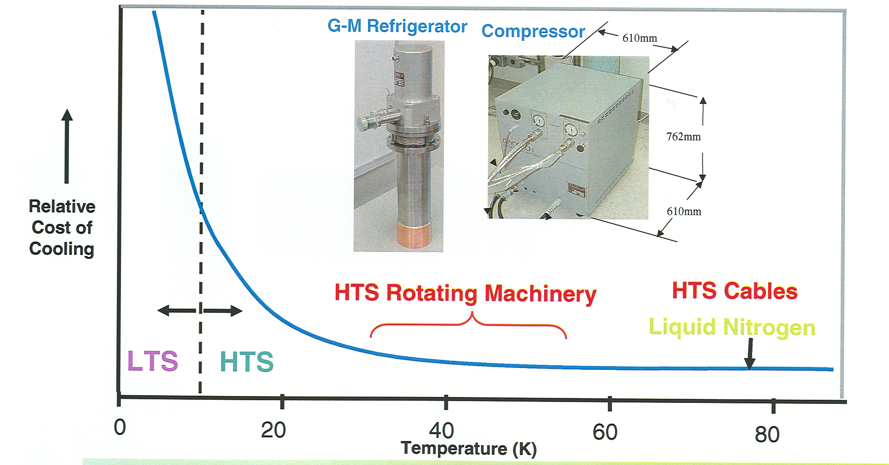
Cooling Regime for various Superconducting wires

Slide 6
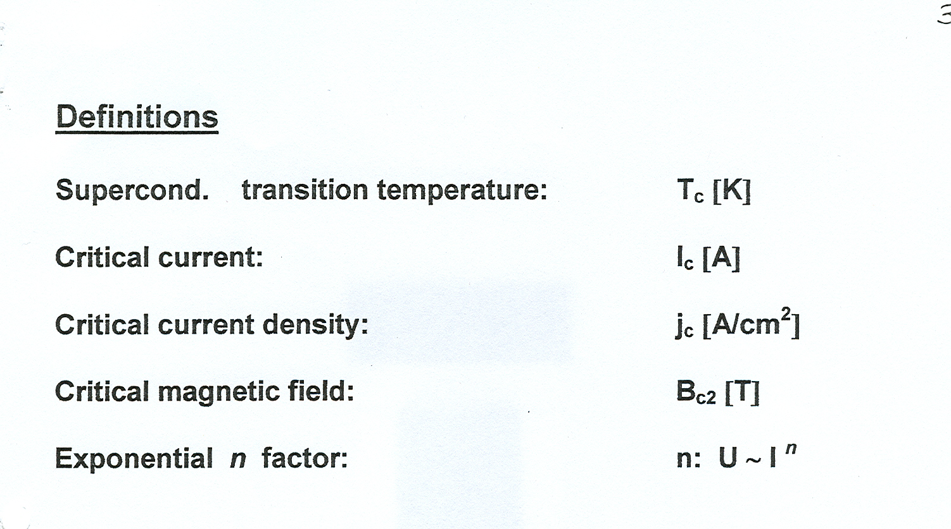
Applied Superconductivity: Definitions
; j_{c} [A/mm²]

Slide 7
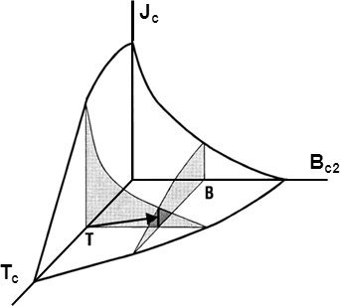
Critical surface in type II superconductors
The critical surface is the boundary between
superconductivity and normal resistivity in the
3 dimensional space.
Below the 3D surface: superconductivity.
Above the 3D surface: normal state, with R ≠ 0.

Slide 8
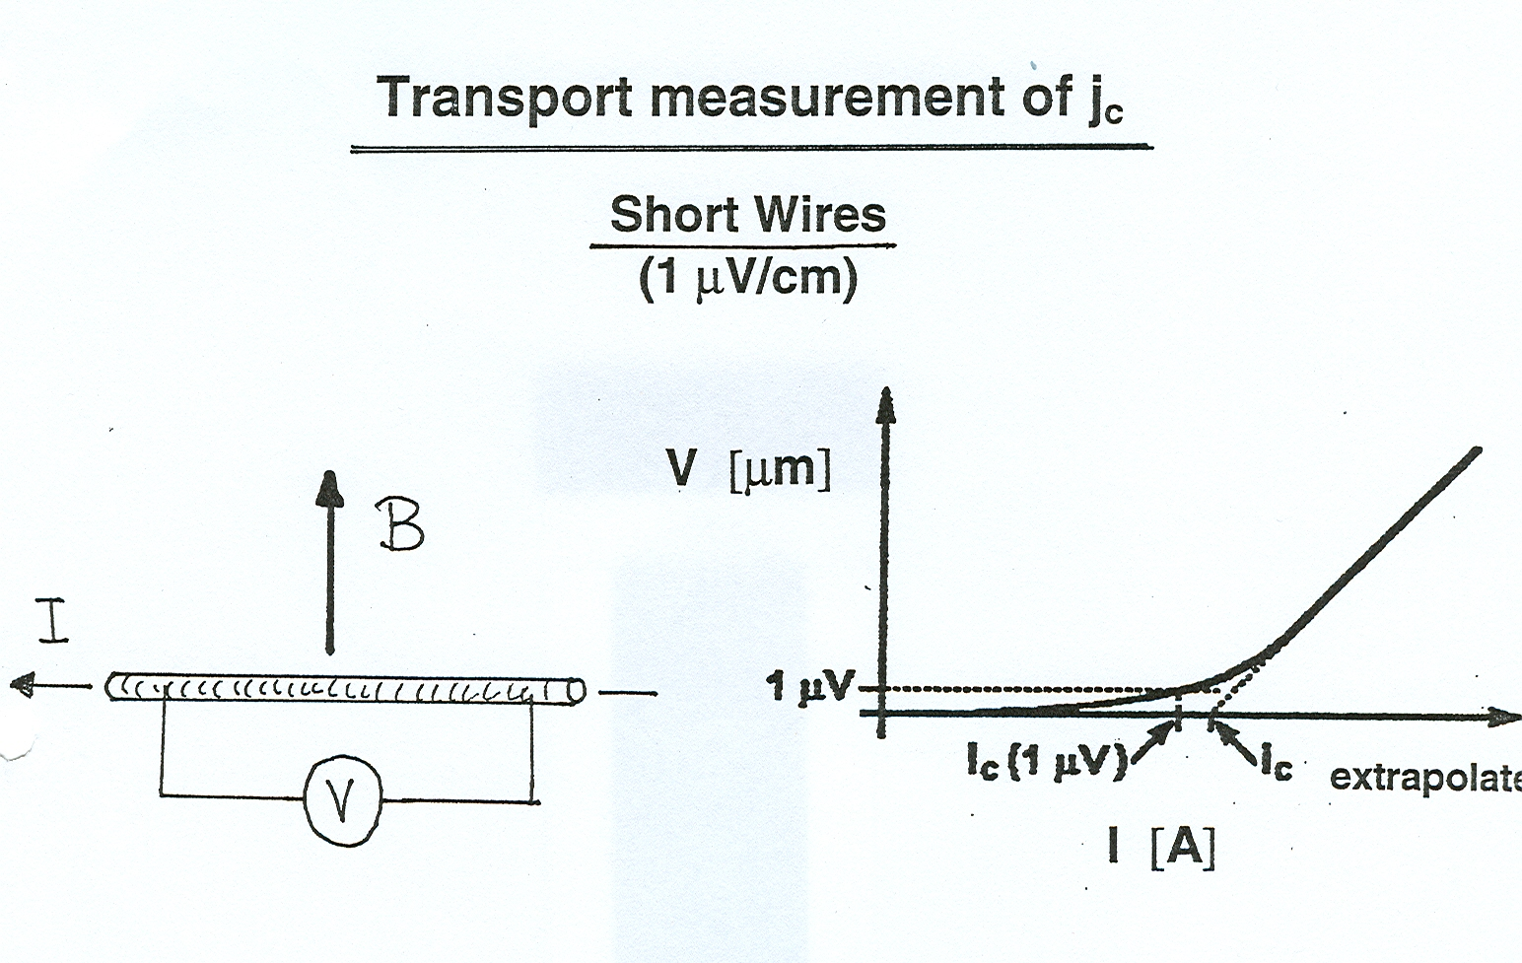
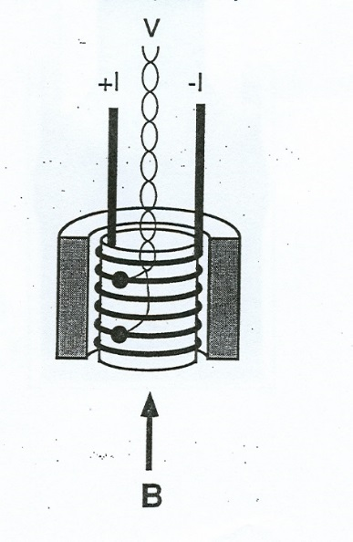
Transport Measurement of J_{c}
Long wires
(length: > 0.1 m)
V
(μV)
Industrial wires:
Criterion for J_{c}: 0.1 mV/cm
B
Short wires
(2-3 cm length)
Short wires (research): Criterion for J_{c}: 1 mV/cm

Slide 9
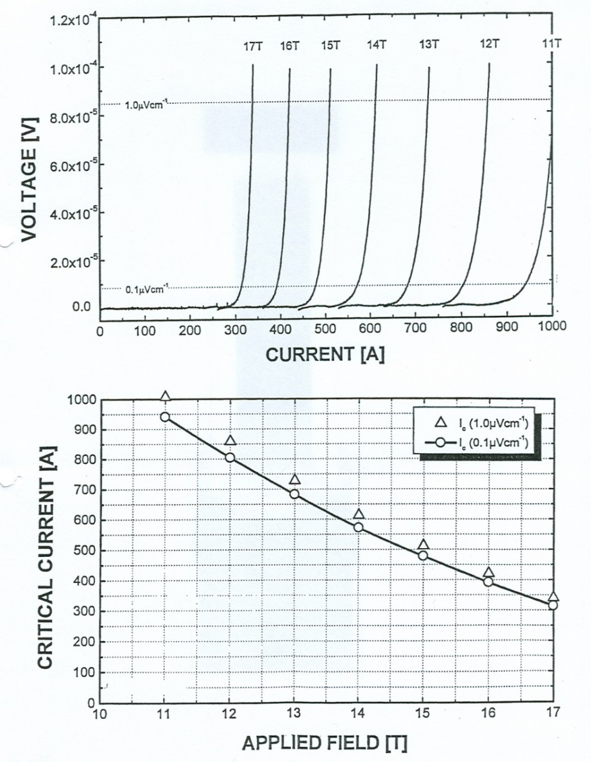
Measurement of Industrial Nb₃Sn wires
Resistive superconducting transition at various magnetic fields
1.0 μV/cm
0.1 μV/cm
Variation of critical current vs.
applied magnetic field B

Slide 10
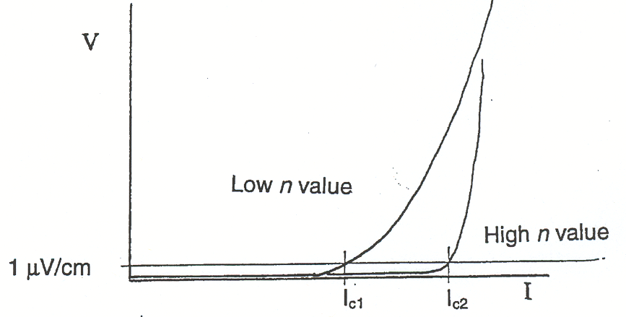
The exponential n factor
The n factor is an empirical quantity describing the quality of the wire:
* surface state of the filaments
* homogeneity along the wire axis («sausaging»)
Definition: V ~ I^{n} at a given operational B and T
V ~ I^{n}
v
I
In general, a high n value corresponds to a wire of higher quality
Required: n > 30 at operational B and T.
In particular: NMR magnets (persistent mode)

Slide 11
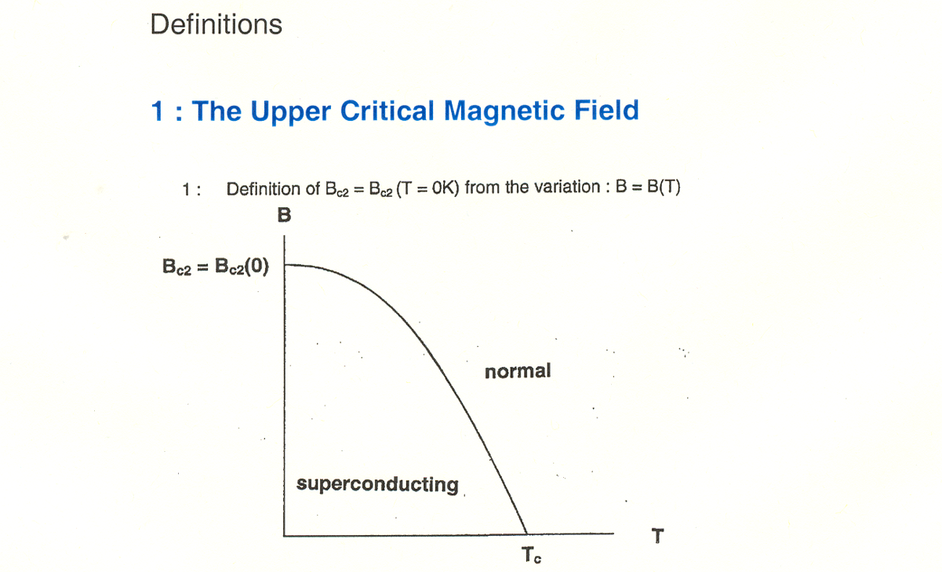
II. Physical properties of superconducting Materials: NbTi and Nb₃Sn
The upper critical magnetic field B_{c2}

Slide 12
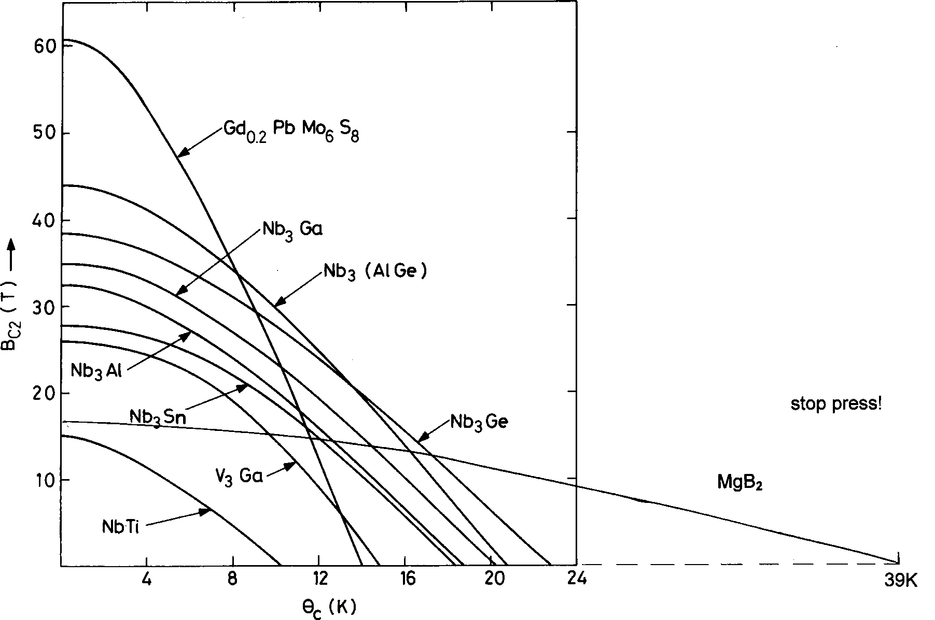
Upper critical fields of metallic (LTS) superconductors
NbTi is the only ductile superconductor
with B_{c2} > 10T !
B_{c2} (T)
T_{c} (K)

Slide 13
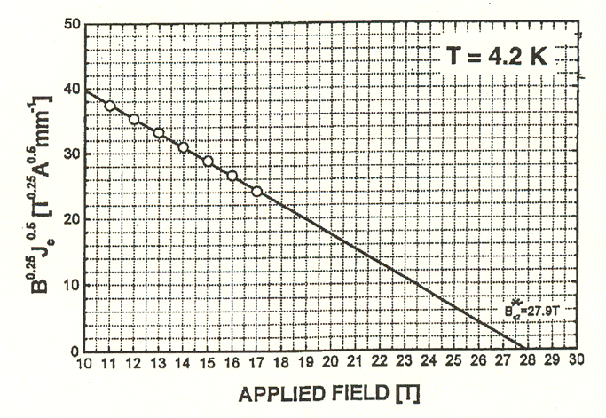
Kramer extrapolation: estimation of B_{c2} at a given T
B_{c2}(0) is determined by measuring B_{c2}(T) either resistively or inductively.
In the case of wires, where I_{c} is known, one uses the Kramer extrapolation:
the function B^{¼} I_{c}^{1/2} (T) vs. B is extrapolated to B = 0 B_{c2}* _{T}
B^{¼} I_{c}^{1/2} (T) vs. B
For magnets, one defines usually:
NbTi : B_{c2}*(1.9 K),
Nb₃Sn: B_{c2}*(4.2K).
These extrapolated values may differ from B_{c2}(4.2K) or B_{c2}(1.9K) determined
by a direct measurement.

Slide 14
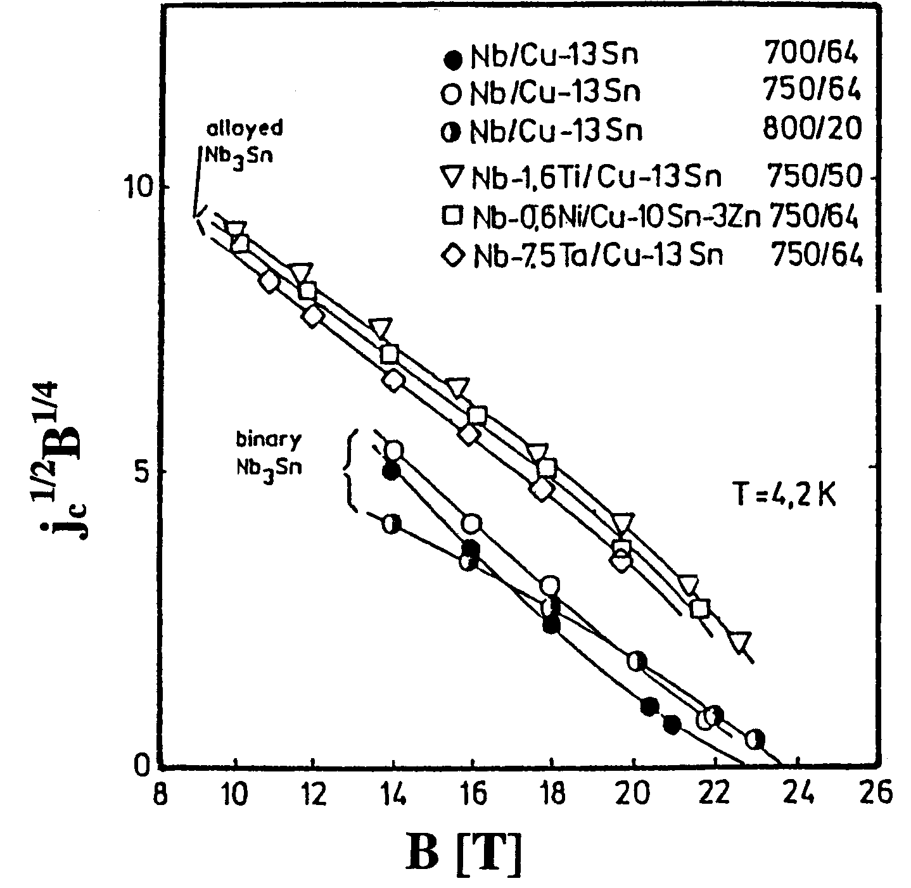
The Kramer extrapolation
Examples for the
uncertainty in the determination of B_{c2}
binary
Ternary Nb₃Sn

Slide 15
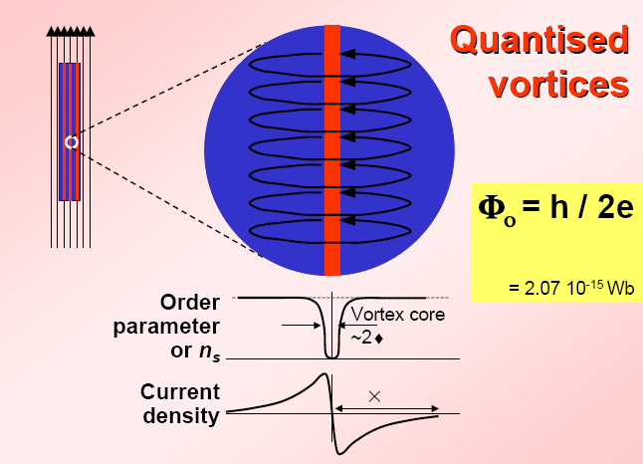
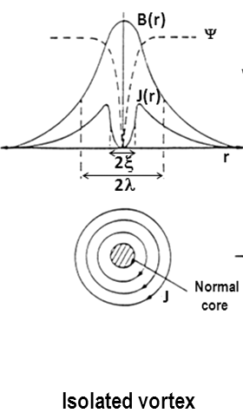
Flux pinning in superconducting wires

Slide 16
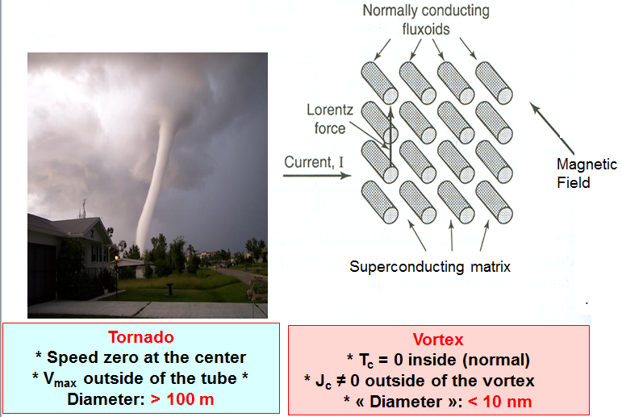
How to imagine a vortex?

Slide 17
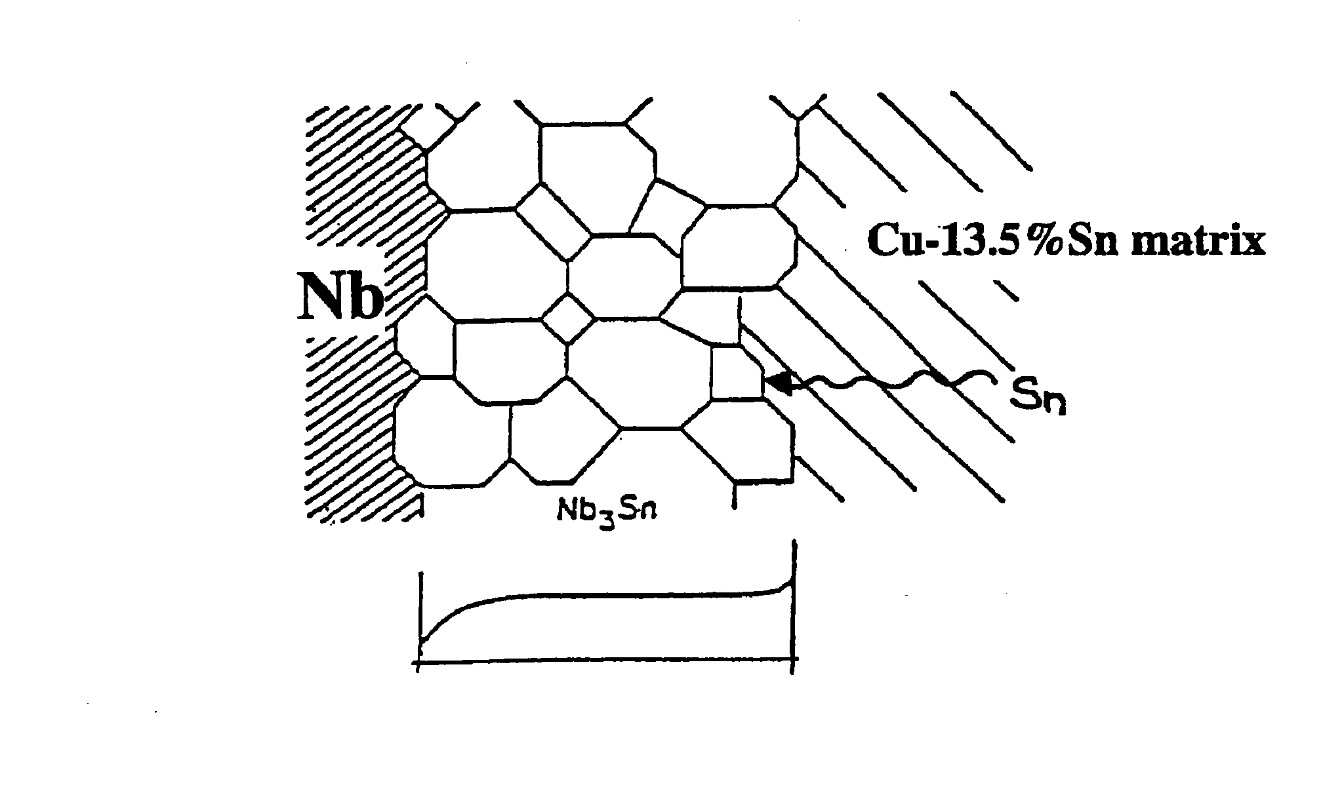
Possible pinning mechanisms
J_{c} in a wire is zero, unless vortices can be «pinned» !
Microscopic defects provide pinning sites:
Precipitates
Dislocations
Twin boundaries, stacking faults
Irradiation tracks
Grain boundaries
Grain boundaries: main contribution to pinning in LTS

Slide 18
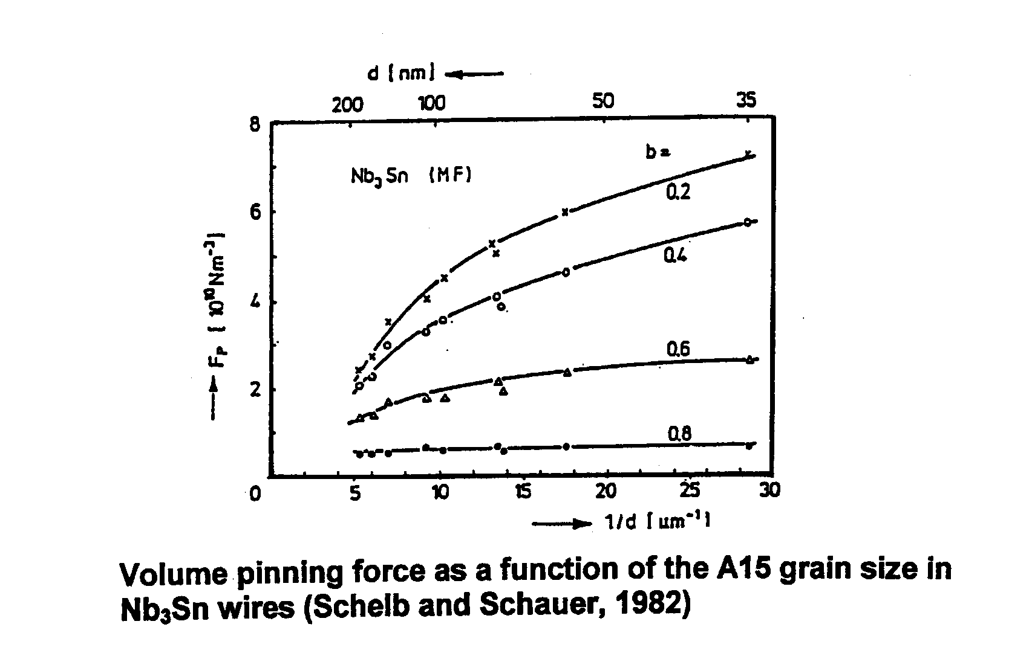
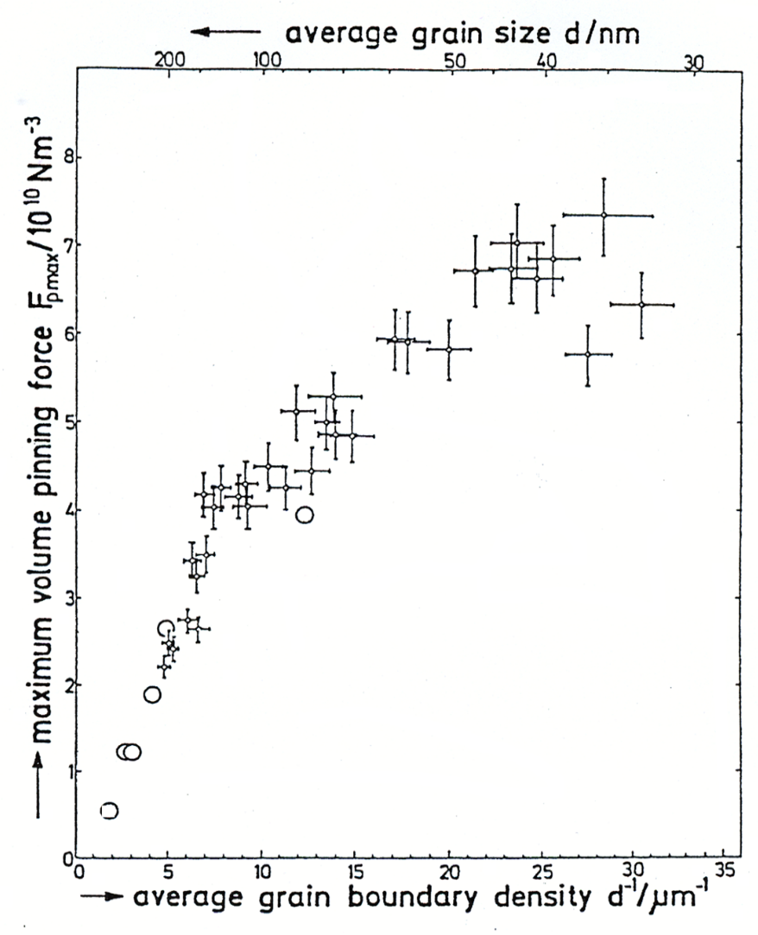
Correlation between grain size and J_{c} in LTS
100 nm
Nb₃Sn
100 nm
The smaller the grain the larger the pinning force due to grain boundaries !
Schauer and Schelb, 1980

Slide 19
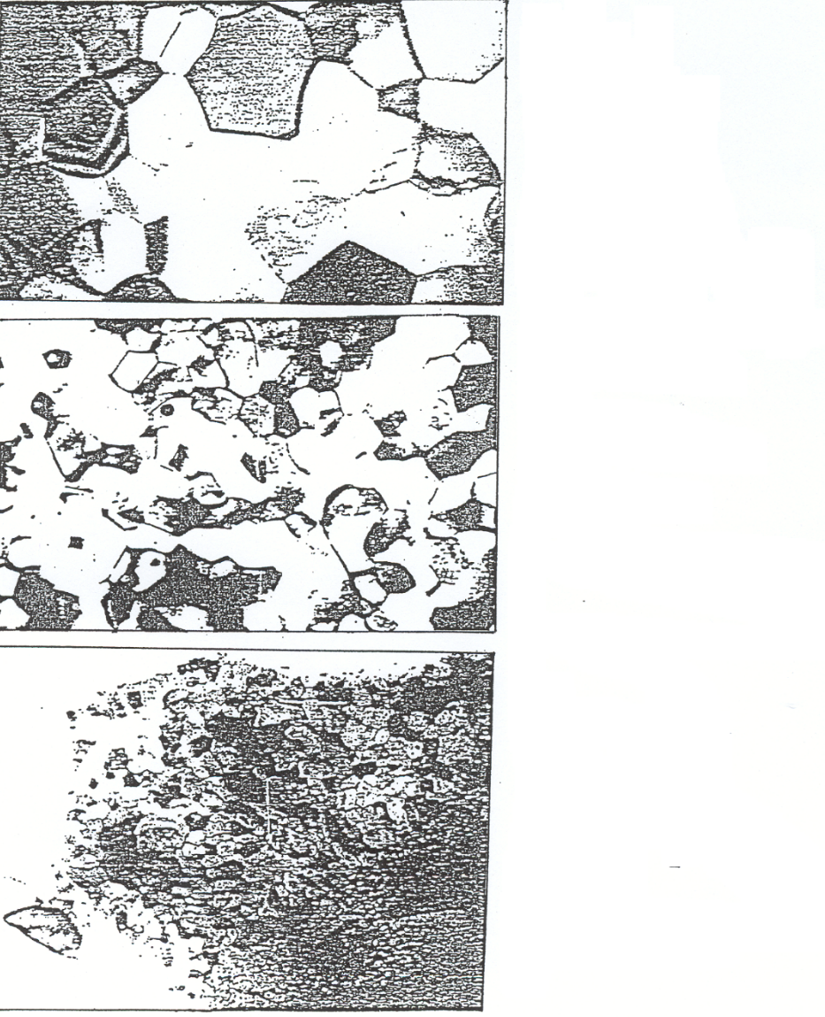
Nb₃Sn: effects of grain size and pinning force
Nb₃Sn bronze route wire
(valid for all wire types)
800 °C/48h
d_{k} =200 nm
F_{pmax} = 2.5 x 10¹⁰ Nm⁻³
Increase of grain size with reaction temperature
=
decrease of the pinning force F_{p}
680 °C/48h
d_{k} = 85 nm
F_{pmax} = 5.1 x 10¹⁰ Nm⁻³
600 °C/200h
d_{k} = 40 nm
F_{pmax} = 6.8 10 ¹⁰ Nm ⁻³

Slide 20
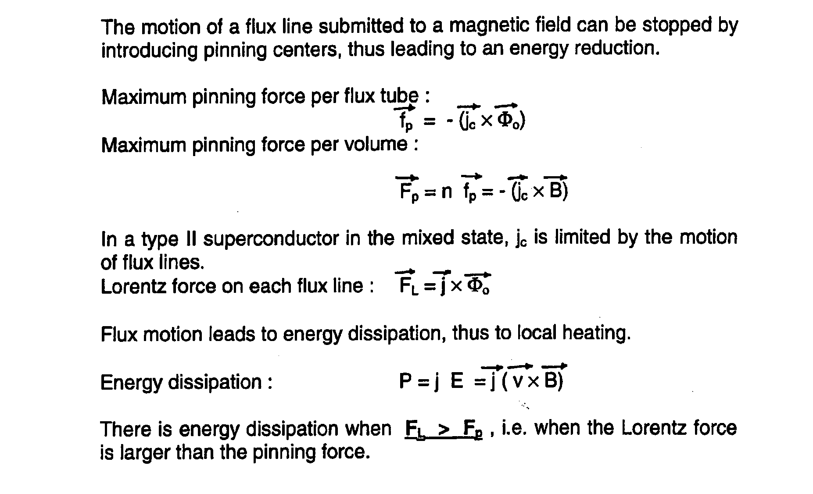
The Pinning Force
Pinning Force
Lorentz Force
F_{P} > F_{L}

Slide 21
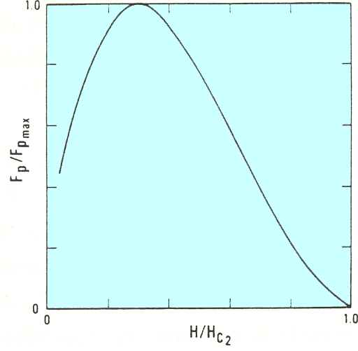
Variation of the Lorentz force F_{p} with reduced field
Reduced field: b = B/B_{c2}
F(b) ~ b^{p}(1-b)^{q}
Reduced volume pinning force
B/B_{c2}

Slide 22
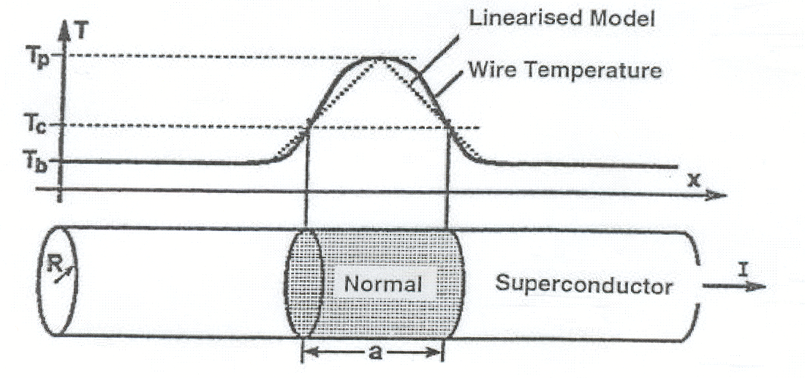
III. Thermal Stability of a wire submitted
to a current
Local and/or temporary perturbations may lead to thermal instability and to a quench.
Consider a wire with T_{c} submitted to I in bath T_{b}. Stable operation conditions: T_{c} > T_{b}

Slide 23
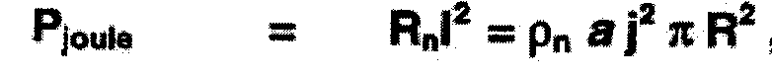
Why multifilamentary superconducting wires?
Suppose a local perturbation causing : T = T_{p} > T_{c}
* a resistive zone develops in the wire
* Joule heat is built up locally.
Energy to be evacuated to restore the superconducting state comprises: *the energy leading to the perturbation, and
*the energy produced by the Joule heat.
Three different power terms have to considered:
1: The Joule heat
where j = I / πR², and ρ_{n} = normal resistivity.

Slide 24
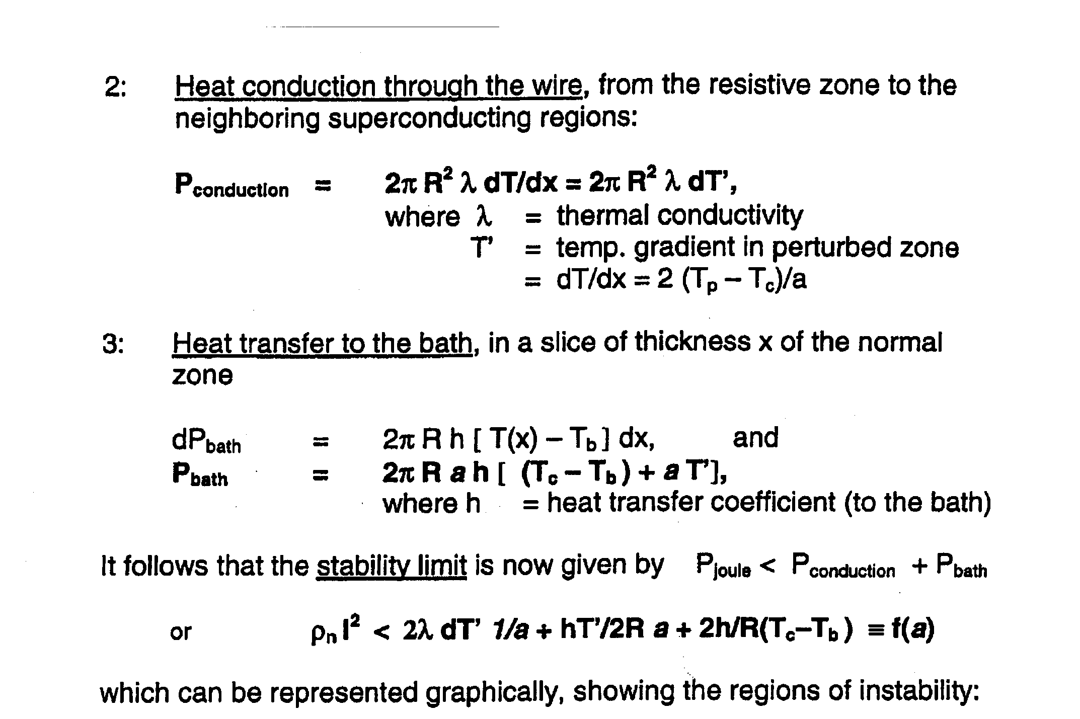
2. Heat conduction through the wire
Heat from the resistive zone to the neighbouring superconducting region:
3. Heat transfer to the bath, in a slice of thickness x
The thermal stability limit is now given by :
P_{joule} < P_{conduction} + P_{bath}

Slide 25
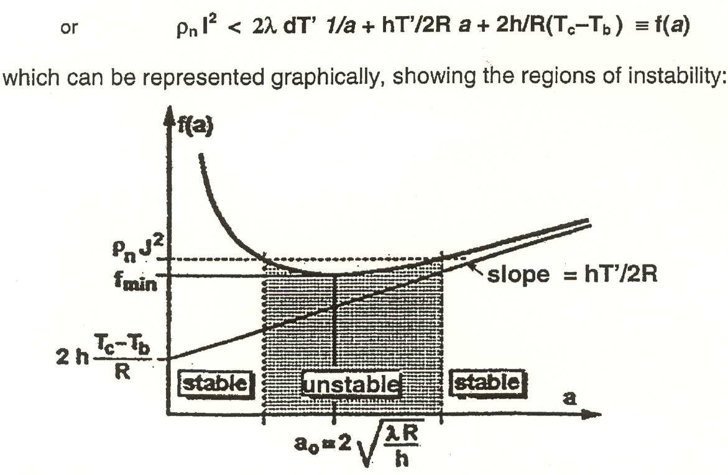
Regions of instability in a wire
Graphical representation showing the regions of instability

Slide 26
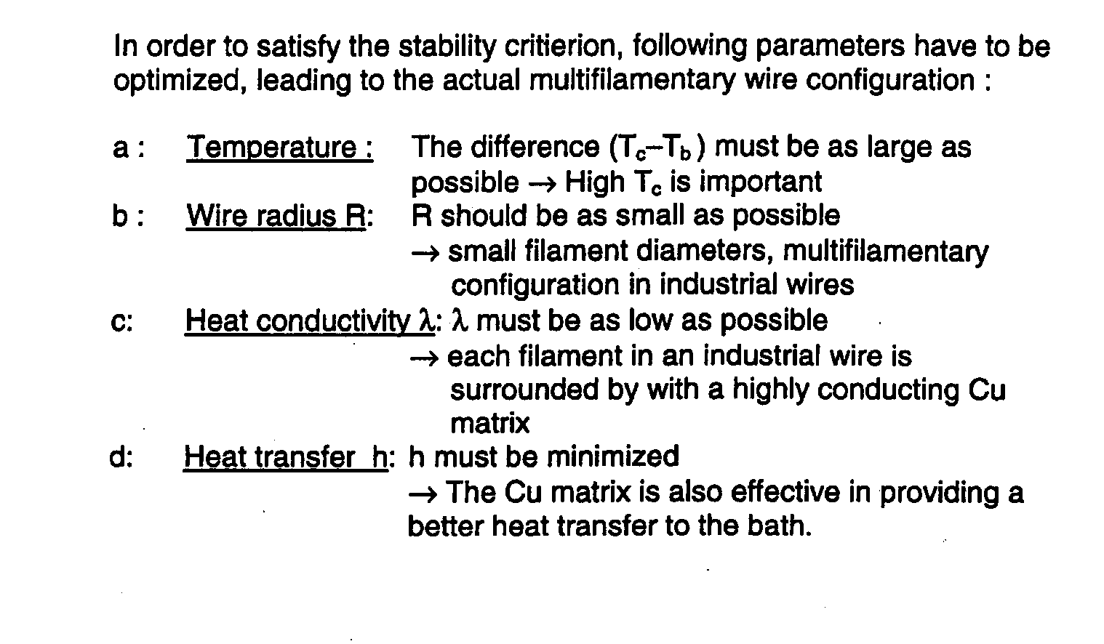
Stability criteria for wires
R should be as small as possible
l must be as high as possible
h
maximized

Slide 27
Practical criteria for stability and applicability of superconducting wires
1 : Chemical stability
2 : Mechanical stability :
Bulk superconductors (except NbTi) break at e <0.05 % !
→ microcomposite (multifilamentary) configuration Filament size: < 5 - 30 mm
Wires: Irreversible strain: e_{irr} > 0.4 %
3 : Cryogenic stability : presence of Cu as stabilizer
High thermal conductivity of Cu
→ a minimum quantity of stabilizer is required (> 23% Cu)
4 : Electromagnetic stability :
Low AC coupling losses required → Twisting of wires
5 : Low material costs
6: Length: > 1 km
Typical wire configuration: 1’000 -10’000 filaments
5 - 30 μm filament size
25 cm twist pitch

Slide 28
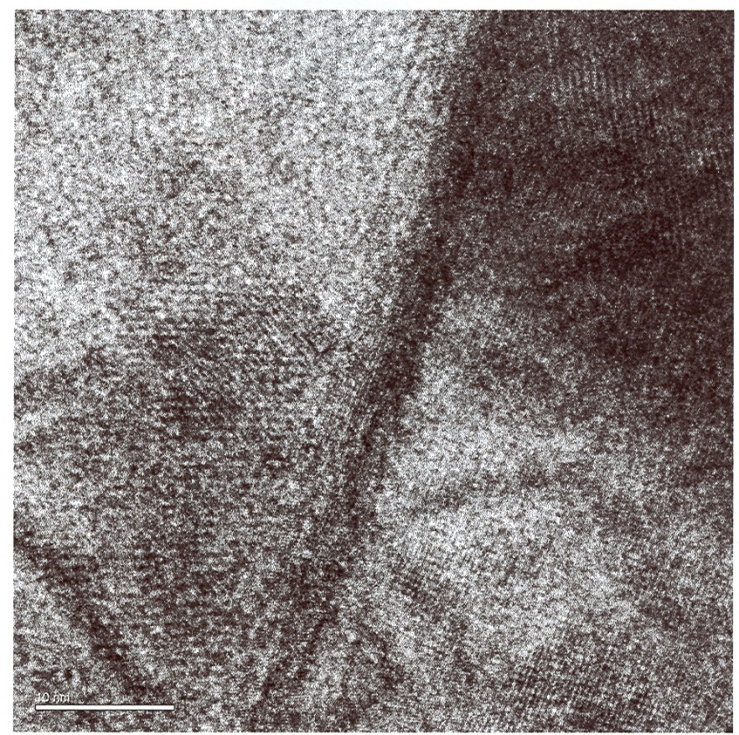
Applied superconductivity:
Phenomenon at nanometric scale
Intergrain boundary at the high Sn limit of Bronze Route Wires
Boundary between Nb₃Sn grains
LTS:
Defects at grain boundaries: breakage of periodicity creates normalconducting regions: Vortices, will pin the flux lines
Grain boundaries are the main factor for the enhancement of Jc in superconducting wires
10 nm
4 nm: ~ Coherence length ξ_{ο}
R. Flükiger and M. Cantoni, 2005

Slide 29
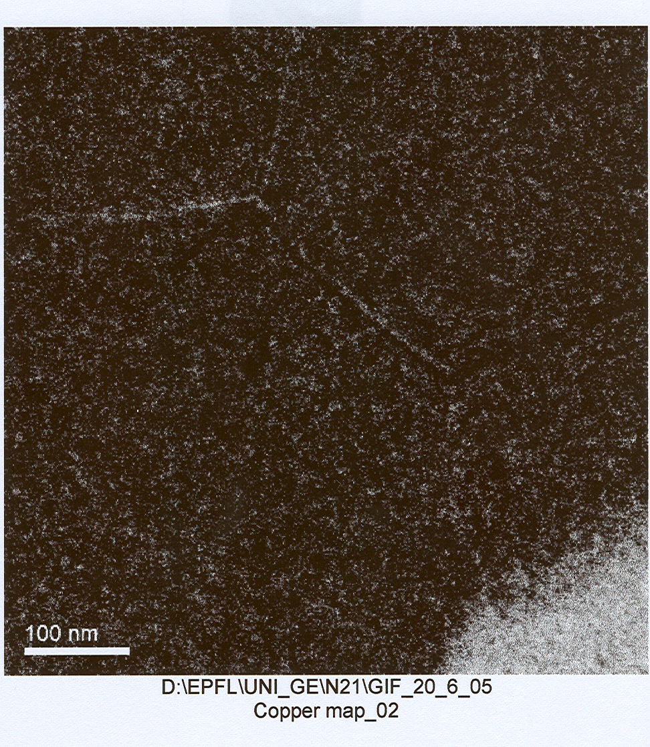
Grain boundaries in Nb₃Sn wire
Cu at grain boundaries of a 20 nm thick slice
(projection):
Cu discontinuous: there is no Cu « layer », thus allowing current transport through the layer.
50 nm
M. Cantoni, R. Flükiger, 2005, unpublished

Slide 30
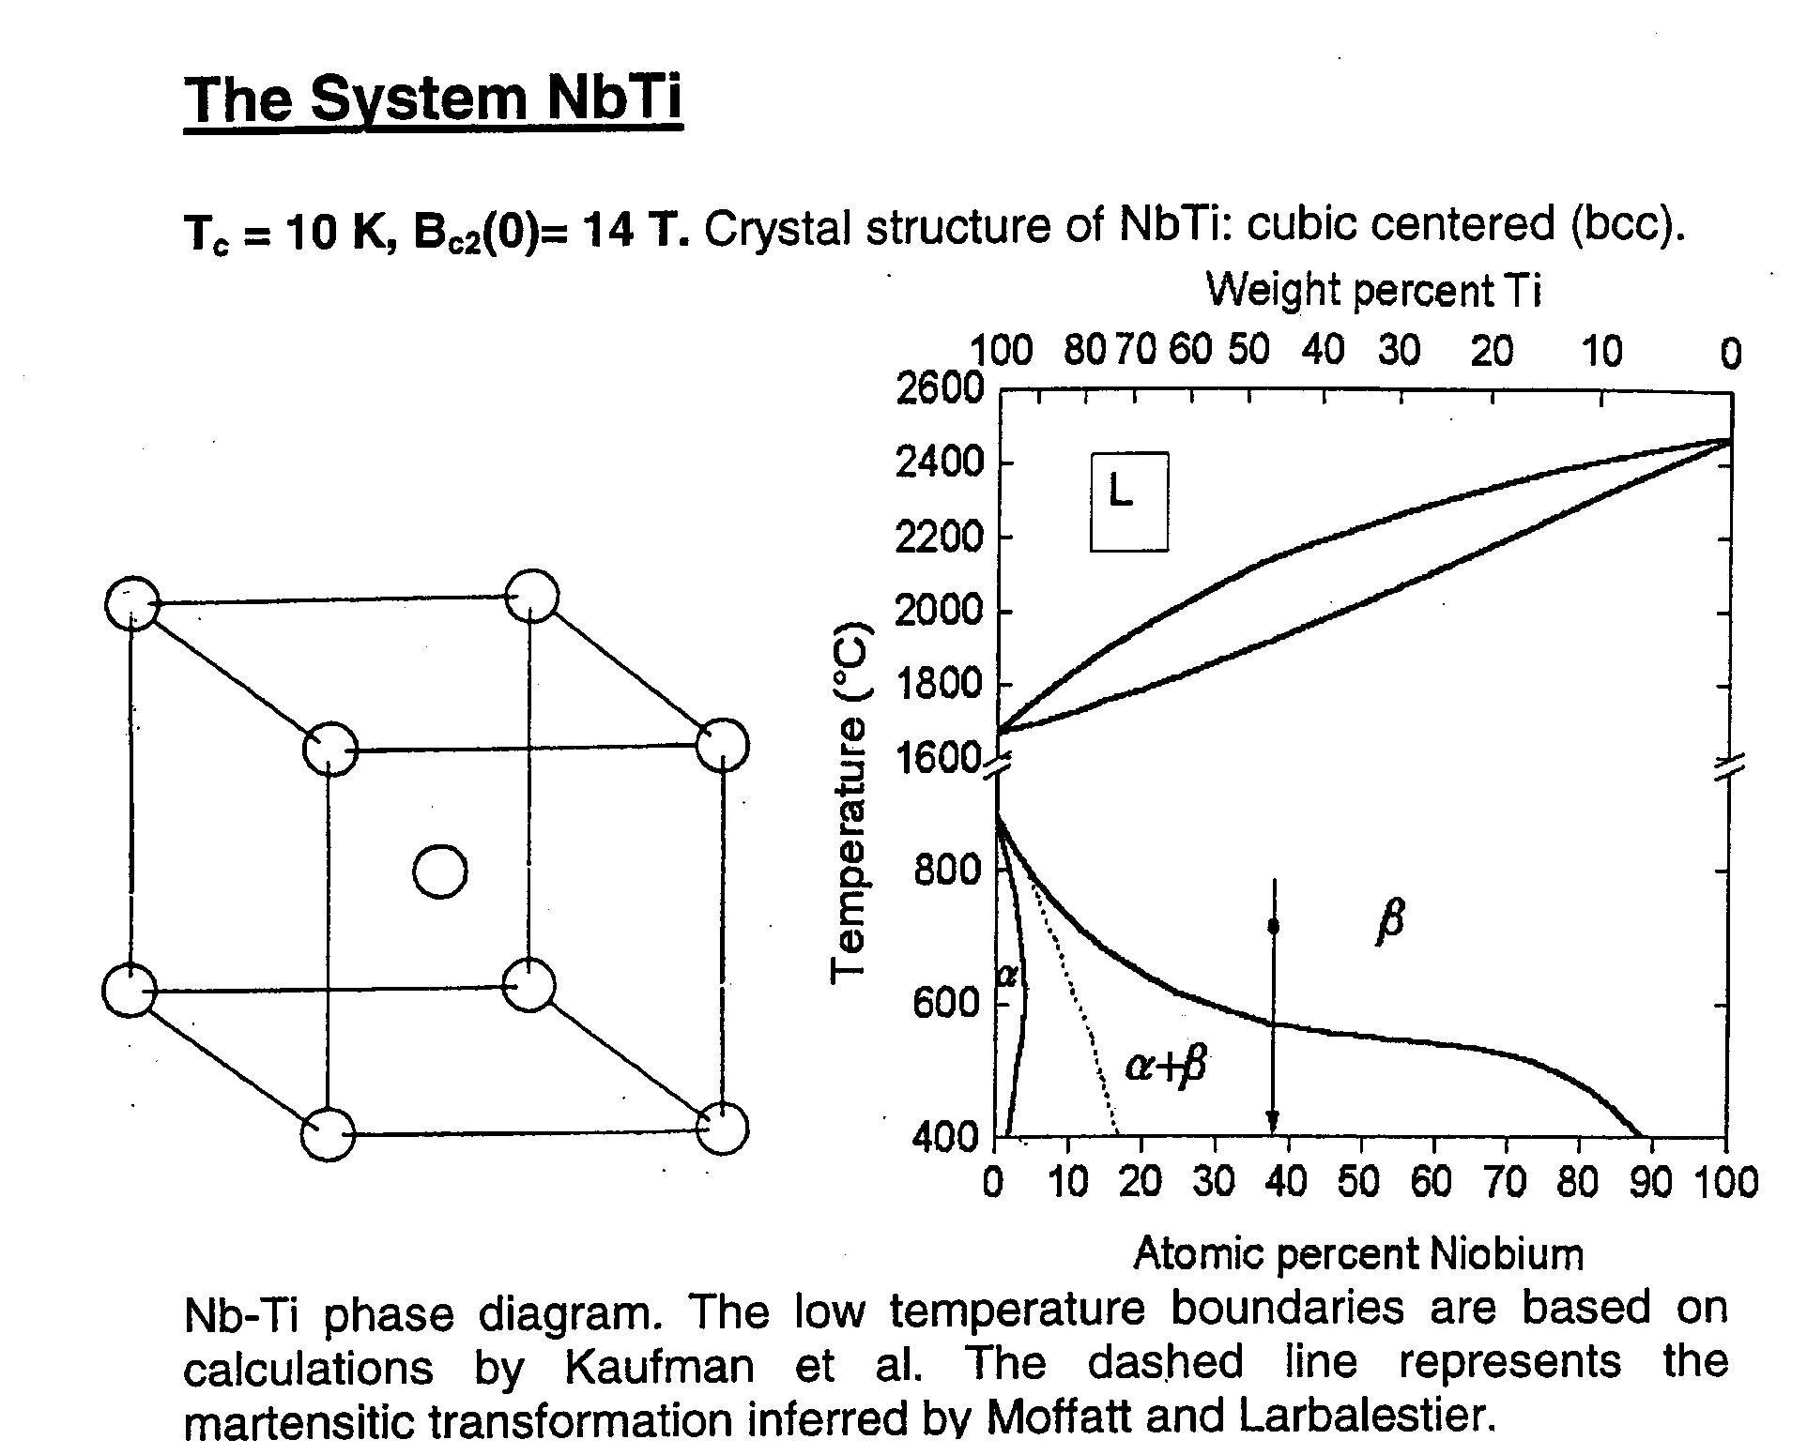
IV. The system NbTi
Crystal structure and phase diagram
NbTi: T_{c} = 10 K, B_{c2} = 14 T
Body cubic cented structure Phase diagram
Ti
Ti
Ti
Liquid
Nb
bcc phase
Ti
Ti
α Forms during
deformation
Ti
Ti
Nb

Slide 31
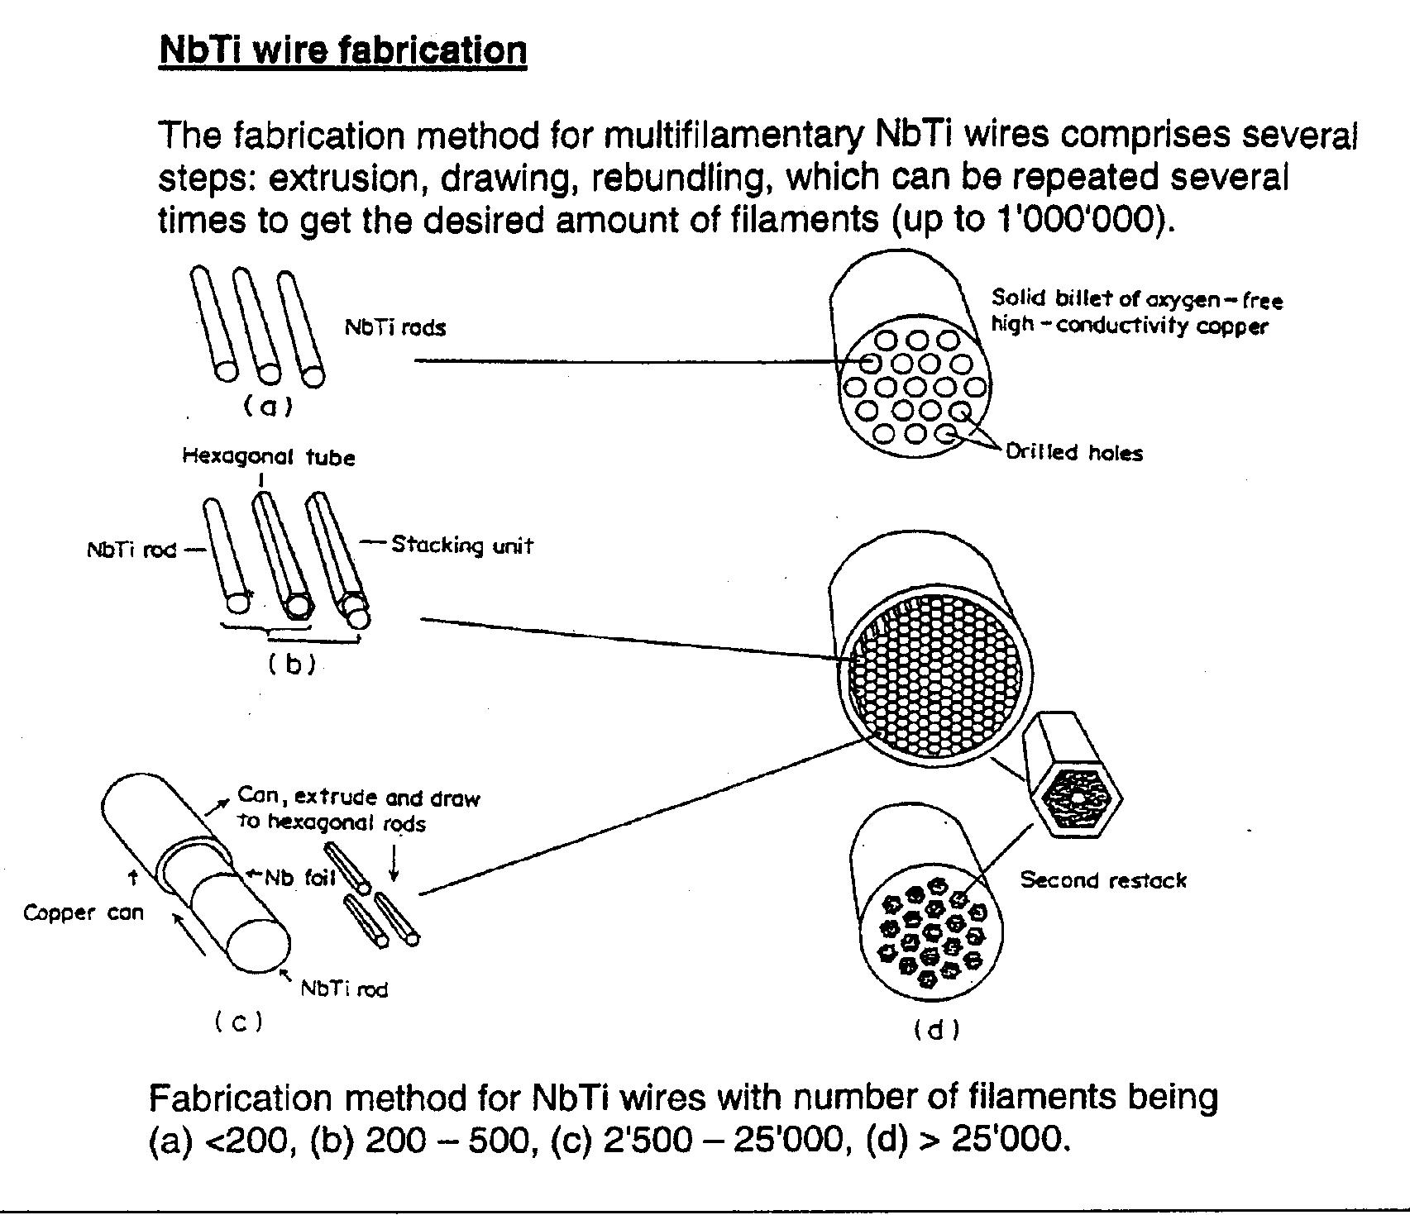
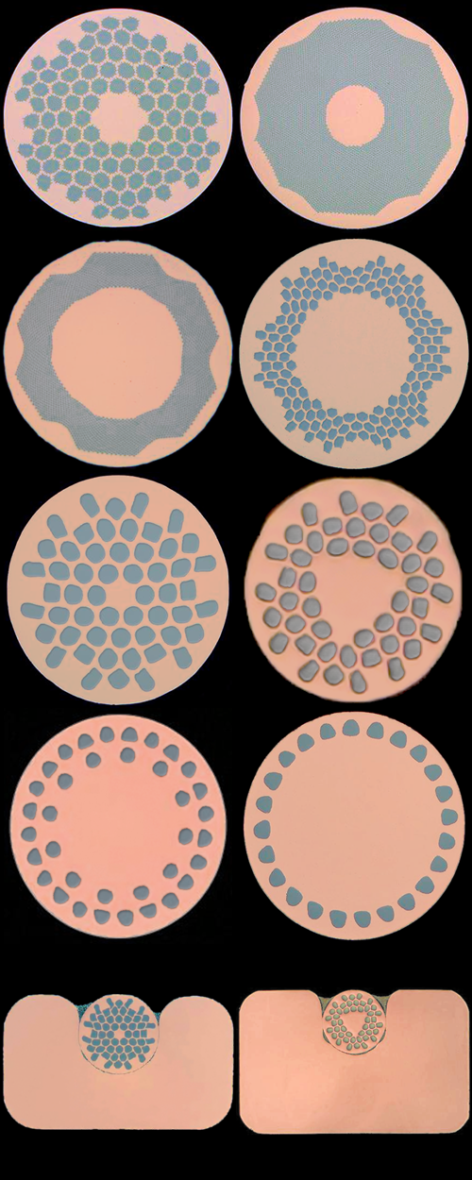
The fabrication of NbTi wires
Solid billet of oxygen-free
high conductivity Cu
NbTi rods
1.Extrusion
2.Extrusion
Diam.: 300 50 mm
Hexagonal tube
Drilled holes
NbTi rod
Stacking unit
Diam.: 300 50 mm
Can, extruded and drawn to hexagonal rods
Cu can

Slide 32
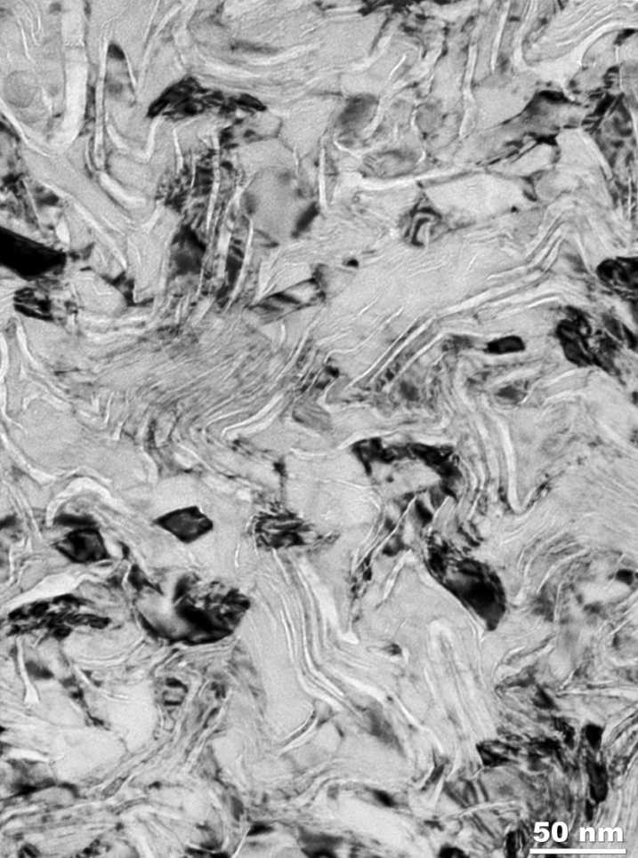
TEM image of NbTi filaments
− Ti ribbons: form spontaneously
during wire deformation
TEM image of the microstructure (transverse cross-section) of a 3700 A/mm² (5 T, 4.2 K) multifilamentary strand from Oxford Instruments (OST).
This image shows the dense array of folded α-Ti ribbons (lighter contrast) that create the strong vortex pinning.
D. Larbalestier and P. Lee, 1995
Courtesy Oxford Instruments

Slide 33
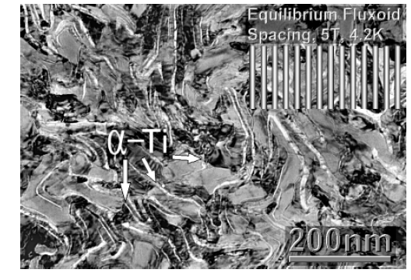
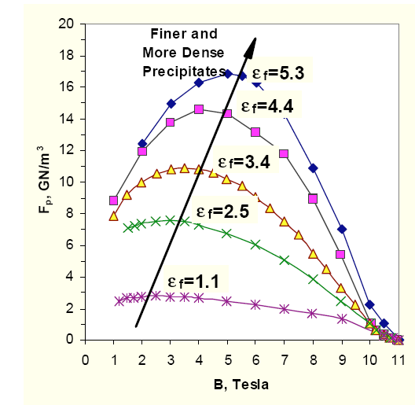
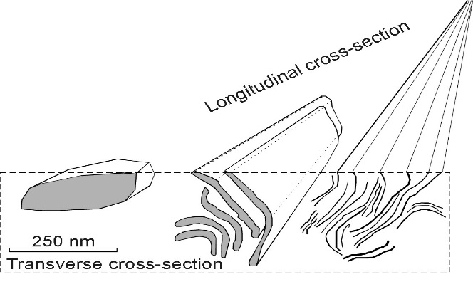
Artificial pinning centers in NbTi
Artificial pinning: Introducing defects having sizes comparable or smaller than ξ_{o}
Artificial pinning:
At the interface between the α – Ti precipitations and the NbTi matrix: periodicity of NbTi matrix is broken
creation of defects
creation of normal conducting centers:
new vortices
Enhancement of J_{c}
D. Larbalestier and P. Lee, 1995

Slide 34
Artificial pinning
Today, NbTi is used * for NMR up to 9T,
* for a background field in high field magnets
and * for accelerator magnets (LHC)
No further work is performed for a further enhancement of J_{c} in industrial NbTi wires.
In contrast to NbTi, Artificial pinning in Nb₃Sn was so far unsuccessful.

Slide 35
The system Nb₃Sn

Slide 36
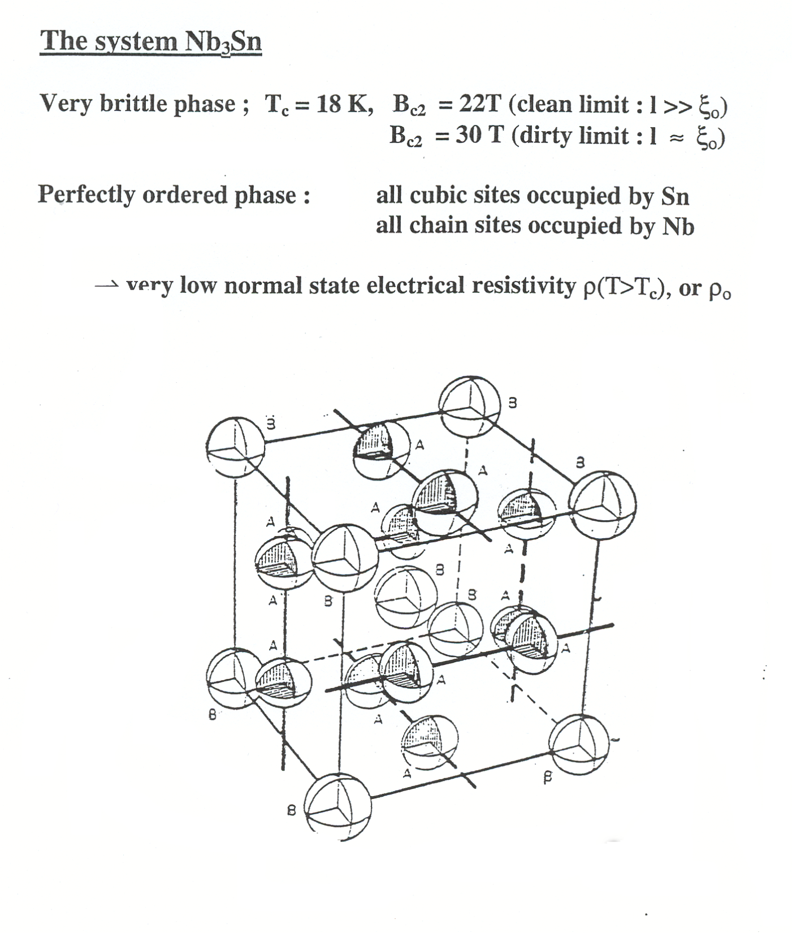
V. The system Nb₃Sn
Sn
The cubic A15 type structure A₃B
Sn
Nb
Sn
Sn
Nb
at 25 at.%Sn: ρ_{o} ~ 5 μΩcm
Orthogonal, non intersecting Nb-Nb chains

Slide 37
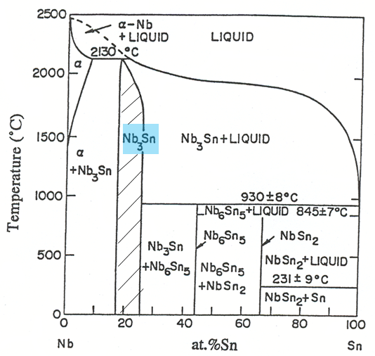
The Nb-Sn phase diagram
T> 43K: cubic
T< 43K : tetragonal
High temperature Low temperature

Slide 38
A. Superconducting properties of the A15 phase
Variation of T_{c} with Sn content in Nb₃Sn
T_{c}( linear extrapolation): ~ 19 K
Saturation at > 24.5 at.%:
Attributed to phonon softening
T_{c} = T_{c}(max ) at 25 at.% Sn
T_{c} = T_{c max =} 18.3 K at the stoichiometric composition (25 at.%Sn):

Slide 39
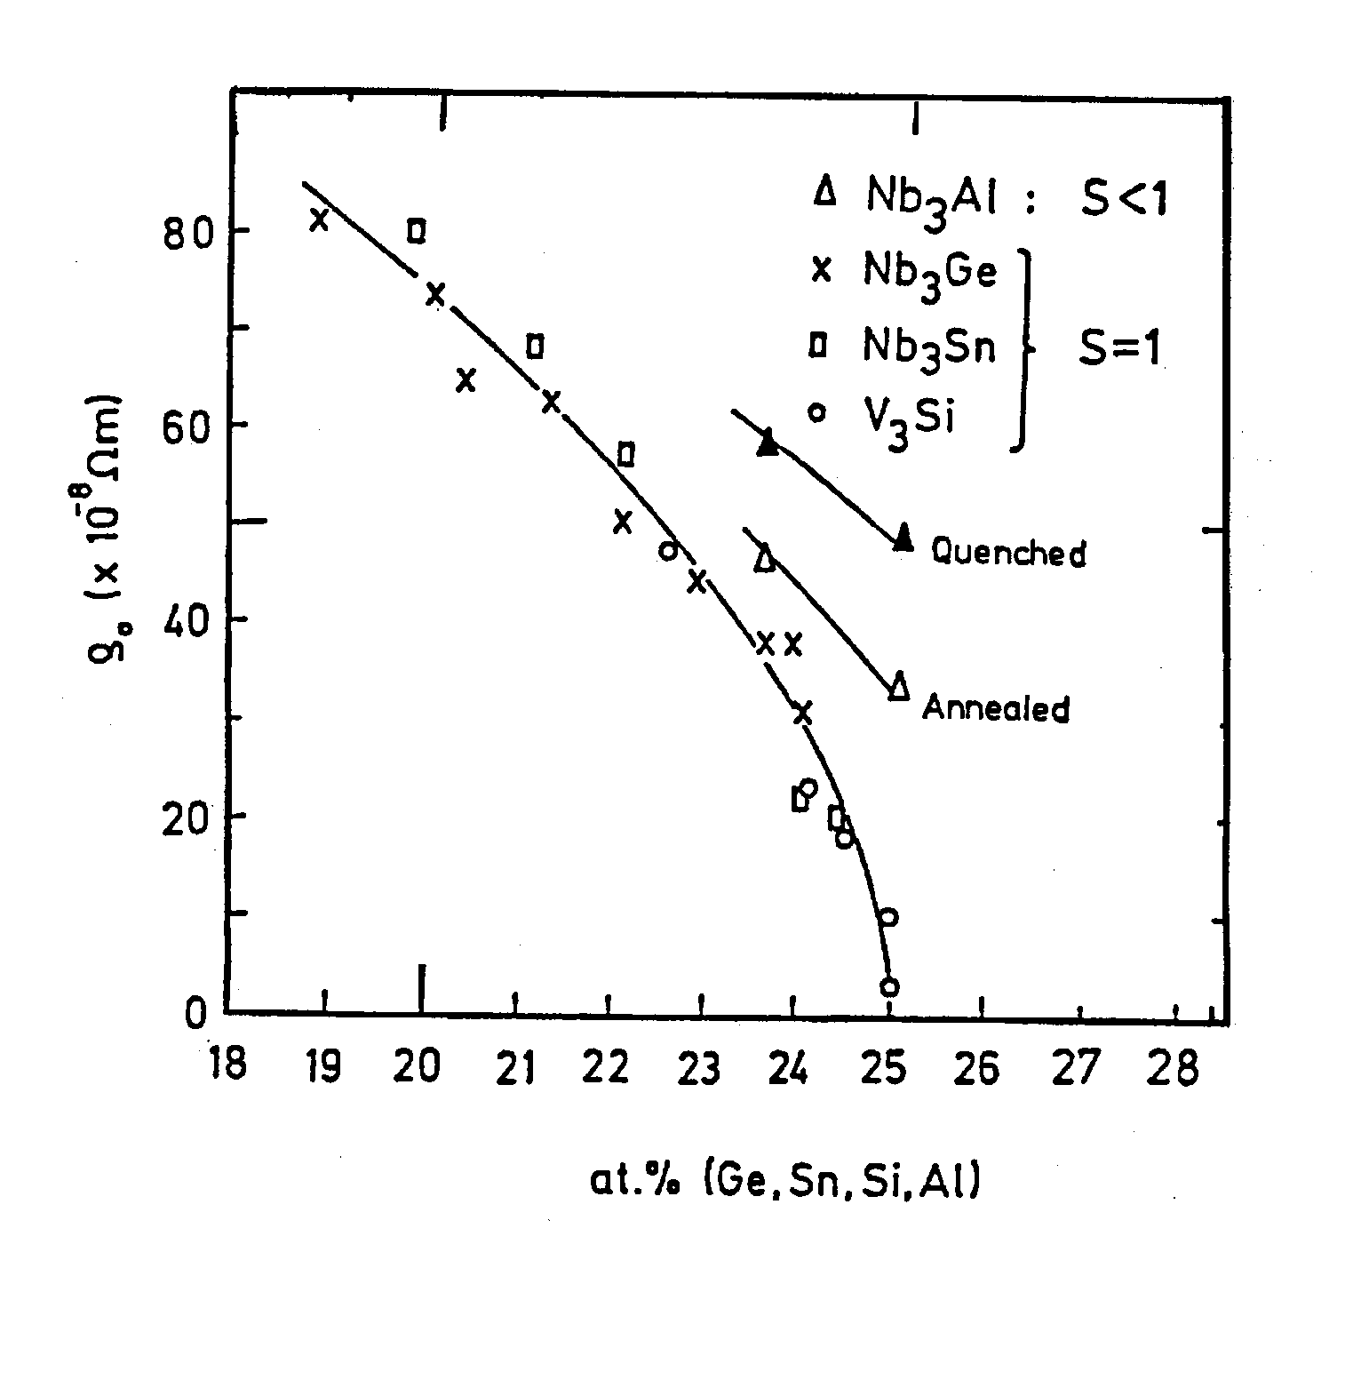
Variation of ρ_{o} vs. Sn content in Nb₃Sn
ρ_{o} = ρ_{o}(min)
at 25 at.% Sn:
< 10 μΩcm
Nb_{1-x}Sn_{x}
19 20 21 22 23 24 25 26 27 28
x (at. % Sn)
R. Flükiger and W. Goldacker, 1983

Slide 40
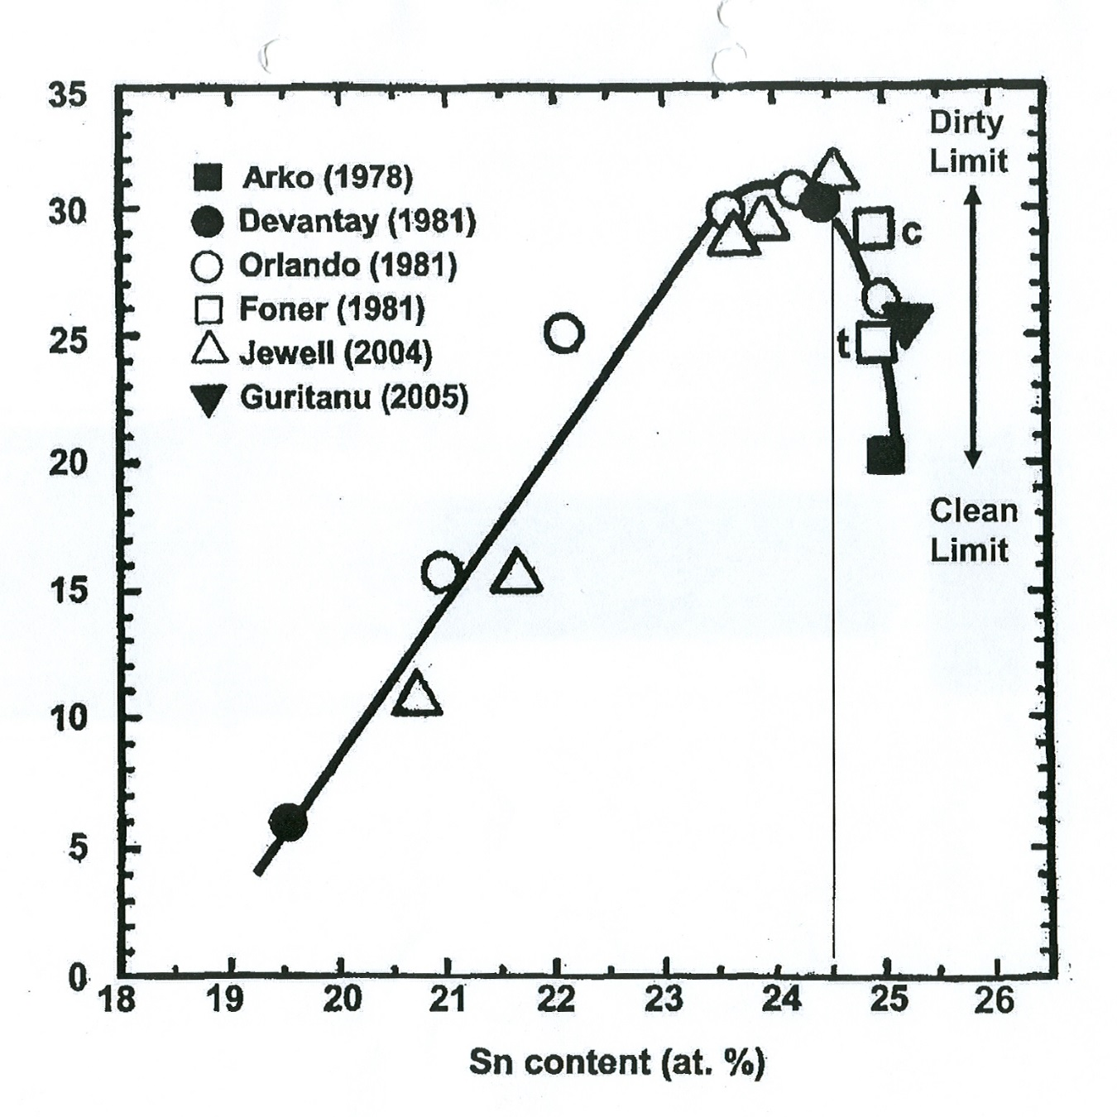
Variation of B_{c2} vs. Sn content in Nb₃Sn
Effect due to
electronic
mean free path: ρo
B_{c2} = B_{c2}(max)
at ~ 24.5 at.% Sn
B_{c2} ~ T_{c} γ ρ_{o}
Not at 25 at.% Sn!
at.% Sn

Slide 41
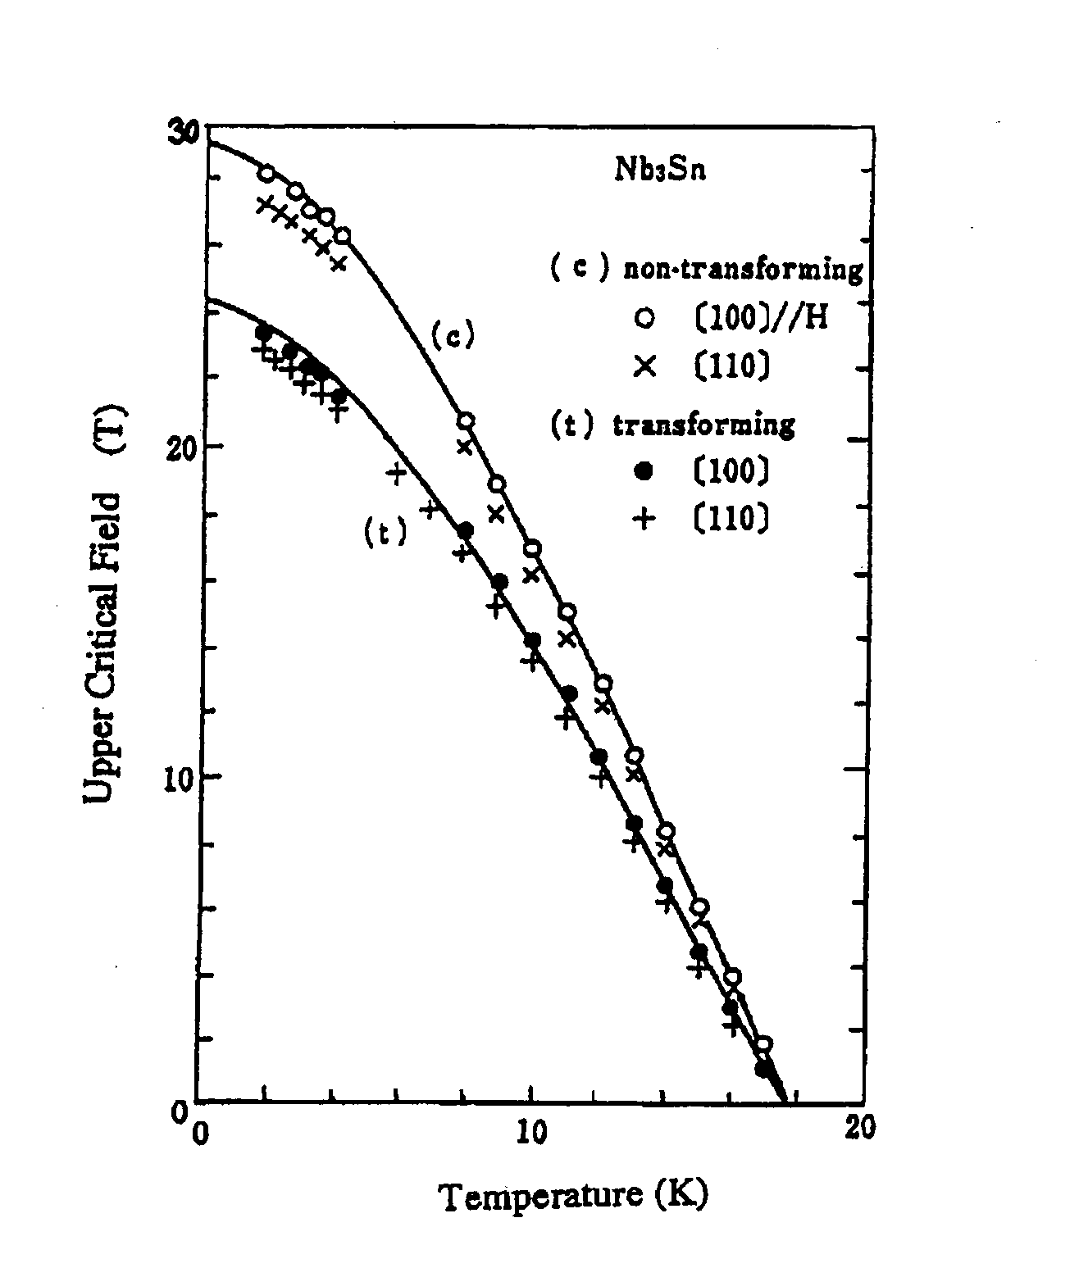
Clean and dirty limit in Nb₃Sn
30
20
10
0
Clean limit
« Clean » limit: low ρ_{o}
< 5 μΩcm
(very close to stoichiometry)
« Dirty » limit: high ρ_{ο}
> 20 μΩcm
(deviation from stoichiometry
or disordered)
B_{c2}
(T)
B_{c2} ~ T_{c} γ ρ_{o}
Dirty limit
Nb₃Sn
0 10 20
T (K)

Slide 42
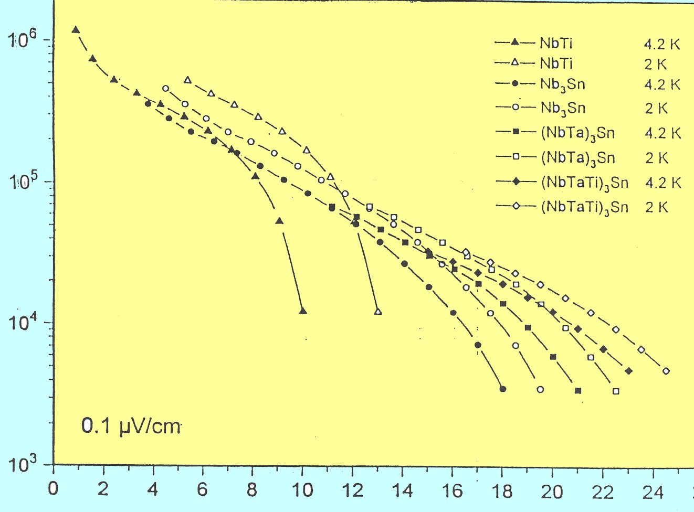
Enhancement of J_{c} at high fields by Ta and Ti additives
Effect of
Ti and Ta additives
J_{c} (A/cm²)
Ta: Cody et al. (1972)
Ti: Sekine et al. (1980)
Drost et al. (1985),
Suenaga et al., (1986),
Geneva group (2007)
Nb₃Sn wire
(Bronze, VAC)
B (T)

Slide 43
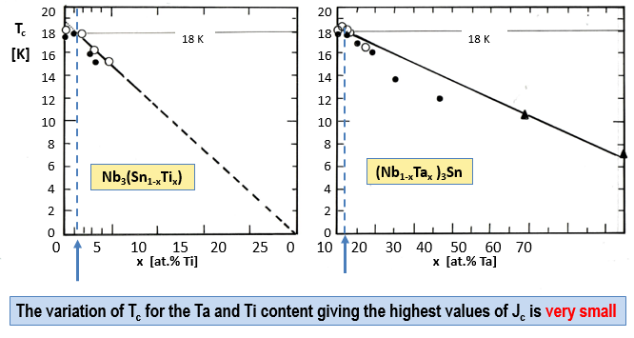
Effect of Ta and Ti alloying on T_{c} of Nb₃Sn

Slide 44
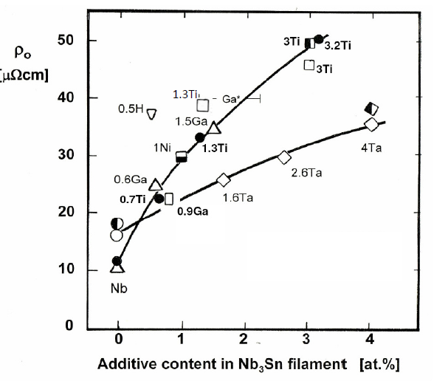
Enhancement of J_{c} at high fields by Ta and Ti additives
Effect of Ta and Ti additives:
Enhancement of ρ_{o}
Since B_{c2} ~ T_{c} γ ρ_{o} ,
and ΔT _{c} and Δρ_{o} small:
ρ_{o} B_{c2}
binary
Ternary Ta and Ti additions
Additives lead always to enhanced ρ_{o} and thus B_{c2} : NbTi, Nb₃Sn, MgB₂, Chevrel phases,...

Slide 45
B. Wire fabrication and
critical current densities: Nb₃Sn
Nb₃Sn wires
Industrial fabrication techniques
A: Bronze Route
B: Internal Sn Diffusion
C: Powder in Tube (or PIT) method

Slide 46
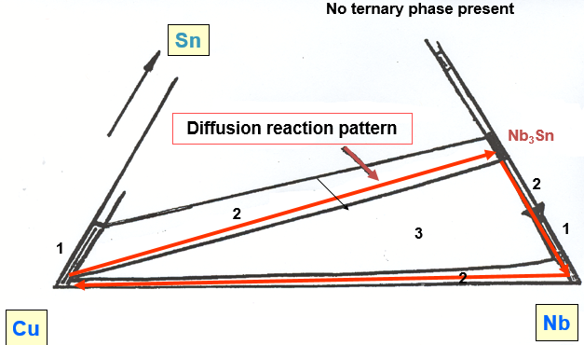
The diffusion - reaction pattern for Nb₃Sn

Slide 47
The bronze diffusion reaction to Nb₃Sn
Conditions after reaction
Cu-Sn Bronze
-
18
T_{c}(K)
6
18
at.% Sn
25

Slide 48
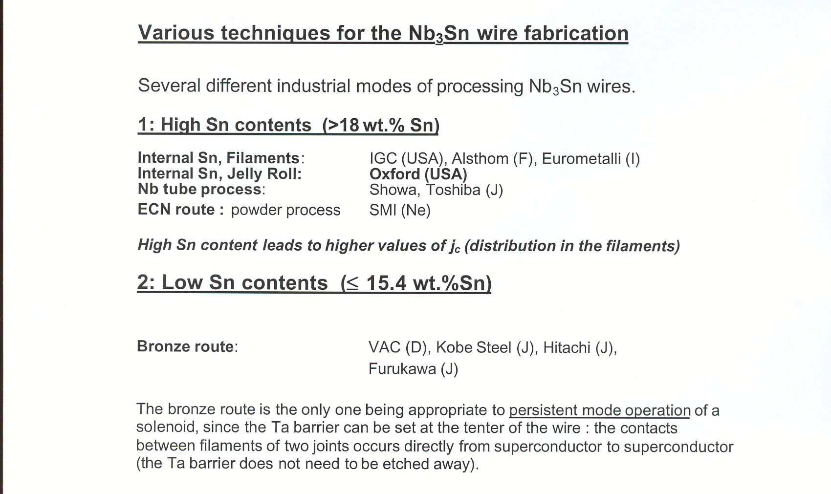
Techniques for the Nb₃Sn wire fabrication

Slide 49
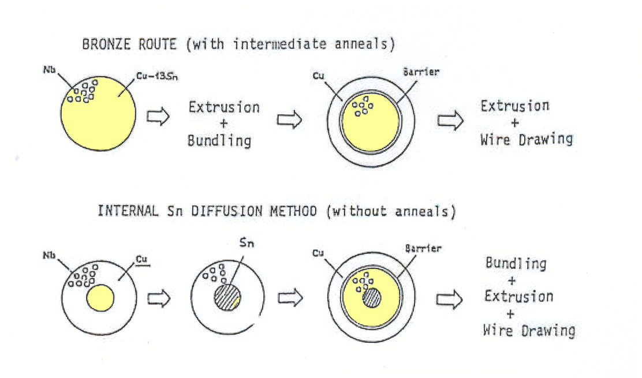
Processing of Bronze route and Internal Sn diffusion Nb3Sn wires
Bronze Route: With intermediate anneals
Cu-15.6wt.%Sn bronze: difficult to deform
Internal Sn Diffusion method: No intermediate anneals
Cu: easy to deform

Slide 50
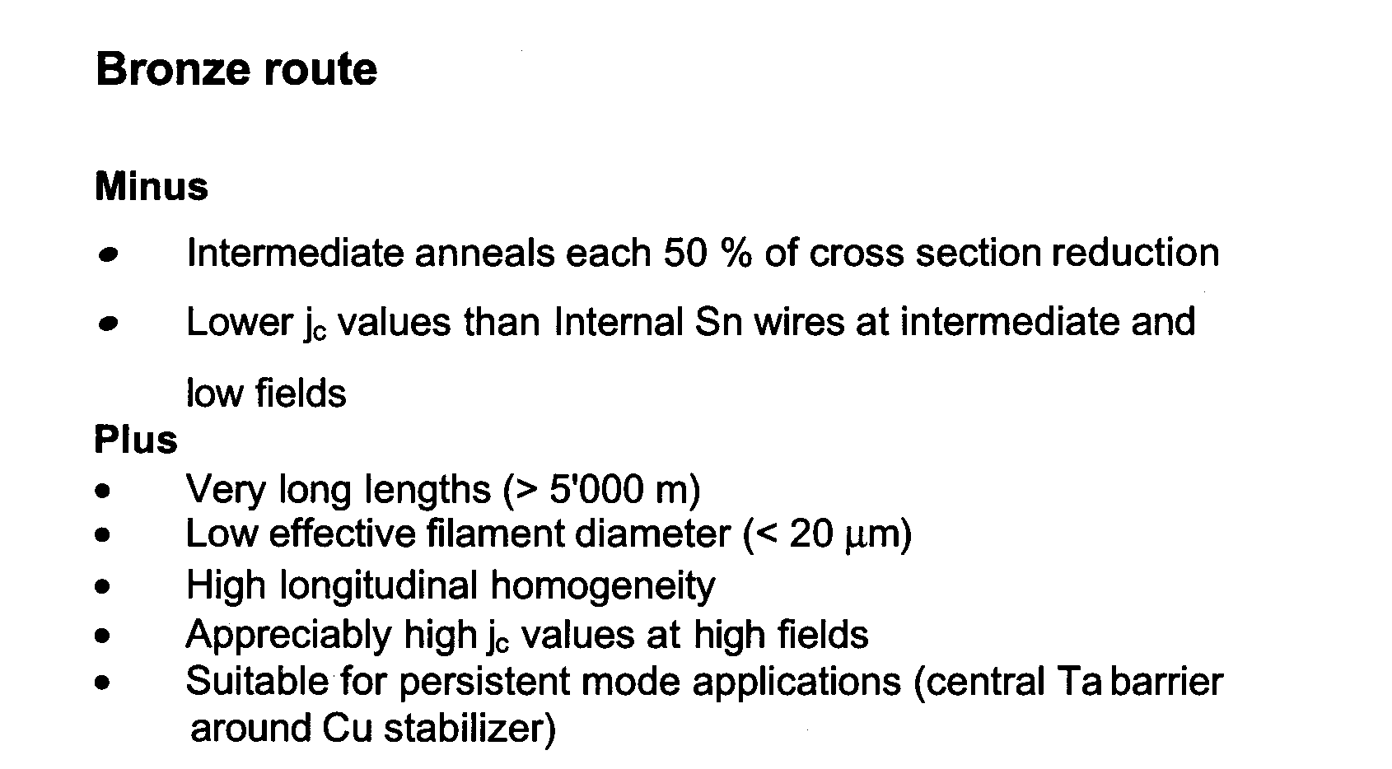
Bronze Route wires, advantages
* Has the best mechanical properties (J_{c} vs. ε) of all Nb₃Sn wire types

Slide 51
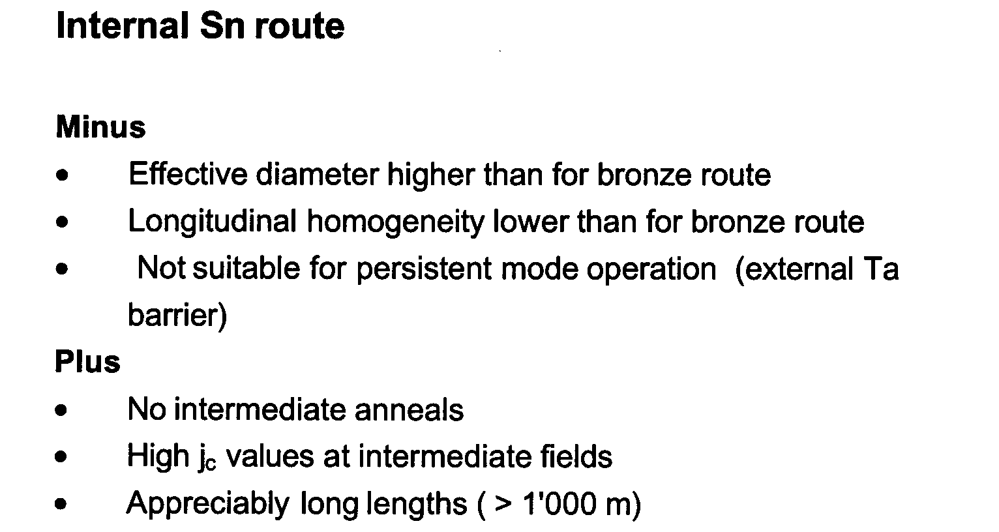
Internal Sn Diffusion wires
Less
(lower costs than bronze route wires)
: > 3’500 A/mm² at 4.2K/12T

Slide 52
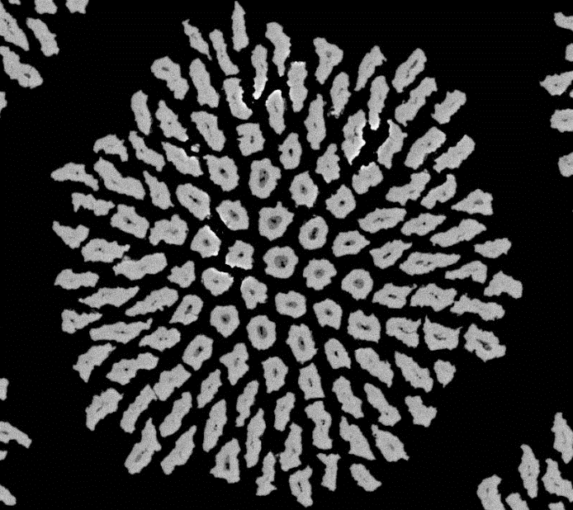
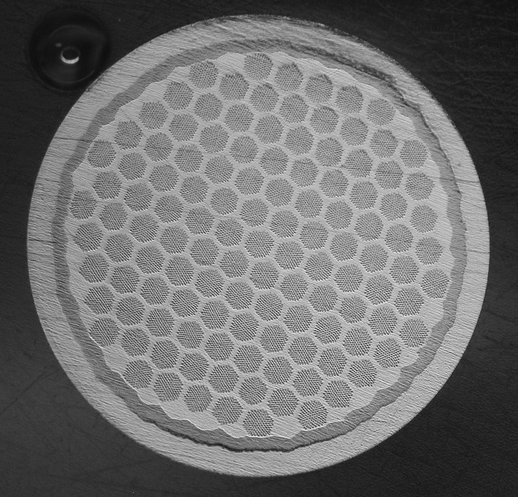
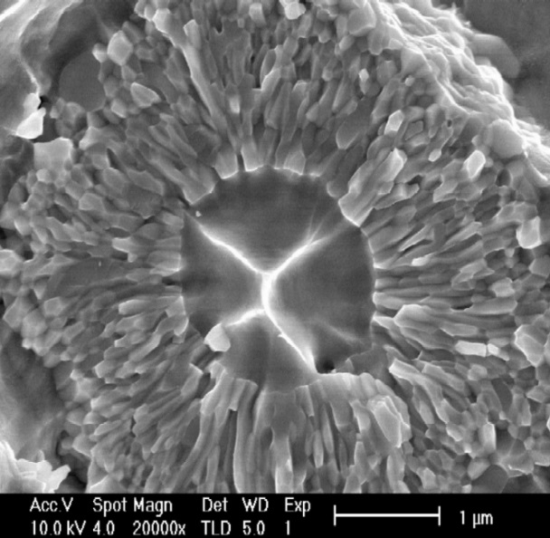
Multifilamentary Nb₃Sn wires
Nb₃Sn: T_{c} = 18K, H_{c2}(0) = 30T
Filament group
Filament diameter 4 μm)
Grain sizes: 100 – 200 nm
Ta
Cu
Bronze type Nb₃Sn wire (10’000 filaments)

Slide 53




Filament diameter: 4 mm
The Bronze Route
V.Abächerli et al., ASC 2004
Limitation: only a small part of the filament carries supercurrent !

Slide 54

Nb₃Sn wire configuration by Internal Sn diffusion
2 RRP wires with J_{c} (non-Cu) = 2’000 A/mm² at 4.2K/12T
Cu
Thick Nb
barrier
Nb₃Sn
Cu
Thin Nb barrier
a: thin Nb barrier, almost fully reacted: RRR = 10
b: thick Nb barrier, a complete unreacted Nb barrier remains: RRR = 100.

Slide 55

NbTi addition in Internal Sn wires (OST)
Ti additives introduced by NbTi rods.
Cu
Nb
Nb₃Sn
Ti
(from NbTi)
P. Lee, D. Larbalestier, J.A. Parrell, M.B. Field, Y. Zhang, S. Hong, ICMC 05, Keystone, USA

Slide 56

Optimized Nb₃Sn reaction
Required for LHC Upgrade: J_{c}(non-Cu) = 1’500 A/mm² at 4.2K/15T
Courtesy Parrell (OST)

Slide 57

RRP wires for various applications
Courtesy Parrell (OST)

Slide 58

Powder in Tube (or PIT) technique
PIT technique
* Higher costs than other techniques
> 3’000 A/mm² at 4.2K/12T
Note: As starting material, one uses NbSn₂ powders, which are difficult to
fabricate higher costs

Slide 59


PIT: Powder in tube Nb₃Sn wires
« hole »:
low density
Cu matrix
Nb, residual
Nb₃Sn

Slide 60
C. Calorimetric analysis of Nb₃Sn wires
Specific heat measurements:
No shielding effects
Measures the totality of the superconducting volume in the wire
Measurement with the matrix (under prestress)
Up to high fields (21 T)
Technique
Measurement at 0T and 14T
Subtraction, to eliminate normal conducting part
Deconvolution of the superconducting part T_{c} distribution
Result: All Nb₃Sn wires are inherently inhomogeneous! Susceptibility or resistivity measurements give only the onset value of T_{c}!

Slide 61
T_{c} distribution from specific heat measurements
Clear difference between Bronze route and Internal Sn (RRP) wires:
Bronze Route wires have a lower T_{c} lower average Sn content
C. Senatore, V. Abächerli, R.Flükiger, 2011

