Slide 1
Materials properties at low temperature
Contact : Patxi DUTHIL
duthil@ipno.in2p3.fr

Slide 2
Contents
Thermal properties
  Heat capacity
  Thermal conductivity
  Thermal expansion
Electrical properties
  Electrical resistivity
  RRR
  Insulation properties
Mechanical properties
  Tensile behaviour
  Material
Magnetic properties
  Introduction
  Dia, para, ferro, antiferromagnets

Slide 3
THERMAL PROPERTIES
Introduction
  Thermal properties are related to:
  atoms vibrations around their equilibrium position (in lattice crystal):
    vibrations amplitude diminishes with temperature
    vibrations may propagate at the sound speed and are studied as plane waves to witch phonons are associated
  movements of negative charges (electrons) and positive charges (vacancies) for conductor materials
  other effects: magnetic properties, superconducting state... (see specific lectures)

Slide 4
THERMAL PROPERTIES
Heat capacity C
  Definition:
  quantity of energy (heat) extracted/introduced from/into 1kg of material to decrease/increase by 1K its temperature.
  NB1 - Specific heat c: heat capacity or thermal capacity per unit of mass (J⋅kg⁻¹⋅K⁻¹).
  Molar heat capacity (J⋅mol⁻¹⋅K⁻¹).
  NB2 - The difference c_{p} – c_{v} is generally negligible for solids at low temperature.
  Physical behaviour: capacity of a material to stock or release heat energy
  as T → 0, c → 0
  Heat capacity is important in cool-down or warm-up processes:
    to estimate the energy involved (and cost);
    to asses the transient states of thermal heat transfers as it relates to thermal diffusivity.
(J⋅K⁻¹)

Slide 5
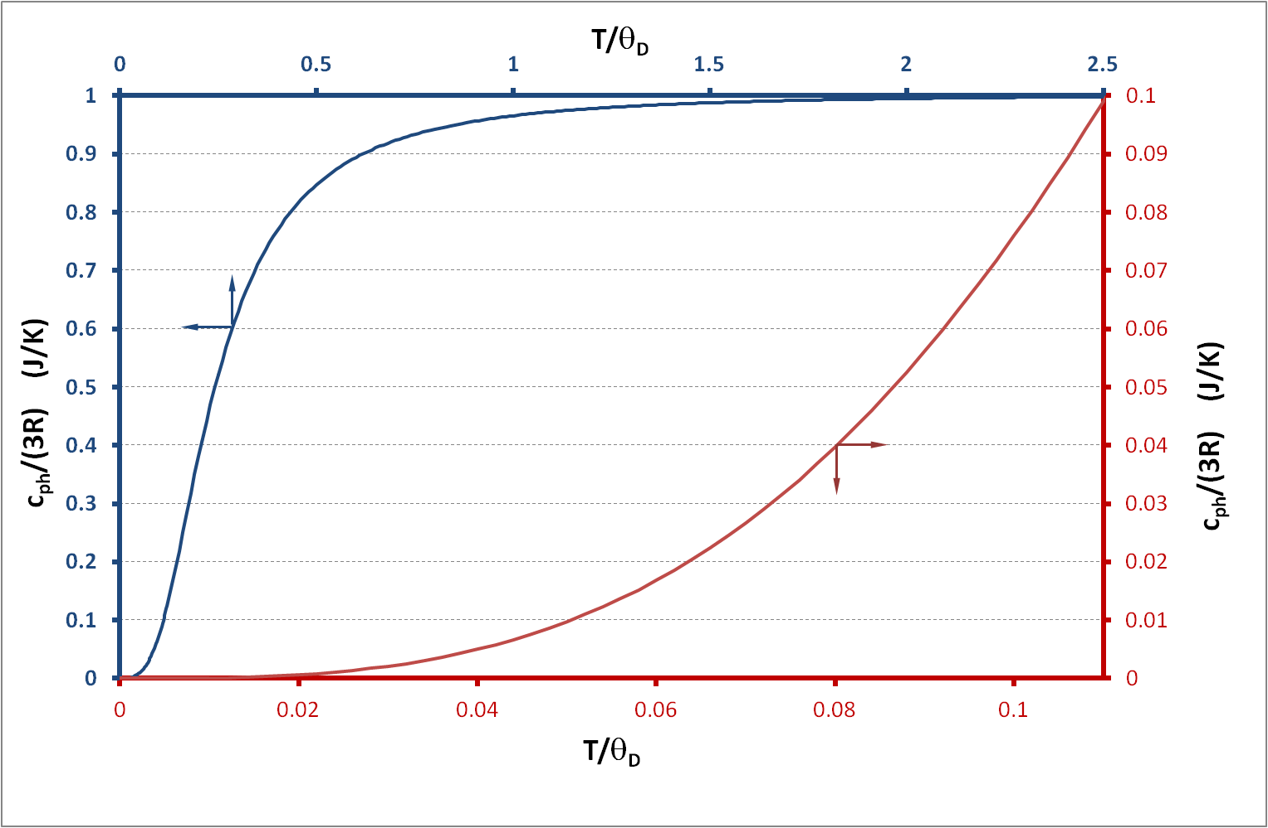
THERMAL PROPERTIES
Heat capacity c
  Crystal lattice contribution: c_{ph}
  Debye model:
D₃ is the third Debye function
R is the gas constant
⇒
The Debye temperature is given by:
    can be represented by a unique function:
h: Planck constant
k_{B}: Boltzmann constant
v_{s}: sound speed in the material
N/V: number of atoms per unit volume
    For T>2θ_{D}: c_{ph}~3R
Material | θ_{D} (K)
Copper | 340
Aluminium | 430
Titanium | 420
Niobium | 265
SS 304 | 470
SS 316 | 500
    For T<θ_{D}/10: c_{ph} ∝T³

Slide 6
THERMAL PROPERTIES
Heat capacity c
  Electron contribution: c_{e}
    For solid conductor : c_{e}= γT
  Heat capacity of metallic conductors:
    c = c_{ph} + c_{e}
    For T>2θ_{D}: (c_{ph}~3R ) ⇒ c ∝ T and diminishes slowly as T decreases (γ <<1)
    For T<θ_{D}/10: c=c_{ph} + c_{e}= ηT³ + γT
    Bellow ∼10K: c_{ph}<<1 → c ∝ T
  Heat capacity of thermal insulator:
    c_{ph} is predominant
    For T>2θ_{D}: c_{ph}~3R
    For T<θ_{D}/10: c_{ph} ∝ T³
  Heat capacity of superconductors:
  c= γ ⋅ T_{c}⋅ a⋅ e^{(-b⋅ Tc/T)} for T < T_{c}, T_{c} the critical temperature
  γ : coefficient of the electronic term and determined at T> T_{c}
  a, b: coefficients
Material | γ (10⁻³ J⋅kg⁻¹⋅K⁻²)
Copper | 11.0
Aluminium | 50.4
Titanium | 74.2
Niobium | 94.9

Slide 7
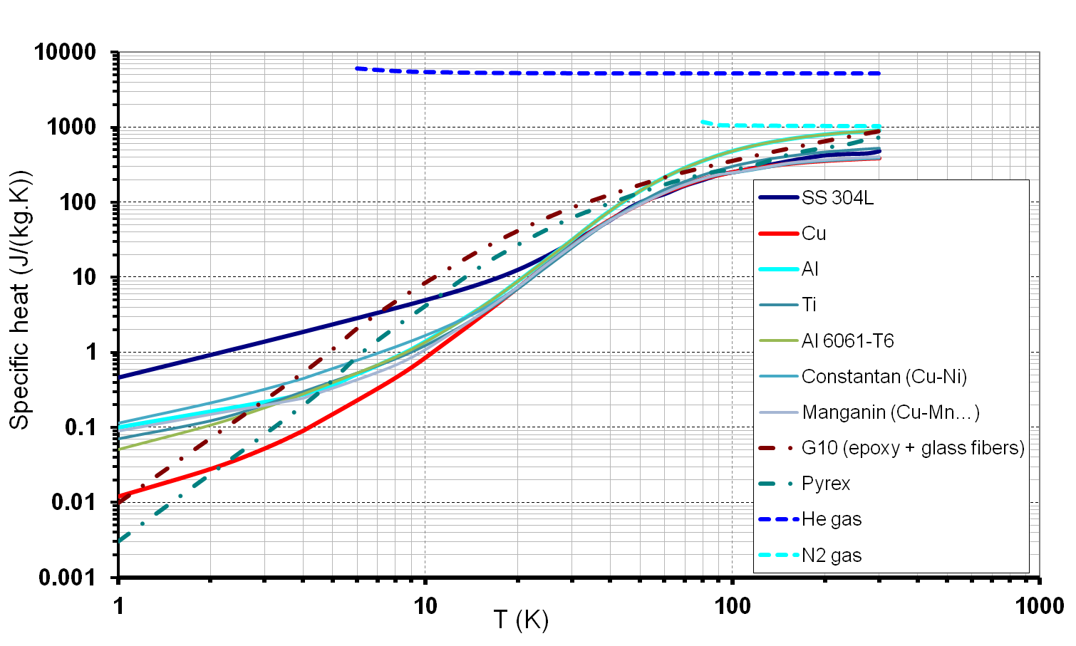
THERMAL PROPERTIES
Specific heat capacity curves for some materials
10⁴
10³
10²
10¹
10⁰
10⁻¹
10⁻²
10⁻³

Slide 8
THERMAL PROPERTIES
Specific heat capacities of some materials
Constantan: Cu-Ni
Manganin: Cu-Mn-Ni
Monel: Ni-Cu-Fe

Slide 9
THERMAL PROPERTIES
Specific heat capacities of some materials

Slide 10
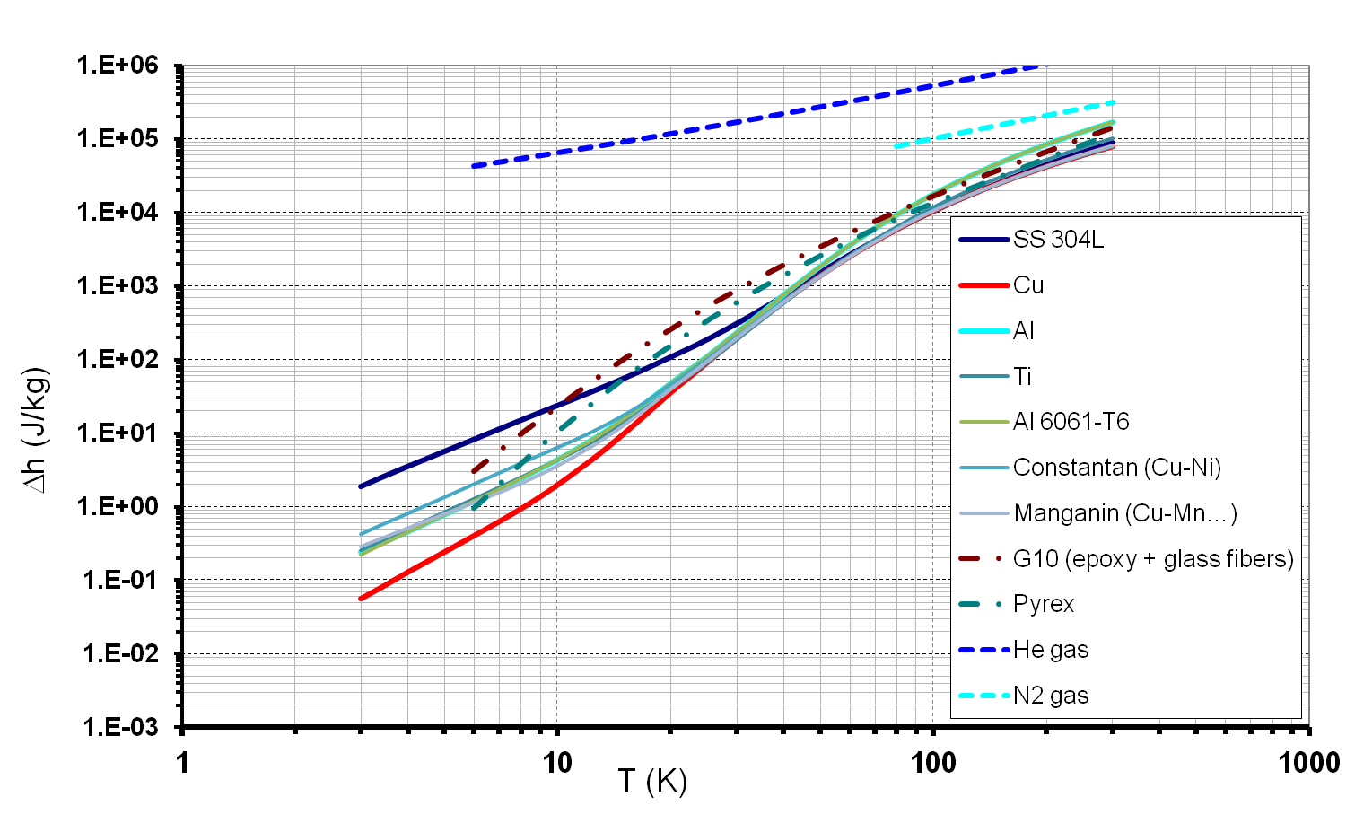
THERMAL PROPERTIES
Heat capacity
  During a thermodynamic process at constant pressure:
  The involved energy is then E= m⋅Δh
  Δh can be seen as a heat stock per mass unit (J⋅kg⁻¹)
10⁶
10⁵
10⁴
10³
10²
10¹
10⁰
10⁻¹
10⁻²
10⁻³
  At low temperature, it can be noticed: - the high value of G10 (epoxy+glass fibers)
  - the high value of stainless steel 304 L
  - the high values of He and N₂ gases

Slide 11
THERMAL PROPERTIES

Slide 12
THERMAL PROPERTIES

Slide 13
THERMAL PROPERTIES
Thermal conductivity
  The Fourier’s law gives the quantity of heat through a unit surface and diffusing during a unit of time within a material subjected to a temperature gradient
  Example: heat conduction (diffusion) into a lineic support
  L: length (m); A: cross section area (m²)
  Thus we can write
  and (if k=cst) :
  k is the thermal conductivity (W/m/K). It relates to the facility with which heat can diffuse into a material.
  However, k is non constant especially on the cryogenic temperature range.
(J/s/m²≡W/m²)
T_{H}
T_{C}
0
L
x

Slide 14
THERMAL PROPERTIES
Thermal conductivity
  Similarly simplified, heat is transported in solids by electrons and phonons (lattice vibration) ⇒ k = k_{e} + k_{ph}
  Lattice contribution:
    k_{ph}=1/3 ⋅ c_{ph}⋅ v_{s}⋅ l_{ph}⋅ V_{m}, V_{m} is the material density (Kg/m³)
    l_{ph} is the mean free path of the phonons
    At very low T (T<<θ_{D}) k_{p}~ T³
  Electronic contribution:
    k_{e}=1/3 ⋅ c_{e}⋅ v_{F}⋅ l_{e}⋅ V_{m}, V_{m} is the material density
    l_{e} is the mean free path of the electrons
    v_{F} is the Fermi velocity
    At very low T (T<<θ_{D}) k_{e}~ T
  In semi-conductors, heat conduction is a mixture of phonons and electrons contribution
  Other interactions may occur (electron-vacancy...)

Slide 15
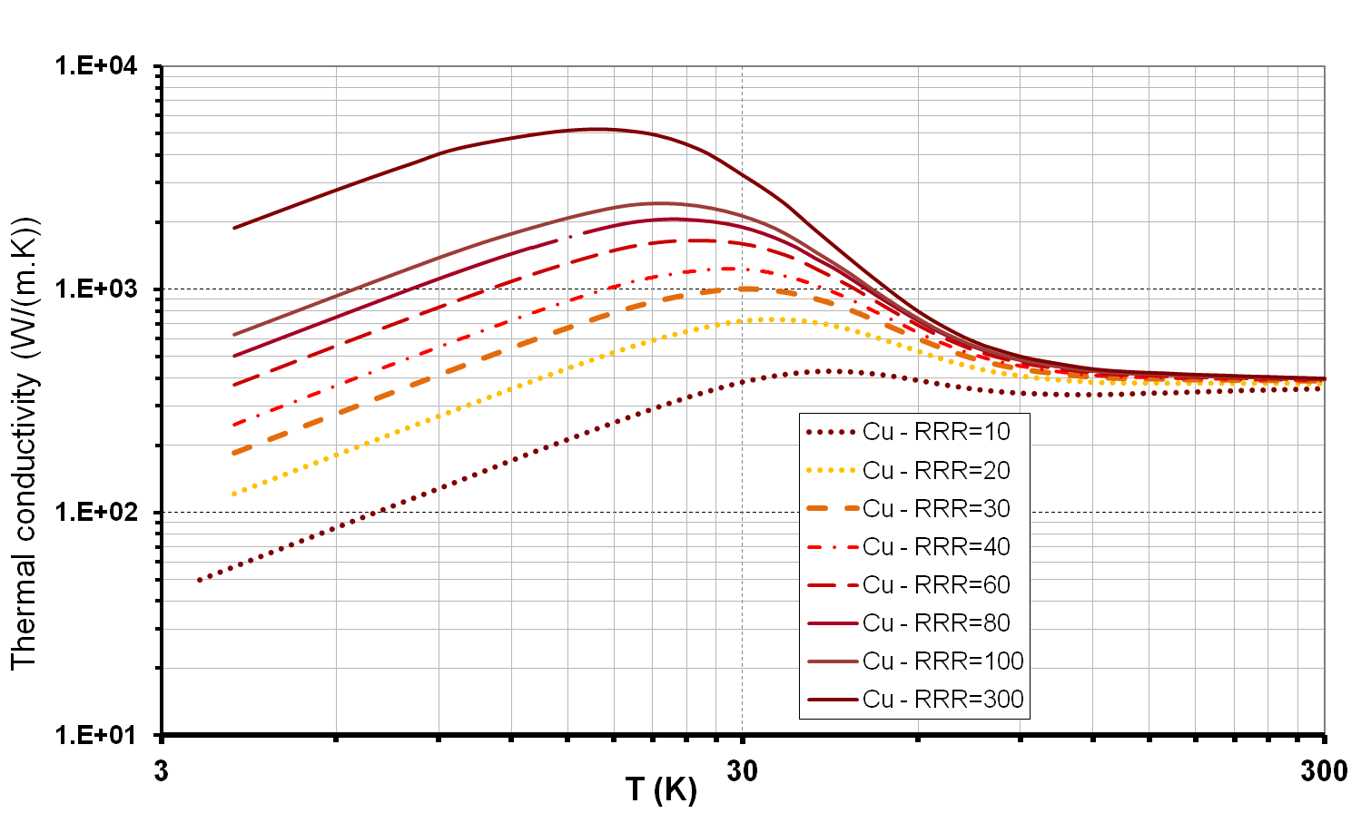
THERMAL PROPERTIES
Ordinary copper: 5<RRR<150
OFHC copper: 100<RRR<200
Very pure copper 200<RRR<5000
Thermal conductivity
  For pure metals:
    k_{ph} is negligible
    k has a maximum at low temperature
    At low T°, k is affected by impurities
    The more is the purity of the material,
      the higher is this maximum
      the lower is the T° of this maximum
    k ∝ T at low temperature
  For metallic alloys:
    k decreases as T decreases
    k ∝ T at low temperature
    Wiedemann-Franz law:
    relates k_{e} and the electric resistivity ρ : ρ ·k_{e} /T = 2.445⋅10⁻⁸ (W⋅Ω/K²)
  For superconductors:
    T > T_{c} (normal state) ⇒ cf. behaviour of metals
    T < T_{c} (Meissner state): k_{s} ∝ T³ and k_{s}(T) << k_{n}(T) ⇒ thermal interrupter
10⁴
10³
10²
10¹

Slide 16
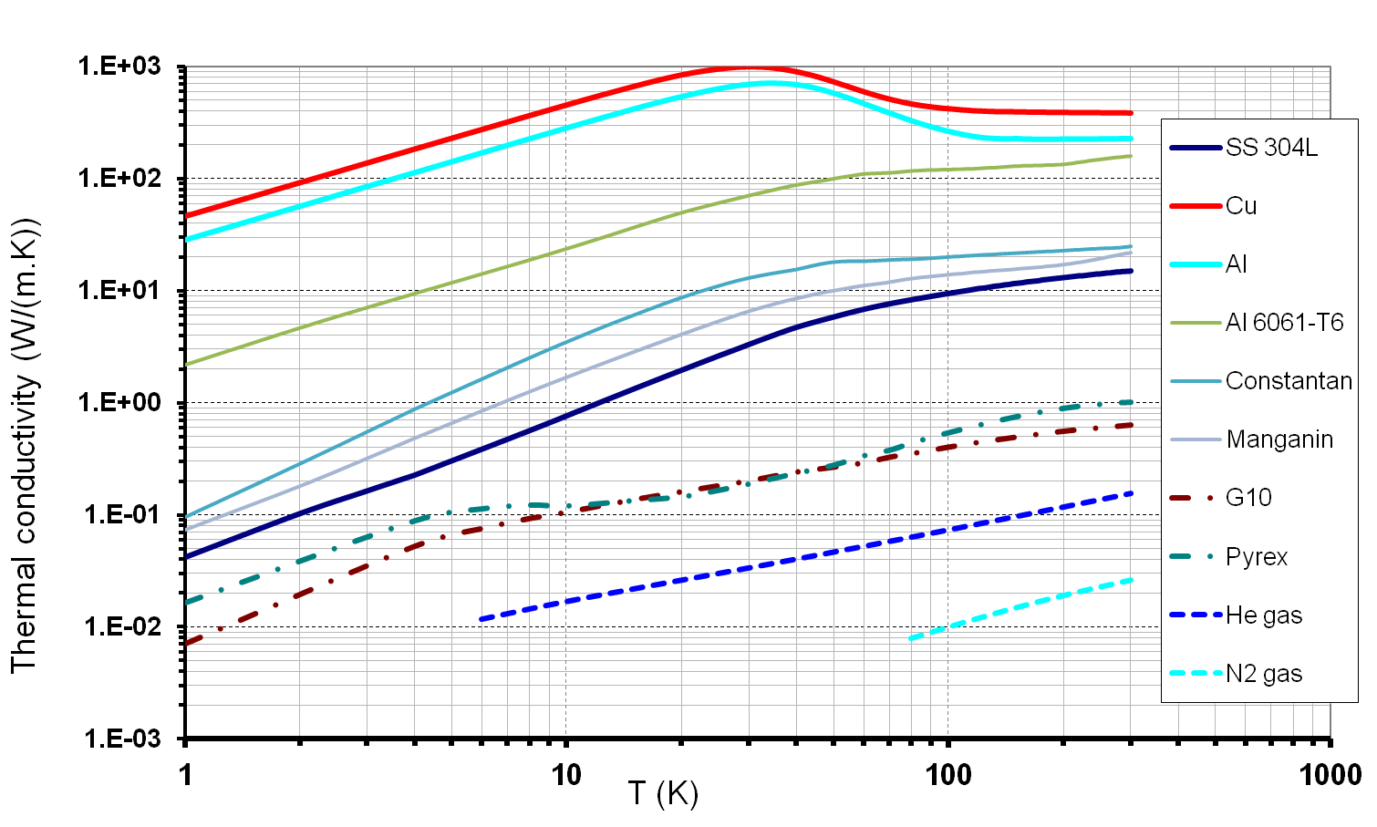
THERMAL PROPERTIES
Thermal conductivity
  For thermal insulators
    k is smaller than for metals (by several orders of magnitude)
    k ∝ T³ (for crystallized materials)
  Thermal conductivities
10³
10²
10¹
10⁰
10⁻¹
10⁻²
10⁻³
(RRR=30)
  NB: LHe at 4K or He at 300 K (gas), has smaller thermal conductivity than an insulator like G10.

Slide 17
THERMAL PROPERTIES
Thermal conductivity

Slide 18
THERMAL PROPERTIES
Thermal conductivity integrals
  one must integrates the thermal conductivity over the considered temperature range in order to evaluate the diffused heat quantity.
  Thermal conduction integrals are evaluated from a reference temperature T_{REF} (1K for example). Thus conduction integrals of interest over a given temperature range is given by the difference:

Slide 19
THERMAL PROPERTIES
Thermal conductivity integrals

Slide 20
THERMAL PROPERTIES
Thermal diffusivity
  Heat conduction equation (non stationary):
  The thermal diffusivity allows to asses the time constant of heat to diffuse over a characteristic length L (time to warm-up or cool-down by a system by heat conduction)
  For metals, at low T°: k ∝ T and c_{p} ∝ T³ ⇒ k rises as T decreases
  (especially for highly pure metals for which k is strongly affected by purity at low T° ; not c_{p})
  Generally speaking C_{p} rises as T decreases
⇒
Isotropic
Cst coefficients
Thermal diffusivity: [m²/s]

Slide 21
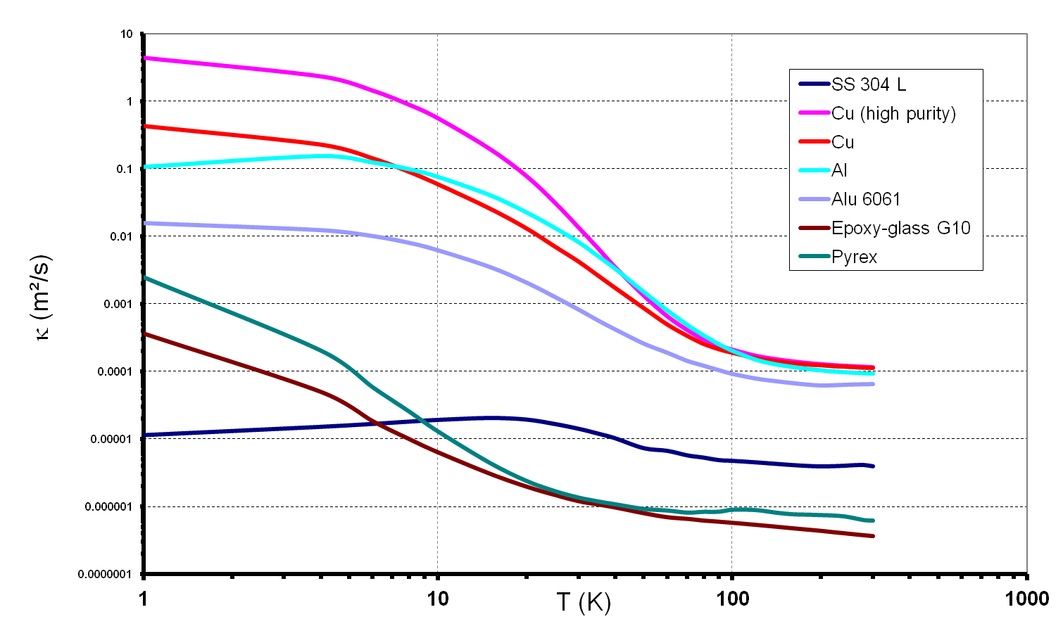
THERMAL PROPERTIES
Thermal diffusivity
10¹
10⁰
10⁻¹
10⁻²
10⁻³
10⁻⁴
10⁻⁵
10⁻⁶
10⁻⁷
  NB: 304L thermal diffusivity is two order of magnitude lower than G10

Slide 22
THERMAL PROPERTIES
Thermal expansion/contraction
  Coefficient of thermal expansion (cf. Basics thermodynamics):
  Generally speaking, α_{V}>0 and so at constant pressure, a temperature decrease induces a reduction of the physical dimensions (size) of a body.
Thermal expansion/contraction of solids
  For solid, we can ignore the effect of pressure
  In cryogenic systems, components can be submitted to large temperature difference:
    because they are links to both cold and warm surfaces (cold mass supports) ;
    during cool-downs or warm-ups transient states.
  Being a function of the temperature, thermal expansion can affect:
    the resistance of an assembly, generating large stresses;
    the dimensional stability of an assembly (buckling).

Slide 23
THERMAL PROPERTIES
Thermal expansion/contraction of solids
  Linear expansion coefficient: (K⁻¹)
  For a crystallized solid, it varies as c_{ph}
    At very low temperature: α ∝ T³
    Tends to a constant value as T increases towards ambient temperature
  In practice, the expansion coefficient is computed from a reference temperature (300K):
    around ambient temperature: Δl / l ∝ T
    at low temperature (4-77K ): Δl / l ∝ T⁴ (in practice the coefficient of proportionality is negligible)
where l denotes for the length of the body at the reference temperature

Slide 24
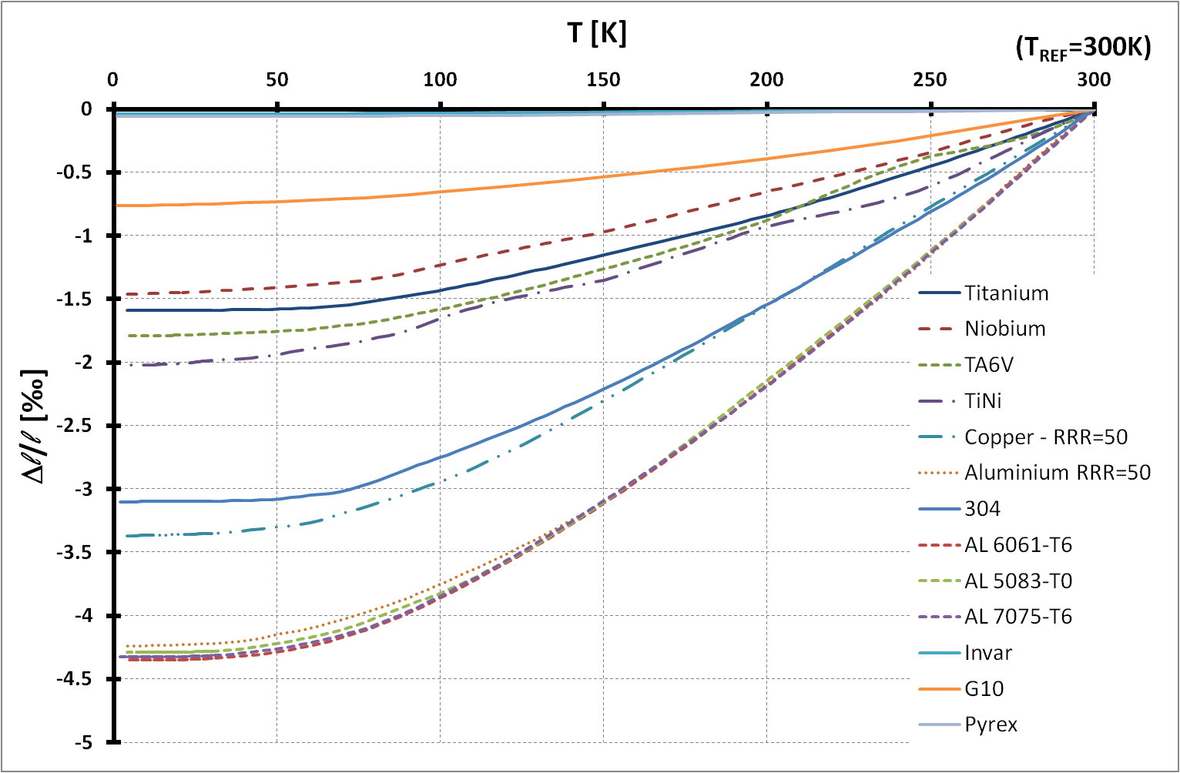
THERMAL PROPERTIES
Thermal expansion/contraction of solids
  We note that most of the thermal expansion/contraction is effective between 300K and 77K (temperature of boiling LN₂ at P=1atm).

Slide 25
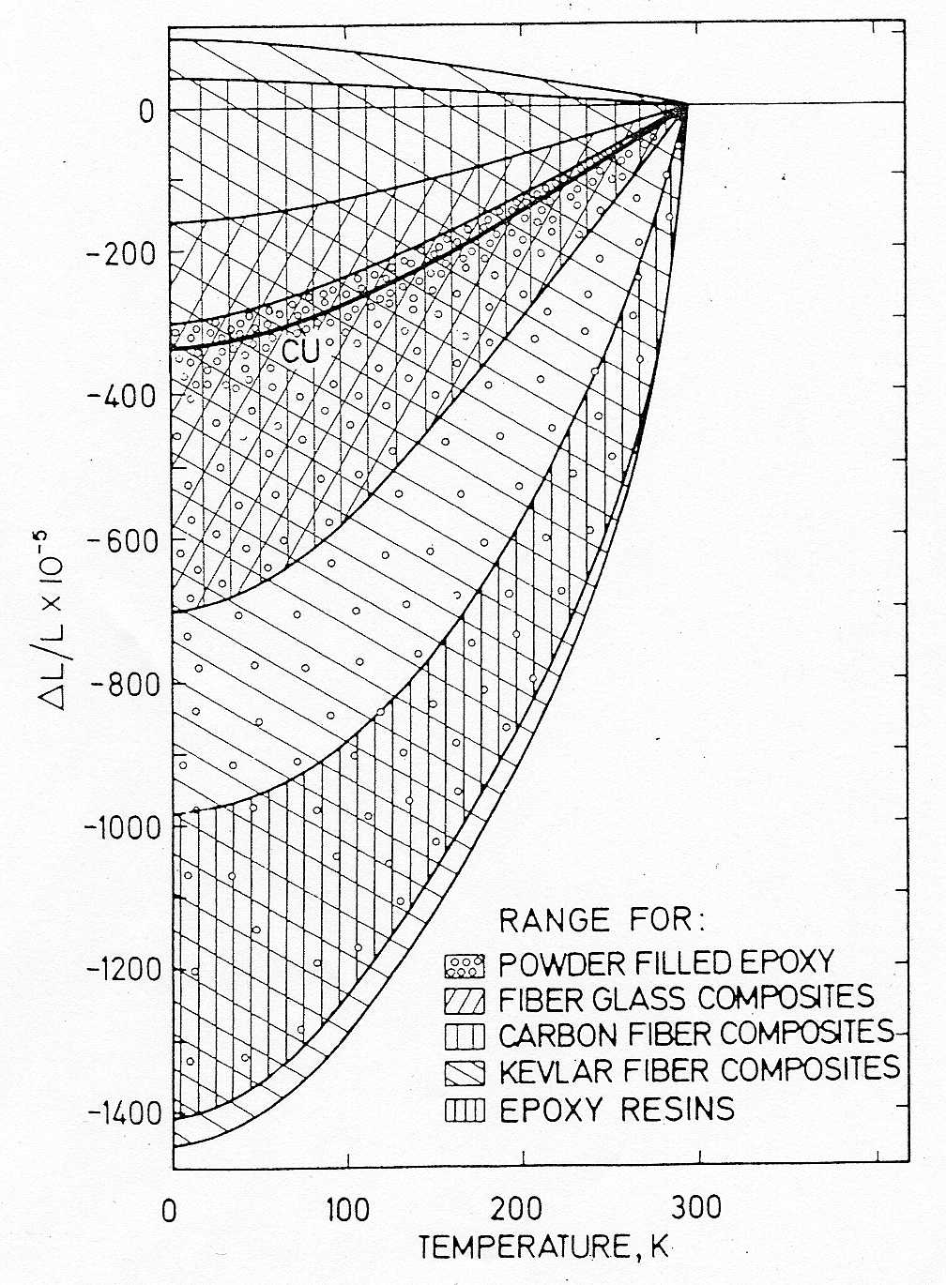
THERMAL PROPERTIES
B
Thermal expansion/contraction of solids
  Example:
T_{amb}
A ( for example Cu)
Cu
T << T_{amb}
Induces:
Large stress
Mechanical instability (buckling)
T << T_{amb}
Induces large stress

Slide 26
ELECTRICAL PROPERTIES
Electric conductivity
  Within metals, electrical charge is transported by the "free electrons".
  The parameters determining the electrical conductivity of metals are:
    N: the number of electrons per unit volume
    e: the charge carried by an electron
    m: the mass of an electron
    v: the average velocity of "conduction electrons"
    l_{e} : the average distance the electrons travel before being scattered by atomic lattice perturbation (the mean free path)
  Only the mean free path l_{e} is temperature dependant.
  At high (ambient) temperature, the electron free path l_{e} is dominated by electron scattering from thermal vibrations (phonons) of the crystal lattice. The electrical conductivity is linearly temperature-dependant.
  At low temperature, the free path l_{e} is limited mainly by scattering off chemical and physical crystal lattice imperfections (impurities, vacancies, dislocations). The electrical conductivity tends to a constant value.

Slide 27
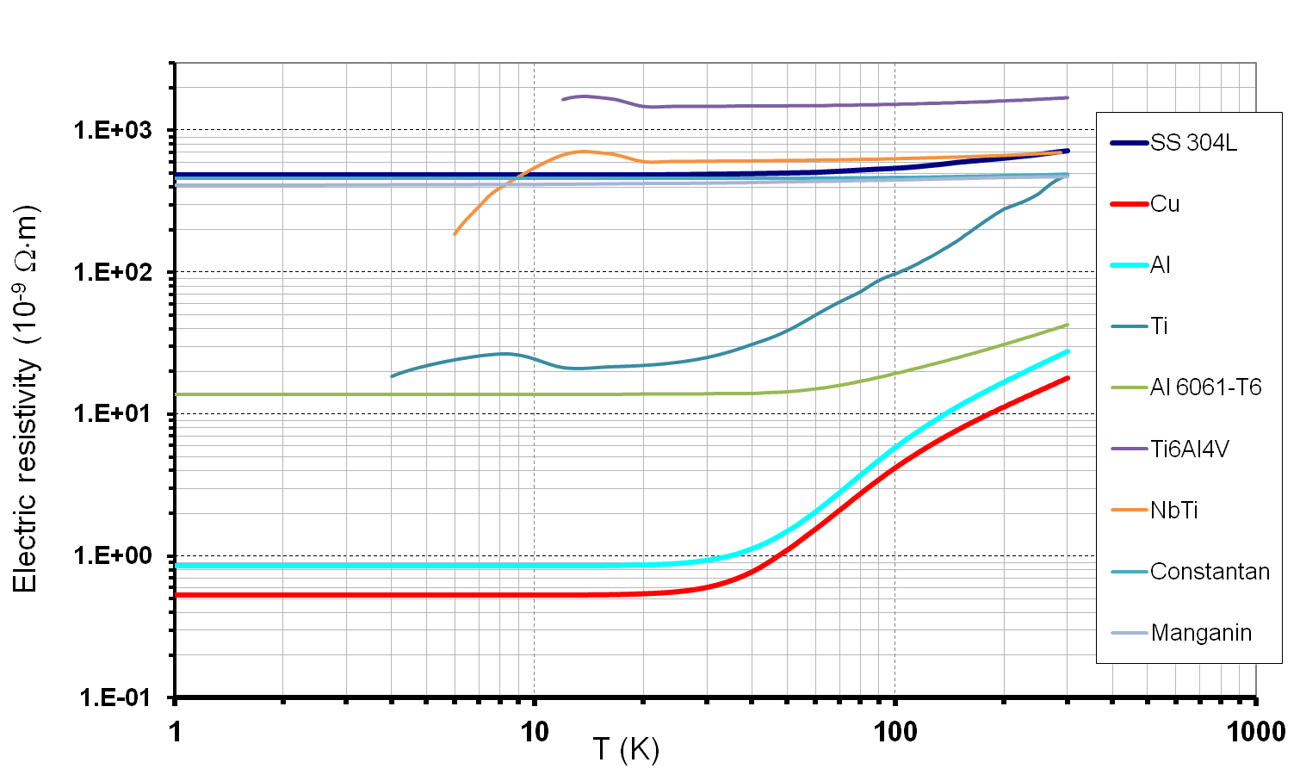
ELECTRICAL PROPERTIES
Electric resistivity of metals
  ρ(T)=ρ₀+ρ_{i}(T), ρ₀ =cst and ρ_{i} relates to the electron-phonon interaction
  It can be shown that:
    For T>2θ_{D}: ρ_{i}(T) ∝ T
    For T<θ_{D}/10: ρ_{i}(T) ∝ T⁵ and in practice ρ_{i}(T) ∝ T^{n} with 1<n<5
10³
10²
10¹
10⁰
10⁻¹
NB: electrical resistance: R(T)=ρ⋅L/S (Ω)

Slide 28
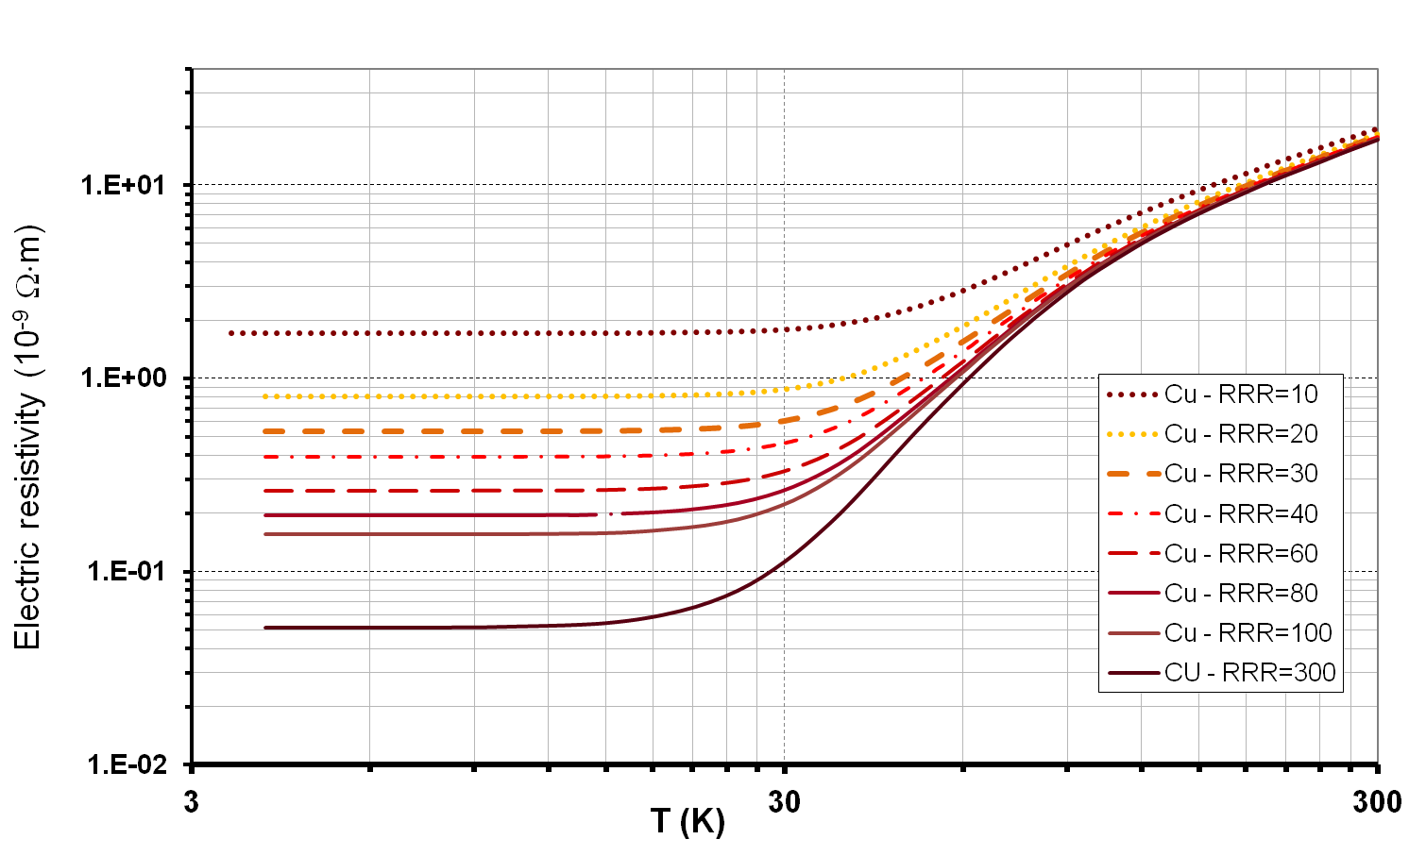
ELECTRICAL PROPERTIES
Electric resistivity of metals
  An indication of metal purity is provided by the determination of a Residual (electrical) Resistivity Ratio:
Ordinary copper: 5<RRR<150
OFHC copper: 100<RRR<200
Very pure copper 200<RRR<5000
10¹
10⁰
10⁻¹
10⁻²

Slide 29
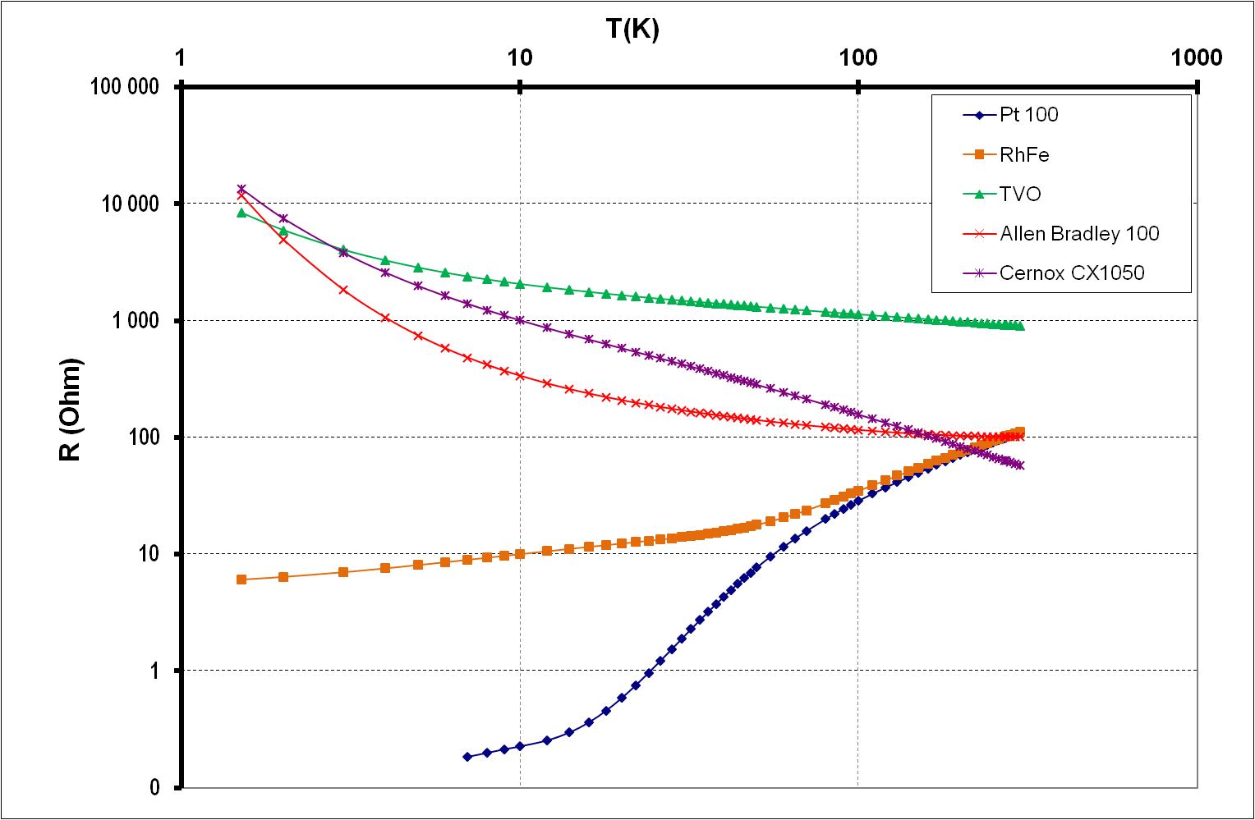
ELECTRICAL PROPERTIES
Electric resistivity
  Resistivity of semiconductors is very non linear
  It typically increases with decreasing the temperature due to fewer electron in the conduction band (used to make temperature sensors: thermistor)
  Around high (ambient) temperature, electrical properties are not modified by impurities and:
          where
          A is an experimental constant
          δ energy band depending on the material

Slide 30
MECHANICAL PROPERTIES
F/2
Introduction
  Tensile test:
Stress
σ=F/s₀ (N/m²≡Pa)
cross section s₀
ΔL
Ultimate tensile strength
UTS
Fracture
F/2
YS_{0.2}
0.2% offset line
Yield tensile strength
YS
Slop:
Young modulus
E = R_{e} × L/ΔL
NB: stiffness k=EA/L
Plastic deformation
(irreversible)
Necking
Strain
Elastic deformation
(reversible)
ΔL/L (%)

Slide 31
MECHANICAL PROPERTIES
Introduction
  Ductile behaviour
  (think about lead, gold...)
  Brittle behaviour
  (think about glass)
Stress
Stress
Strain
Strain

Slide 32
MECHANICAL PROPERTIES
Introduction
  When temperature goes down, a material tends to become brittle (fragile) even if it is ductile at ambient temperature.
T₁
>
T₂
>
T₃
Fragile fracture
F/S₀
F/S₀
F/S₀
F/S₀
UTS
YS
A%
A%
A%
T
T₃
T₂
T₁

Slide 33
MECHANICAL PROPERTIES
Mechanical behaviour
  The mechanical behaviour at cold temperature of metals and metallic alloys depends on their crystal structure.
  For face-centered cubic crystal structure (FCC):
  (Cu-Ni alloys, aluminium and its alloys, stainless steel (300 serie), Ag, Pb, brass, Au, Pt),
  they belongs ductile until low temperatures and do not present any ductile-brittle transition.
  For body-centered cubic cristal structure (BCC):
  (ferritic steels, carbon steel, steel with Ni (<10%), Mo, Nb, Cr, NbTi)
  a ductile-brittle transition appears at low T°.
  For compact hexagonal structure (HCP):
  (Zn, Be, Zr ,Mg, Co, Ti alloys (TA5E)...)
  no general trend comes out.
  mechanical properties depends on interstitial components

Slide 34
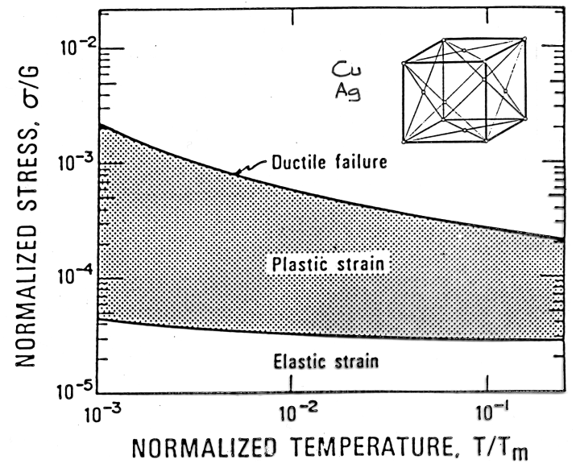
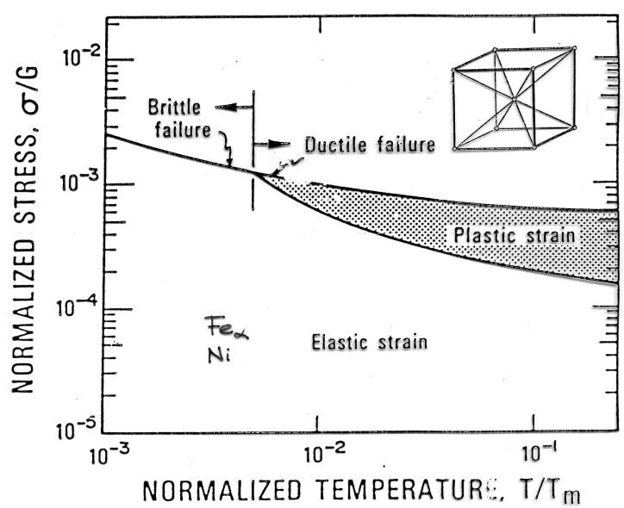
MECHANICAL PROPERTIES
Mechanical behaviour
FCC | BCC | HCP
Copper | Iron | Zinc
Aluminium | Carbon steel | Titanium
Nickel | Nickel Stell | Magnesium
Silver | Niobium | Cobalt
Gold | Chromium
Austenitic stainless steel (304, 304L, 316, 316L, 316LN) | Niobium-Titanium
Lead
Platinium

Slide 35
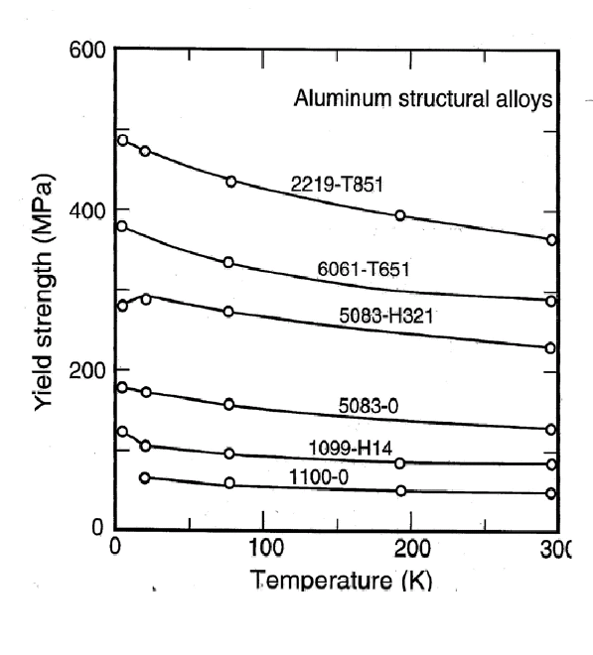
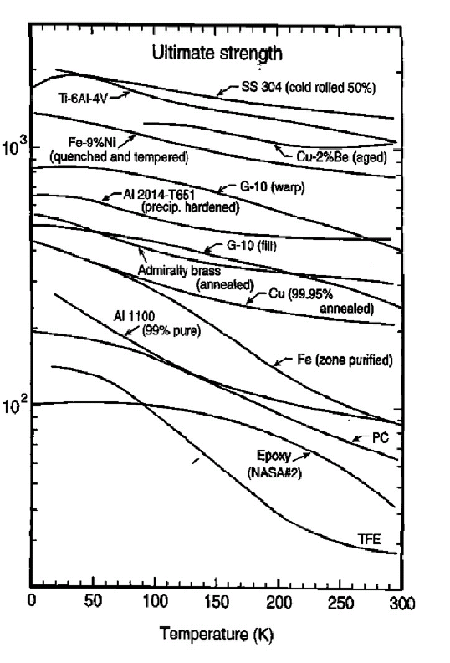
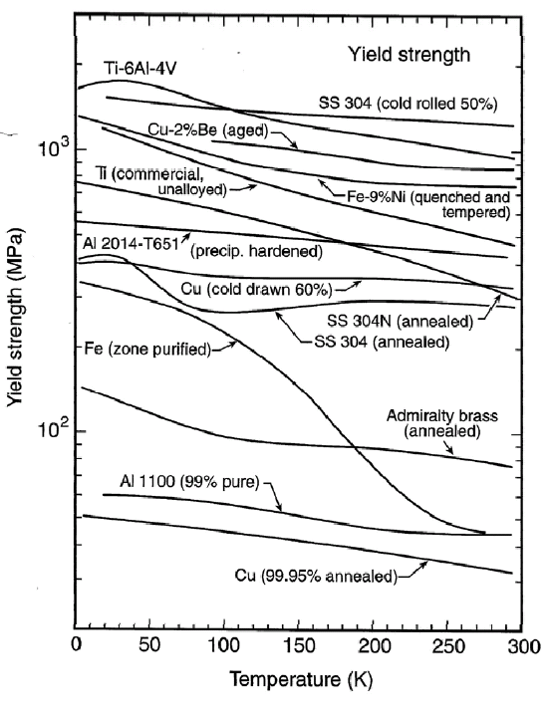
MECHANICAL PROPERTIES
Yield, ultimate strength
  Young Modulus slightly change with temperature
  Yield and ultimate strengths increases at low temperature
From: Ekin, J.W. Experimental Techniques for Low Temperature Measurements

Slide 36
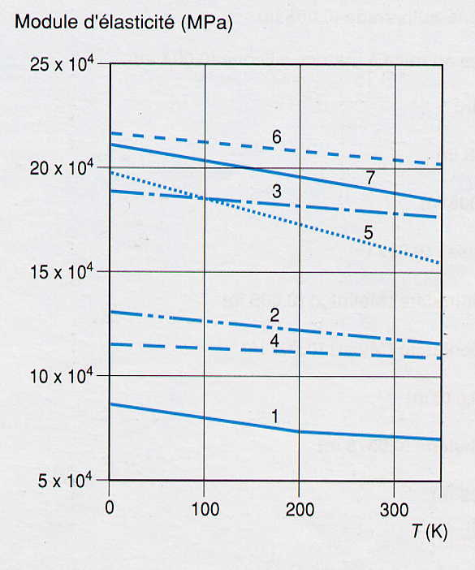
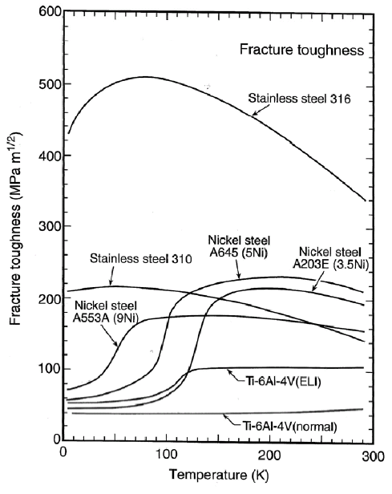
MECHANICAL PROPERTIES
General behaviours
Young Modulus
1 : 2024 T4 aluminium
2 : copper-beryllium
3 : K monel
4 : Titanium
5 : SS 304
6 : Carbon Steal C 1020
7 : Steal 9% Ni
From: Ekin, J. Experimental Techniques for Low Temperature Measurements
From: Technique de l’Ingénieur

Slide 37
MAGNETIC PROPERTIES
Introduction
  In vacuum:
  In a material: B=μ₀ H + μ₀ M
  M = χ H is the magnetization and represents how strongly a region of material is magnetized. It is defined as the net magnetic dipole moment per unit volume.
  Thus: B= μ₀(1 + χ) H = μ₀ μ_{r} H
  The magnetic moment of a free atom depends on:
    electrons spin
    orbital kinetic moment of the electrons around the nucleus
    kinetic moment change induced by the application of a magnetic field
  5 types of magnetic behaviour can be distinguished:
    Diamagnetism and paramagnetism due to isolated atoms (ions) and free electrons
    Ferromagnetism, anti-ferromagnetism and ferrimagnetism due to collective behaviour of atoms
B (T≡V⋅s ⋅m⁻²≡N ⋅A⁻¹ ⋅m⁻¹); μ₀=4π ⋅10⁻⁷ (N ⋅A⁻²); H (Vs/Am ≡A ⋅m⁻¹)
M (Vs/Am ≡A ⋅m⁻¹)

Slide 38
MAGNETIC PROPERTIES
Diamagnetic materials
  If magnetic susceptibility χ = μ_{R}-1 <0 where μ_{R} is the relative magnetic permeability
  It causes a diamagnet to create a magnetic field in opposition to an externally applied magnetic field
  When the field is removed the effect disappears
  Examples: Silver, Mercury, Diamond, Lead, Copper
  If the (small) field H is applied then:
  M = χ H
  χ does not depend on temperature
  NB: type I superconductors are perfect diamagnets for T<T_{C}
    Ex.: Cu, Nb

Slide 39
MAGNETIC PROPERTIES
Paramagnetic materials
  χ = μ_{R}-1 >0
  Paramagnets are attracted by an externally applied magnetic field
  χ is small → slight effect
  Different models of paramagnetic systems exist
  Relation to electron spins
    Permanent magnetic moment (dipoles) due to the spin of unpaired electrons in the atoms’ orbitals. But randomization ⇒ no effect
    If a magnetic field is applied, the dipoles tend to align with the applied field ⇒ net magnetic moment
    When the field is removed the effect disappears
    For low levels of magnetization, M = χ ⋅ H = C / T⋅ H (χ = C / T )
      where C = N μ₀ mu²/(3k_{B}T) is the Curie constant (mu is the permanent magnetic moment)
      Thus χ increases as T decreases
      (Application: magnetic thermometers)
    Ex.: Al

Slide 40
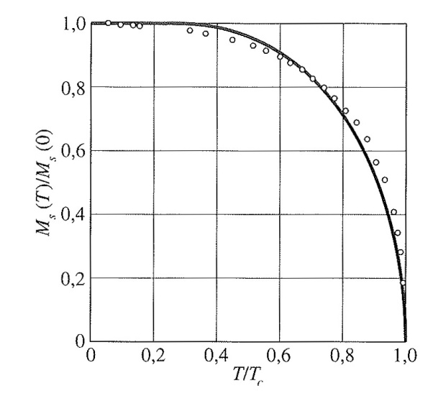
MAGNETIC PROPERTIES
Ferromagnetic materials
  Unpaired electron spins (cf. paramagnets)
  + electrons’ intrinsic magnetic moment ; tendency to be parallel to an applied field and parallel to each other
  ⇒ Magnetization remains
  χ = Cst / (T-θ_{C} ) ; θ_{C} =Curie temperature
  Ferromagnets loose their ferromagnetic properties above θ_{C} .
  For classical ferromagnets, θ_{C} > T_{amb}
  Examples: Fe, Ni or Co alloys (not austenitic steels)
  When an increase in the applied external magnetic field H cannot increase the magnetization M the material reaches saturation state :
  Bellow θ_{C} :
∝
T/θ_{C}

Slide 41
MAGNETIC PROPERTIES
Antiferromagnetic materials
  for antiferromagnets, the tendency of intrinsic magnetic moments of neighboring valence electrons is to point in opposite directions.
  A substance is antiferromagnetic when all atoms are arranged so that each neighbor is 'anti-aligned'.
  Antiferromagnets have a zero net magnetic moment below a critical temperature called Néel temperature θ_{N} ⇒ no field is produced by them.
  Above Néel temperature, antiferromagnets can exhibit diamagnetic and ferrimagnetic properties:
Ferrimagnetic materials
  Ferrimagnets keep their magnetization in the absence of an applied field (like ferromagnets)
  Neighboring pairs of electron spins like to point in opposite directions (like antiferromagnets)

Slide 42
REFERENCES
  CRYOCOMP, CRYODATA software (based on standard reference data from NIST), Cryodata Inc. (1999).
  Bui A., Hébral B., Kircher F., Laumond Y., Locatelli M., Verdier J., Cryogénie : propriétés physiques aux basses températures, B 2 380 − 1 (1993).
  Ekin J.W., Experimental Techniques for Low Temperature Measurements, Oxford University Press, ISBN 978-0-19-857054-7 (2006).
  Amand J.-F., Casas-Cubillos J., Junquera T., Thermeau J.-P., Neutron Irradiation Tests in Superfluid Helium of LHC Cryogenic Thermometers, ICEC'17 Bournemouth (UK), July (1998)

Slide 43
Thank you for your attention

Slide 44
THERMAL CONDUCTIVITY OF CRYOFLUIDS
Liquids
  As liquids T_{amb}, cryogenic liquids are bad thermal conductors (small k)
  LHe:
    LHe thermal conductivity is lower than thermal insulator like G10
    LHe II (superfluid helium, T<2,17 K) is a heatsuperconductor (k_{LHe II} ∼ 2kW/(mK)
    Maximum of thermal conductivity arround 1.95K (k is 100 larger that the thermal conductivity of a high pure copper)
Gases
  Small thermal conduction
    At P=P_{atm}, k ∝ T^{1/2} (ℓ_{p} is limited by molecules collisions)
    Low pressure:
    ℓ_{p} comparable with distance between hot and
    cold surfaces (free-molecule regime) ⇒ k ∝ T
v ∝ T^{1/2}
c_{V} ∝ ρ
ℓ_{p} ∝ 1/ρ ∝ 1/P

