Slide 1
Mechanical & Material Aspects - Tutorial Group 3
Presented by Marco MORRONE

Slide 2
Project outline
Design the mechanical system of a room temperature [operating] vacuum system for a circular collider with high intensity proton beams.
Inner diameter [circular aperture] = 100mm
Length of vacuum chamber = 10m
Operating temperature = 20°C
Maximum temperature = 230°C
External pressure = atmospheric pressure [1 atm]
Internal pressure = <10⁻⁹ mbar
No magnetic field

Slide 3

Temperature induced Forces
Thermal deformation $ε= α ∆ T$
Thermal expansion $∆ \text{l}=ε l$
Thermal stress $σ=E ε$
The bellows are needed to allow the thermal expansion and for alignment purposes.
Material | Thermal deformation | dl [mm] | Thermal stress [MPa] | sigma y [MPa] | Cost [€/kg]
Copper OF | 0.00357 | 35.7 | 410.55 | 35 | ~25-40
Aluminium | 0.00462 | 46.2 | 355.74 | 393 | ~15
Stainless steel 316 L | 0.00336 | 33.6 | 655.2 | 240 | ~11-32
Titanium Grade 5 | 0.001869 | 18.69 | 214.94 | 880 | ~50

Slide 4
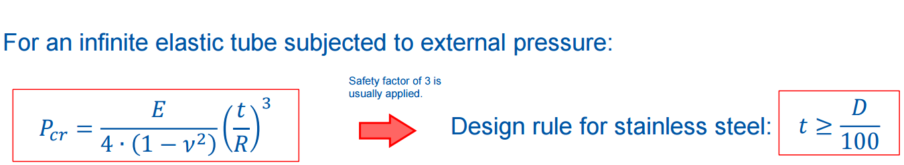

Structural stability
For the 316 L ss chamber the minimum thickness to avoid the tube to collapse is around 1 mm.
The thickness decided for the chamber is 1.5 mm (only available thickness for d=100 standard tube).
Hoop stress: $σ_{1}=\frac{pD}{2t}$ =3.3 MPa
Longitudinal stress: $σ_{2}=negligible because of the bellow$

Slide 5

Chamber supports
-2x sliding supports
-1 x fixed support
250 mm
250 mm
4750 mm
4750 mm
250mm
250 mm
1000 mm

Slide 6
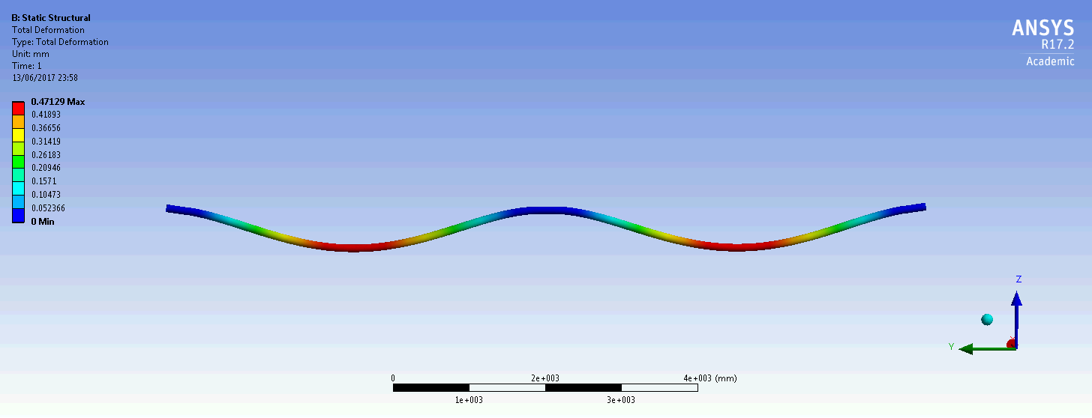
Finite elements modelling
Self-weight deformation
Weight chamber: 36.2 Kg
2 x Bellow + flanges: 3.2 Kg
TOTAL = 42.6 Kg
0.47 mm
0.47 mm
Displacement magnification:
x 1100

Slide 7
Bellows specification
  Total chamber expansion during bake-out = 33.6 mm
  2x individual bellows chambers to be installed at each end of the chamber
  Using standard industry item
Spec:
    UHV specification
    316L bellow hydroformed
    DN100CF 316LN ESR 3D forged flanges (1x rotatable)
    Ø_{inner} 100mm
    Convolutions needed = 2*thermal displacement / convolution stroke (6.5 mm) = 11

Slide 8
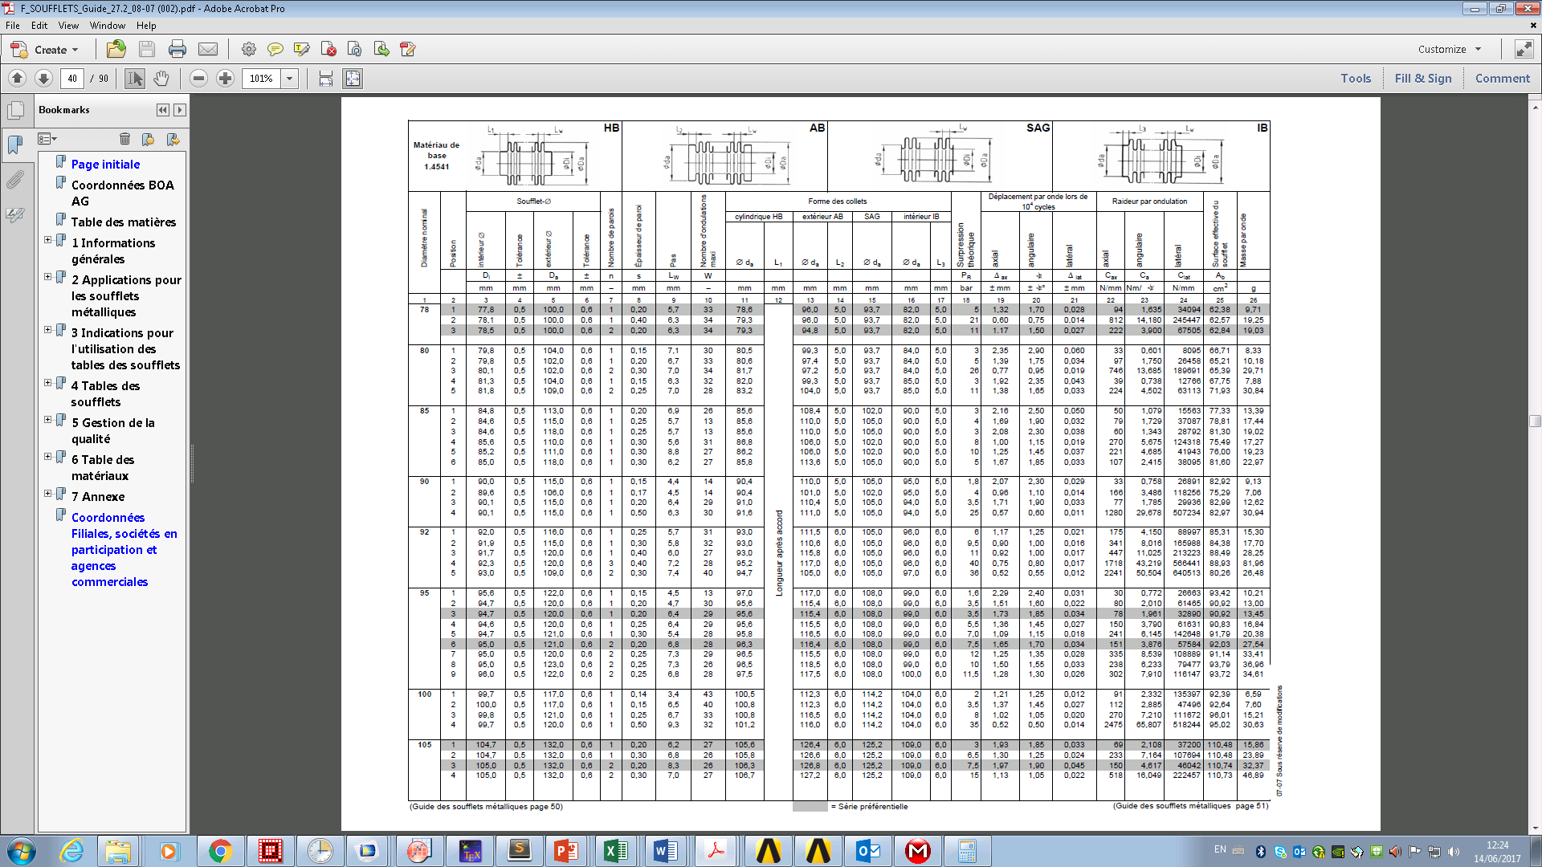

Bellows specification

Slide 9
Chamber Manufacture
  Stainless steel tube [Ø100mm],
    Typical length of tube 6m,
    100% weld penetration orbital 6 + 4 m (due to length)
  Internal welding DN100CF flanges
  Fixed support bracket to be mounted on the chamber
  Leak detection
  UHV cleaning to CERN specification EDMS:1626970
  Copper electroplating to reduce the impedance seen by the beam
  NEG coating for distributed pumping.

Slide 10
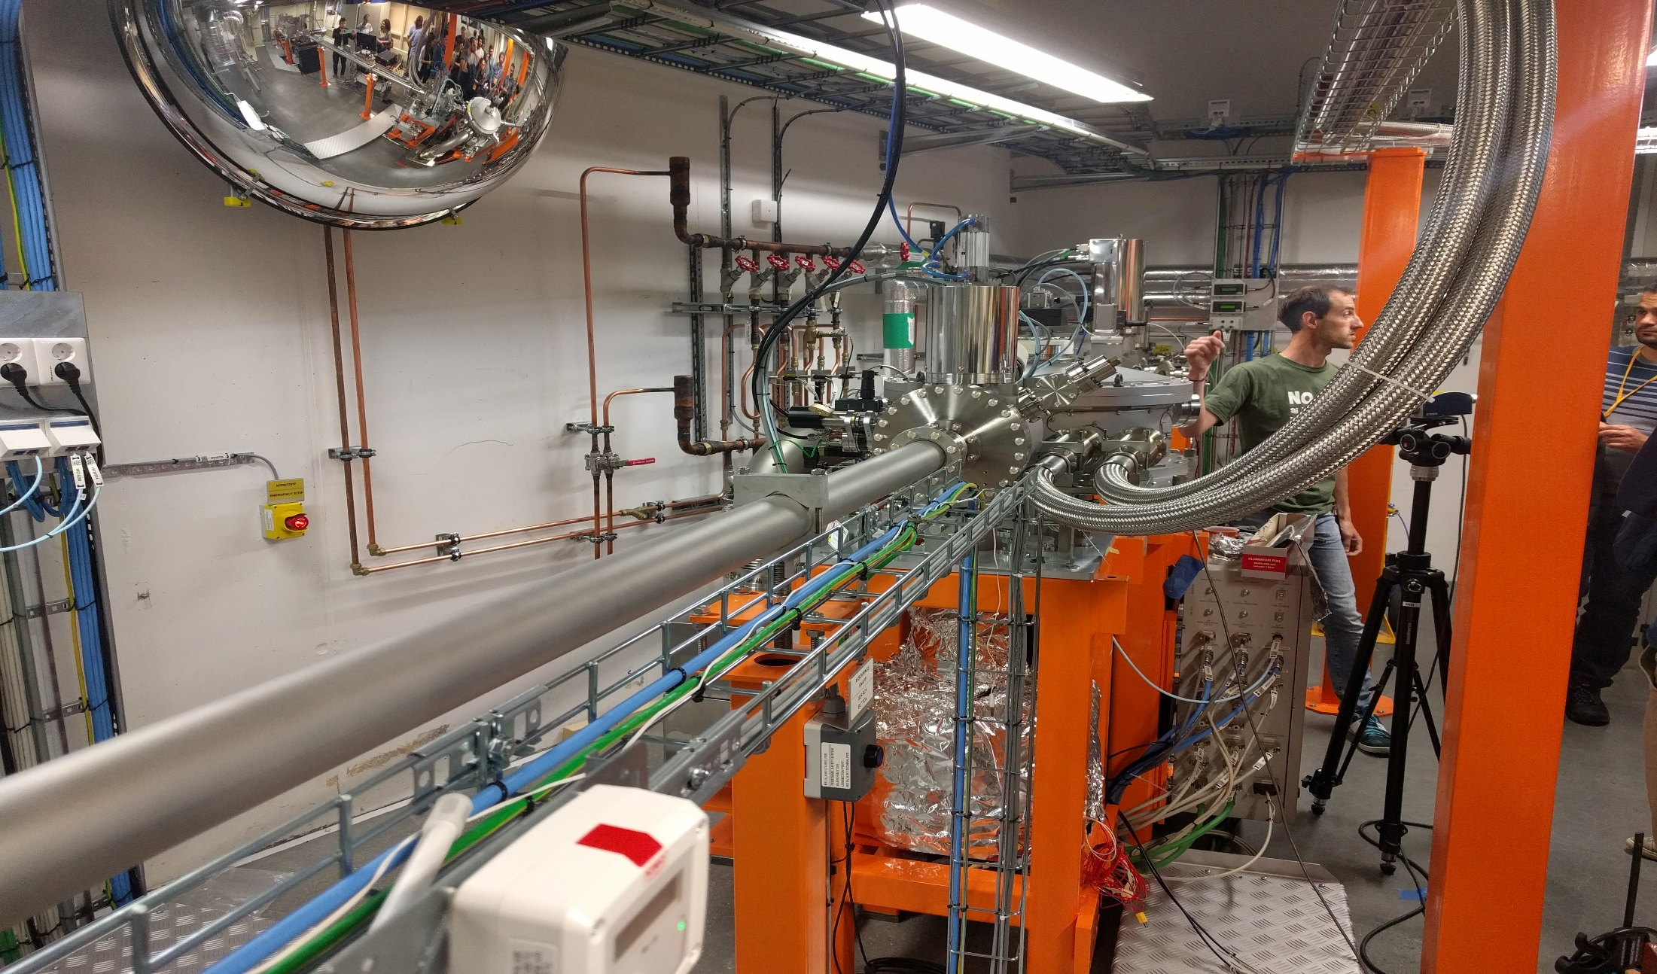
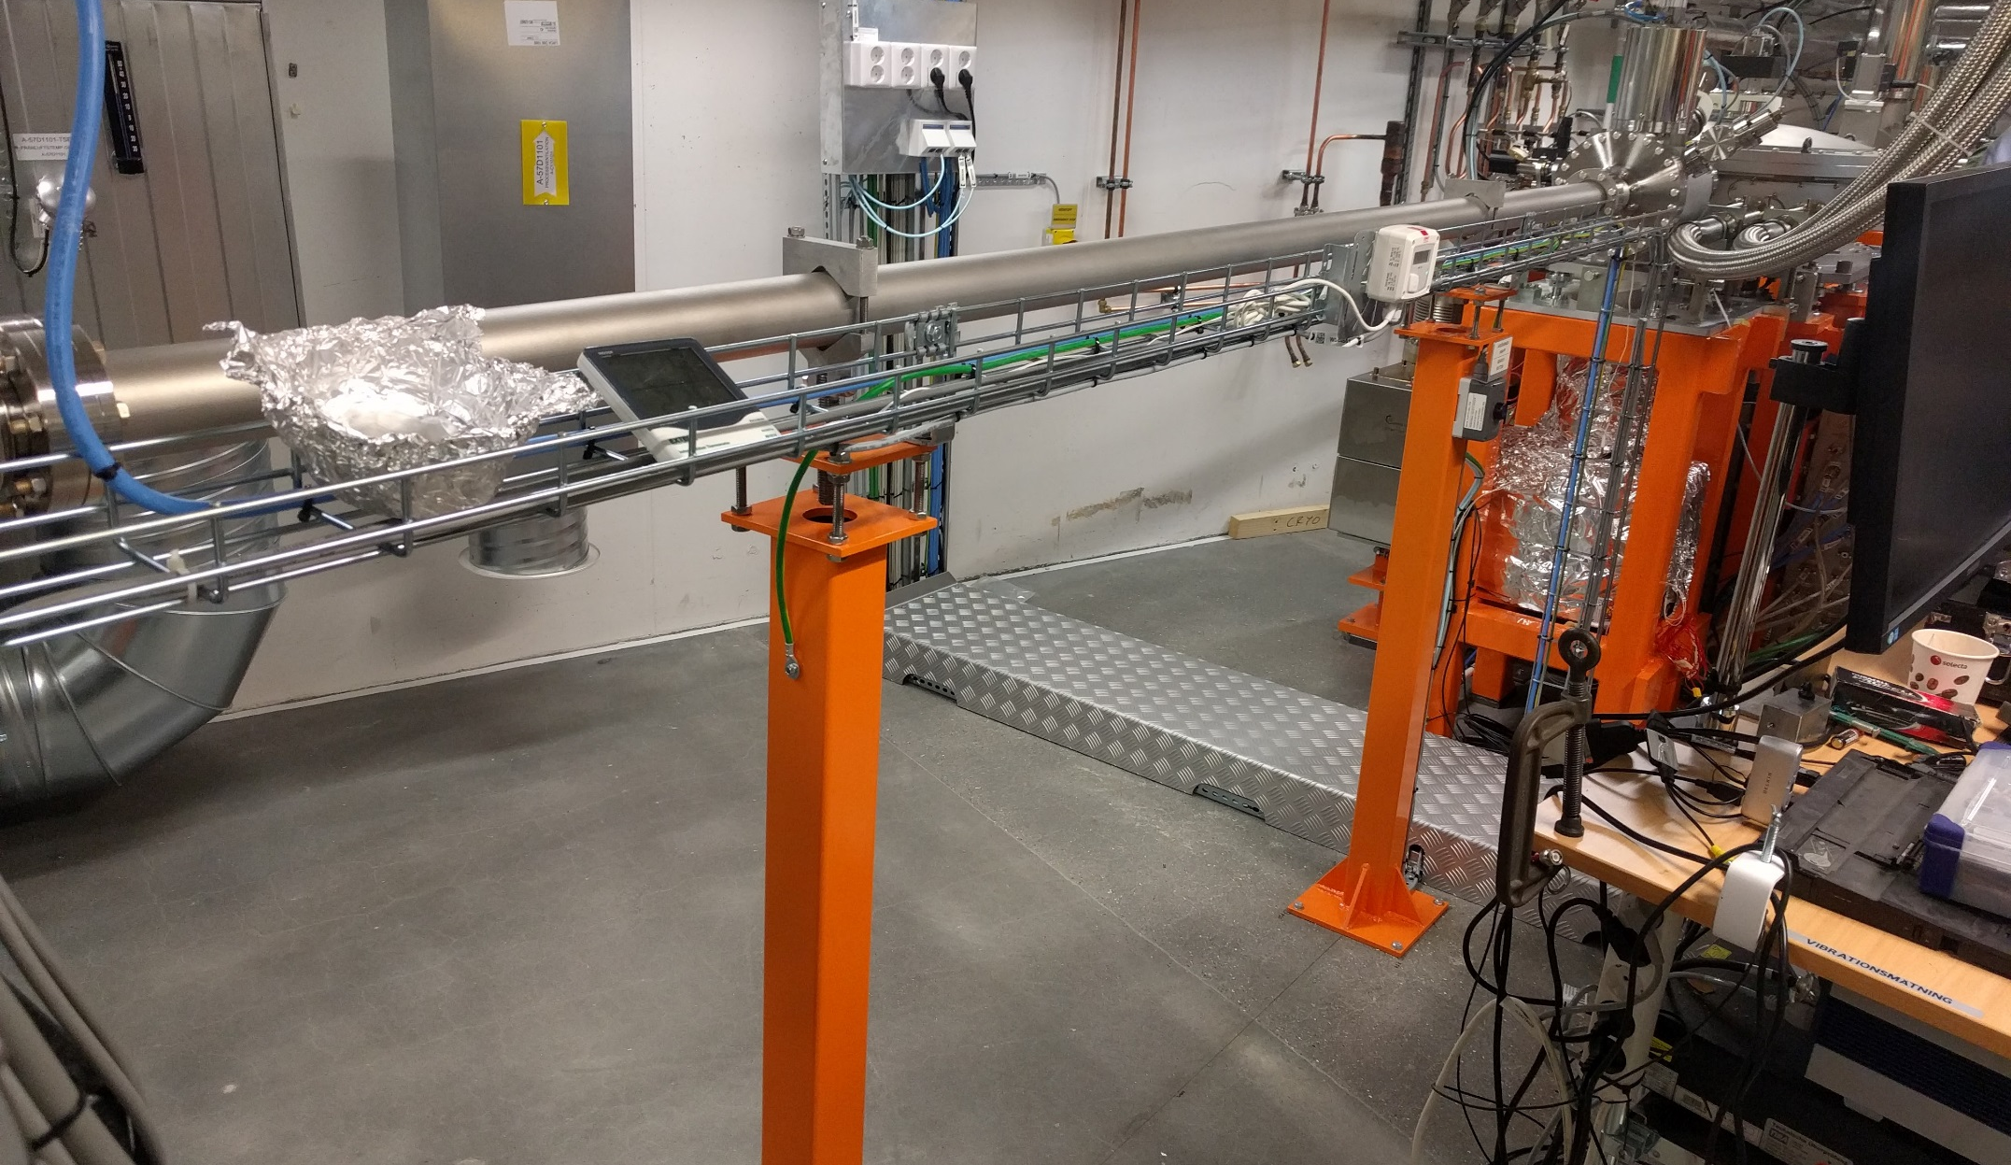
Chamber Max 4 - Experiment room

Slide 11
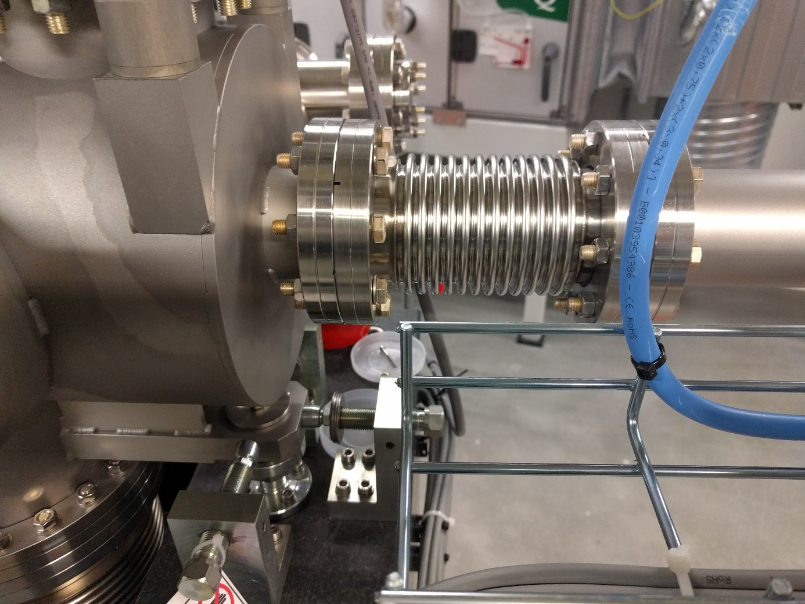
Chamber Max 4 - Experiment room

Slide 12
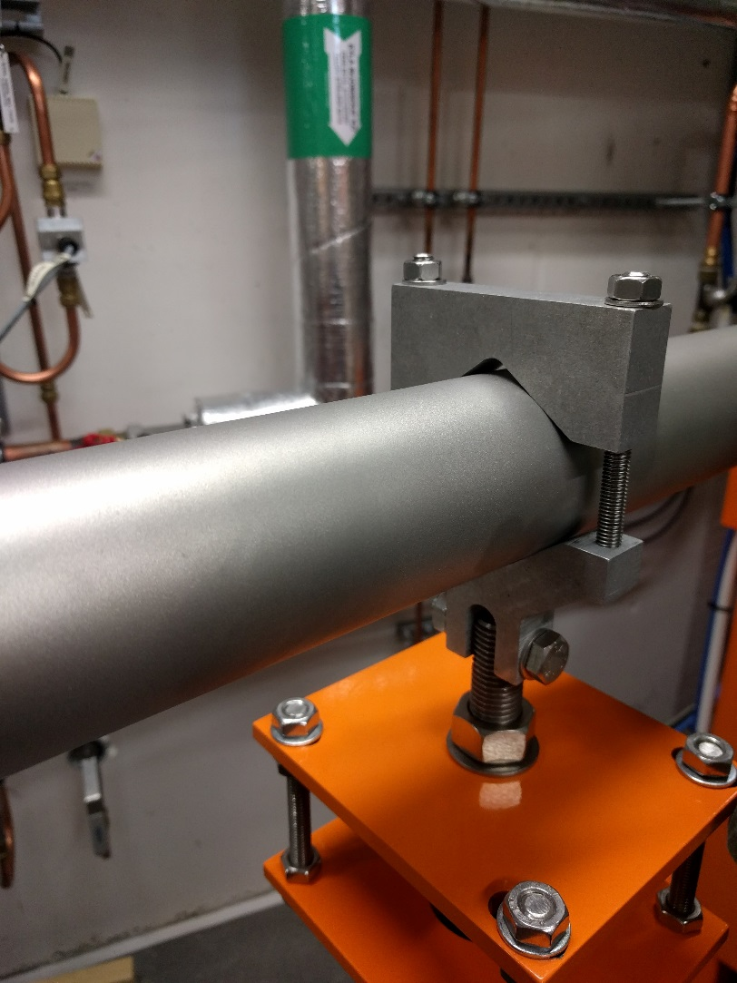
Chamber Max 4 - Experiment room

Slide 13
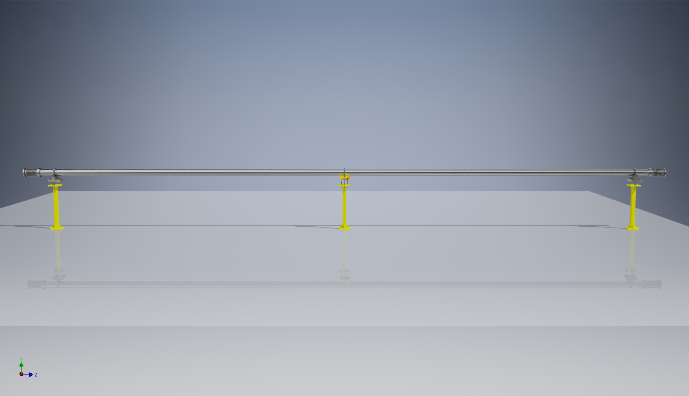
3D model of the vacuum system

Slide 14
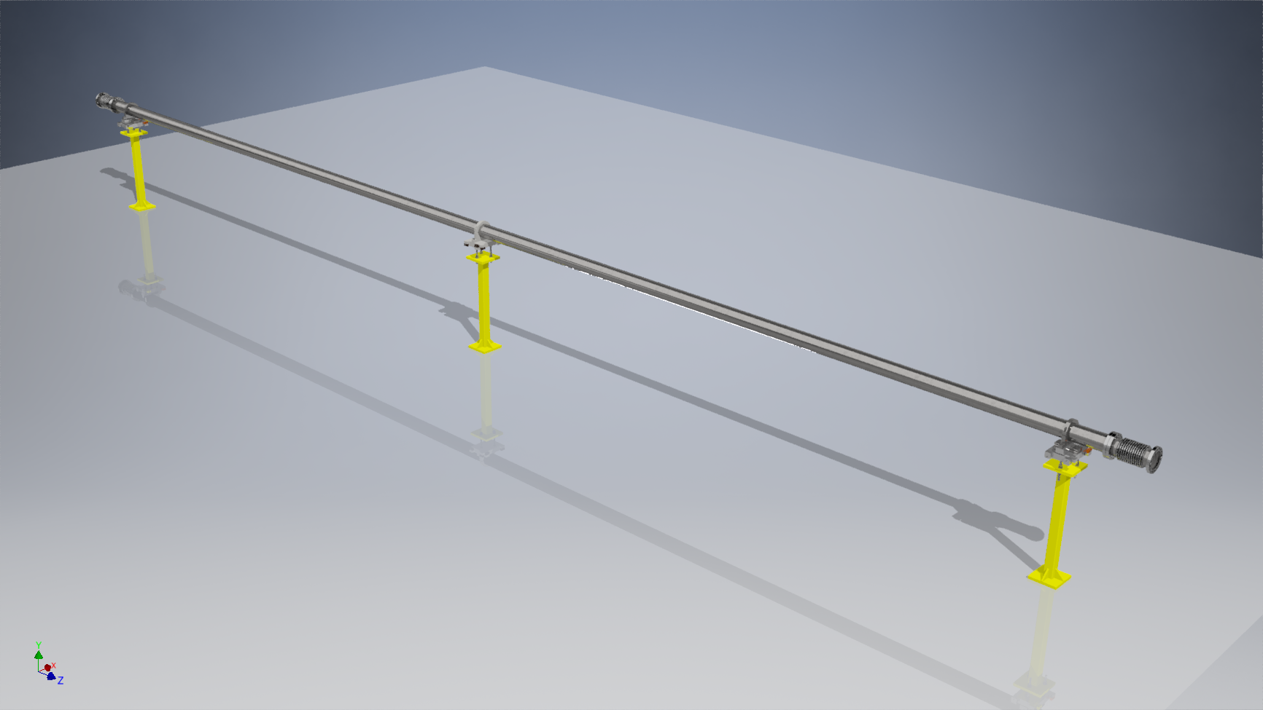
3D model of the vacuum system

Slide 15
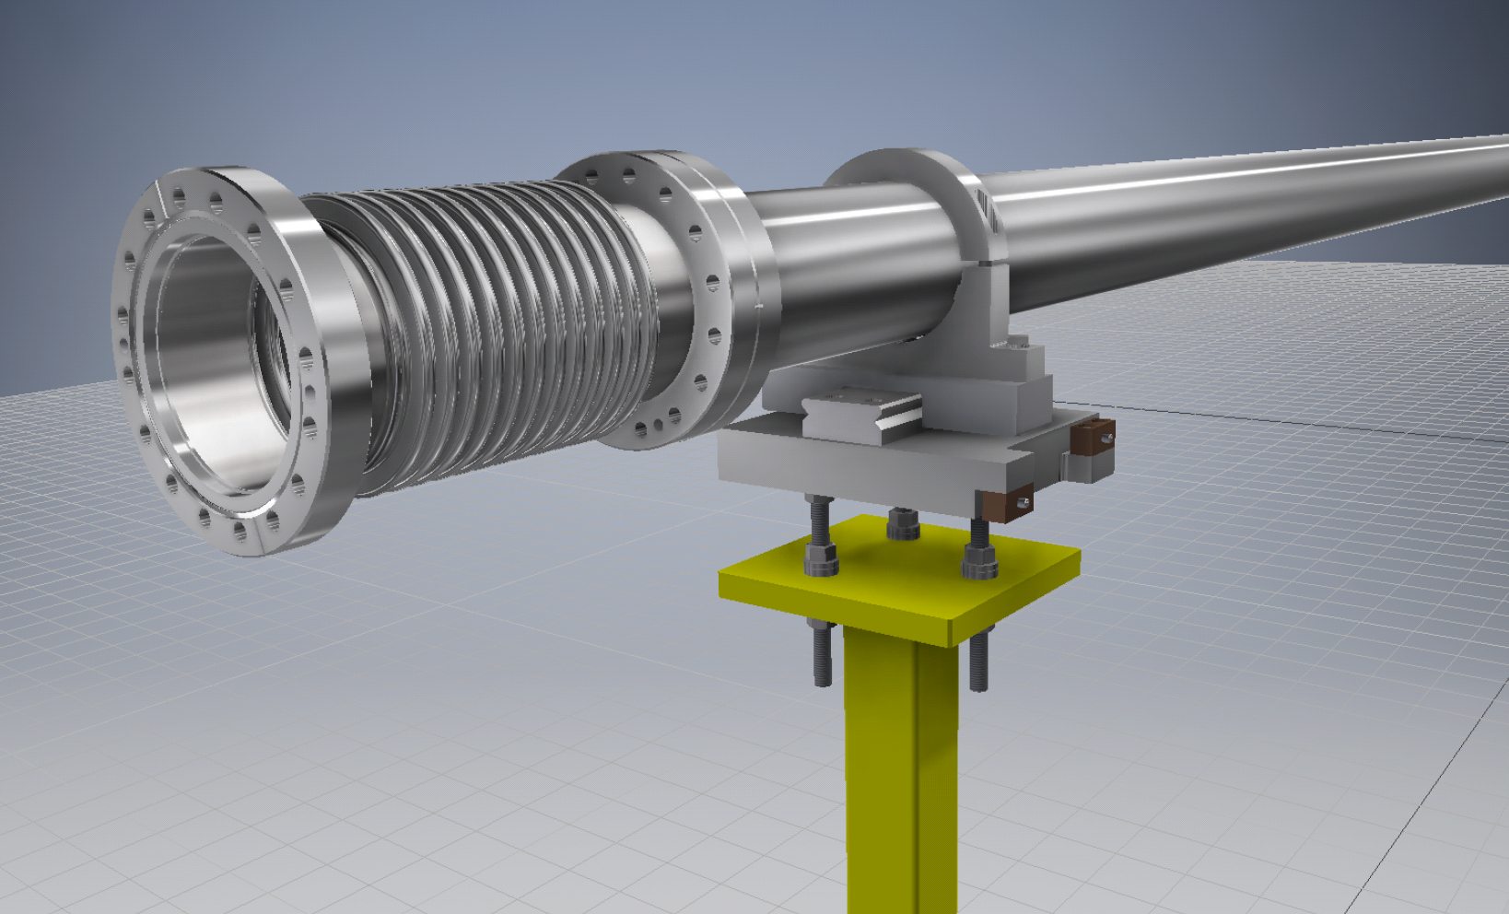
3D model of the vacuum system

Slide 16
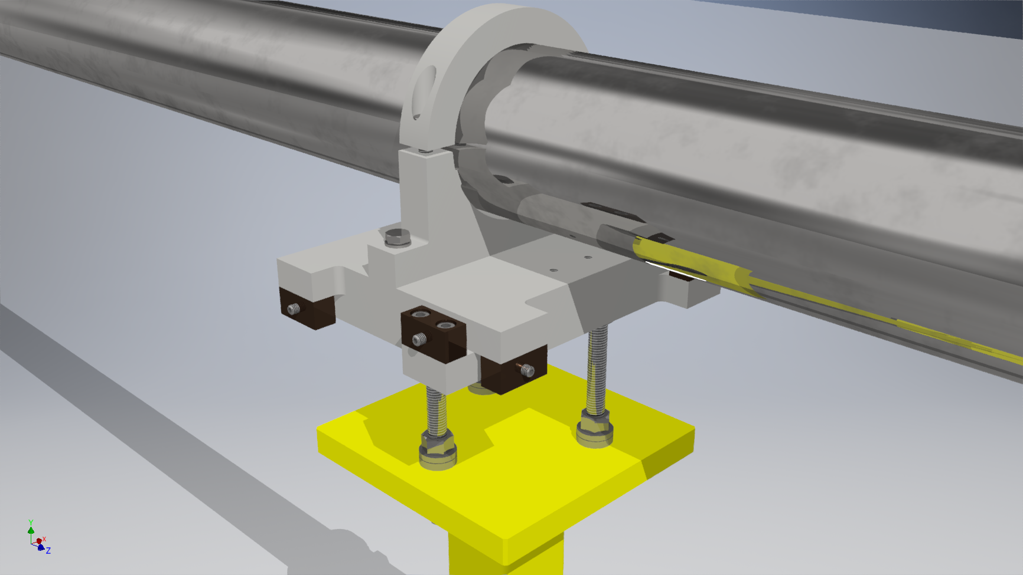
3D model of the vacuum system
weld

Slide 17
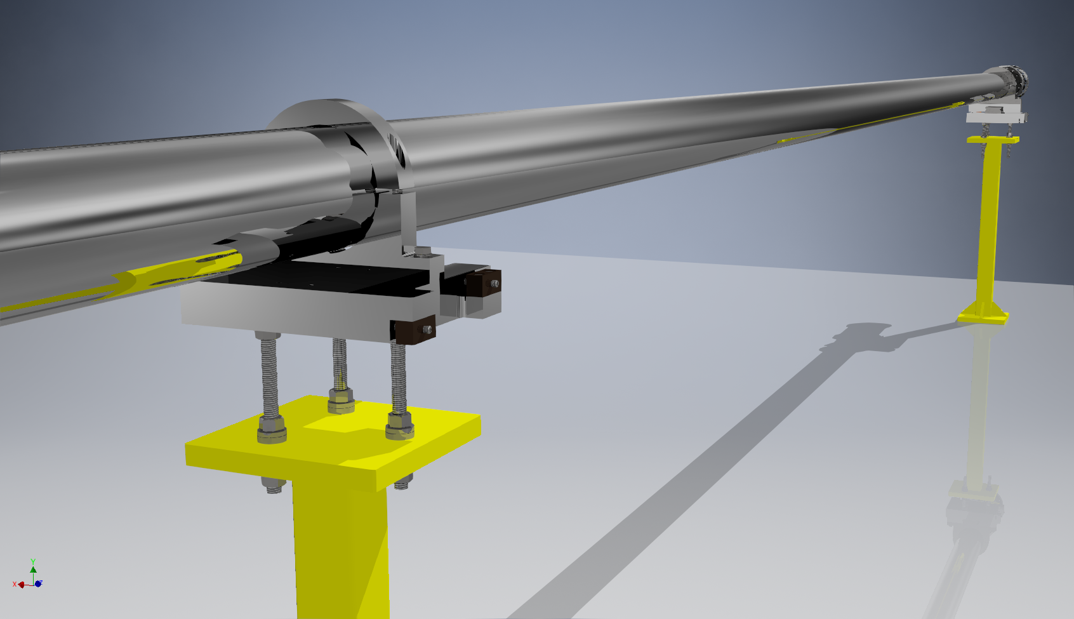
3D model of the vacuum system

Slide 18
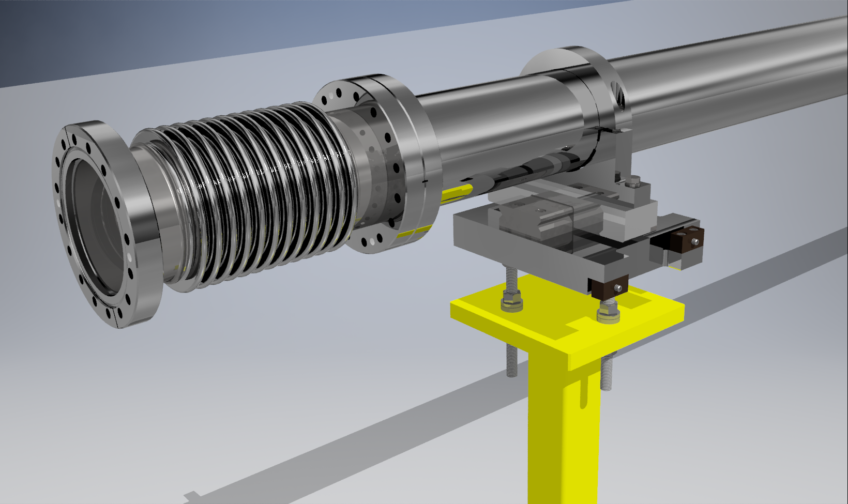
3D model of the vacuum system

Slide 19
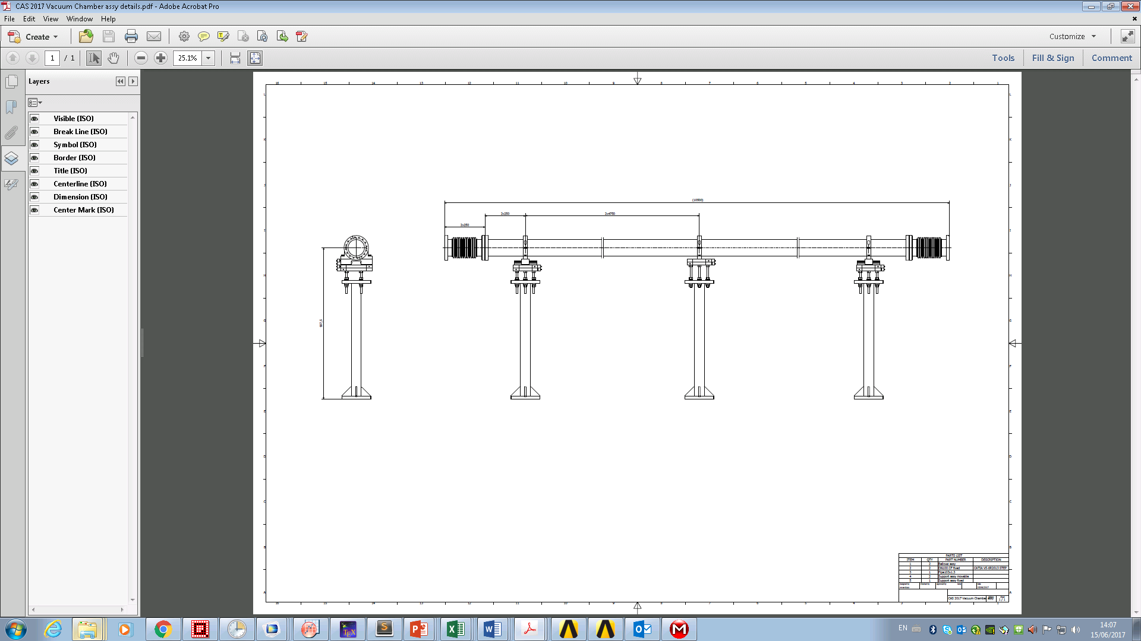
Technical drawing

Slide 20
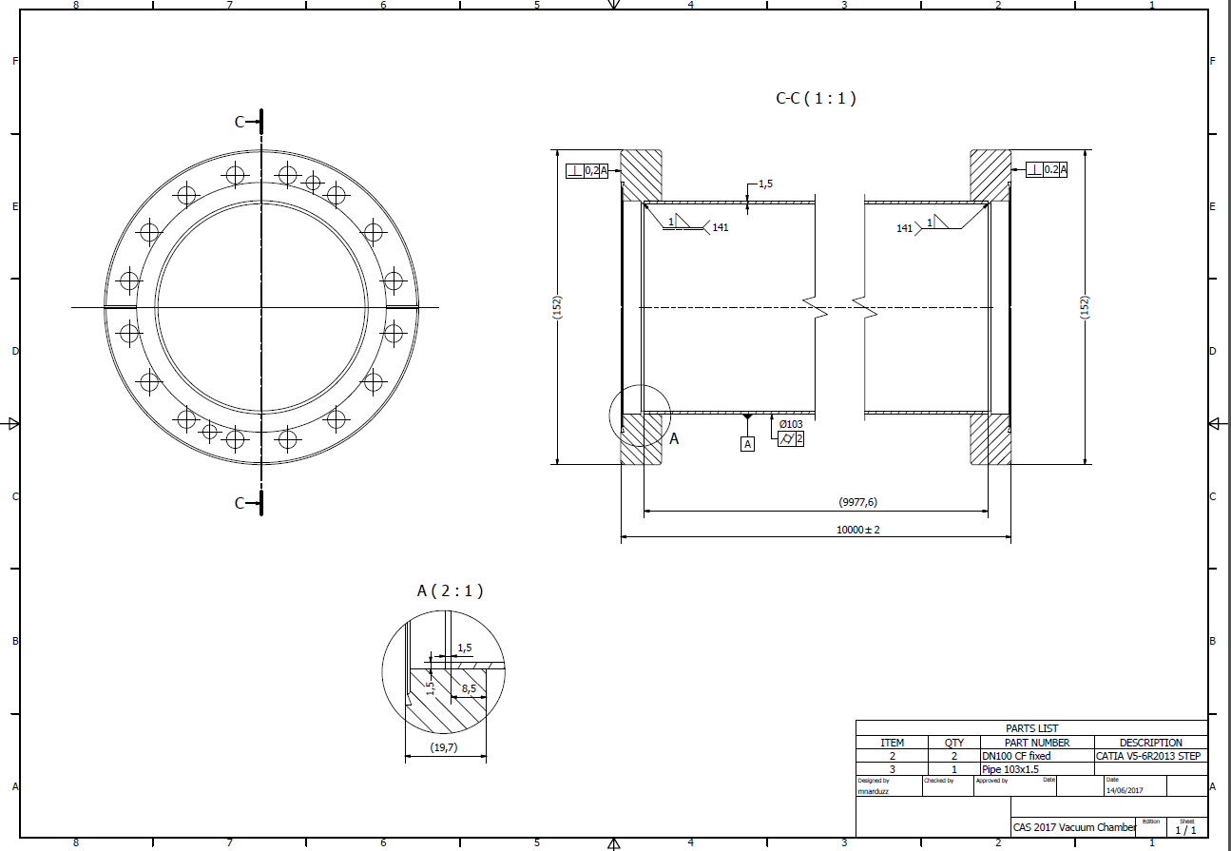
Technical drawing

Slide 21
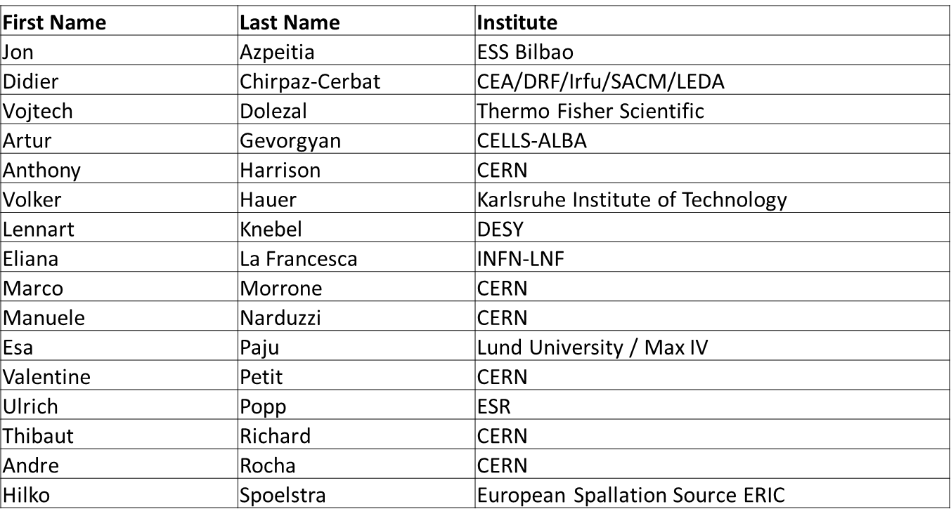
Meet the Team:
Tutorial Group 3
GSI

Slide 22
References
  Materials & Properties I: Introduction. CAS, Vacuum for Particle Accelerators 2017
  Dr. Stefano SGOBBA (CERN)
  Materials & Properties II: Thermal & Electrical Characteristics. CAS, Vacuum for Particle Accelerators 2017
  Dr. Cedric GARION (CERN)
  Surface Cleaning & Finishing. CAS, Vacuum for Particle Accelerators 2017
  Dr. Mauro TABORELLI (CERN)

Slide 23
Material selection
 | Copper OF annealed | Al-6082-T6 | Stainless steel 316L | Titanium Ti-6Al-4V (Grade 5)
Density | 8950 kg/m³ | 2830 kg/m³ | 7970 kg/m3 | 4430 kg/m3
Young’s modulus | 115 GPa | 77 GPa | 195 GPa | 115 GPa
Yield strength | 35 MPa | 393 MPa | 240 MPa | 880 MPa
Thermal expansion coefficient | 17 · 10⁻⁶ 1/K | 22 · 10⁻⁶ 1/K | 16 · 10⁻⁶ 1/K | 8.9 · 10⁻⁶ 1/K

Slide 24
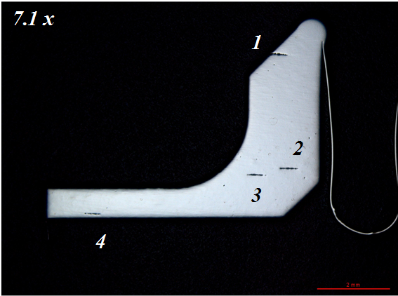
Esr to reduce inclusions

