Slide 1
CAS 2017 Vacuum simulations
Individual work – Tutorial Group #1
15 June 2017 – Glumslov - Sweden

Slide 2
Outline
Problem description
Molflow in a nutshell
Geometrical model
Results
Sticking factor & outgassing rate
Saturation time - analytical versus Monte Carlo approaches
Transmission probability and pressure ratio as a function of sticking probability
Reference paper
Conclusions

Slide 3
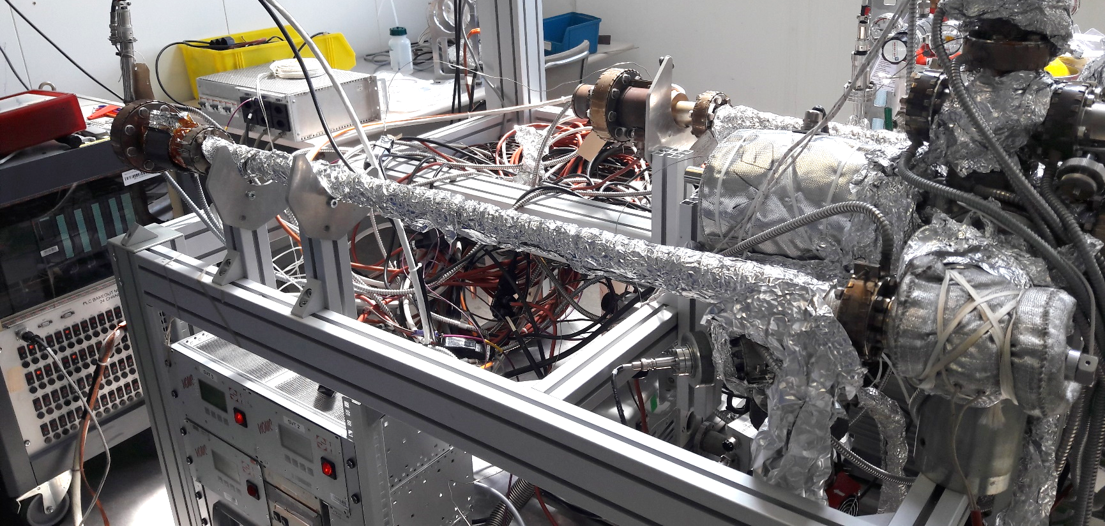
Problem description
We have a NEG coated vacuum pipe connected to a vacuum system and two pressure gauges reading. A gas injection is performed and at steady state, the pressures measured in gauges 1 and 2 are:
$P_{1}=1∙{10}^{−6} mbar$
$P_{2}=2.5∙{10}^{−9} mbar$
What is the sticking factor of the NEG?
What is the flow rate of the inlet gas?
P2
P1

Slide 4
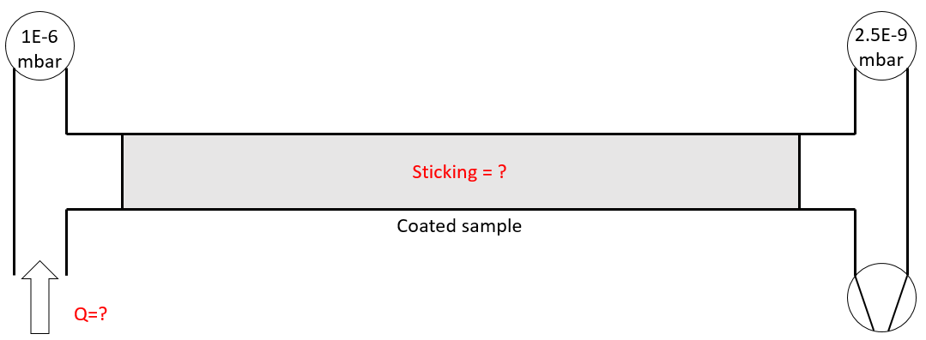
Problem description
What do we know:
Pipe geometry
Pumping speed of the pump
Pressure on gauges
Gauge 1
Gauge 2
S = 300 l/s

Slide 5
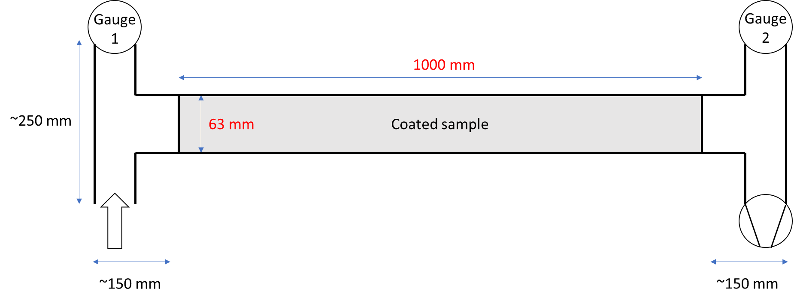
Problem description
Principle:
Mass flow flowing through
a coated chamber
Some molecules sticking
to the coating
Some molecules pumped

Slide 6
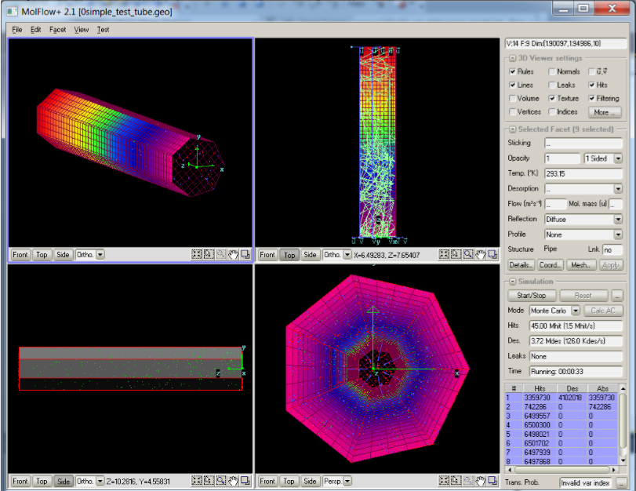
Molflow in a nutshell
MolFlow+ is a software developed at CERN in 1990 based on Monte Carlo method
The software allows to:
Draw a vacuum system
Calculate pressure profiles for complex geometries in molecular flow regime
In our case, evaluate the sticking probability α of NEG coating
All the results can be visualized in a user friendly way and shown in a real time

Slide 7
Building the geometry
Gauge
1
Gauge
2
1000 mm
63 mm
Coated sample
Q
S = 300 l/s
~150 mm
~150 mm

Slide 8
Building the geometry

Slide 9
Question 1: sticking probability and injection rate
Work out pressure ratio of two gauges
Apply sticking probability to obtain the same pressure ratio in Molflow
– 0.052
Set the gas injection rate in the simulation to get the same pressures as given above
– 0.0001 mbar*l/s
$$P_{ratio}=\frac{P_{2}}{P_{1}}=2.5∗{10}^{−3}$$

Slide 10
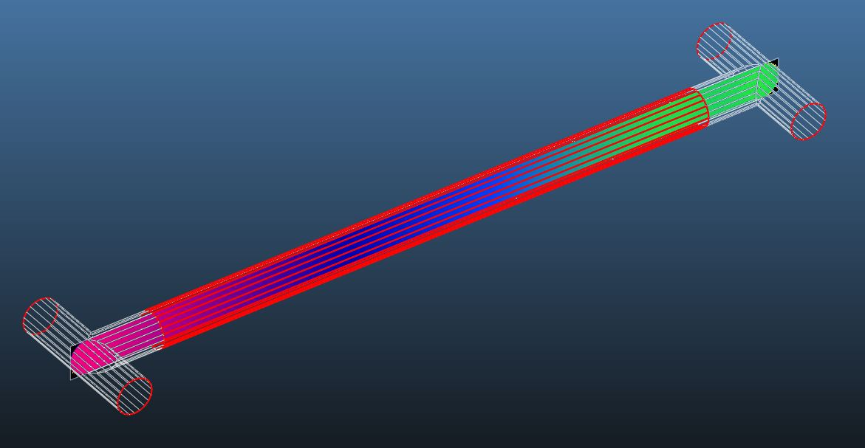
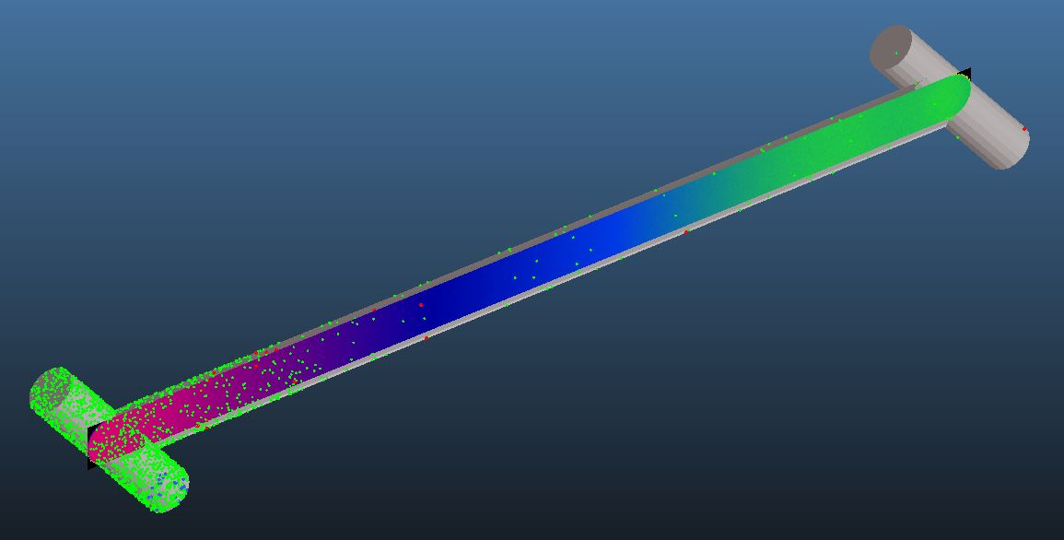
The complete system
P2 = 2.5e-9 mbar
NEG coating
Sticking factor 0.052
S = 300 l/s
P1 = 1e-6 mbar
Q = 1e-4 mbar*l/s

Slide 11
Question 2
NEG coating is an effective pump, but it can’t pump gas forever: eventually it saturates. Its pumping ability drops quickly when the pumped gas forms one monolayer on the surface – corresponding to about 1E15 pumped molecules/cm²
In our setup, how much gas is that?
How much time does it take until our setup saturates?

Slide 12
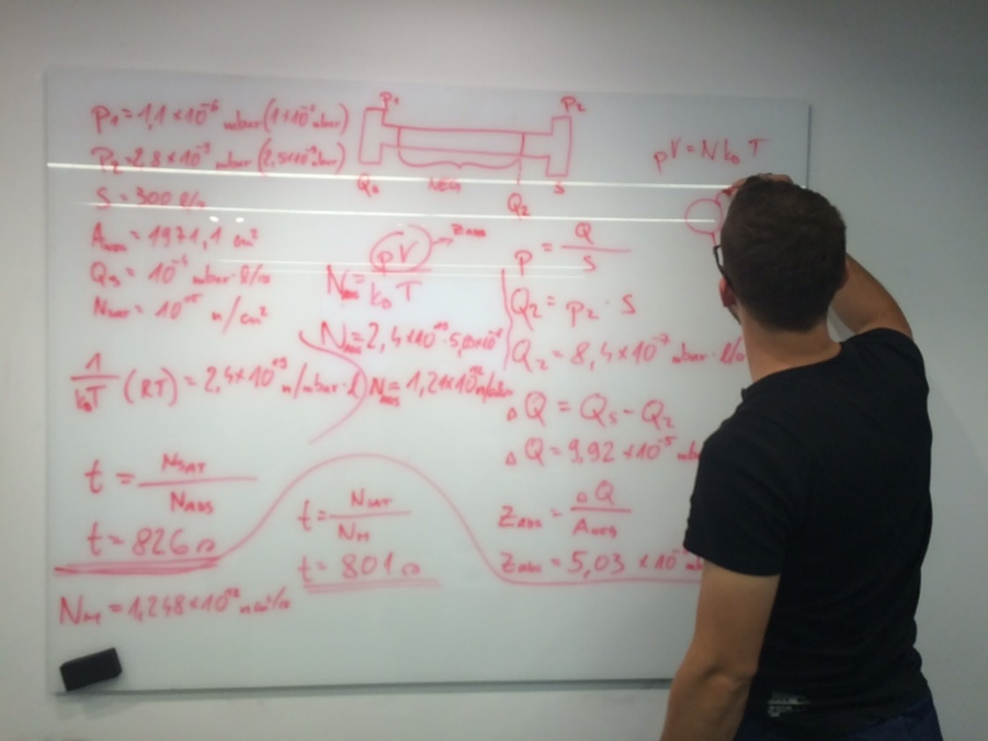
Question 2: time for complete saturation - analytical way
How much time does it take until our setup saturates?
p₁=1*10⁻⁶ mbar
p₂=2.5*10⁻⁷ mbar
S=300l/s
A_{neg}=1971.1cm²
Q_{s}=10⁻⁴ mbar*l/s
N_{sat}=10¹⁵ molecules/cm²

Slide 13
Question 2: time for complete saturation - analytical way
As first we calculate the gas load Q₂ after the NEG chamber:
$$p2=\frac{Q2}{S}$$
$$Q2=p2∗S=8.4∗{10}^{−7}\frac{mbar∗l}{s}$$
To get the gas load absorbed by NEG coating we just subtract it from the total inlet gas:
$$∆Q=Qs−Q2=9.92∗{10}^{−5}\frac{mbar∗l}{s}$$
By dividing with the total surface area of NEG chamber we get the absorption rate of coating:
$$zabs=\frac{∆Q}{Aneg}=5.03∗{10}^{−8}\frac{mbar∗l}{cm2∗s}$$

Slide 14
Question 2: time for complete saturation - analytical way
With the ideal gas equation we get number of molecules absorbed by NEG surface area in a second:
$$p∗V=N∗k_{b}∗T$$
$$Nabs=\frac{p∗V}{kb∗T }=\frac{zabs}{kb∗T }=1.21∗{10}^{12}\frac{molecules}{cm2∗s}$$
With division of number of absorbed molecules with total number of molecules needed to saturate the film we gate the time before pumping speed of NEG drops to zero:
$$ta=\frac{Nsat}{Nabs}=826s$$
In our setup, how much gas is that?
$$N=Nsat∗A_{NEG}=1.97∗1018molecules$$
13.77 min

Slide 15
Question 2- time for complete saturation in Molflow
Engineering way: Using Molflow+ to solve the problem
1) Select a facet of the NEG area and read impingement rate : 2.4 x10¹⁷ molecules*m⁻²*s⁻¹ = 2.4 x10¹³ molecules*cm⁻²*s⁻¹
2) The impingement rate times the sticking factor of the NEG of 0.05 gives us the number of absorbed particles per area N_{abs} = 1.2x10¹² molecules*cm⁻²*s⁻¹
3) We know that NEG coating is saturated at N_{sat} =10¹⁵ molecules*cm⁻²
4) The full saturation is reached at t=N_{sat}/N_{Abs}
t=10¹⁵ molecules*cm⁻²/2.4 x10¹³ molecules*cm⁻²*s⁻¹= 833 s
13.88 min

Slide 16
Question 3
What was the transmission ratio of the gas for the pressure ratio given in the task?
By changing the simulation parameters, make a “transmission ratio as a function of the sample’s sticking factor” plot given that:
X axis: different sticking factor values (around 5-7 different values)
Y axis: gas transmission ratio

Slide 17
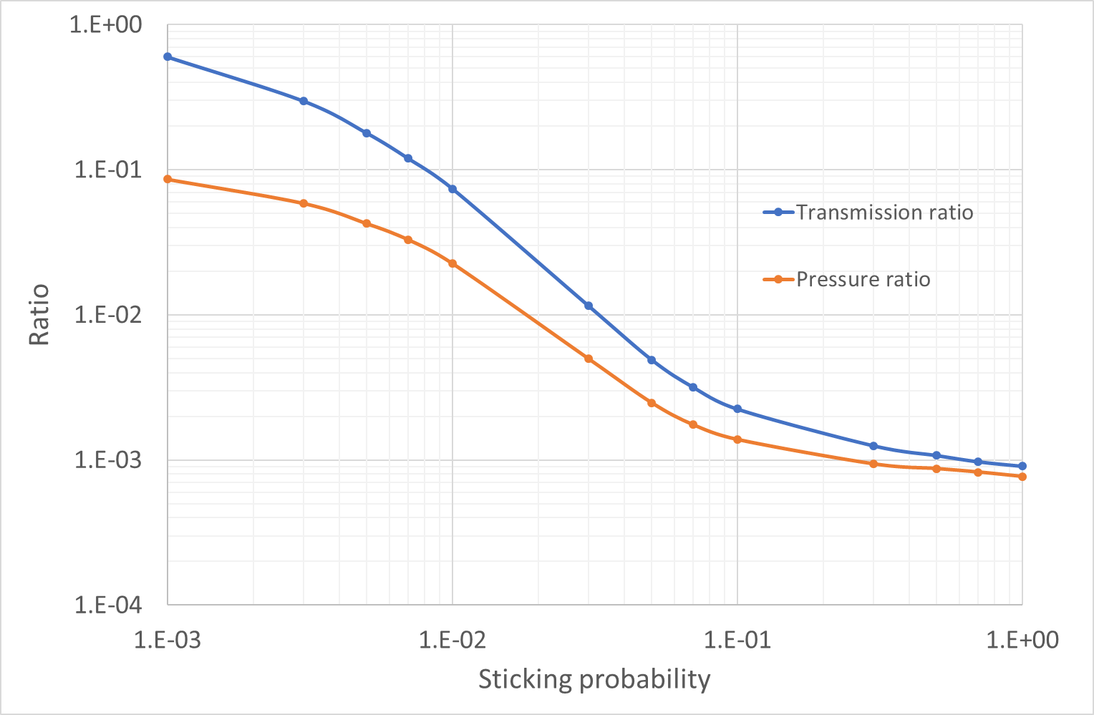
Question 3: trans. probability and pressure ratio as a function of α
$$T_{ratio}=\frac{N_{abs}}{N_{inj}}=5∗{10}^{−3}$$
$$P_{ratio}=\frac{P_{2}}{P_{1}}=2.5∗{10}^{−3}$$
5.E-2

Slide 18
Real life applications
Ref.: CERN, building 101

Slide 19
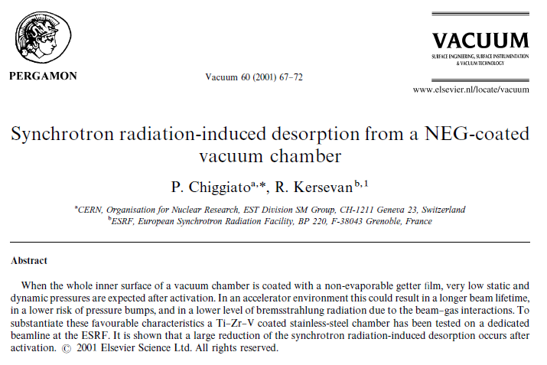
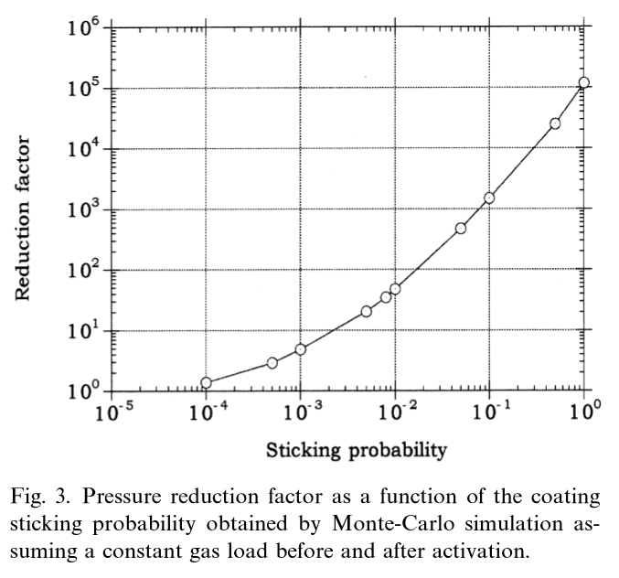
Reference paper

Slide 20
Conclusions
Tutorial based on a real world application
The same problem was addressed analytically and numerically
With the basic knowledge of vacuum technology, Molflow becomes a very powerful tool

Slide 21
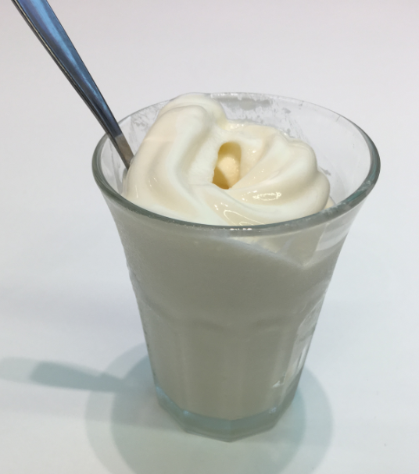
Final conclusion Hard work & Ice cream

