Slide 1
CERN Accelerator School
Superconductivity for Accelerators
Case study 6:
RF test and properties of a superconducting cavity
GROUP B
C. Darve
S. Izquierdo Bermudez
X. Niu
K. Papke
R. Santiago Kern

Slide 2
Elliptical 5-cell cavity in pi-mode:
Basic Parameters (I)
1. Energy of the protons:
2. Distance between two neighbouring cells (L) and length of the cavity (Lacc)

Slide 3
Elliptical 5-cell cavity in pi-mode:
Basic Parameters (II)
3. All the given parameters depend ONLY in the geometry of the cavity
Remark 1: Typically, for elliptical cells β=[0.6,0.8] and Epk/Eacc=[2,2.6]
Cavities with elliptical cells for low beta become very big as lower frequencies are used and less stable mechanically (the accelerating gap shortens and cavity walls become more vertical)
Remark 2: In circular accelerators the factor Ra/Q is usually defined as:

Slide 4
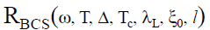
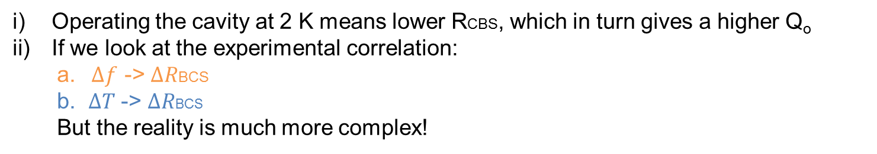


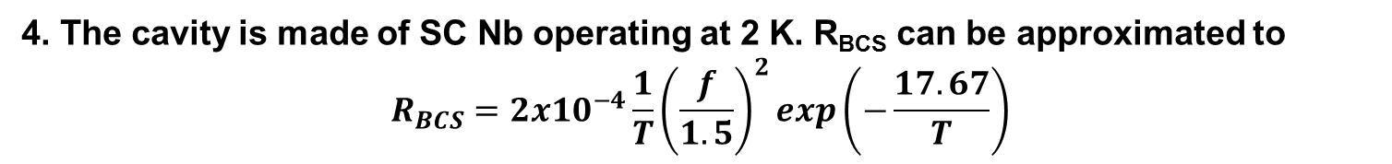
RBCS
4. The cavity is made of SC Nb operating at 2 K. R_{BCS} can be approximated to
$$R_{BCS}=2x{10}^{−4}\frac{1}{T}{\left(\frac{f}{1.5}\right)}^{2}exp\left(−\frac{17.67}{T}\right)$$
f=704.4 MHz
T_{c}(Nb)=9.2 K
$$∆f$$
T | Rbcs [nΩ]
4.3 | 168.4
4 | 133.0
3 | 40.7
2 | 3.2
$∆$T
Operating the cavity at 2 K means lower RCBS, which in turn gives a higher Q_{o}
If we look at the experimental correlation:
  a. $∆f$ -> $∆R$BCS
  b. $∆T$ -> $∆R$BCS
  But the reality is much more complex!

Slide 5
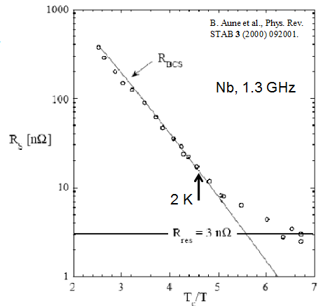

Quality Factor Qo
For a real cavity, the residual resistance should be taken into account.
The possible contributions to Rres:
Trapped magnetic field
Normal conducting precipitates
Grain boundaries
Interface losses
Subgap states
RRR?
Typically $\sim 1−10nΩ$(0.5 $nΩ$ achievable?)

Slide 6
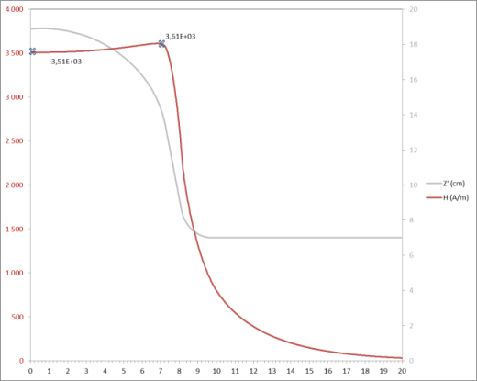
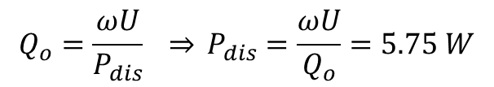
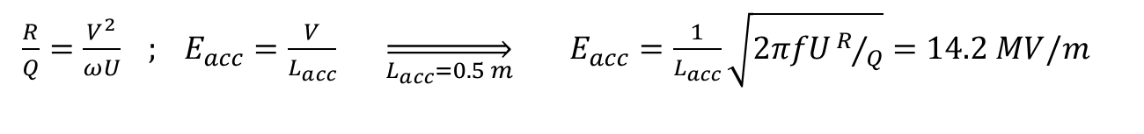
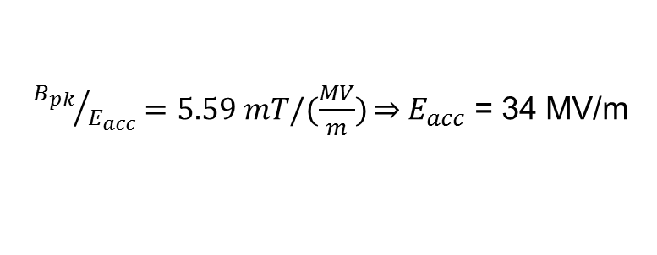
Accelerating and maximum gradient (I)
6. Operation @ stored energy of 65 J
i) Accelerating gradient
ii) Dissipated power in the cavity walls
$\frac{R}{Q}=\frac{V^{2}}{ωU} ; E_{acc}=\frac{V}{L_{acc}} \overset{⇒}{L_{acc}=0.5 m} E_{acc}=\frac{1}{L_{acc}}\sqrt{2πfUR/Q}=14.2 MV/m$
$$Q_{o}=\frac{ωU}{P_{dis}} \overset{⇒}{} P_{dis}=\frac{ωU}{Q_{o}}=5.75 W$$
7. Maximum gradient that can be achieved in this cavity If we take 190 mT as the critical magnetic RF surface field at 2 K
${B_{pk}}/{E_{acc}}=5.59 mT/(\frac{MV}{m})\overset{⇒}{}{ E}_{acc}$ = 34 MV/m
Expected location of the Magnetic quench
Magnetic field
z

Slide 7
Accelerating and maximum gradient (II)
Eacc (14.2 MV/m) < Emax (34 MV/m)
We are operating at half of the maximum accelerating gradient. Is this standard?
Of course, we don’t wont to work at Emax → any perturbation in the system will involve a quench:
Pdis
Cooling power is able to compensate: nothing happens
Heat source
∆T
Possible sources:
Surface defects
Bad cooling
Multipacting
Field emission
Magnetic quench

Slide 8
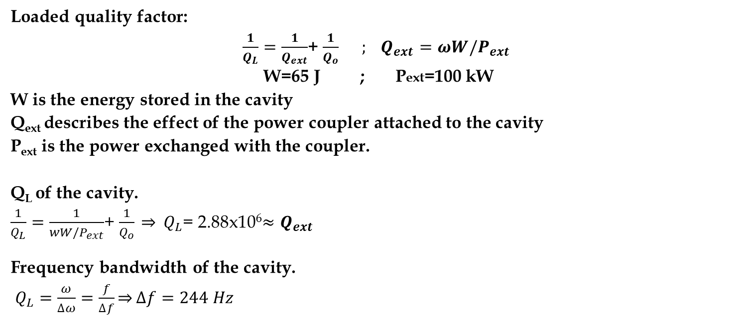
Loaded Quality Factor QL
Loaded quality factor:
$\frac{1}{Q_{L}}=\frac{1}{Q_{ext}}$+ $\frac{1}{Q_{o}} ; Q_{ext}=ωW/P_{ext}$
W=65 J ; Pext=100 kW
W is the energy stored in the cavity
Q_{ext} describes the effect of the power coupler attached to the cavity
P_{ext} is the power exchanged with the coupler.
Q_{L} of the cavity.
$\frac{1}{Q_{L}}=\frac{1}{{wW/P}_{ext}}$+ $\frac{1}{Q_{o}} \overset{⇒}{} Q_{L}$= 2.88x10⁶${≈Q}_{ext}$
Frequency bandwidth of the cavity.
$Q_{L}=\frac{ω}{∆ω}=\frac{f}{∆f}\overset{⇒}{}∆f=244 Hz$
Q_{L}
Δω
We will be able to tune the cavity within this range

Slide 9
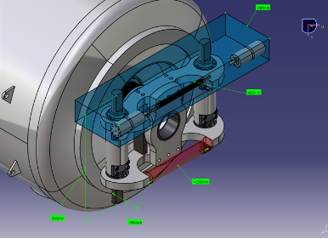
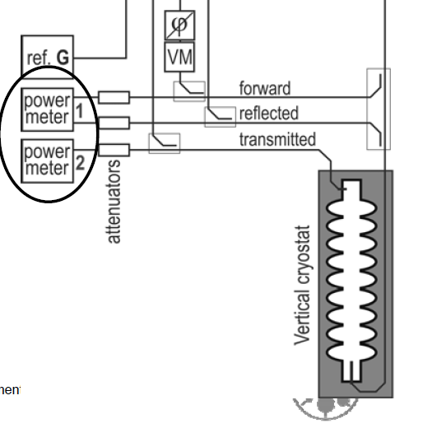
Tuners
FREQUENCY TUNERS: Keep the frequency of the cavity on its nominal value.
Stepper motor tuners: for coarse tuning, they are slow in response (i.e. when the cavity is cooled down)
Piezo-tuners: for fine tuning, fast response (i.e. to accommodate for vibrations and pressure fluctuations from the He bath). The control of the piezo tuners is done by comparing the phase difference between reflected and forward signals
H. Saugnac SLHiPP2

Slide 10



Impact of a normal conducting incursion
Local Surface resistant at the defects much higher
Mean surface resistance Rs (averaged over the surface) increased
The impact will be different depending in the location!
defect (piece of copper)
Especially in high magnetic field regions, defects lead to high energy dissipation
Critical magnetic RF surface field
Defects of 1µm already have an impact!
R over Q

Slide 11
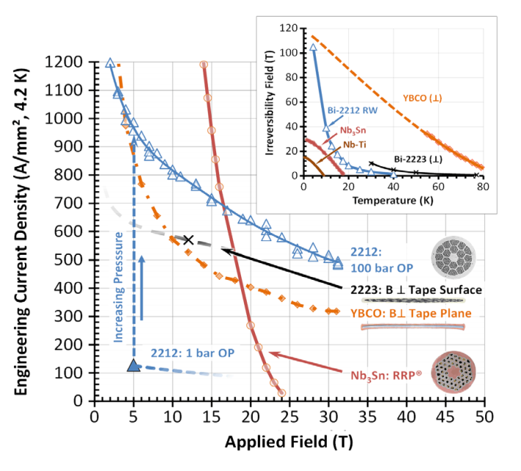
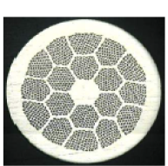
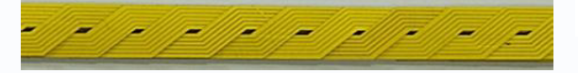
Additional questions (I)
Let’s assume that we are thinking about a high field accelerator quality magnet
    High temperature superconductor: YBCO vs. Bi2212
Bi2212:
We can produce round wires with multifilamentary configuration
Mechanically instability is still an issue
YBCO:
Seems very promising, lower cost?
But…
  Strongly anisotropic
  Nowadays only available in tapes and lot of open questions
    Effect of transverse stress?
    AC losses/ transient effects on field quality
No significant differences in terms of critical surface/penetration depth in between Bi2212/YBCO
Our choice: Bi2212

Slide 12
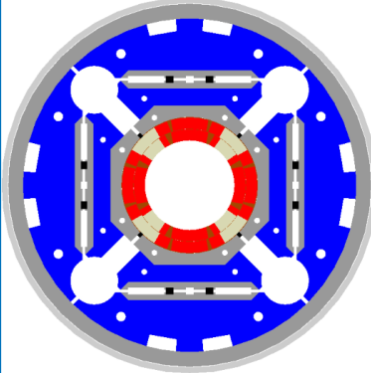
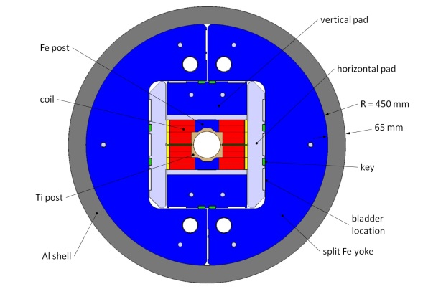
    Additional questions (II)
    Superconducting coil design: block vs. cosϑ
cosϑ
Use the beam pipe as inner support
More flexibility: dipole, quadrupole, sextupole…
  Ratio central field/current density is more with the same quantity of cable.
  Block
  Easier to wind
  For the case of a dipole, simple way to achieve good field quality...but mechanical support can be an issue
Our choice: cosϑ
    Support structures: collar-based vs. shell-based
If the field is very high, you need higher pre-stress after cool down…so the bladders/shell-based solution should be better. Still lot of development needed to assure mechanical stability at 20T! Our choice: shell-based

Slide 13
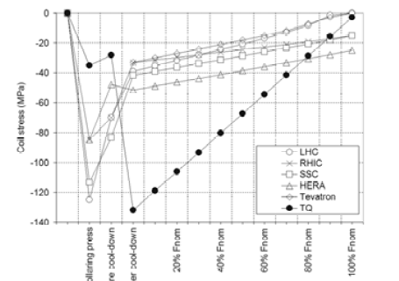
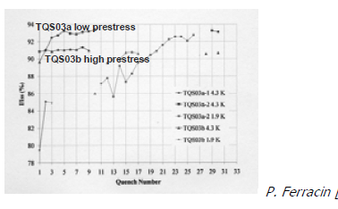
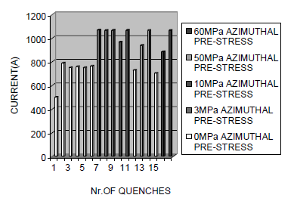
    Additional questions (III)
    Assembly procedure: high pre-stress vs. low pre-stress
We always want to apply sufficient pre-stress to assure that all the cables are under compression in operation conditions.
During the R&D phase, one should look at maximum pre-stress can be applied before degradation and stays bellow this value.
For production, to assure reproducibility, one should keep some margin (about 20%-40%) from this upper boundary. If the pre-stress is very low, reproducibility might become an issue?

