Slide 1
RIB Accelerator Proposal
Radioactive Ion Beam Facility
Pierre-André Duperrex PSI
Federico Roncarolo CERN
Edgar Sargsyan CERN
Suzie Sheehy RAL
May thanks to Oliver BOINE-FRANKENHEIM (GSI) for inputs about Heavy Ion Accelerators for Nuclear Physics

Slide 2
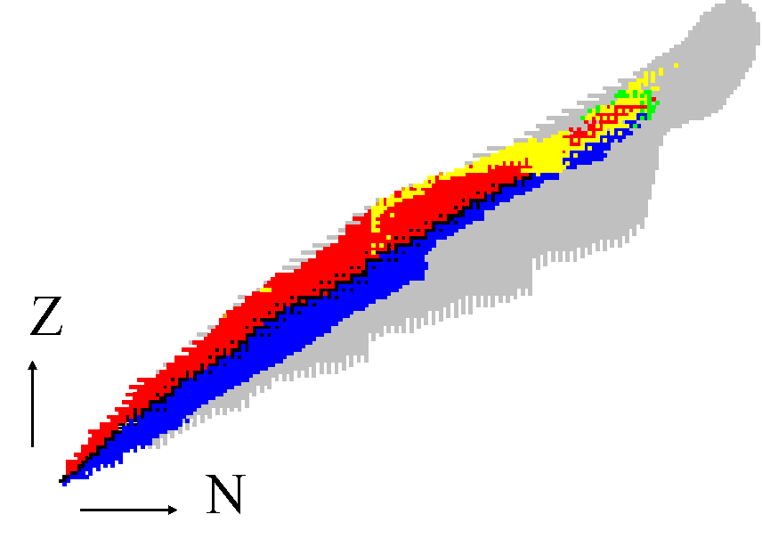
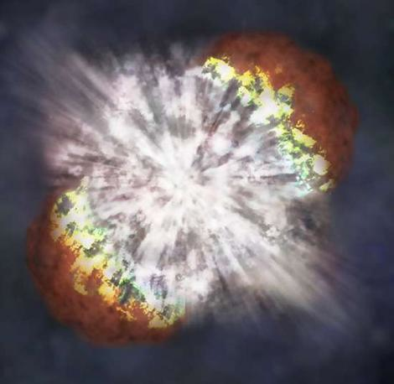
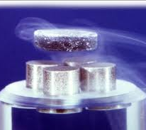
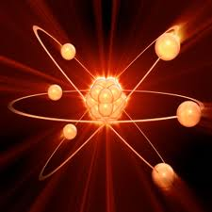
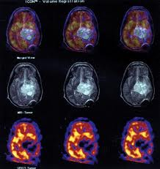
Motivation
Nuclear Astrophysics
Condensed matter
Atomic physics
Nuclear medicine
Notes:
I want you to consider, for a second, how much we take matter for granted. We know that we’re made up of atoms, and that those atoms are mostly stable, formed of a certain number of protons and neutrons. We know that they were created billions of years ago in violent events deep in outer space, and we don’t expect our own bodies or the objects around us to suddenly decay away to nothing.
But all of the matter that we are most familiar with, ‘stable’ matter, can be found in a very tiny region of the chart of nucleides. Plotted here is the number of neutrons (N) vs the number of protons (Z), and all the stable matter is in black. We also know about certain types of radioactive decay, isotopes that decay with beta decay (blue), inverse beta decay (red), alpha decay (yellow) and through spontaneous fission (green). This big grey area isn’t a shadow, it’s isotopes which are predicted (theoretically) to exist. We know NOTHING about them.
Theoretical models are very well advanced, but imperfect. As this chart shows we don’t know enough about nuclear structure and it’s properties at all. In a way, it’s quite surprising that we know so much, yet really so little about matter and it’s stability. The only way to find out more is to experiment, and that is where a radioactive ion beam facility is needed.
But on top of finding out more about nuclear structure, a radioactive ion beam facility can also be used for a wide range of research, from nuclear astrophysics and the formation of super-heavy elements, to probing the properties of materials like superconductors in condensed matter, basic atomic physics right through to medical applications like radioactive isotopes used in imaging.

Slide 3
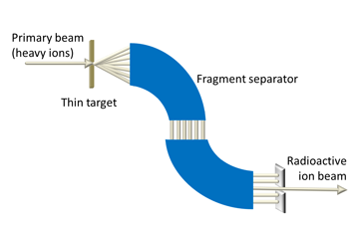
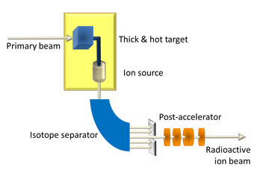
Radioactive Ion Beams
“radioactive ion beam research is a top priority in nuclear physics”
High demand for beam time! (many users!)
2 complimentary methods: in-flight or ISOL (isotope separation on-line)
In-flight
ISOL
Accelerator requirements:
0.5 MW, CW
Accelerate from (0.4-1GeV/u) p+ to U
Intense radioactive beams
Notes:
In-flight: ions, thin target, fragmentation -> experiments (good choice of isotopes, don’t need post acceleration) + target depends on user
ISOL: p or light ions -> target -> limited range of radioactive elements (spallation, fission or fragmentation)

Slide 4
Existing or under design facilities
LABs | Facility | Type | Mode | Power | Ion production method
RIKEN | RIBF | Cyclotrons | CW | varaible | In-flight
FLNR | DRIBs | Cyclotron | CW | .7KW (?) | In-flight
MSU | FRIB (2017) | SC Linac | CW | 400KW | In-flight
GSI | UNILAC-FAIR (2016) | Linac + synchrotrons | Pulsed | variable | In-flight
TRIUMF | ISAC | Cyclotron | CW | 50 KW | ISOL
GANIL | SPIRAL2 (2013) | Linac+cyclotrons | CW | 200 kW | ISOL
CERN | ISOLDE | Synchrotron | Pulsed | 2.8 kW | ISOL
 | EURISOL (2020) | Synchrotron | CW | 5MW | ISOL

Slide 5
Design choices
CW : Cyclotron or Linac?
Linac: more flexible & clear upgrade possibility (to include ISOL)
Source(s)
ECRIS of the 3rd generation (e.g. LBL VENUS)
Can produce up to 200eμA Uranium, CW
Use SC cavities as soon as possible after RFQ
Lower power consumption
Higher Q
High gradient
Need to accelerate different ion species
Cavity sections with large acceptance in velocity (less sections)
Best: independent klystrons to adapt gradient to different species
Spoke cavities
Large mechanical aperture (relevant for heavy ion beams)
‘Wide’ beta acceptance
Can think about using them already after RFQ (3-5 MeV)
Notes:
Cavities – only need 4 types of cavities for whole energy range because they are flexible
All spoke cavities so that we use all the same technology – less complication & expertise needed!

Slide 6
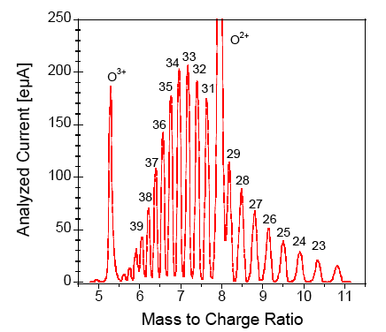
Ion source: 3rd generation SC ECRIS
production of intense beams of medium to low charge states ions, (up to uranium), for radioactive ion beam facilities
adjustable high-voltage platform to ensure the same velocity for all ions for injection into the RFQ
Uranium charge-states distribution from VENUS ECRIS

Slide 7
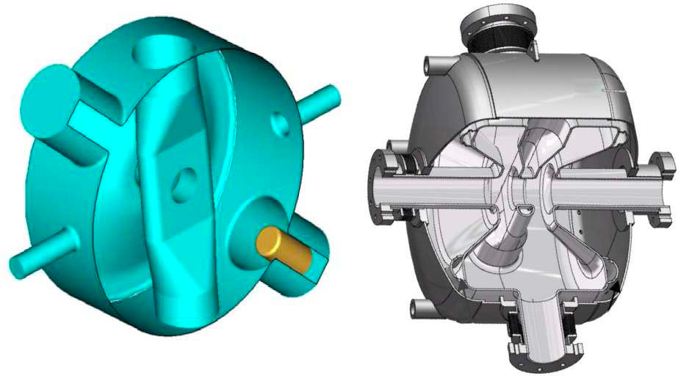
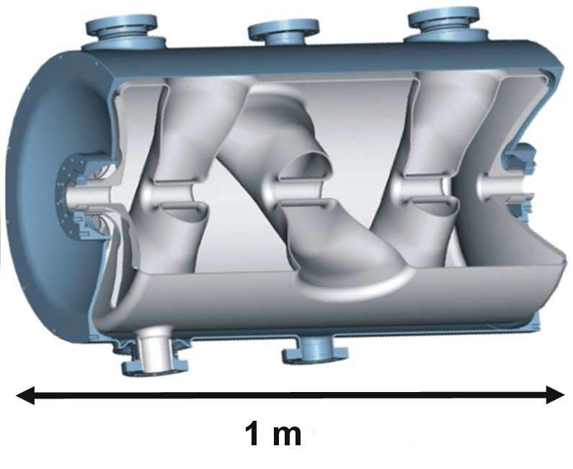
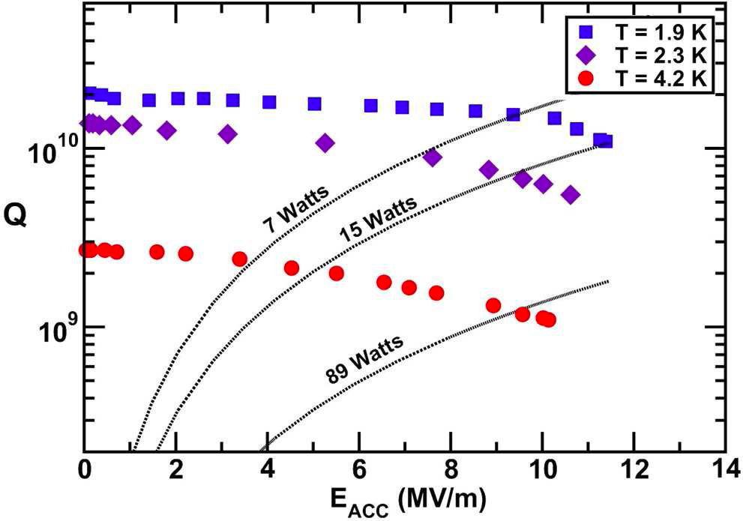
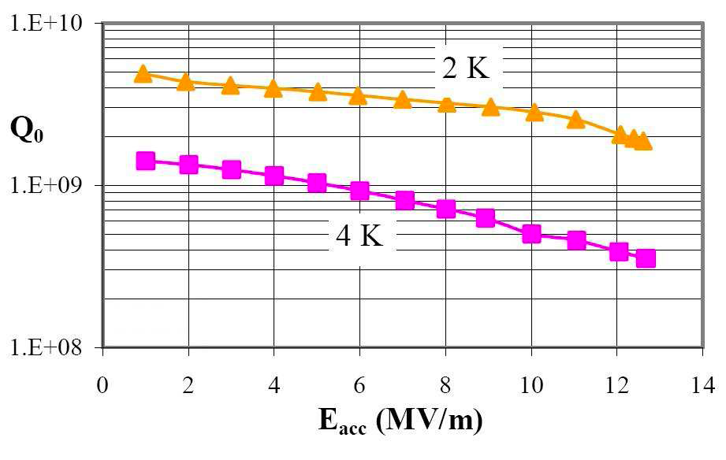
SC Spock Cavities
SC Spoke Cavities
“cavity of choice for intermediate velocity hadron linac applications” – M. Kelly (Argonne)
A 350 MHz β=0.175 single-spoke cavity from LANL (left) and a 352 MHz b=0.15 single-spoke cavity from IPN-Orsay (right)
A SC 345 MHz β=0.63 3-spoke cavity built and tested for the RIA driver linac
Notes:
A very high Q – efficient
Large aperture – good for ion beams because we want a very low loss (superconducting).

Slide 8
Cost vs. flexibility
 | 40 MeV deuteron linac | 80 MeV deuteron cyclotron
Building Infrastructure | 5,6 | 4,3
Driver | 18,6 | 12,2
Targets Sources | 3,2 | 3,2
Source N+ | 0,4 | 0,4
Beam lines | 4,6 | 4,3
Radioprotection | 1,5 | 1,5
Control system | 0,3 | 0,3
Miscellaneous | 0,3 | 0,3
Hazards (10%) | 3,5 | 2,6
TOTAL (M€) | 38,0 | 29,1
“…Concerning the deuteron driver, a cyclotron is a quick and less expensive solution but without versatility and scope for evolution, whereas a LINAC solution allows a multi-beam driver. This last solution, despite of a higher cost, allows us to benefit from the different mechanisms to produce both neutron-deficient and neutron-rich nuclei. Moreover, it could also provide light and intermediate mass beams with intensities, which cannot be achieved by upgrading the present [GANIL] accelerators...”
-Extract of document "SPIRAL2: preliminary design study” (2002)
Notes:
Also multi-species more flexible with LINAC

Slide 9
Accelerator layout
352 MHz Superconducting LINAC @ 2K
Achromatic filter
176 MHz, 3 MeV
β=0.15
1-spoke
3-30 MeV
β=0.35
1-spoke
30-100 MeV
β=0.5
3-spoke
100-200 MeV
β=0.65
3-spoke
200-500 MeV
ECRIS-2
Stripper
LEBT
RFQ
RFQ
QUADS
Buncher to match to SC cavity entrance
To the target
ECRIS-1
Solenoid
To the target
Two ECR ion sources for light and heavy ions
Ion selection dipole and LEBT to match to the RFQ
Two RFQs (for A/q≤3 and A/q≤7) for beam bunching and first stage acceleration
Stripping section to increase the charge state for more efficient acceleration, to increase the beam current and consequently the power
Achromatic magnetic filter for charge-state selection
Multi-charge-state acceleration to achieve higher current/power
352 MHz SC single and triple spoke cavities with high transverse and velocity acceptance
Individually controlled cavities for efficient acceleration of different ions
Possibility for energy/power upgrade using SC elliptical cavities

Slide 10
scRIBe
“Sustainable Community & Radioactive Ion Beam Enterprise”
Aim for sustainable development – “pattern of resource use that aims to meet human needs while preserving the environment, so that these needs can be met not only now, but for generations to come.” [Wikipedia, font of all knowledge…]
Environment
‘Green’ site
Create local jobs
Educational programs
Strong links with local research
Low emissions (low power!)
Aim for carbon neutral
Sustainable architecture
Recycling – whole life cycle
Local people
Future
Notes:
Education is a driver for development
“High tech” skills – SC technology, computing etc…

Slide 11
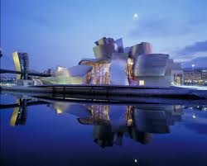
Conclusion
Radioactive Ion Beams are a top priority & rapidly developing field
Our design ensures ultimate flexibility and upgrade path at reasonable cost
Provides ions from p to U for a wide range of research
Incorporates sustainable design concepts – adding value
Science, architecture for sustainability & inspiration!

